Slide 1
What is Generative AI?
Created with AI Presentation Generator

Slide 2
Introduction
Generative AI refers to a subset of artificial intelligence (AI) that focuses on creating new, original content such as images, music, videos, or text based on patterns and structures learned from existing data. This technology has numerous applications in various industries, including entertainment, education, and marketing. As generative AI continues to evolve, it raises interesting questions about creativity, authorship, and the future of human work.

Slide 3
What is Generative AI?
Generative AI uses machine learning algorithms to generate new content that is unique and often indistinguishable from human-created work.
These algorithms can learn from large datasets and identify patterns, allowing them to create new content that is coherent and contextually relevant.
Generative AI can be applied to various tasks, including text generation, image synthesis, and music composition.

Slide 4

Applications of Generative AI
Generative AI has numerous applications in the entertainment industry, including the creation of realistic special effects, character animation, and video game assets.
In the education sector, generative AI can be used to create personalized learning materials, such as adaptive assessments and interactive simulations.
Generative AI also has significant potential in the marketing industry, enabling the creation of customized content, such as product descriptions and social media posts.

Slide 5
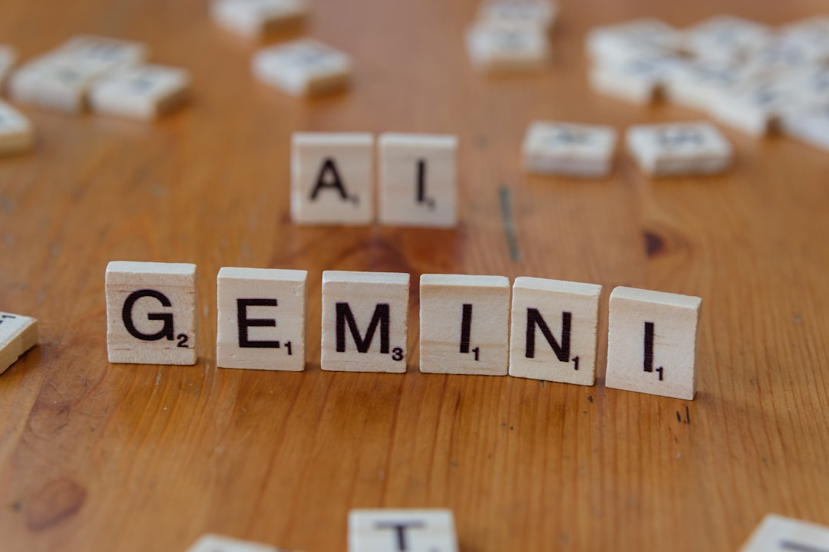
Benefits and Challenges
The primary benefit of generative AI is its ability to automate time-consuming tasks, freeing up human creators to focus on high-level tasks and complex decision-making.
However, generative AI also raises challenges related to ownership, authorship, and accountability, particularly in cases where AI-generated content is indistinguishable from human-created work.
Additionally, generative AI requires large amounts of data to learn and improve, which can be a significant challenge, especially in domains where high-quality data is scarce.

Slide 6
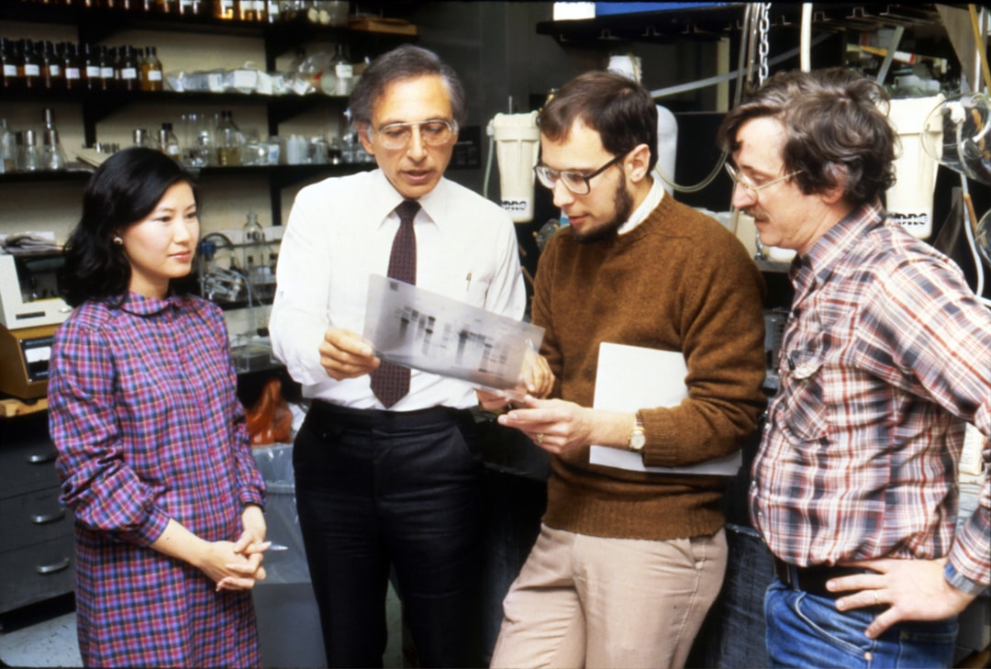
Future Directions
Researchers are actively exploring new applications of generative AI, including the creation of realistic virtual humans and the generation of novel scientific discoveries.
The development of more advanced generative models, such as those capable of learning from multiple sources and adapting to new contexts, is also underway.
As generative AI continues to evolve, it is essential to address the social and ethical implications of this technology, ensuring that it benefits society as a whole.

Slide 7
Conclusion
Generative AI has the potential to revolutionize various industries and aspects of our lives, but it also raises important questions about creativity, authorship, and accountability.
As we move forward with generative AI, it is crucial to prioritize responsible development and deployment, ensuring that this technology benefits society and enhances human capabilities.

Slide 8
Thank You!
Questions & Discussion

