Slide 1
The Fashion Industry
Created with AI Presentation Generator

Slide 2
Introduction
The global fashion industry is a significant contributor to the world's economy.
It is a dynamic and rapidly evolving sector driven by changing consumer preferences and technological advancements.
This presentation aims to provide an overview of the current state of the fashion industry.

Slide 3
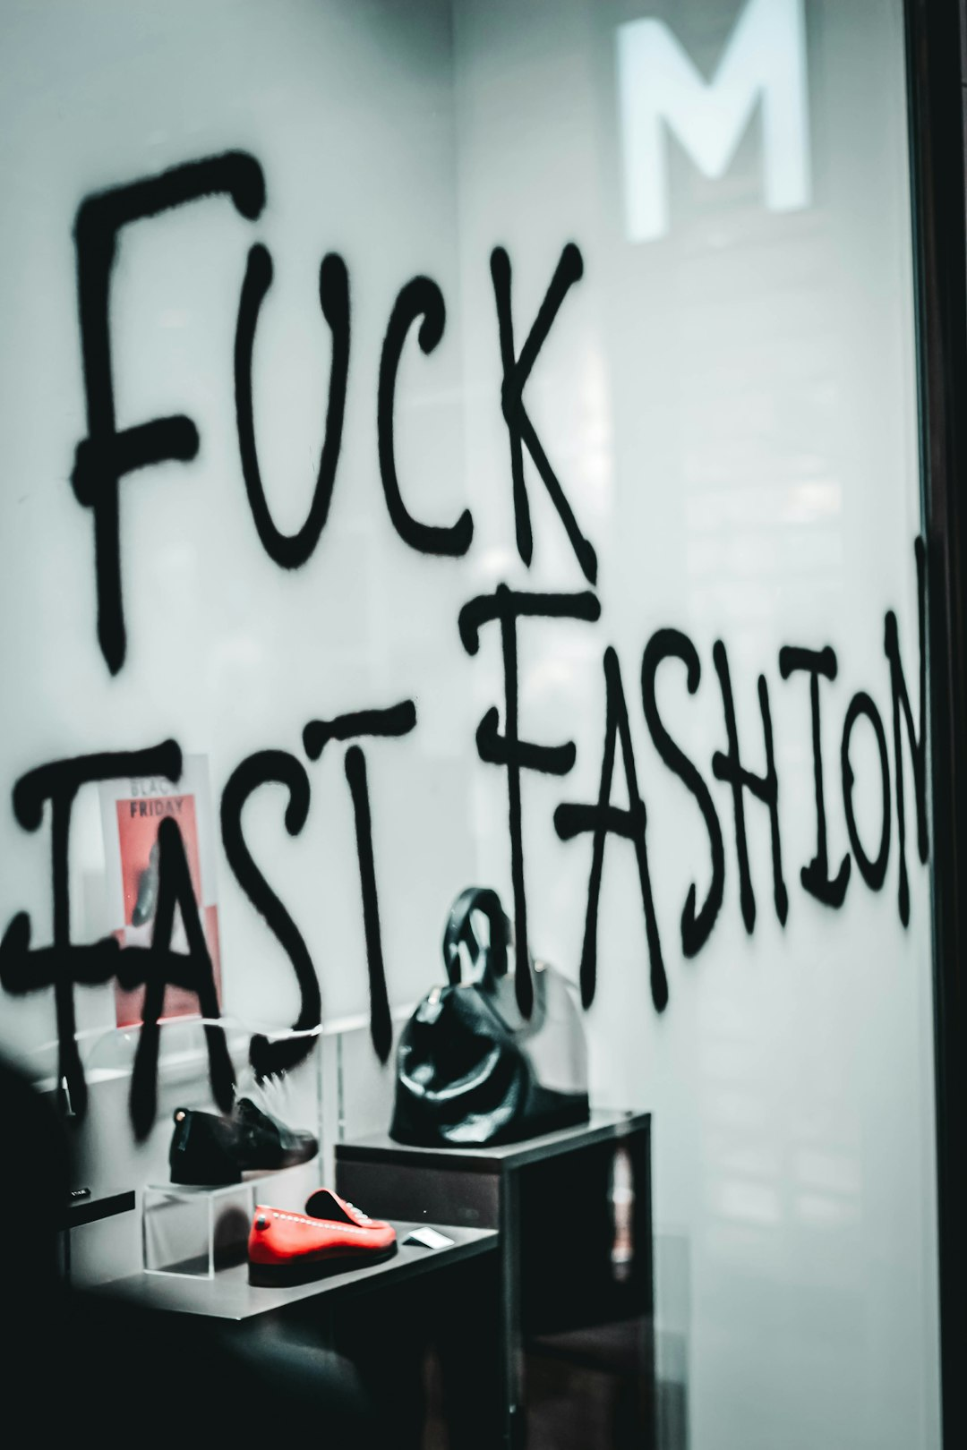
Market Trends
Fast Fashion
Sustainable Fashion
Digital Retail

Slide 4
Consumer Behavior
Demographics and Psychographics
Purchase Decision Making
Social Media Influence

Slide 5

Key Players
Luxury Brands
Fast Fashion Retailers
Emerging Brands

Slide 6
Trends in Manufacturing
Global Sourcing
Supply Chain Management
Technological Innovations

Slide 7

E-commerce and Digital Platforms
Online Retailing
Social Media Marketing
Mobile Commerce

Slide 8
Sustainability and Ethics
Environmental Impact
Labor Practices
Social Responsibility

Slide 9
Marketing and Advertising
Branding and Positioning
Advertising Strategies
Influencer Marketing

Slide 10
Global Market Overview
Regional Markets
Market Size and Growth
Key Statistics

Slide 11
Future of the Fashion Industry
Emerging Technologies
Changing Consumer Preferences
Industry Evolution

