Slide 1
Egyptian Pyramids
Created with AI Presentation Generator

Slide 2
Introduction
The ancient Egyptian pyramids are one of the most fascinating and awe-inspiring architectural wonders of the world, built as tombs for pharaohs and their nobles. Constructed over 4,500 years ago, these massive structures have stood the test of time, captivating the imagination of people around the globe. This presentation will delve into the history, significance, and majesty of the Egyptian pyramids.

Slide 3
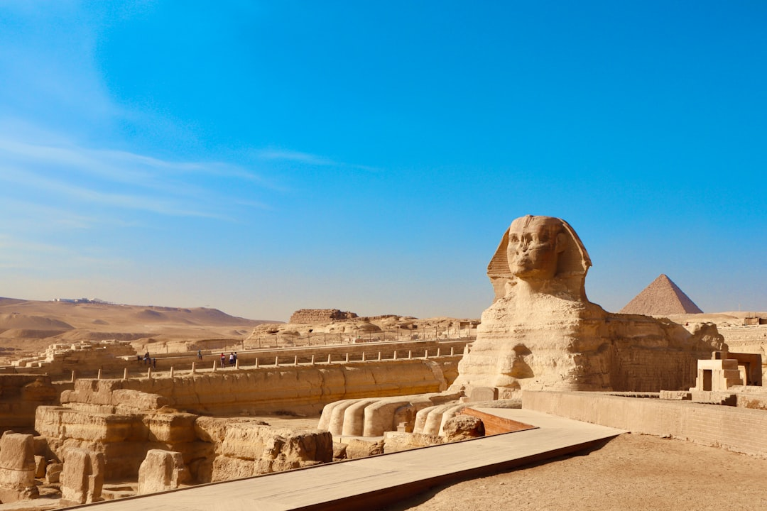
Ancient Egyptian Civilization
Mummification practices
Pharaonic dynasties
Nile River significance
Pyramid building techniques
Ancient Egyptian mythology

Slide 4
Pyramid of Giza
Largest of the three pyramids
Built for Pharaoh Khufu
Original height: 481 feet
Base perimeter: 3,025 feet
Estimated construction time: 20 years

Slide 5
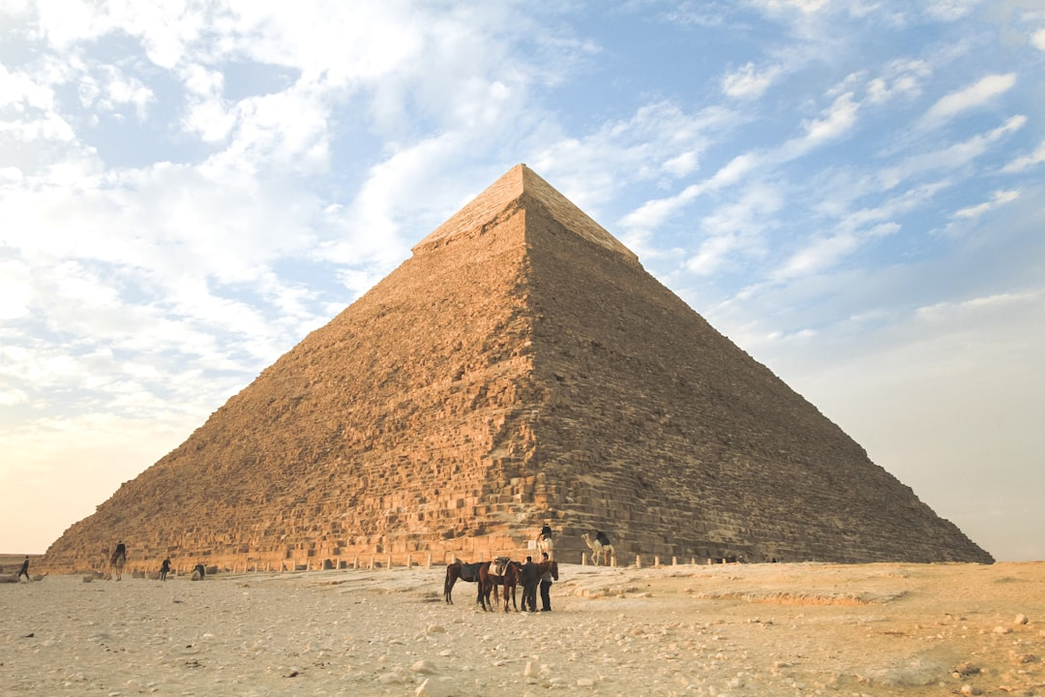
The Great Sphinx
Lion's body with human head
Built during the Old Kingdom
Estimated age: 4,500 years
Purpose: guardian of the pyramids
Location: Giza plateau

Slide 6
Pyramid Construction
Limestone and granite blocks
Advanced engineering techniques
Thousands of skilled laborers
Pyramid's precise alignment
Construction materials and tools

Slide 7
Pyramid Architecture
Triangular base shape
Pyramid's internal chamber
Grand entrance and passageway
Hieroglyphic inscriptions
Symbolism and spiritual significance

Slide 8
Pharaohs of the Pyramids
Khufu, builder of the Great Pyramid
Sneferu, builder of the Bent Pyramid
Khafre, builder of the second pyramid
Menkaure, builder of the third pyramid
Pharaohs' role in pyramid construction

Slide 9
Pyramid Significance
Tomb for the pharaoh
Symbol of power and wealth
Key to the afterlife
Ancient Egyptian spirituality
Pyramid's cultural impact

Slide 10
Preservation and Tourism
UNESCO World Heritage Site
Thousands of visitors annually
Restoration and conservation efforts
Economic benefits and challenges
Cultural exchange and education

Slide 11
Legacy of the Pyramids
Enduring architectural wonder
Cultural and historical significance
Inspiration for modern architecture
Fascination with ancient Egypt
Global appreciation and respect

