Slide 1
Egyptian Pyramids
Created with AI Presentation Generator

Slide 2
Introduction
The ancient Egyptians were a highly advanced and sophisticated civilization that built some of the most impressive architectural wonders of the world. The pyramids of Egypt are a testament to the ingenuity and skill of the Egyptians, who built these massive structures as tombs for their pharaohs and as symbols of their power and wealth. The pyramids have fascinated people for centuries, and their secrets and mysteries continue to be studied and explored by archaeologists and historians today.

Slide 3
Geography and Climate
The pyramids were built in a hot and dry desert climate, which required the ancient Egyptians to develop sophisticated techniques for constructing and preserving these massive structures.
The pyramids were built on the west bank of the Nile River, which provided a reliable source of water and a means of transportation for the construction materials and workers.
The pyramids were also built on a plateau of limestone bedrock, which provided a stable and solid foundation for the structures.

Slide 4
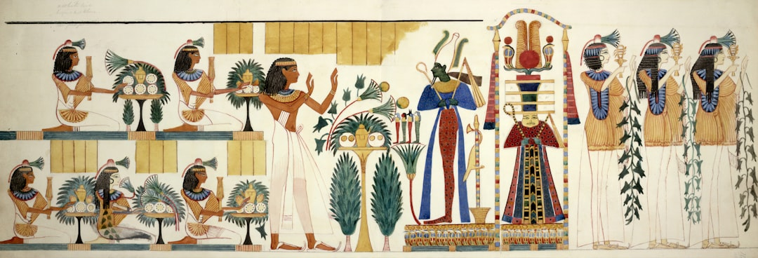

Slide 5
The Great Pyramid of Giza
The Great Pyramid of Giza, built for Pharaoh Khufu, is the largest and most impressive of the pyramids and is considered one of the Seven Wonders of the Ancient World.
The pyramid is estimated to have taken over 20 years to build and required the labor of thousands of skilled workers, who used simple yet effective techniques to construct the massive structure.
The pyramid is built using over 2.3 million stone blocks, each weighing an average of 2.5 tons, and stands at a height of 481 feet (147 meters).

Slide 6
The Pyramid of Khafre
The Pyramid of Khafre, built for Pharaoh Khafre, is the second largest pyramid and is slightly smaller than the Great Pyramid of Giza.
The pyramid is built using a combination of limestone and granite blocks, with the granite blocks used for the inner chamber and the limestone blocks used for the outer casing.
The pyramid is estimated to have taken around 15 years to build and required the labor of thousands of skilled workers, who used advanced techniques to construct the massive structure.

Slide 7
The Pyramid of Menkaure
The Pyramid of Menkaure, built for Pharaoh Menkaure, is the smallest of the three main pyramids and is built using a combination of limestone and granite blocks.
The pyramid is estimated to have taken around 10 years to build and required the labor of thousands of skilled workers, who used advanced techniques to construct the massive structure.
The pyramid is built on a smaller scale than the other two pyramids, with a base perimeter of around 440 feet (134 meters).

Slide 8


Slide 9
The Sphinx
The Great Sphinx of Giza, built during the Old Kingdom period, is a large limestone statue with the body of a lion and the head of a human.
The Sphinx is believed to have been built as a guardian of the pyramids and is believed to represent the wisdom and power of the pharaohs.
The Sphinx is estimated to have taken around 10 years to build and required the labor of thousands of skilled workers, who used advanced techniques to construct the massive statue.

Slide 10
The Construction Process
The ancient Egyptians used a combination of simple yet effective techniques to construct the pyramids, including the use of ramps and pulleys to move the massive stone blocks into place.
The workers used copper tools to cut and shape the stone blocks, which were then transported to the construction site using simple yet effective techniques.
The pyramids were built using a combination of limestone and granite blocks, with the granite blocks used for the inner chamber and the limestone blocks used for the outer casing.

Slide 11
The Purpose of the Pyramids
The pyramids were built as tombs for the pharaohs, who were believed to become gods in the afterlife.
The pyramids were also built as symbols of the power and wealth of the pharaohs, who used the structures to demonstrate their status and authority.
The pyramids were also built as centers of worship and pilgrimage, with the pharaohs believed to have the power to communicate with the gods.

Slide 12
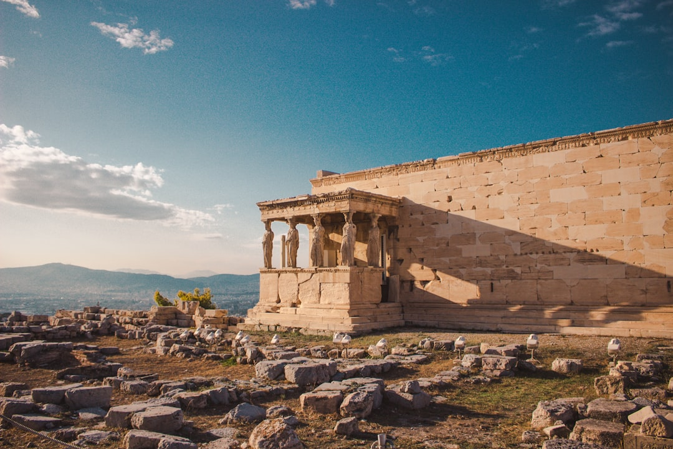

Slide 13
The Pyramids as a Source of Revenue
The pyramids were built as a source of revenue for the pharaohs, who used the structures to control the flow of goods and resources.
The pyramids were also built as a source of employment for thousands of skilled workers, who were paid in goods and services rather than money.
The pyramids were also built as a source of prestige and status for the pharaohs, who used the structures to demonstrate their power and authority.

Slide 14
The Pyramids as a Source of Knowledge
The pyramids were built as a source of knowledge for the ancient Egyptians, who used the structures to demonstrate their advanced understanding of mathematics, engineering, and architecture.
The pyramids were also built as a source of knowledge for the pharaohs, who used the structures to demonstrate their power and authority.
The pyramids were also built as a source of knowledge for future generations, who used the structures to learn about the advanced techniques and technologies of the ancient Egyptians.

Slide 15
The Preservation of the Pyramids
The pyramids were built to last for eternity, with the ancient Egyptians using advanced techniques to preserve the structures and protect them from the elements.
The pyramids were also built with a system of ventilation and drainage to keep the internal temperature stable and to prevent water from accumulating in the structure.
The pyramids were also built with a system of protection, including the use of limestone and granite blocks to prevent erosion and damage.

Slide 16
Conclusion
The pyramids of Egypt are a testament to the ingenuity and skill of the ancient Egyptians, who built these massive structures as tombs for their pharaohs and as symbols of their power and wealth.
The pyramids have fascinated people for centuries, and their secrets and mysteries continue to be studied and explored by archaeologists and historians today.
The pyramids remain an important source of knowledge and inspiration for people around the world, and continue to be a source of wonder and awe.

