Slide 1
Monkeys in Africa
Created with AI Presentation Generator

Slide 2
Introduction
The rich biodiversity of Africa is home to a wide variety of monkey species
These primates play a vital role in the continent's ecosystem
This presentation aims to provide an overview of monkeys in Africa

Slide 3
African Monkey Species
Mandrills
Gorillas
Chimpanzees
Baboons

Slide 4
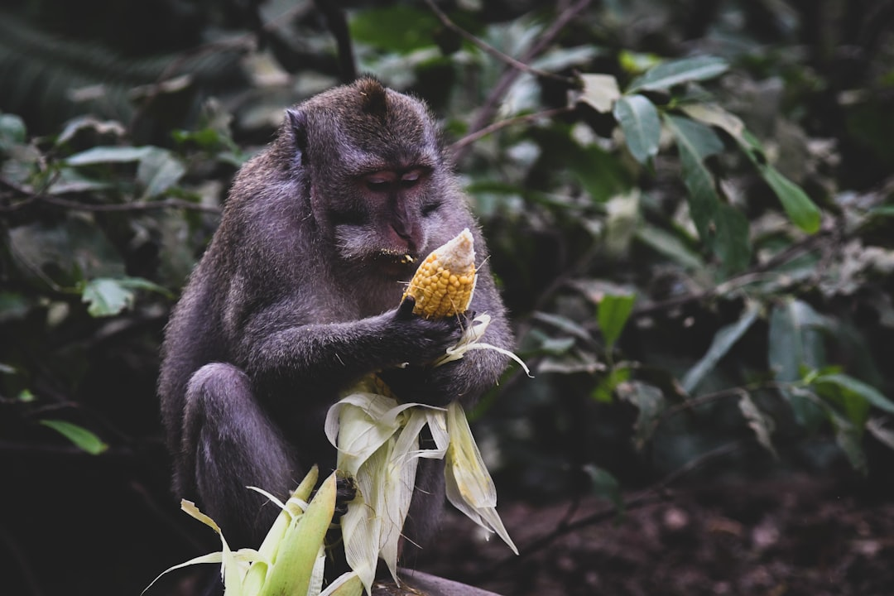
Habitat and Distribution
Tropical rainforests
Savannas
Mountains
Deserts

Slide 5
Behavior and Diet
Omnivorous
Herbivorous
Social animals
Intelligent

Slide 6
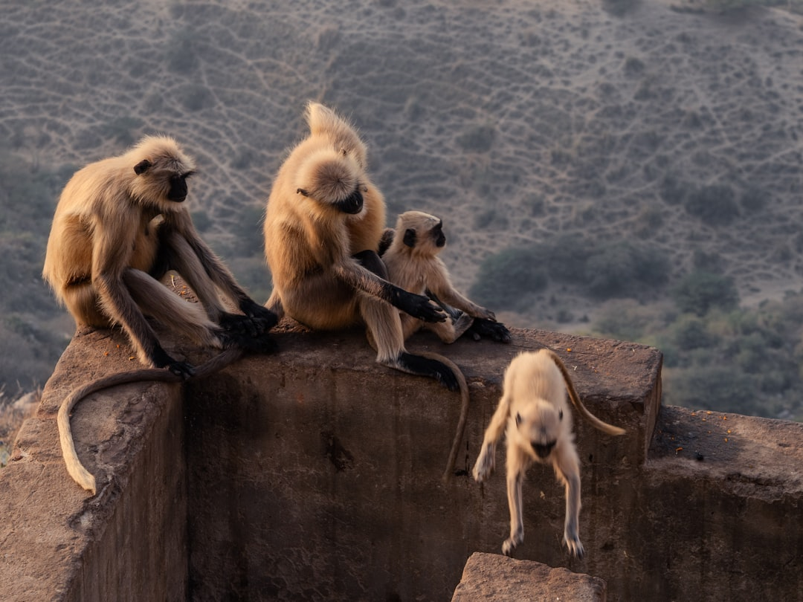
Threats and Conservation
Habitat loss
Poaching
Disease
Human-wildlife conflict

Slide 7
Conservation Efforts
National parks and reserves
Research centers
Community-based conservation
International cooperation

Slide 8

Impact on Local Communities
Economic benefits
Cultural significance
Ecological importance
Conflict mitigation

Slide 9
Research and Science
Studying primate behavior
Genetics and evolution
Disease ecology
Conservation biology

Slide 10
Tourism and Economy
Ecotourism
Monkey trekking
Safari tourism
Job creation

Slide 11
Challenges and Future Directions
Climate change
Human population growth
Infrastructure development
Adaptive conservation

Slide 12
Conclusion
Monkeys in Africa are an integral part of the continent's ecosystem
Their conservation is essential for maintaining biodiversity
Collaborative efforts are necessary to protect these species

