Slide 1
Egyptian Pyramids
Created with AI Presentation Generator

Slide 2
Introduction
The ancient Egyptians built some of the most impressive architectural marvels in history – the pyramids. These structures not only showcase the engineering prowess of the Egyptians but also reveal the significance of their funerary practices and the importance of the pharaohs in their society. The pyramids were built to provide a means for the deceased pharaohs to ascend to the afterlife, and their construction reflects the advanced skills and knowledge of the ancient Egyptians.

Slide 3
History and Purpose
The pyramids of ancient Egypt date back to around 2600 BC, with the oldest and largest pyramid, the Great Pyramid of Giza, being built during the Old Kingdom period, specifically during the reign of Pharaoh Khufu.
The pyramids were built as tombs for the pharaohs, who were believed to become gods in the afterlife, and were designed to provide a means for them to ascend to the heavens.
The pyramids were also seen as symbols of the pharaoh's power and wealth, showcasing the engineering and architectural skills of the Egyptians.

Slide 4
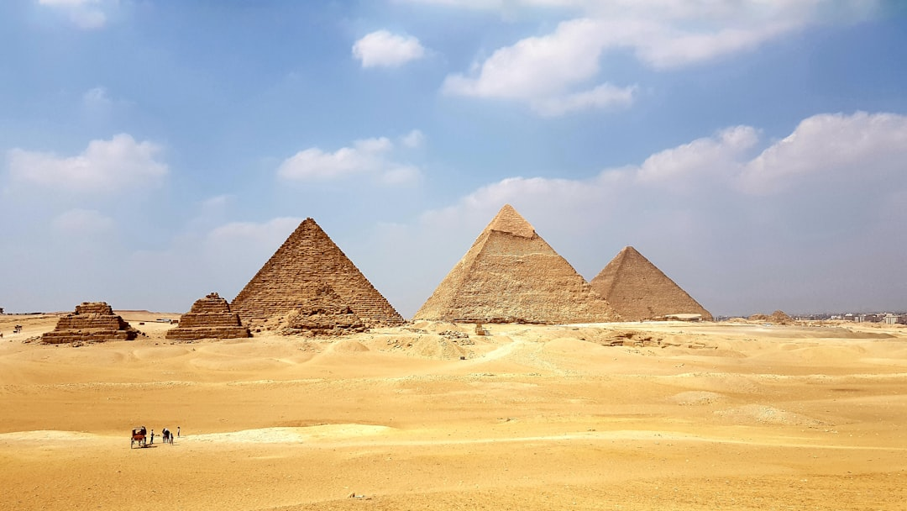

Slide 5
The Great Pyramid of Giza
The Great Pyramid of Giza is the largest and most impressive of the three pyramids, standing at a height of 146 meters and covering an area of 13 acres.
It is estimated that the Great Pyramid took around 20 years to build and required the labor of thousands of skilled workers, who used simple yet effective tools made of copper and stone.
The Great Pyramid is an engineering marvel, with its base covering an area of 13 acres and its original height of 146 meters, making it one of the tallest structures in the world for over 3,800 years.

Slide 6
The Pyramids of Saqqara
The pyramids of Saqqara are a group of five pyramids located in Saqqara, a necropolis on the outskirts of modern-day Cairo.
The pyramids of Saqqara date back to around 2500 BC, during the Old Kingdom period, and were built for the pharaohs of the 3rd and 4th dynasties.
The pyramids of Saqqara are smaller than the Great Pyramid of Giza but are notable for their unique shape and architectural style, which is different from the pyramids in Giza.

Slide 7
The Pyramid of Dahshur
The pyramid of Dahshur is a group of pyramids located in Dahshur, a town on the outskirts of modern-day Cairo.
The pyramid of Dahshur is notable for its unique shape, which is a combination of the step pyramid and the smooth-sided pyramid.
The pyramid of Dahshur was built during the 12th dynasty, specifically during the reign of Pharaoh Sneferu, who is also credited with the construction of the Bent Pyramid.

Slide 8


Slide 9
The Bent Pyramid
The Bent Pyramid is a pyramid located in Dahshur and is notable for its unique shape, which is a combination of the step pyramid and the smooth-sided pyramid.
The Bent Pyramid was built during the 12th dynasty, specifically during the reign of Pharaoh Sneferu, who is also credited with the construction of the pyramid of Dahshur.
The Bent Pyramid is interesting because it shows the transition from the step pyramid to the smooth-sided pyramid, with the upper part of the pyramid being built in the traditional smooth-sided style.

Slide 10
The Red Pyramid
The Red Pyramid is a pyramid located in Dahshur and is notable for its unique shape, which is a combination of the step pyramid and the smooth-sided pyramid.
The Red Pyramid was built during the 12th dynasty, specifically during the reign of Pharaoh Sneferu, who is also credited with the construction of the pyramid of Dahshur.
The Red Pyramid is interesting because it shows the transition from the step pyramid to the smooth-sided pyramid, with the upper part of the pyramid being built in the traditional smooth-sided style.

Slide 11
Funerary Practices
The pyramids were built as tombs for the pharaohs, who were believed to become gods in the afterlife, and were designed to provide a means for them to ascend to the heavens.
The pyramids were also seen as symbols of the pharaoh's power and wealth, showcasing the engineering and architectural skills of the Egyptians.
The funerary practices of the ancient Egyptians were complex and involved a series of rituals and ceremonies to ensure the safe passage of the deceased pharaoh to the afterlife.

Slide 12


Slide 13
Architectural Style
The pyramids of ancient Egypt were built using limestone and granite blocks, with the largest pyramids requiring over 2 million blocks.
The pyramids were designed to be symmetrical and were built on a square base, with the sides of the base aligned with the four cardinal directions.
The pyramids were built with a series of layers, with the base layer being the largest and the upper layers becoming smaller as they ascended.

Slide 14
Symbolism
The pyramids were seen as symbols of the pharaoh's power and wealth, showcasing the engineering and architectural skills of the Egyptians.
The pyramids were also seen as symbols of the afterlife, providing a means for the deceased pharaohs to ascend to the heavens.
The pyramids were also seen as symbols of the cyclical nature of time, with the pyramids being built to last for eternity.

Slide 15
Significance
The pyramids of ancient Egypt are a testament to the advanced skills and knowledge of the Egyptians, showcasing their engineering, architectural, and mathematical prowess.
The pyramids also provide a window into the funerary practices and the importance of the pharaohs in ancient Egyptian society.
The pyramids continue to captivate people around the world, inspiring fascination and awe for their sheer scale and majesty.

Slide 16
Conclusion
The pyramids of ancient Egypt are a testament to the advanced skills and knowledge of the Egyptians, showcasing their engineering, architectural, and mathematical prowess. The pyramids also provide a window into the funerary practices and the importance of the pharaohs in ancient Egyptian society.

