Slide 1
The Ancient Pyramids of Egypt
Created with AI Presentation Generator

Slide 2
Introduction
The pyramids of Egypt are among the most impressive architectural achievements in human history, with a rich history spanning over 4,500 years. These massive structures were built as tombs for the pharaohs of ancient Egypt, who were believed to have been gods on earth. The pyramids were built with precision and skill, using simple yet effective tools and techniques that have fascinated people for centuries.

Slide 3
The Great Pyramid of Giza
The Great Pyramid of Giza, also known as the Pyramid of Khufu, is the oldest and largest of the three pyramids on the Giza plateau. It is estimated to have taken around 20 years to build and required the labor of thousands of skilled workers. The pyramid stands at an impressive 481 feet tall and was originally covered in smooth white limestone to create a shining beacon that could be seen from a distance.
The pyramid's base is a near-perfect square, with each side aligning almost perfectly with the four cardinal directions. This alignment is believed to have been achieved using advanced surveying techniques and mathematical calculations. The pyramid's base also forms a square with each side measuring around 756 feet in length.
The Great Pyramid of Giza is not only an architectural marvel but also a testament to the ingenuity and skill of the ancient Egyptians. Its construction demonstrates a deep understanding of mathematics, engineering, and architecture that was unmatched in the ancient world.

Slide 4
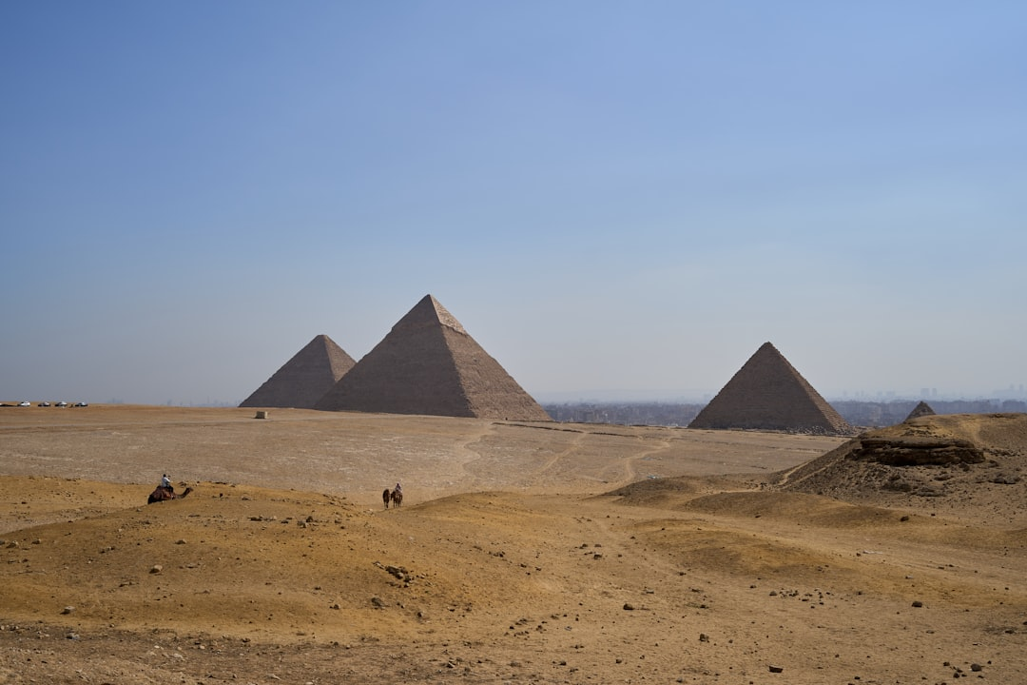

Slide 5
The Pyramid of Khafre
The Pyramid of Khafre, also known as the Pyramid of Chephren, is the second-largest pyramid on the Giza plateau and is believed to have been built by Pharaoh Khafre. The pyramid stands at an impressive 446 feet tall and was originally covered in smooth white limestone. The pyramid's base is a near-perfect square, with each side aligning almost perfectly with the four cardinal directions.
The Pyramid of Khafre is slightly smaller than the Great Pyramid of Giza, but its base is slightly larger. The pyramid's internal chamber is also more complex than the Great Pyramid, with a series of passageways and chambers that were believed to have been used for the pharaoh's final journey. The pyramid's exterior is also adorned with a series of reliefs and carvings that depict the pharaoh's military campaigns and other important events.
The Pyramid of Khafre is a testament to the advanced engineering and architectural skills of the ancient Egyptians. Its construction demonstrates a deep understanding of mathematics, engineering, and architecture that was unmatched in the ancient world.

Slide 6
The Pyramid of Menkaure
The Pyramid of Menkaure, also known as the Pyramid of Mykerinos, is the smallest of the three pyramids on the Giza plateau and is believed to have been built by Pharaoh Menkaure. The pyramid stands at an impressive 218 feet tall and was originally covered in smooth white limestone. The pyramid's base is a near-perfect square, with each side aligning almost perfectly with the four cardinal directions.
The Pyramid of Menkaure is the only one of the three pyramids that is not aligned with the four cardinal directions. Instead, its base is aligned with the rising of the star Sirius, which was believed to have been an important celestial body in ancient Egyptian mythology. The pyramid's internal chamber is also simpler than the other two pyramids, with a single passageway that leads to a small chamber.
The Pyramid of Menkaure is a testament to the advanced engineering and architectural skills of the ancient Egyptians. Its construction demonstrates a deep understanding of mathematics, engineering, and architecture that was unmatched in the ancient world.

Slide 7
The Construction of the Pyramids
The construction of the pyramids required the labor of thousands of skilled workers who were responsible for quarrying, transporting, and placing the massive stone blocks into position. The workers used simple yet effective tools and techniques to achieve this feat, including the use of ramps and pulleys. The construction of the pyramids is believed to have taken around 20 to 30 years to complete.
The pyramids were built using local limestone and granite, with the Great Pyramid of Giza requiring around 2.3 million stone blocks, each weighing around 2.5 tons. The blocks were cut and polished to fit together with incredible precision, with some joints as small as 1/50th of an inch. The construction of the pyramids demonstrates a deep understanding of mathematics, engineering, and architecture that was unmatched in the ancient world.
The construction of the pyramids is a testament to the ingenuity and skill of the ancient Egyptians. The pyramid's internal chamber is also a marvel of engineering, with a series of passageways and chambers that were believed to have been used for the pharaoh's final journey.

Slide 8
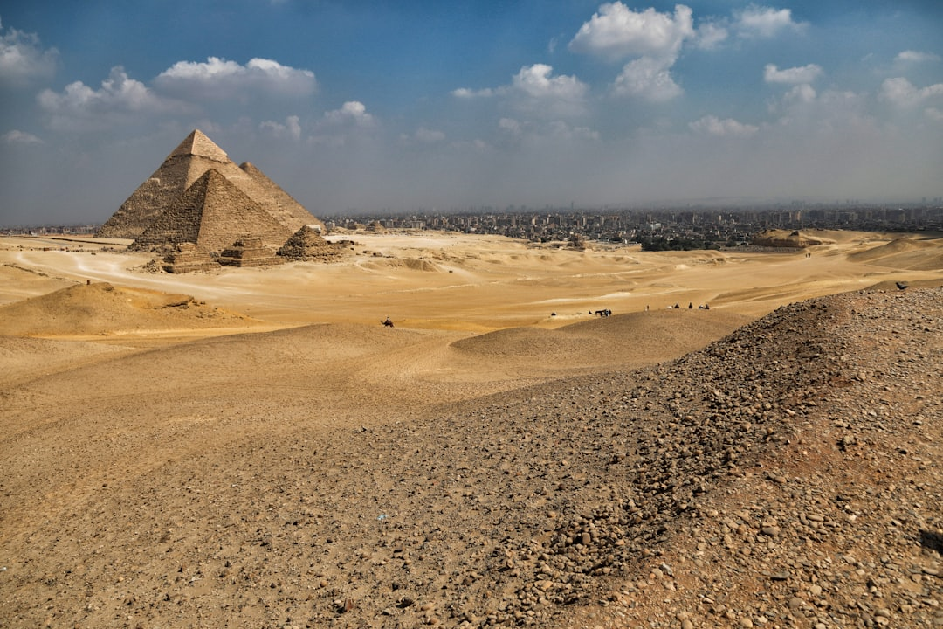

Slide 9
The Purpose of the Pyramids
The pyramids were built as tombs for the pharaohs of ancient Egypt, who were believed to have been gods on earth. The pyramids were believed to have provided a means for the pharaohs to ascend to the afterlife, where they would be judged by the god Osiris. The pyramids were also believed to have been a means for the pharaohs to provide for their families and subjects in the afterlife.
The pyramids were also believed to have been a symbol of the pharaoh's power and wealth. The pyramids were built to last for eternity, and their construction was seen as a way for the pharaohs to leave a lasting legacy. The pyramids were also believed to have been a means for the pharaohs to communicate with the gods and to ensure their safe passage into the afterlife.
The pyramids were a testament to the advanced engineering and architectural skills of the ancient Egyptians. The pyramid's internal chamber is also a marvel of engineering, with a series of passageways and chambers that were believed to have been used for the pharaoh's final journey.

Slide 10
The Significance of the Pyramids
The pyramids are a testament to the ingenuity and skill of the ancient Egyptians. The pyramid's internal chamber is also a marvel of engineering, with a series of passageways and chambers that were believed to have been used for the pharaoh's final journey. The pyramids were built using simple yet effective tools and techniques, demonstrating a deep understanding of mathematics, engineering, and architecture.
The pyramids are also a symbol of the advanced engineering and architectural skills of the ancient Egyptians. The pyramid's exterior is adorned with a series of reliefs and carvings that depict the pharaoh's military campaigns and other important events. The pyramids were also believed to have been a means for the pharaohs to provide for their families and subjects in the afterlife.
The pyramids are a reminder of the rich history and culture of ancient Egypt. The pyramid's internal chamber is also a marvel of engineering, with a series of passageways and chambers that were believed to have been used for the pharaoh's final journey.

Slide 11
The Legacy of the Pyramids
The pyramids have left a lasting legacy in the field of engineering and architecture. The pyramid's internal chamber is also a marvel of engineering, with a series of passageways and chambers that were believed to have been used for the pharaoh's final journey. The pyramids were built using simple yet effective tools and techniques, demonstrating a deep understanding of mathematics, engineering, and architecture.
The pyramids are also a testament to the ingenuity and skill of the ancient Egyptians. The pyramid's exterior is adorned with a series of reliefs and carvings that depict the pharaoh's military campaigns and other important events. The pyramids were also believed to have been a means for the pharaohs to provide for their families and subjects in the afterlife.
The pyramids are a reminder of the rich history and culture of ancient Egypt. The pyramid's internal chamber is also a marvel of engineering, with a series of passageways and chambers that were believed to have been used for the pharaoh's final journey.

Slide 12
Conclusion
The pyramids of Egypt are a testament to the ingenuity and skill of the ancient Egyptians. The pyramid's internal chamber is also a marvel of engineering, with a series of passageways and chambers that were believed to have been used for the pharaoh's final journey. The pyramids were built using simple yet effective tools and techniques, demonstrating a deep understanding of mathematics, engineering, and architecture. The pyramids are a reminder of the rich history and culture of ancient Egypt and continue to inspire and fascinate people to this day.

