Slide 1
The Pyramids of Egypt
Created with AI Presentation Generator

Slide 2
Introduction
The Pyramids of Egypt are one of the most fascinating and awe-inspiring architectural achievements in the history of human civilization. These towering structures have captivated the imagination of people for centuries, and continue to be a source of fascination and wonder for visitors from around the world. The Pyramids were built over 4,500 years ago, during the Old Kingdom period of Ancient Egypt, and their construction is a testament to the ingenuity, skill, and determination of the ancient Egyptians.

Slide 3
Geography and Climate
The Pyramids are located in the Giza Necropolis, on the west bank of the Nile River in modern-day Egypt, which was the ancient settlement of Memphis.
The climate of Egypt during the time of the Pyramid's construction was characterized by a hot desert climate with very little rainfall, which presented a significant challenge to the construction of these massive structures.
The Giza plateau, where the Pyramids are located, has a unique geology that consists of limestone and granite bedrock, which provided a stable foundation for the Pyramid's base.

Slide 4


Slide 5
Design and Architecture
The Pyramids were designed as tombs for the pharaohs of Ancient Egypt, who were believed to become gods in the afterlife.
The Pyramids' design is based on a square base, with four sides of equal length, and a triangular apex, which is a mathematical representation of the Egyptian symbol for eternity.
The Pyramids' architecture is characterized by a series of internal chambers and passageways, including the King's Chamber, the Queen's Chamber, and the Grand Gallery.

Slide 6
Construction Techniques
The ancient Egyptians used simple yet effective construction techniques, such as quarrying and transporting massive stone blocks, using ramps and pulleys to move them into place.
The Pyramid's core was built using limestone and granite blocks, which were cut and transported from nearby quarries using copper tools.
The Pyramid's outer casing was made of highly polished white limestone, which was intended to reflect the sun's rays and create a dazzling effect.

Slide 7
The Great Pyramid of Giza
The Great Pyramid of Giza, also known as the Pyramid of Khufu, is the largest of the three Pyramids and is believed to have taken over 20 years to build.
The Pyramid stands at a height of 146.5 meters (480.6 feet) and has a base perimeter of 1,005 feet (306 meters).
The Pyramid's original height was around 150 meters (492 feet), but it has been reduced by erosion and the loss of its outer casing.

Slide 8
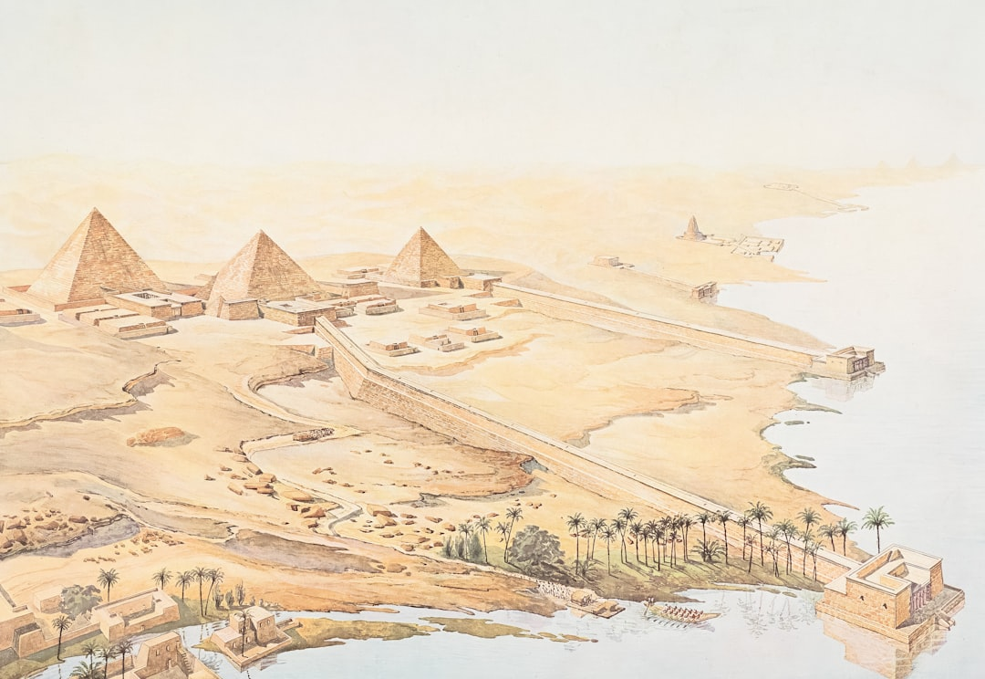

Slide 9
The Pyramid of Khafre
The Pyramid of Khafre, also known as the Pyramid of Chephren, is the second-largest Pyramid and is believed to have been built by the son of Khufu.
The Pyramid stands at a height of 136.4 meters (448.0 feet) and has a base perimeter of 706 feet (215 meters).
The Pyramid's original height was around 143 meters (469 feet), but it has also been reduced by erosion and the loss of its outer casing.

Slide 10
The Pyramid of Menkaure
The Pyramid of Menkaure, also known as the Pyramid of Mykerinos, is the smallest of the three Pyramids and is believed to have been built by the grandson of Khufu.
The Pyramid stands at a height of 65.5 meters (215 feet) and has a base perimeter of 411 feet (125 meters).
The Pyramid's original height was around 68 meters (223 feet), but it has also been reduced by erosion and the loss of its outer casing.

Slide 11
Pyramid Texts
The Pyramid Texts are a collection of spells and prayers that were inscribed on the walls of the Pyramids, which were intended to help the pharaoh navigate the afterlife.
The Pyramid Texts are a unique source of information about ancient Egyptian mythology and funerary practices.
The Pyramid Texts are also a testament to the advanced knowledge of mathematics and astronomy possessed by the ancient Egyptians.

Slide 12
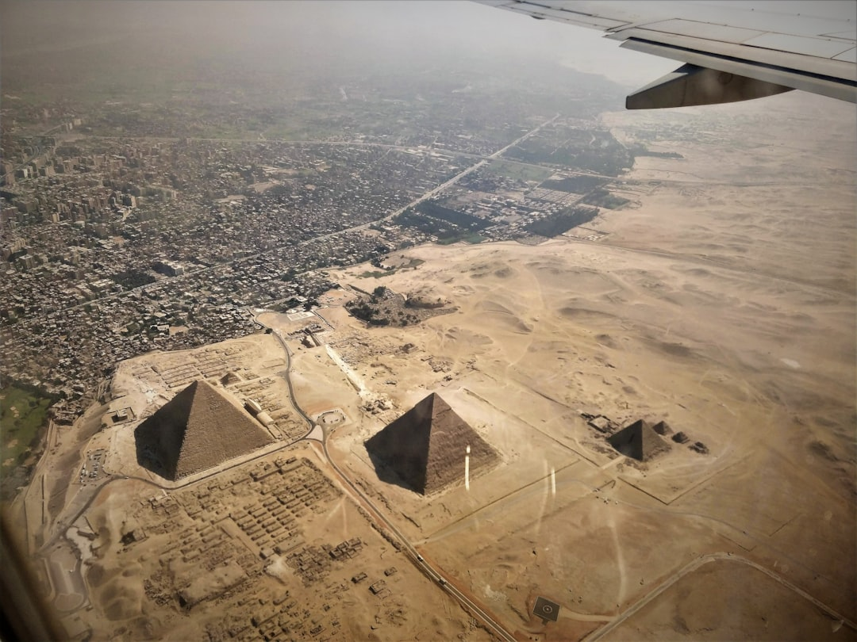

Slide 13
The Purpose of the Pyramids
The Pyramids were built as tombs for the pharaohs of Ancient Egypt, who were believed to become gods in the afterlife.
The Pyramids were also intended to provide a means of sustenance and comfort for the pharaoh in the afterlife.
The Pyramids were also seen as a symbol of the pharaoh's power and wealth, and were intended to demonstrate his ability to create and sustain a vast and complex society.

Slide 14
The Significance of the Pyramids
The Pyramids are one of the most significant architectural achievements in human history, and continue to inspire wonder and awe in people around the world.
The Pyramids are a testament to the ingenuity, skill, and determination of the ancient Egyptians, who were able to build these massive structures using simple yet effective construction techniques.
The Pyramids are also a source of cultural and historical significance, and continue to be studied and appreciated by scholars and enthusiasts around the world.

Slide 15
The Legacy of the Pyramids
The Pyramids have had a profound impact on the development of architecture and engineering, and continue to influence the design of buildings and structures around the world.
The Pyramids have also had a significant impact on the development of mathematics and astronomy, and continue to be a source of fascination and inspiration for scientists and scholars.
The Pyramids are also a source of cultural and historical significance, and continue to be a source of pride and inspiration for the people of Egypt.

Slide 16
Conclusion
In conclusion, the Pyramids of Egypt are one of the most fascinating and awe-inspiring architectural achievements in human history.
The Pyramids are a testament to the ingenuity, skill, and determination of the ancient Egyptians, who were able to build these massive structures using simple yet effective construction techniques.
The Pyramids continue to inspire wonder and awe in people around the world, and remain a source of cultural and historical significance, and a testament to the enduring legacy of the ancient Egyptians.

