Slide 1
History of France in Football
Created with AI Presentation Generator

Slide 2
Introduction
The history of France in football spans over a century, with the country's national team first competing in the 1920 Summer Olympics.
France has experienced periods of great success and failure, shaping the nation's identity and passion for the sport.
This presentation will explore the major milestones, achievements, and influential figures that have contributed to France's rich football heritage.

Slide 3
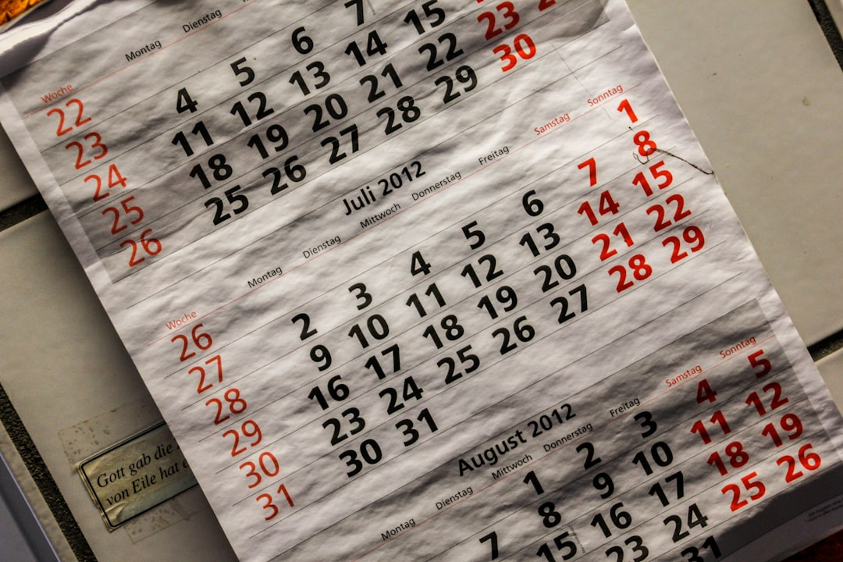
Early Years (1920s-1950s)
France's national team first gained international recognition after participating in the 1920 Summer Olympics, where they finished as runners-up.
The team's early successes were largely due to the efforts of players such as André Maschinot and Marcel Langiller, who were known for their exceptional skills on the pitch.
However, the team's performance declined in the 1930s, and France failed to qualify for the 1934 World Cup, marking a low point in the nation's football history.

Slide 4
The Golden Generation (1958-1966)
France's fortunes changed with the emergence of a new generation of talented players, including Raymond Kopa and Jean Vincent, who led the team to the 1958 World Cup semifinals.
This period also saw the introduction of the 4-2-4 formation, which became a hallmark of French football and influenced the development of the game worldwide.
France's success in the 1960s was capped by their victory in the 1960 European Nations' Cup, marking the country's first major international title.

Slide 5
The Tricolor Era (1984-1998)
The 1984 European Championship marked the beginning of a new era for French football, as the team, led by Michel Platini, won their first major international title in 20 years.
This period saw the emergence of iconic players such as Eric Cantona, Didier Deschamps, and Zinedine Zidane, who would go on to become some of the greatest players in French football history.
France's success continued in the 1990s, as the team reached the 1998 World Cup final, where they defeated Brazil 3-0 to claim their first World Cup title.

Slide 6

The Modern Era (1998-Present)

Slide 7
Notable Players
Zinedine Zidane is widely regarded as one of the greatest players in French football history, known for his exceptional skill, vision, and leadership on the pitch.
Michel Platini was a key player in France's 1984 European Championship victory and is remembered for his exceptional goal-scoring ability and vision.
Didier Deschamps is one of the most successful French players of all time, leading the team to World Cup victory in 1998 and becoming the first player to captain the team to both World Cup and European Championship titles.

Slide 8
Coaching Legacy
Aimé Jacquet is credited with leading France to World Cup victory in 1998, introducing the "Tiki-Taka" style of play and creating a team that was both dominant and entertaining.
Raymond Domenech's tenure as coach of the French national team was marked by controversy and disappointment, culminating in the team's disappointing exit from the 2010 World Cup.
Didier Deschamps' second stint as coach of the French national team has been marked by success, as the team won the 2018 World Cup and established a strong foundation for future success.

Slide 9
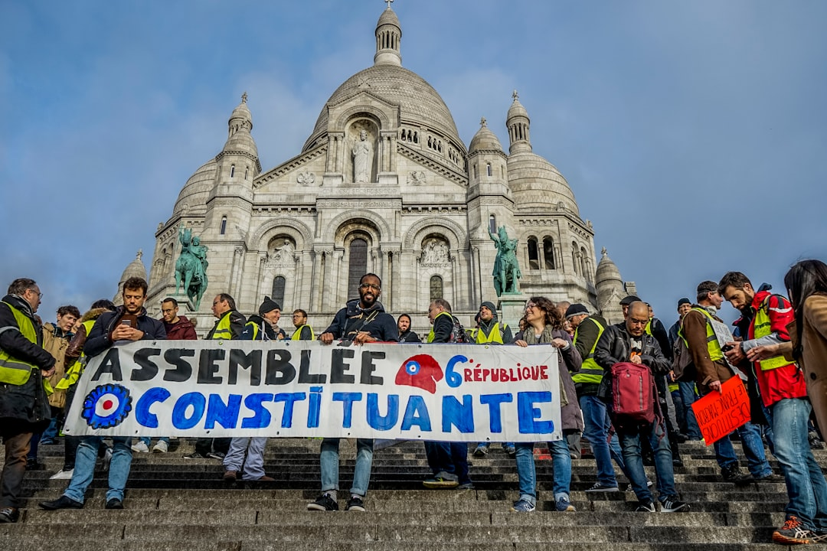
Challenges and Controversies
Racism and sectarianism have been ongoing issues in French football, with several high-profile incidents and controversies surrounding the national team and its players.
Corruption and match-fixing have also been concerns in French football, with several high-profile cases and scandals affecting the sport.
The 2020 Euro qualification campaign was marked by controversy and disappointment, as France failed to qualify for the tournament, marking a low point in the nation's football history.

Slide 10
Future Prospects
France's success in the 2018 World Cup has created a strong foundation for future success, with a talented group of players and a experienced coaching staff.
The emergence of young players such as Kylian Mbappé and Dayot Upamecano has given France a bright future, as they look to build on their World Cup victory.
However, the team will face stiff competition from other European nations, including England, Germany, and Portugal, as they bid to retain their World Cup title in 2022.

Slide 11
Conclusion
Summary of key points and takeaways
Future outlook and recommendations
Q&A and discussion

