Slide 1
History of France in Football
Created with AI Presentation Generator

Slide 2
Introduction
France has a rich history in football, with a legacy spanning over a century. The country has produced some of the greatest footballers and teams in the world, with a unique blend of technical skill, tactical innovation, and passionate fan culture. This presentation will delve into the fascinating story of France's rise to football supremacy, exploring key milestones, legendary players, and iconic moments that have shaped the nation's love affair with the beautiful game.

Slide 3
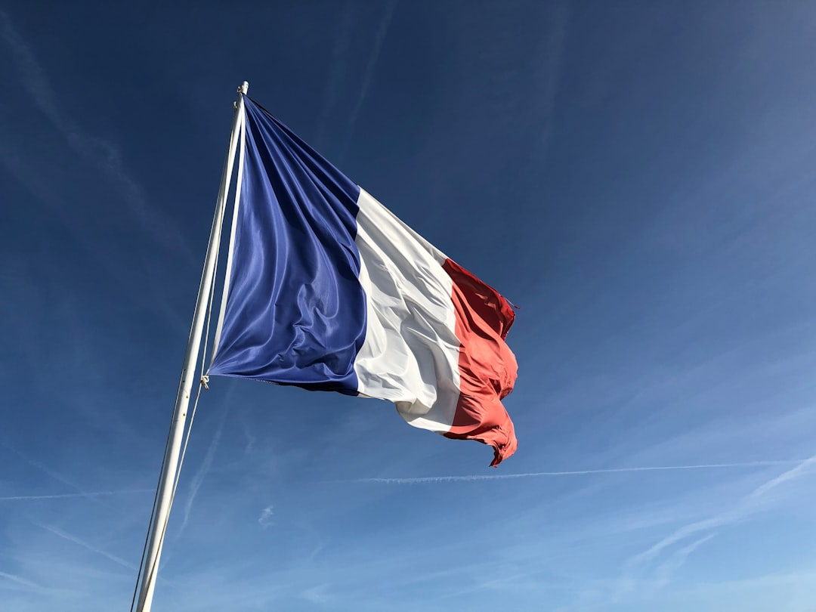
Early Years (1900s-1940s)
France's early football history was marked by inconsistent performances, with the national team failing to qualify for several major tournaments. However, this period saw the emergence of pioneering figures such as Raoul Diagne, a Senegalese-born French footballer who broke racial barriers in the sport. Diagne's trailblazing career paved the way for future generations of French players.
The late 1920s and early 1930s witnessed a significant improvement in France's football fortunes, with the national team reaching the quarter-finals of the 1930 World Cup in Uruguay. This unexpected run to the last eight was a testament to the team's growing maturity and tactical acumen under the guidance of coach Raoul Caudron.
France's domestic football scene was also gaining momentum during this era, with the establishment of the French Football Federation in 1919 and the creation of the French league in 1932. These developments laid the groundwork for the country's football infrastructure and paved the way for future successes.

Slide 4
The Golden Years (1950s-1970s)
The 1950s and 1960s are often regarded as France's golden era in football, with the national team winning the 1958 World Cup in Sweden and reaching the final in 1960. This period was characterized by the dominance of legendary players such as Just Fontaine, who scored 13 goals in the 1958 World Cup, and Raymond Kopa, a skilled midfielder who captained the team to the 1960 European Championship title.
France's success during this era was built on the back of a talented generation of players who were influenced by the country's unique football culture. The team's playing style, which emphasized flair and creativity, was shaped by the likes of coach Albert Batteux and his innovative tactics.
The 1970s saw a slight decline in France's football fortunes, with the national team failing to qualify for several major tournaments. However, this period also witnessed the emergence of new talent, including the likes of Michel Platini, who would go on to become one of the greatest players in French history.

Slide 5
Michel Platini and the Rise of French Football (1980s)
The 1980s are often regarded as the dawn of a new era in French football, with Michel Platini leading the national team to unprecedented success. Under Platini's guidance, France won the 1984 European Championship and reached the final in 1988, where they were narrowly defeated by the Netherlands.
Platini's career was marked by his exceptional skill, vision, and leadership, which inspired a generation of French players. He was the driving force behind France's attacking style, which emphasized speed, agility, and precision.
Platini's influence extended beyond his playing career, as he went on to become the first French player to captain the national team in a major tournament. He was also a pioneer in popularizing the 'tiki-taka' style of football, which emphasized possession and creative play.

Slide 6
Zinedine Zidane and the Modern Era (1990s-2000s)

Slide 7
Modern France and the Road to Success (2010s-Present)
The 2010s saw a significant improvement in France's football fortunes, with the national team winning the 2018 World Cup in Russia. This victory was built on the back of a talented generation of players, including the likes of Kylian Mbappé, Paul Pogba, and N'Golo Kanté.
France's success during this era was characterized by the dominance of a new generation of players who were influenced by the country's unique football culture. The team's playing style, which emphasized speed, agility, and precision, was shaped by the likes of coach Didier Deschamps and his innovative tactics.
The 2020s have seen France continue to evolve as a football nation, with the national team reaching the final of the 2020 European Championship. This period has also witnessed the emergence of new talent, including the likes of Eduardo Camavinga and Aurélien Tchouaméni, who are set to shape the nation's football future.

Slide 8
Conclusion
France's history in football is a rich and fascinating story that spans over a century. From the early years of inconsistent performances to the golden era of the 1950s and 1960s, and from the emergence of Michel Platini to the dominance of Zinedine Zidane, France has produced some of the greatest footballers and teams in the world. Today, France continues to evolve as a football nation, with a new generation of players and coaches shaping the nation's future.

