Slide 1
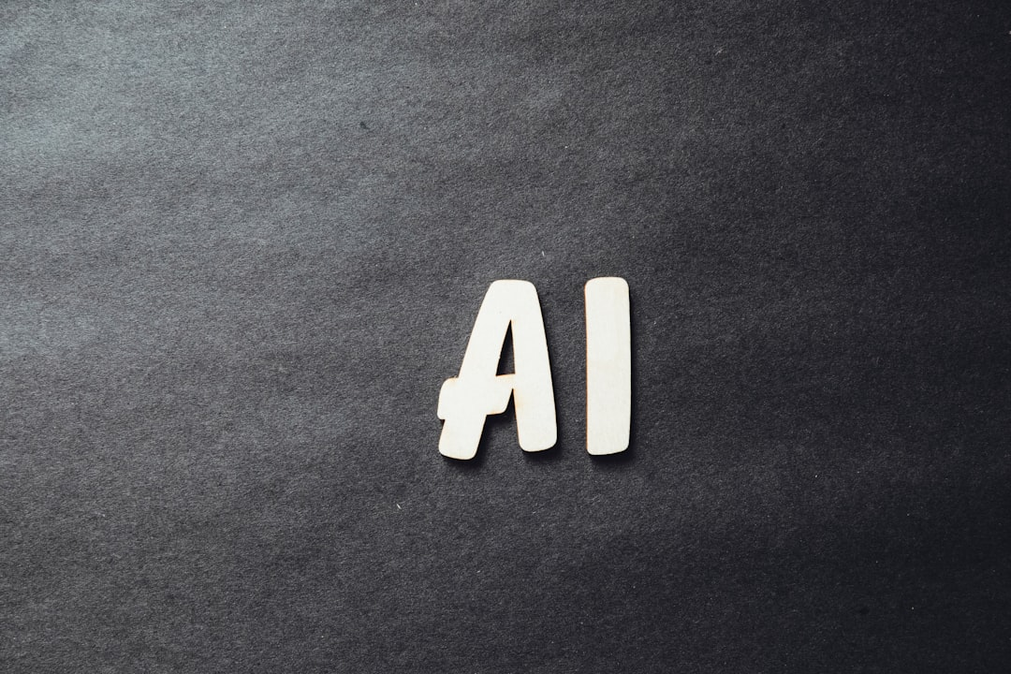
Artificial Intelligence Revolution
Generated with AI Presentation Generator'Ammar Yasser'

Slide 2
Introduction
Artificial Intelligence (AI) has become a crucial part of our daily lives, transforming the way we live, work, and interact with each other. This presentation aims to explore the concept of AI, its applications, and the future of this technology. We will delve into the world of AI and discover its potential.

Slide 3
What is AI?
● Machine Learning
● Deep Learning
● Neural Networks
● Natural Language Processing
● Computer Vision

Slide 4
AI Applications
● Virtual Assistants
● Image Recognition
● Speech Recognition
● Predictive Maintenance
● Chatbots

Slide 5
Benefits of AI
● Increased Efficiency
● Improved Accuracy
● Enhanced Decision Making
● Personalized Experiences
● Automation

Slide 6
Challenges of AI
Bias and Fairness
Job Displacement
Security Risks
Explainability
Transparency

Slide 7
AI in Industry
● Healthcare
● Finance
● Transportation
● Education
● Manufacturing

Slide 8
Future of AI
Quantum Computing
Edge AI
Explainable AI
Human-AI Collaboration

Slide 9
Conclusion
AI has the potential to revolutionize various industries
Its applications are vast and diverse
AI requires careful consideration and development

Slide 10
Thank You!
Questions & Discussion

