Slide 1
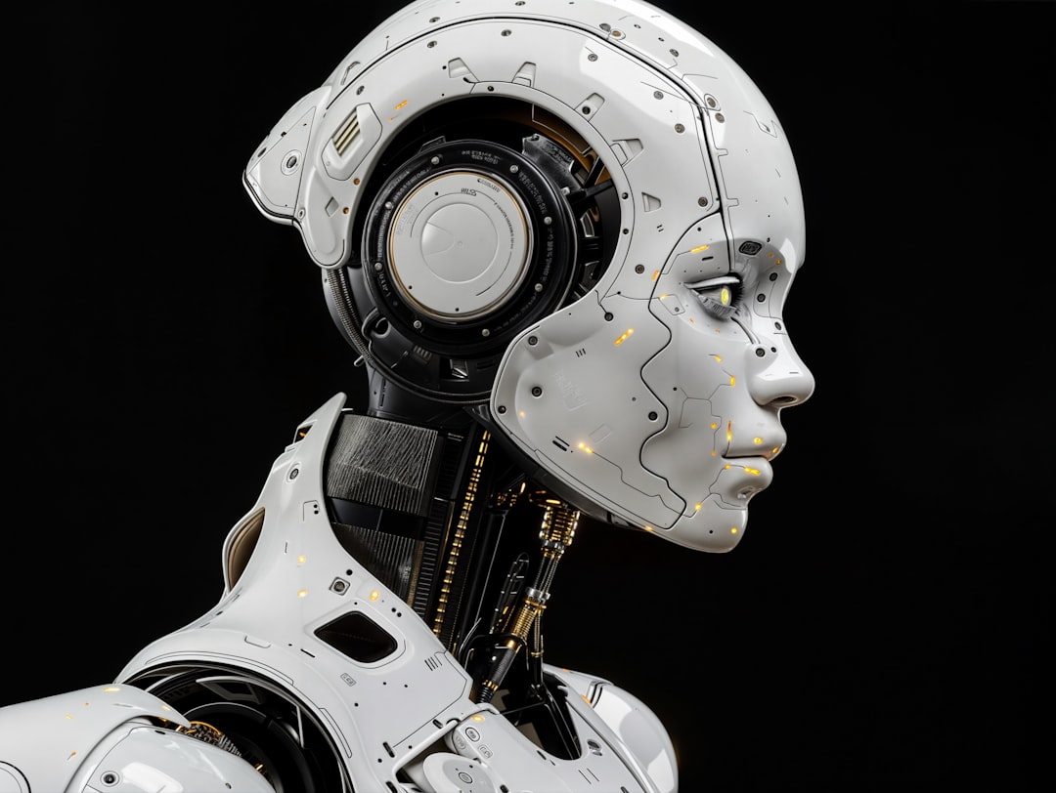
Artificial Intelligence: Revolutionizing Human Experience
Generated with AI Presentation Generator'Ammar Yasser'

Slide 2
Introduction
Artificial Intelligence (AI) is transforming industries and everyday life with its capabilities. This presentation explores the world of AI, its applications, and the future implications. We will delve into the possibilities and challenges of AI, and how it is changing human experience.

Slide 3
Types of AI
• Narrow or weak AI refers to machines that can perform specific tasks, such as virtual assistants or image recognition software.
• General or strong AI, on the other hand, aims to create machines that can perform any intellectual task that humans can.

Slide 4
Applications of AI
• AI is being used in healthcare to diagnose diseases and develop personalized treatments.
• In finance, AI is used for credit scoring, risk assessment, and portfolio management.

Slide 5
Impact on Workforce
AI may automate certain jobs, but it also creates new ones, such as AI developer and data scientist.
The future of work will require humans to upskill and reskill to remain relevant in the AI-driven economy.

Slide 6
AI in Education
• AI-powered adaptive learning systems can provide personalized education to students.
• AI can also help teachers with grading, data analysis, and student assessment.

Slide 7
Benefits and Risks
AI offers numerous benefits, including increased efficiency, improved accuracy, and enhanced decision-making.
However, there are also risks associated with AI, such as job displacement, bias, and cybersecurity threats.

Slide 8
Implementing AI
● Organizations should start by identifying areas where AI can add value, such as customer service or data analysis.
● They should also invest in AI talent and infrastructure to support the adoption of AI technologies.

Slide 9
Overcoming Challenges
• To overcome the challenges of AI adoption, organizations should prioritize data quality, transparency, and explainability.
• They should also establish clear governance and decision-making frameworks for AI implementation.

Slide 10
Conclusion
This presentation has explored the exciting world of Artificial Intelligence, its applications, and the future implications.
As AI continues to transform human experience, it is essential to prioritize responsible AI development and adoption.

Slide 11
Thank You!
Questions & Discussion

