Slide 1
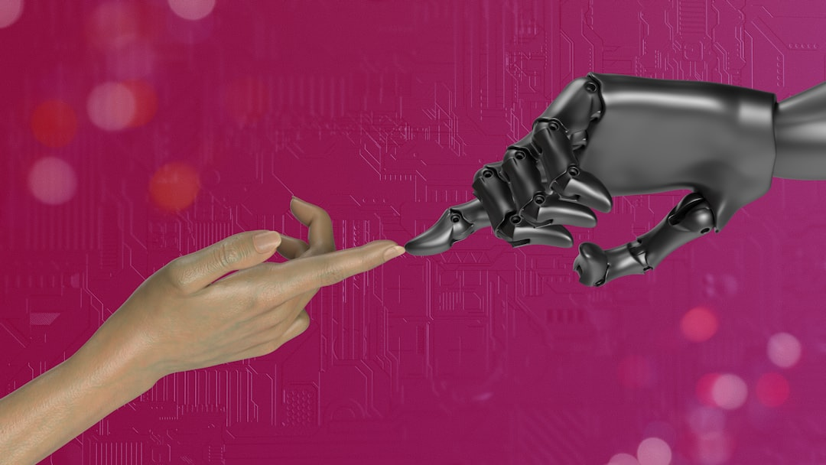
Artificial Intelligence
Generated with AI Presentation Generator

Slide 2
Introduction
Artificial Intelligence is a rapidly growing field that focuses on developing intelligent machines that can think and learn like humans. This presentation aims to provide an overview of the core concepts, applications, and future of Artificial Intelligence. We will explore its potential to transform various industries and aspects of our lives.

Slide 3
History of AI
Early Beginnings
Dartmouth Summer Research Project
Rule-Based Systems
Expert Systems
Machine Learning
Deep Learning
Artificial General Intelligence

Slide 4
Types of AI
• Narrow AI
• General AI
• Superintelligence
• Weak AI
• Strong AI
• AGI
• Multi-Agent Systems

Slide 5
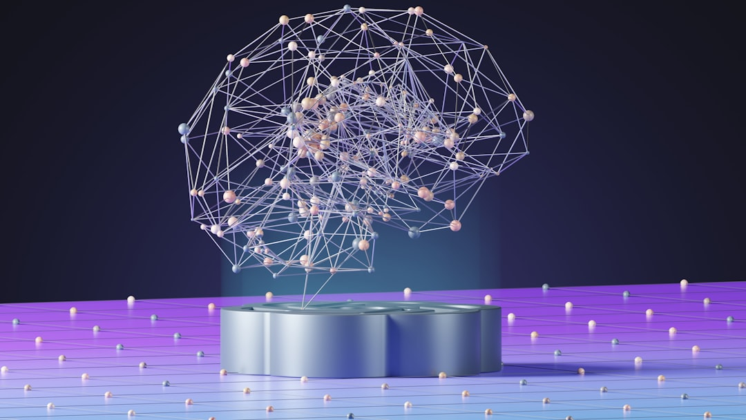
Machine Learning
● Supervised Learning
● Unsupervised Learning
● Reinforcement Learning
● Neural Networks
● Decision Trees
● Random Forest
● Support Vector Machines

Slide 6
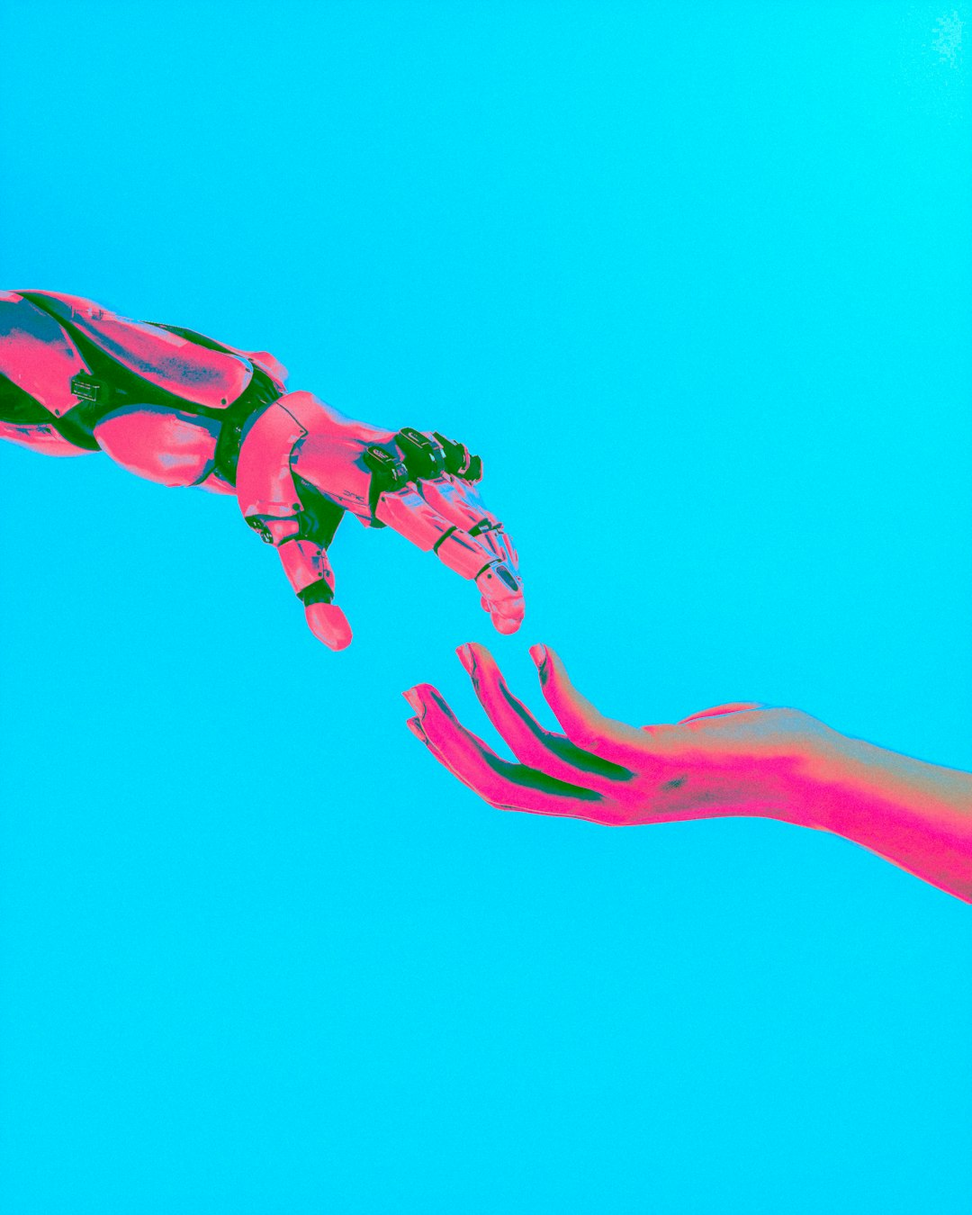
Deep Learning
● Convolutional Neural Networks
● Recurrent Neural Networks
● Long Short-Term Memory
● Generative Adversarial Networks
● Transfer Learning
● Autoencoders
● Word Embeddings

Slide 7
Natural Language Processing
Text Analysis
Sentiment Analysis
Language Translation
Speech Recognition
Text Generation
Chatbots
Voice Assistants

Slide 8
Computer Vision
Image Classification
Object Detection
Facial Recognition
Image Segmentation
Image Generation
Image Denoising
Object Tracking

Slide 9
Robotics and Autonomy
Autonomous Vehicles
Robotics Process Automation
Autonomous Drones
Collaborative Robots
Human-Robot Interaction
Robot Learning
Autonomous Systems

Slide 10
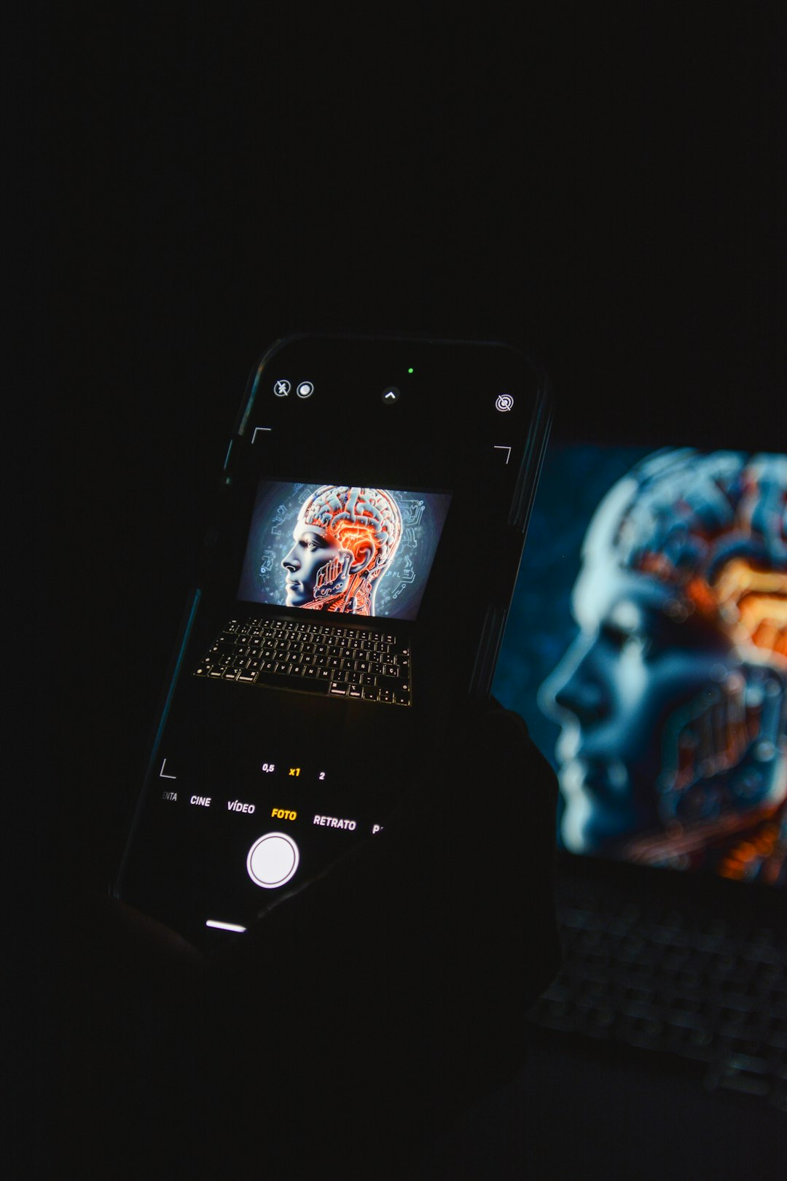
Applications in Healthcare
● Medical Diagnosis
● Personalized Medicine
● Disease Prediction
● Patient Engagement
● Clinical Decision Support
● Medical Research
● Health Informatics

Slide 11
Future of AI
Advancements in Hardware
Breakthroughs in Software
Expanding Applications
Increased Adoption
Growing Expertise
Emerging Trends
New Opportunities

Slide 12
Conclusion
Recap of Core Concepts
Recap of Applications
Future Directions

Slide 13
Thank You!
Questions & Discussion

