Slide 1
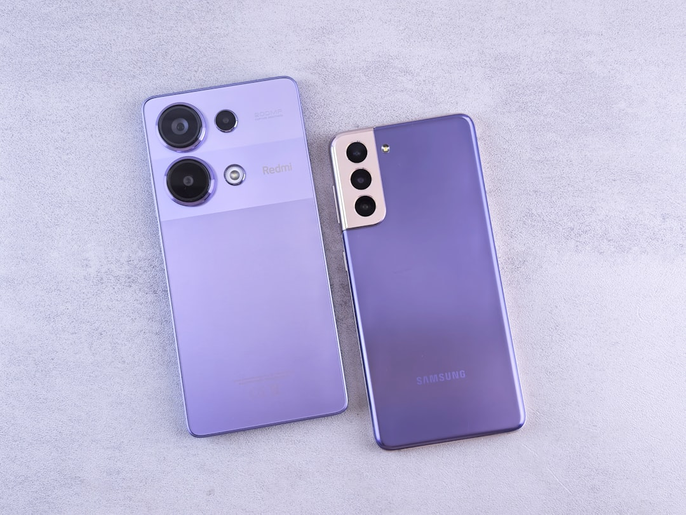
Digital Twin Revolution
Generated with AI Presentation Generator

Slide 2
Introduction
Digital twins are virtual replicas of physical objects, systems, or processes that use real-time data to simulate and analyze performance in a virtual environment. This presentation will explore the concept, applications, and benefits of digital twins. We will delve into the world of digital twin technology and its vast potential.

Slide 3

What is Digital Twin
● Definition
● Virtual replica
● Real-time data
● Simulation
● Analysis
● Performance optimization
● Predictive maintenance
● Improved efficiency

Slide 4
Types of Digital Twins
• Component digital twin
• System digital twin
• Process digital twin
• Product digital twin
• City digital twin
• Industry digital twin
• IoT digital twin
• Simulation digital twin

Slide 5
Key Characteristics
• Real-time data
• Virtual environment
• Simulation
• Analysis
• Optimization
• Predictive maintenance
• Improved efficiency
• Reduced costs

Slide 6

Benefits of Digital Twins
● Improved efficiency
● Reduced costs
● Predictive maintenance
● Enhanced decision-making
● Increased safety
● Better performance
● Reduced downtime
● Improved quality

Slide 7
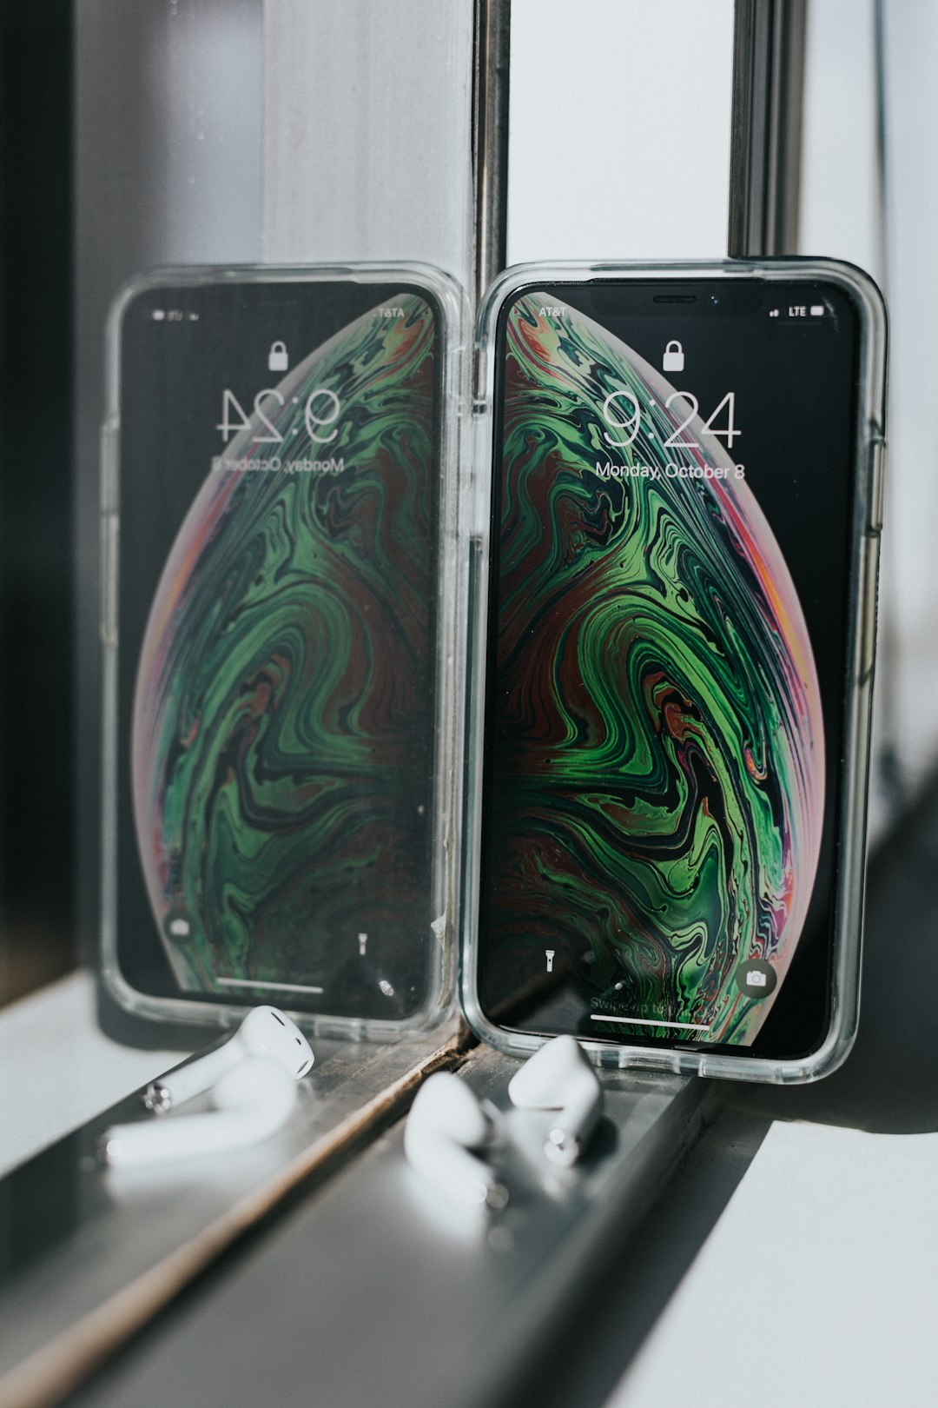
Applications of Digital Twins
● Manufacturing
● Healthcare
● Energy
● Transportation
● Construction
● Aerospace
● Automotive
● Consumer goods

Slide 8
Industry Adoption
Aerospace and defense
Automotive
Energy
Healthcare
Manufacturing
Oil and gas
Retail
Transportation

Slide 9
Real-world Examples
GE's Digital Twin
Siemens' MindSphere
Rolls-Royce's Digital Twin
Boeing's Digital Twin
NASA's Digital Twin
Volkswagen's Digital Twin

Slide 10
Challenges and Limitations
● Data quality
● Integration
● Security
● Scalability
● Cost
● Complexity
● Limited adoption
● Technical challenges

Slide 11
Future of Digital Twins
● Increased adoption
● Improved technology
● Expanded applications
● Enhanced decision-making
● Increased efficiency
● Reduced costs
● Improved performance
● Better quality

Slide 12
Best Practices
● Define clear goals and objectives
● Develop a comprehensive strategy
● Integrate data and systems
● Implement predictive maintenance
● Optimize processes
● Monitor and analyze performance
● Continuously improve

Slide 13
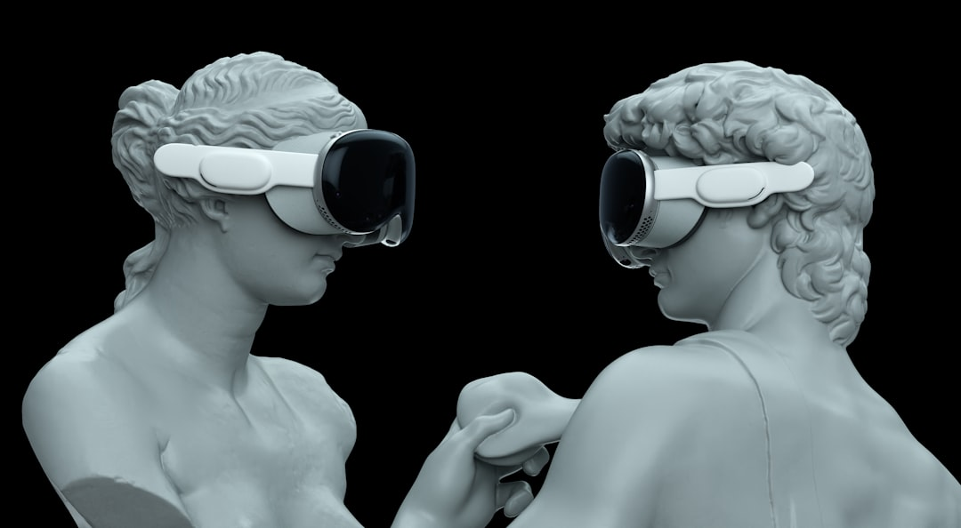
Common Misconceptions
● Digital twins are only for large enterprises
● Digital twins are too complex and expensive
● Digital twins are only for manufacturing
● Digital twins are not scalable
● Digital twins are not secure

Slide 14
Conclusion
The concept of digital twins has the potential to revolutionize the way we approach complex systems and processes. With its vast applications and benefits, digital twins are set to transform industries and improve efficiency, productivity, and decision-making.

Slide 15
Thank You!
Questions & Discussion

