Slide 1

Digital Twins
Generated with AI Presentation Generator'Ammar Yasser'

Slide 2
Introduction
Digital twins are virtual replicas of physical objects, systems, and processes. They enable real-time data analysis, simulation, and prediction. This presentation will explore the concept, benefits, and applications of digital twins.

Slide 3

Key Features
● Real-time data
● Advanced analytics
● Machine learning
● Simulation tools
● Integration capabilities

Slide 4
Types of Digital Twins
• Systemic digital twin
• Component digital twin
• Product digital twin
• Infrastructure digital twin
• Enterprise digital twin

Slide 5
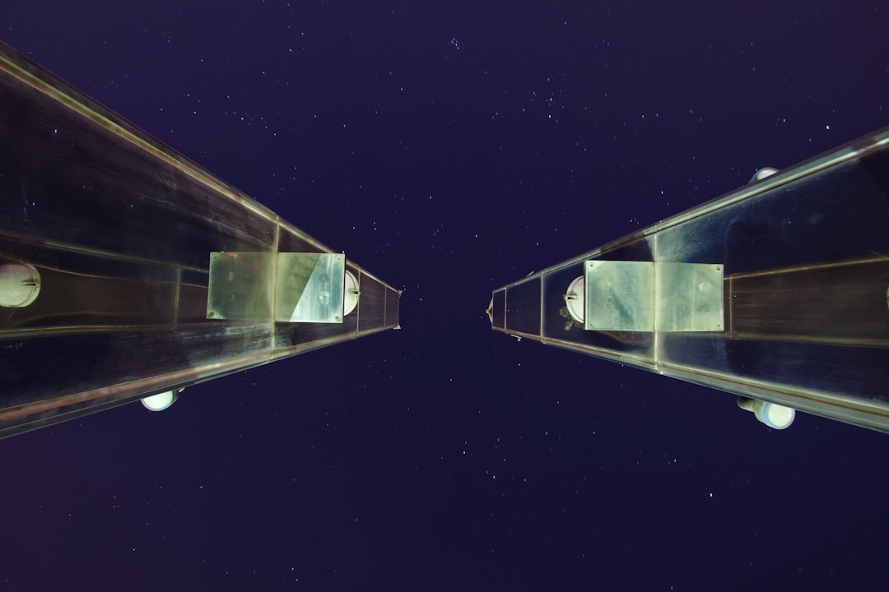
Industrial Applications
● Predictive maintenance
● Quality control
● Supply chain optimization
● Energy management
● Process optimization

Slide 6
Healthcare Applications
• Personalized medicine
• Patient simulation
• Clinical trial optimization
• Medical device testing
• Healthcare facility management

Slide 7

Simulation and Modeling
● Physical modeling
● Mathematical modeling
● Simulation software
● Data analysis tools
● Visualization techniques

Slide 8
Data Integration
● IoT data
● Sensors data
● Cloud data
● On-premises data
● Data fusion

Slide 9
Future of Digital Twins
• Increased adoption
• Improved technology
• Expanded applications
• New business models
• Enhanced value creation

Slide 10
Real-World Examples
Siemens smart factory
GE Healthcare simulation
ABB smart grid
IBM Watson Health
SAP Industry 4.0

Slide 11
Implementation Strategies
● Assess business needs
● Define use cases
● Choose technology
● Implement roadmap
● Monitor progress

Slide 12
Change Management
Communication planning
Stakeholder engagement
Training and support
Cultural adaptation
Continuous improvement

Slide 13
Conclusion
Digital twins have the potential to transform industries by improving efficiency, enhancing decision-making, and reducing costs. As technology advances, we can expect to see increased adoption and expanded applications of digital twins.

Slide 14
Thank You!
Questions & Discussion

