Slide 1
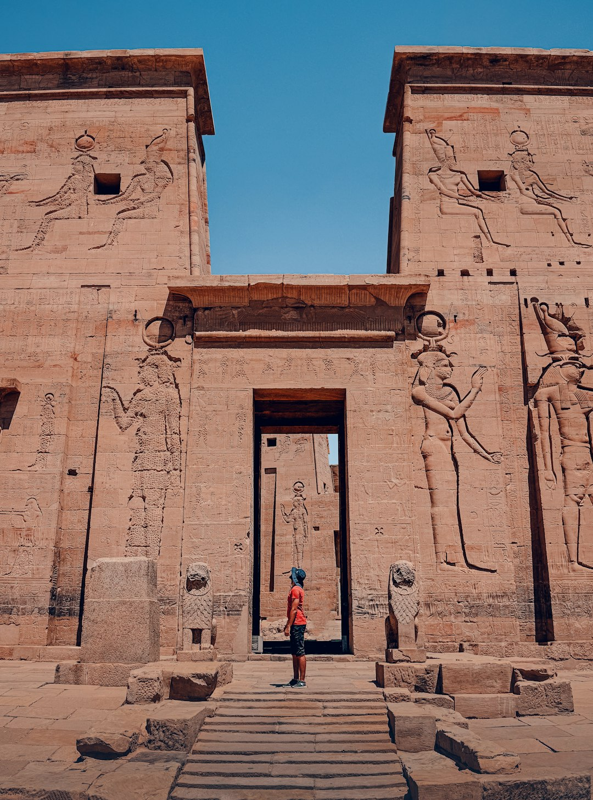
Egyptian Wonders
Generated with AI Presentation Generator

Slide 2
Introduction
The Pyramids of Egypt are one of the most fascinating ancient monuments in the world, attracting millions of tourists every year. These colossal structures are not only impressive in terms of their grandeur but also hold great historical and cultural significance. In this presentation, we will explore the history, construction, and importance of the Pyramids in Egypt.

Slide 3
History of Pyramids
• Ancient Egypt
• Pharaohs
• Tombs
• Mummification
• Nile River
• Egyptian Civilizations
• Pyramid of Giza
• Pyramid of Khafre
• Pyramid of Menkaure

Slide 4
Construction of Pyramids
Limestone
Granite
Sandstone
Cedar Wood
Rope and Pulpit
Thousands of Workers
Advanced Engineering
Mathematical Precision
Astronomical Alignment

Slide 5
Pyramid of Giza
• Largest Pyramid
• Original Height: 146.5m
• Base perimeter: 1,005m
• Sides almost perfect
• Built around 2580 BC
• Pharaoh Khufu
• Designed by Imhotep

Slide 6
Pyramid of Khafre
• Second Largest Pyramid
• Original Height: 136.4m
• Base perimeter: 709m
• Built around 2520 BC
• Pharaoh Khafre
• Designed by Khufu's architects

Slide 7
Pyramid of Menkaure
Third Largest Pyramid
Original Height: 65.5m
Base perimeter: 102m
Built around 2490 BC
Pharaoh Menkaure
Designed by Menkaure's architects

Slide 8
The Great Sphinx
Large limestone statue
Body of Lion
Head of Human
Purpose: Guardian
Built around 2500 BC
Pharaoh Khafre
Designed by Khafre's architects

Slide 9
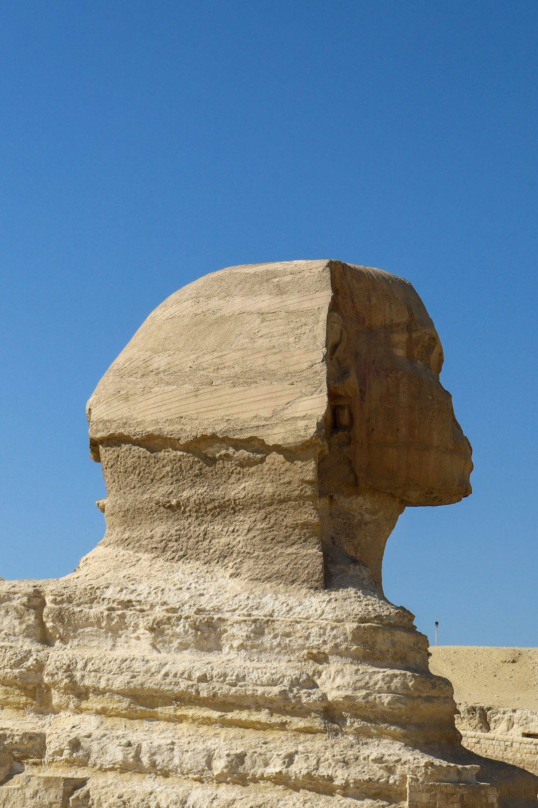
Tomb of Pharaohs
● Burial Chambers
● Internal Chambers
● Tunnels and Passages
● Hieroglyphics and Art
● Mummification Process
● Treasures of the Pharaohs
● Rituals and Ceremonies

Slide 10
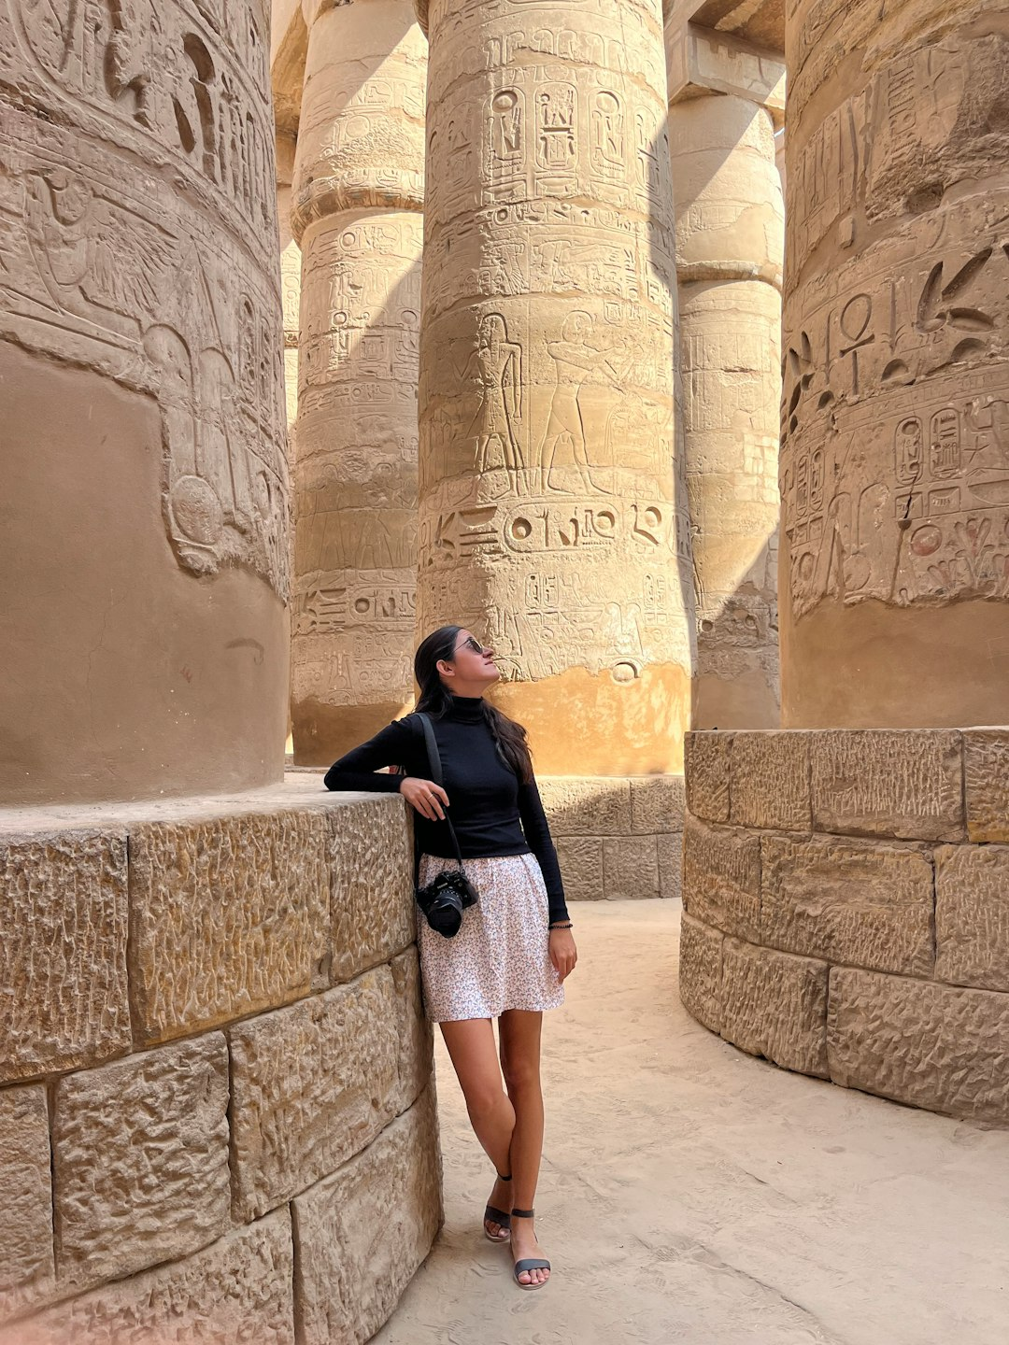
Egyptian Mummification
● Preserving the Body
● Wrapping in Linen
● Applying Resins
● Protecting the Soul
● Beliefs in the Afterlife
● Purpose of Mummification
● Techniques and Methods

Slide 11
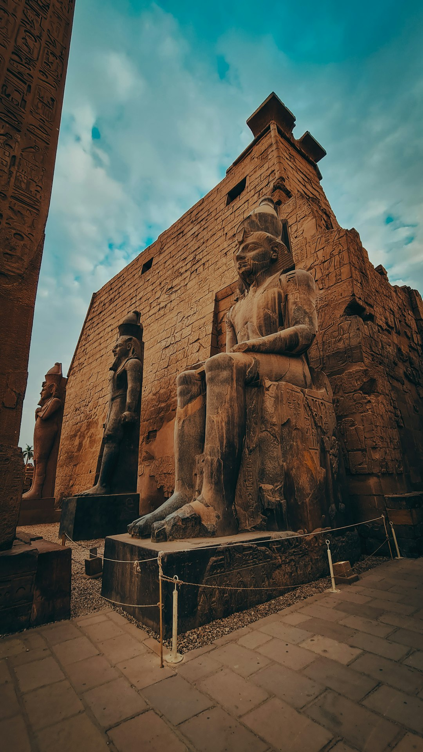
Pyramid's Purpose
● Tomb for Pharaohs
● Protect the Pharaoh's Soul
● Offerings to Anubis
● Guide to the Afterlife
● Symbol of Power
● Architectural Marvel
● Engineering Feat

Slide 12
Pyramid's Symbolism
● Unity and Strength
● Wisdom and Knowledge
● Protection and Safety
● Life and Death
● Heaven and Hell
● Good and Evil
● Order and Chaos

Slide 13
Pyramid's Importance
Historical Significance
Cultural Importance
Architectural Marvel
Engineering Feat
Tourist Attraction
Economic Impact
National Pride

Slide 14
Tourism in Egypt
● Millions of Visitors
● Pyramids of Giza
● Egyptian Museum
● Nile River Cruise
● Desert Safaris
● Luxor Temple
● Valley of the Kings

Slide 15
Pyramid's Preservation
● UNESCO World Heritage Site
● Conservation Efforts
● Restoration Projects
● Protection from Looters
● Preservation of History
● Protection of Cultural Heritage

Slide 16
Conclusion
Summary of Key Points
Recap of Main Topics
Final Thoughts and Reflections

Slide 17
Thank You!
Questions & Discussion

