Slide 1
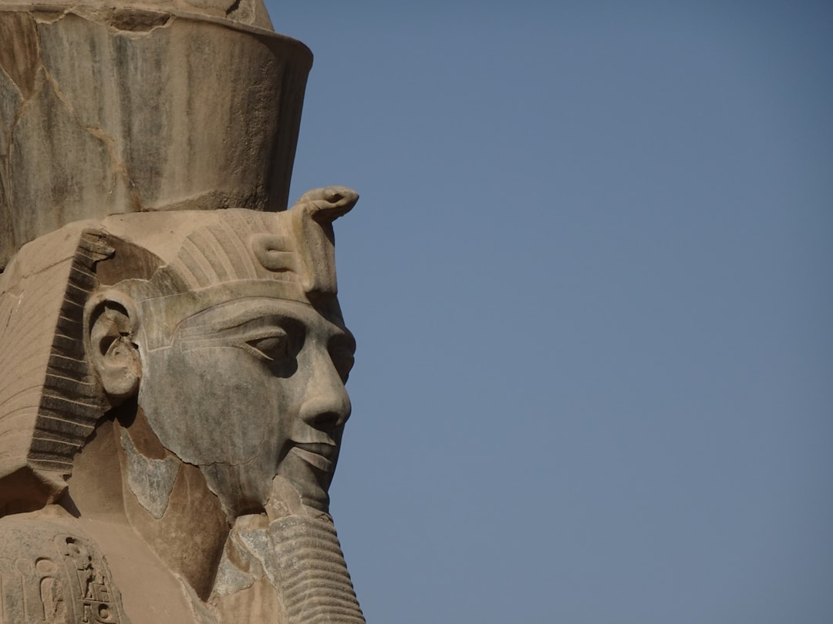
Egypt's Ancient Marvels
Generated with AI Presentation Generator

Slide 2
Introduction
Pyramids in Egypt are a testament to the ingenuity and skill of the ancient Egyptians, constructed over 4,500 years ago, and still shrouded in mystery. These towering structures have captivated the imagination of people worldwide, with their sheer scale and grandeur. The pyramids have played a significant role in shaping the course of history, influencing art, architecture, and culture. Their construction remains an enigma, with questions about the advanced engineering and logistical feats that made them possible.

Slide 3
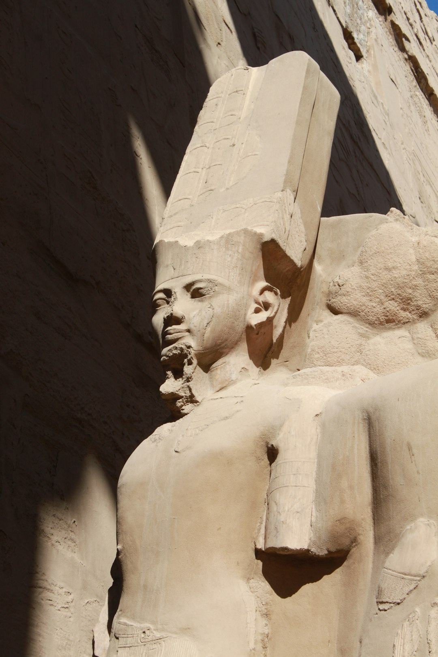
Geographical Significance
● The pyramids are located in the Giza plateau, on the outskirts of modern-day Cairo, in a region known for its fertile Nile River valley and unique geological composition.
● The pyramids' strategic location took advantage of the Nile's annual flooding, which provided a reliable source of water and fertile soil for agriculture.

Slide 4
Architectural Innovations
The pyramids' design and construction showcased advanced engineering skills, with the use of simple yet effective tools, such as copper chisels and wooden mallets, to move and place massive stone blocks weighing up to 2.5 tons.
The pyramid's internal chamber and passageway system was designed to provide a sense of grandeur, with the pharaoh's final resting place located at the heart of the structure.

Slide 5
Symbolism and Cultural Significance
The pyramids were imbued with spiritual significance, representing the pharaoh's connection to the gods and the afterlife, with the pyramid's apex symbolizing the pharaoh's ascension to the heavens.
The pyramids' construction and design influenced the development of ancient Egyptian culture, art, and architecture, with their majestic presence dominating the landscape for centuries.

Slide 6
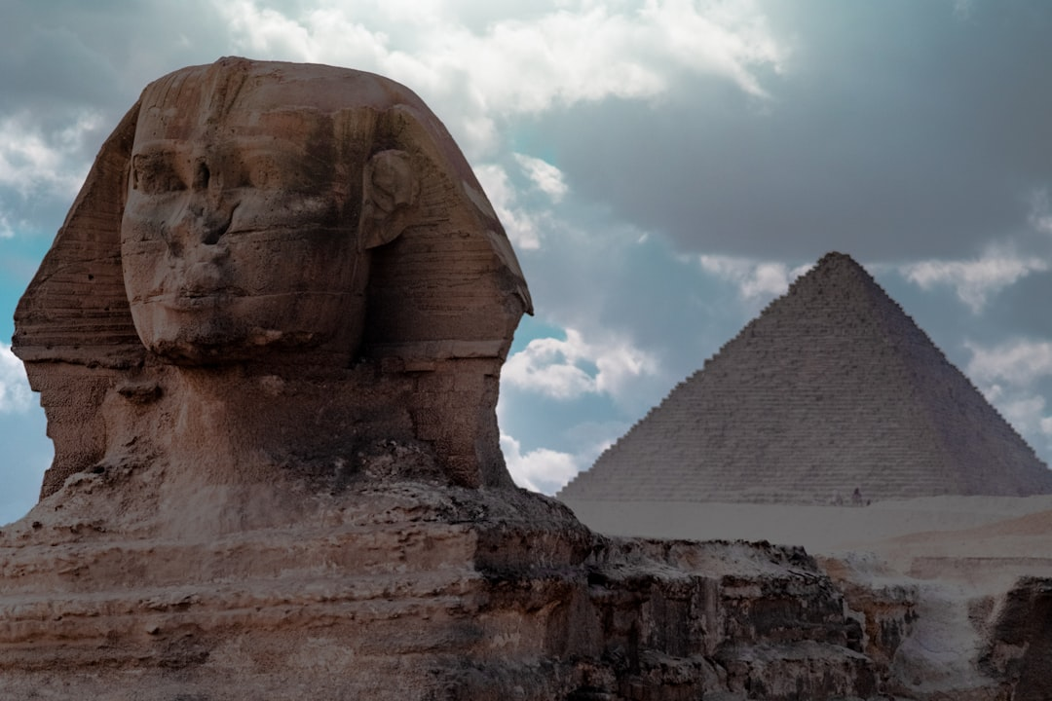
Conservation and Preservation
● The pyramids have faced numerous threats, including erosion, vandalism, and neglect, which have compromised their structural integrity and threatened their very existence.
● Efforts have been made to conserve and preserve the pyramids, with UNESCO declaring them a World Heritage Site and the Egyptian government implementing measures to protect and restore the ancient monuments.

Slide 7
Pyramid Types and Variations
● There are several types of pyramids in Egypt, including the step pyramid, the true pyramid, and the Bent Pyramid, each with unique architectural features and historical significance.
● The pyramids' design and construction varied over time, reflecting the evolution of ancient Egyptian architecture and engineering techniques.

Slide 8
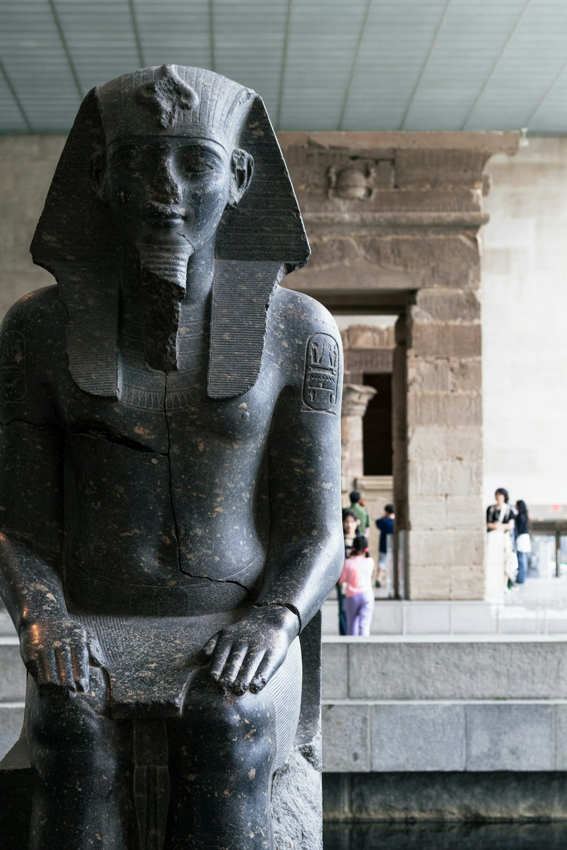
Myths and Legends
● The pyramids have captivated the imagination of people worldwide, inspiring numerous myths and legends, including tales of hidden treasures, secret chambers, and supernatural powers.
● The pyramids' association with mysticism and the occult has led to numerous theories and speculations about their true purpose and meaning.

Slide 9
Pyramid Tourism
The pyramids have become a major tourist destination, attracting millions of visitors each year, who come to marvel at their grandeur and learn about their history and significance.
The pyramids' popularity has led to concerns about over-tourism, erosion, and cultural exploitation, highlighting the need for responsible and sustainable tourism practices.

Slide 10
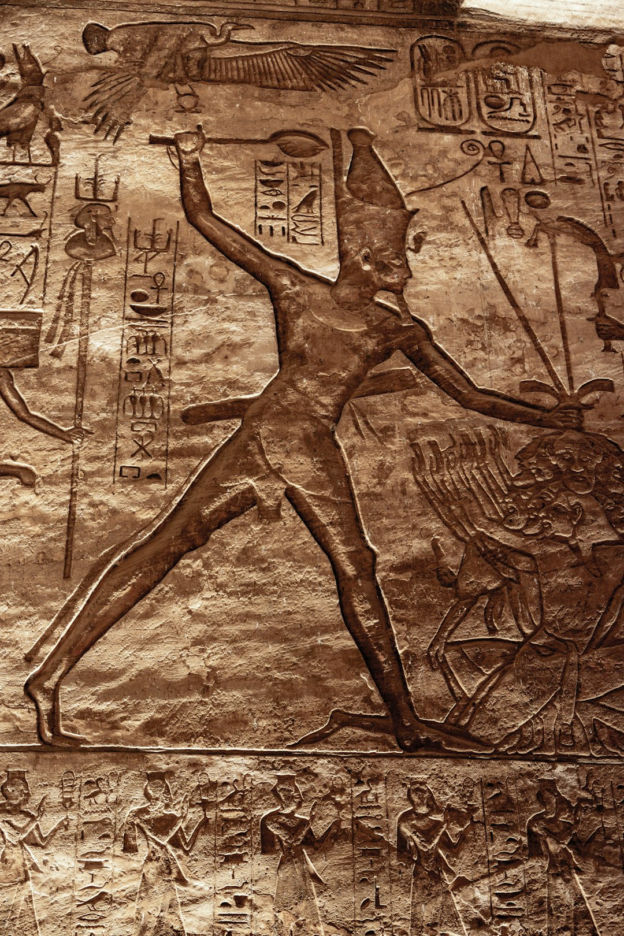
Pyramid Engineering
● The pyramids' construction showcased advanced engineering skills, with the use of simple yet effective tools and techniques to achieve remarkable precision and accuracy.
● The pyramids' internal chamber and passageway system was designed to provide a sense of grandeur, with the pharaoh's final resting place located at the heart of the structure.

Slide 11
Pyramid Mathematics
The pyramids' design and construction involved advanced mathematical concepts, including geometry and trigonometry, which were used to calculate the precise angles and proportions of the structure.
The pyramids' internal chamber and passageway system was designed to provide a sense of grandeur, with the pharaoh's final resting place located at the heart of the structure.

Slide 12
Pyramid Fun Facts
● The Great Pyramid of Giza is the only one of the Seven Wonders of the Ancient World still standing.
● The pyramids were originally covered in smooth white limestone, which reflected the sun's rays and made the structures appear even more majestic.

Slide 13
Conclusion
The pyramids in Egypt are an awe-inspiring testament to the ingenuity and skill of the ancient Egyptians, with their sheer scale, grandeur, and historical significance captivating the imagination of people worldwide. Their construction and design have influenced art, architecture, and culture, shaping the course of history and leaving a lasting legacy.

Slide 14
Thank You!
Questions & Discussion

