Slide 1
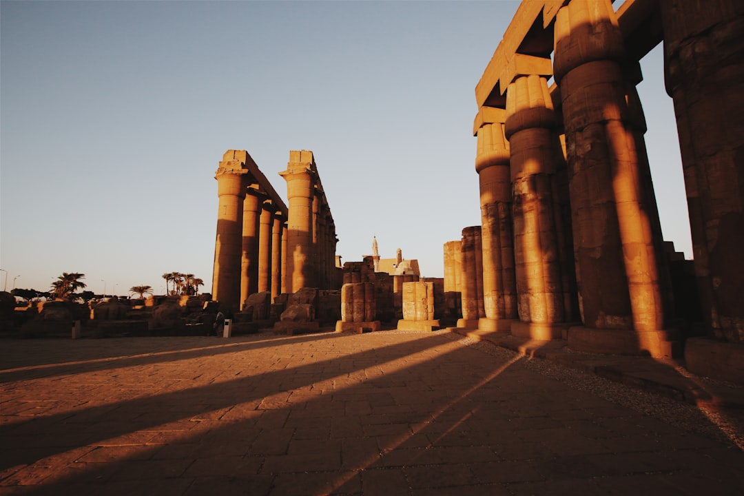
Egyptian Wonders
Generated with AI Presentation Generator

Slide 2
Introduction
The ancient pyramids of Egypt are among the most fascinating and awe-inspiring architectural achievements in human history, built over 4,500 years ago for pharaohs to ensure their safe passage into the afterlife. The pyramids are testaments to the ingenuity and skill of the ancient Egyptians, who were able to construct massive structures with incredible precision and accuracy. This presentation will delve into the history, construction, and significance of the pyramids of Egypt.

Slide 3

Pyramid Locations
● Giza Plateau
● Saqqara Necropolis
● Dahshur
● Abusir
● Abu Rawash
● Pyramid fields
● Royal tombs

Slide 4
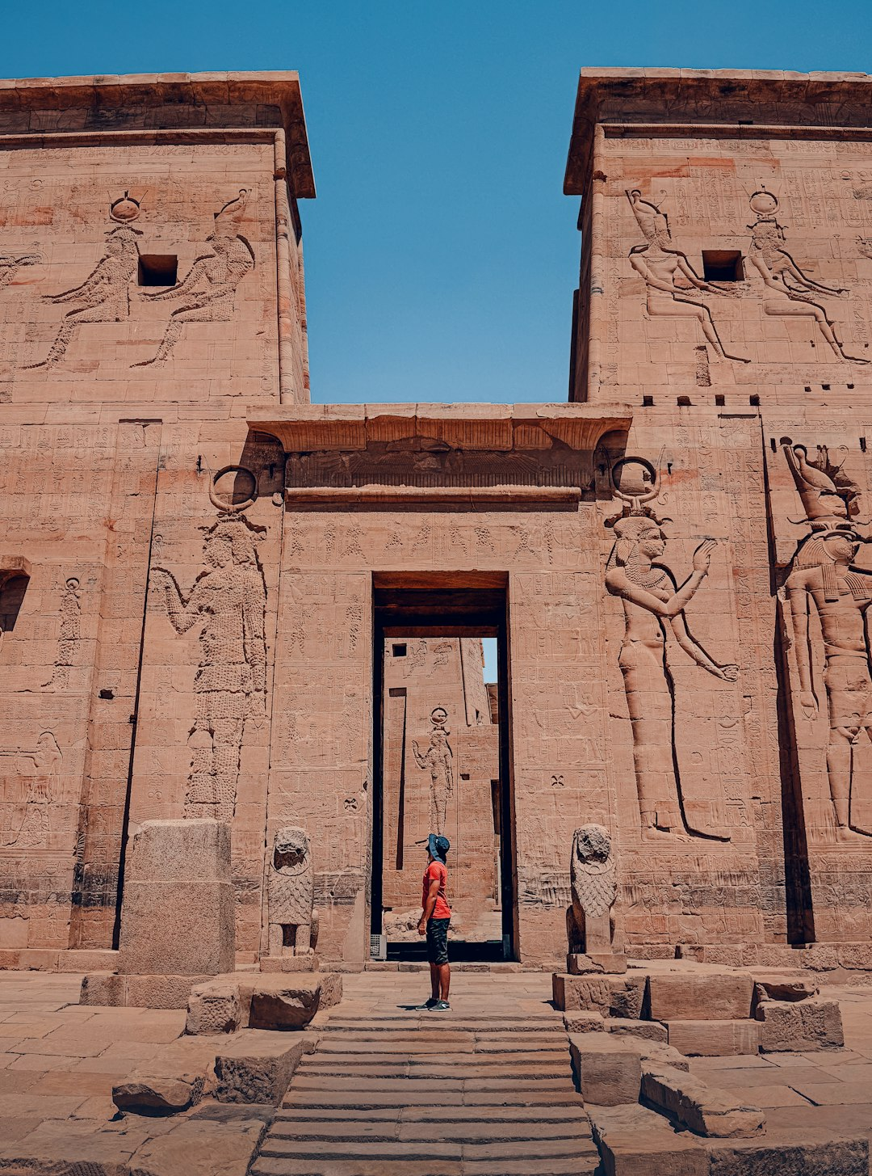
Pyramid Architecture
● Triangular shape
● Base dimensions
● Slope angles
● Internal chambers
● Passageway systems
● Chamber purposes
● Pyramid heights

Slide 5
Pyramid Materials
● Limestone
● Granite
● Sandstone
● Tura limestone
● Aswan granite
● Wooden beams
● Rope systems

Slide 6
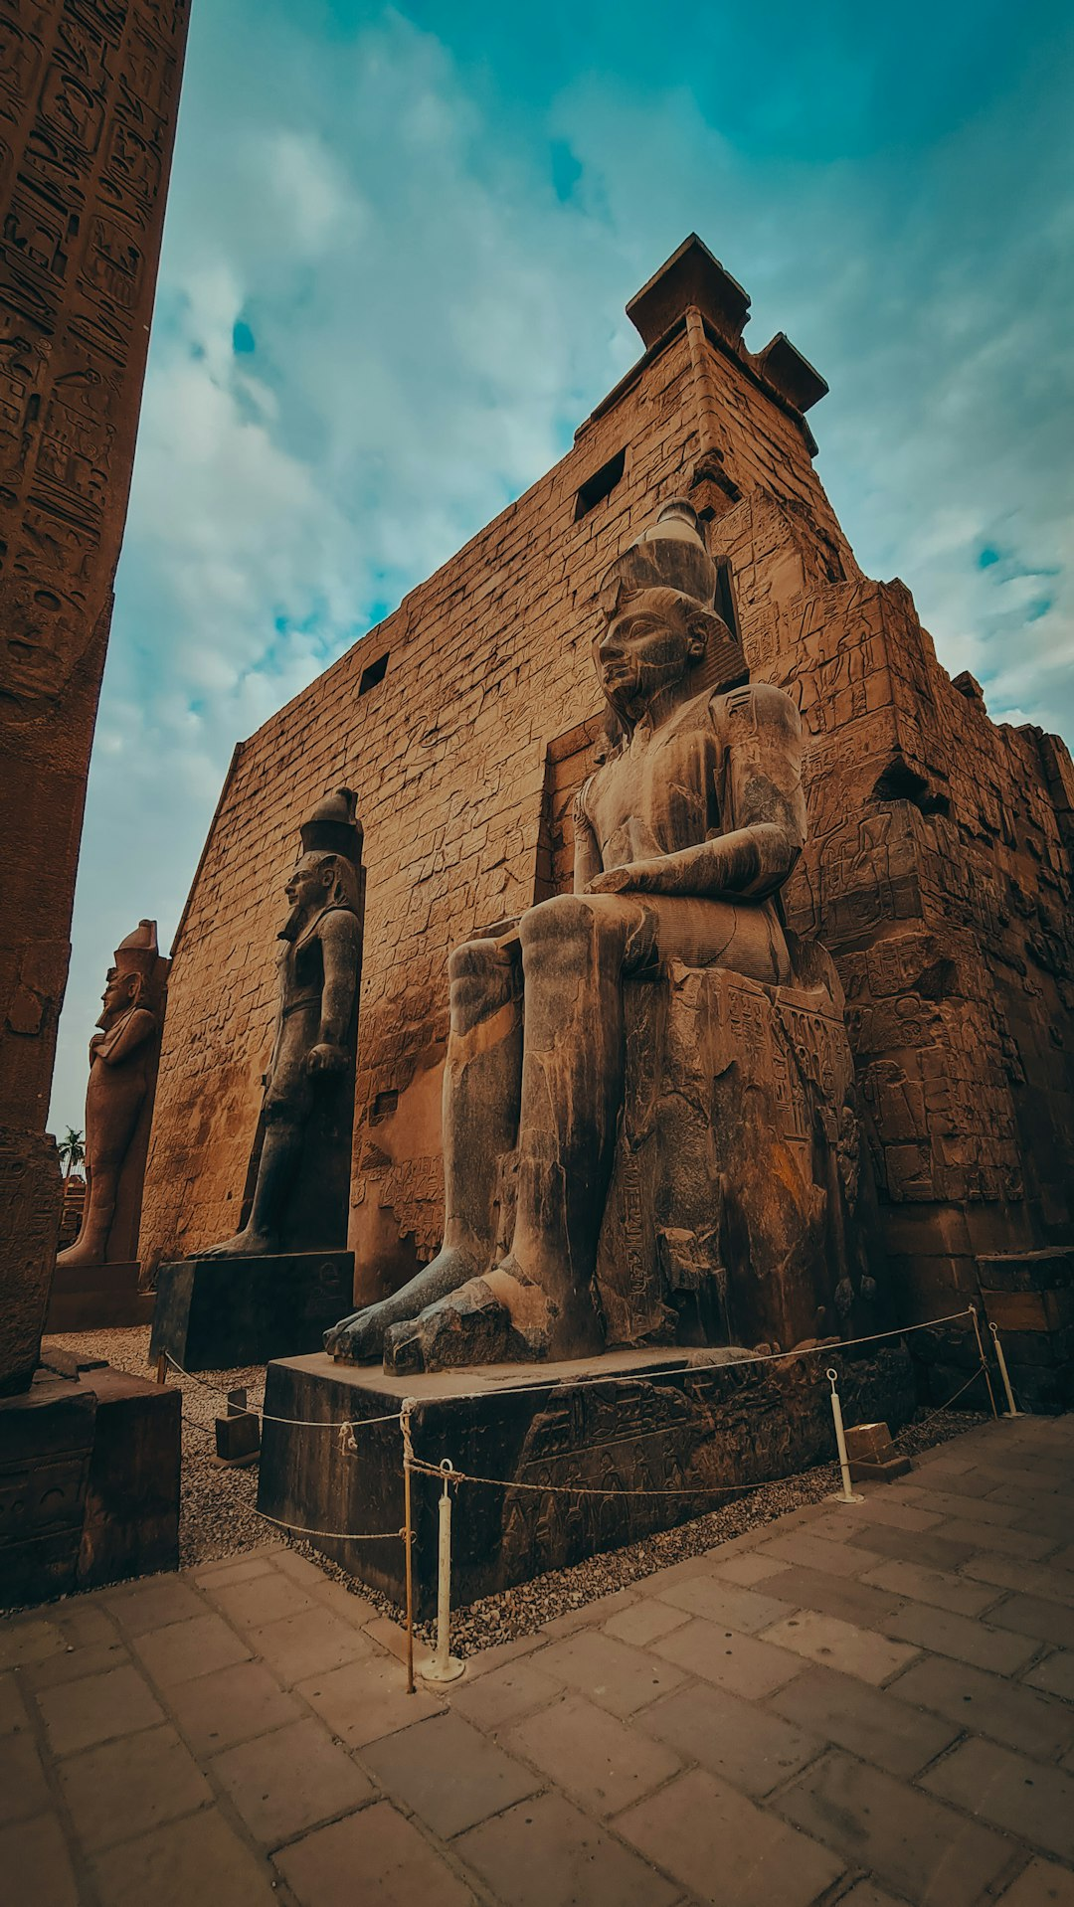
Pyramid Purpose
● Pharaohs' burial
● Ascension to heaven
● Worship centers
● Astronomical observations
● Rituals and ceremonies
● Sacred places
● Ancient knowledge

Slide 7
Pyramid Symbols
Ankh symbol
Was sceptre
Djed pillar
Scarab beetle
Solar disk
Pyramidion
Hieroglyphic symbols

Slide 8
Pyramid Impact
• Cultural significance
• Historical importance
• Architectural innovation
• Engineering feats
• Tourism industry
• Economic impact
• Global interest

Slide 9
Pyramid Preservation
● Restoration efforts
● Conservation techniques
● Climate change effects
● Human impact
● Vandalism and looting
● Protection measures
● UNESCO World Heritage

Slide 10
Pyramid Tourism
● Giza Pyramid complex
● Pyramid tours
● Guided tours
● Entrance fees
● Opening hours
● Pyramid viewing times
● Photography rules

Slide 11
Pyramid Mythology
Ancient myths
Gods and goddesses
Supernatural powers
Pharaohs' divine right
Ankh and Was sceptre
Djed pillar significance
Hieroglyphic legends

Slide 12
Pyramid Science
Geophysics studies
Archaeo-astronomy
Pyramid geometry
Harmonics and sound
Electromagnetic properties
Acoustic properties
Energy patterns

Slide 13
Pyramid Mystery
● Unexplained phenomena
● Anomalous readings
● Energy fields
● Vibrations and frequencies
● Ancient technology
● Lost knowledge
● Unresolved questions

Slide 14
Conclusion
The pyramids of Egypt continue to captivate and inspire people from around the world, a testament to the ingenuity, skill, and creativity of the ancient Egyptians. This presentation has highlighted the history, construction, and significance of these incredible structures, as well as their impact on culture, science, and art.

Slide 15
Thank You!
Questions & Discussion

