Slide 1
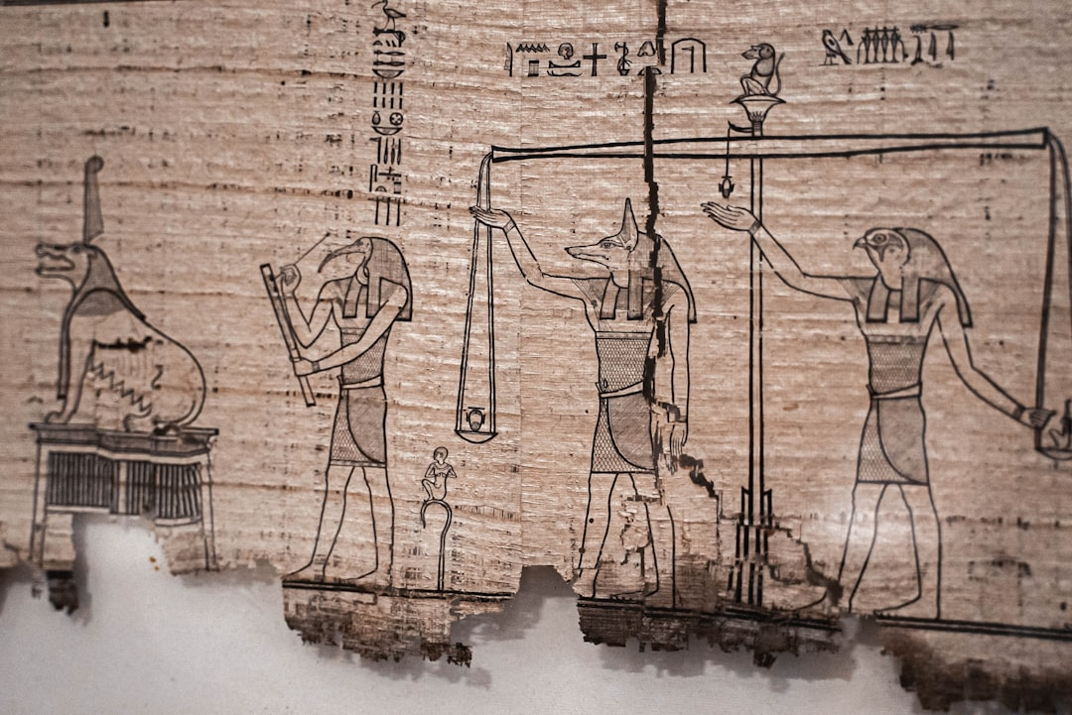
Egyptian Pyramids
Generated with AI Presentation Generator

Slide 2
Introduction
The ancient Egyptian pyramids are a testament to the ingenuity and skill of the ancient Egyptians. These majestic structures have stood the test of time, captivating the imagination of people around the world. The pyramids of Egypt are a source of fascination and wonder.

Slide 3
Pyramid Architecture
● Pyramid shape
● Base structure
● Sides and angles
● Apex designs
● Entrance systems
● Chambers and corridors
● Tunnel systems
● Air shafts and vents

Slide 4
Pyramid of Giza
Largest pyramid
Original height
Pyramid base
Construction methods
Pyramid alignment
Surrounding temples
Sphinx and other structures
Pyramid restoration

Slide 5
Pyramid of Saqqara
Oldest pyramid
Step pyramid structure
Unfinished pyramid
Pyramid complex
Tomb and burial site
Royal necropolis
Saqqara's significance
Archaeological discoveries

Slide 6
Pyramid of Dahshur
• Bent pyramid design
• Red Pyramid structure
• Black Pyramid features
• Unfinished pyramid
• Pyramid complex
• Royal necropolis
• Dahshur's significance
• Archaeological finds

Slide 7
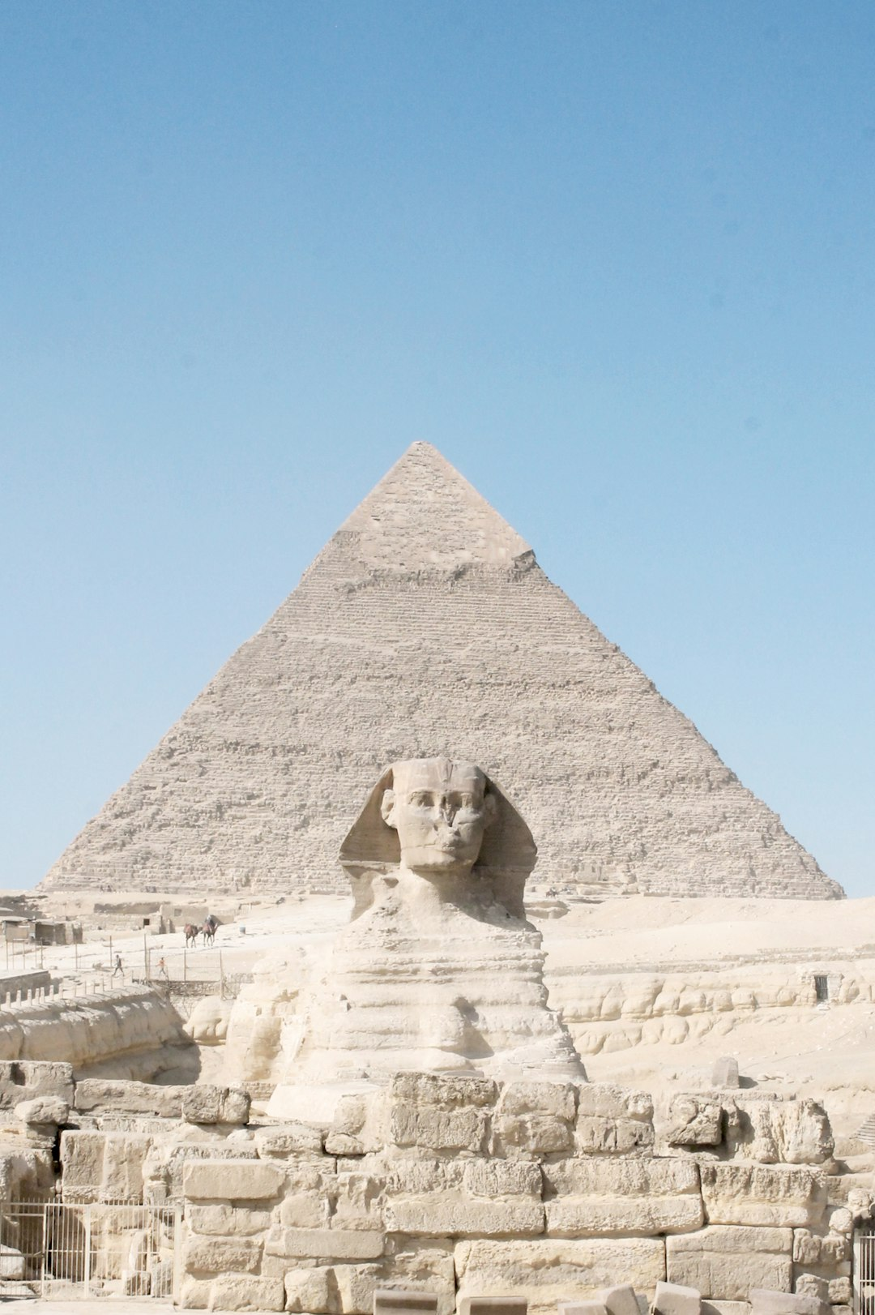
Pyramid Building Techniques
● Stone quarrying
● Transportation methods
● Construction tools
● Labor organization
● Food and accommodation
● Pyramid construction phases
● Engineering and architecture
● Artisan skills

Slide 8
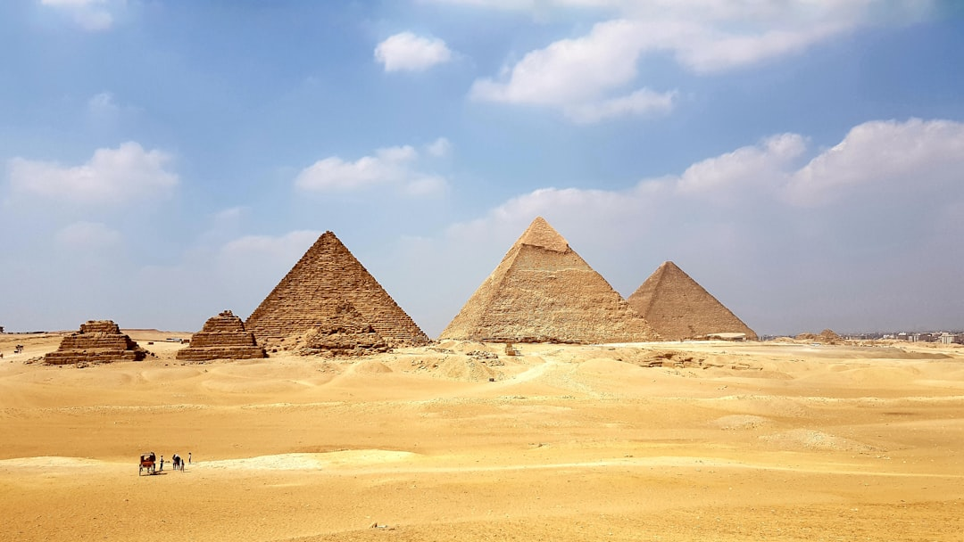
Pyramid Purpose
● Burial sites
● Tombs and chambers
● Mummification and preservation
● Royal burial practices
● Ancient Egyptian beliefs
● Afterlife and spirituality
● Ancestral worship
● Legacy and impact

Slide 9
Pyramid of the Moon
● Lunar alignment
● Pyramid base shape
● Pyramid height
● Construction methods
● Pyramid restoration
● Surrounding temples
● Pyramid significance
● Archaeological finds

Slide 10
Pyramid Symbols and Meanings
• Hieroglyphics and symbols
• Pyramid shape and symbolism
• Ancient Egyptian mythology
• Cosmic and spiritual connections
• Pyramid orientation and alignment
• Pyramid dimensions and geometry
• Pyramid and the universe
• Pyramid and human consciousness

Slide 11
Pyramid Restoration and Preservation
● Historical restoration efforts
● Current preservation projects
● Funding and support
● Collaborations and partnerships
● Restoration techniques and methods
● Conservation and preservation practices
● Cultural heritage importance
● Educational programs

Slide 12
Pyramid Cultural Significance
• Ancient Egyptian culture
• Pyramid influence on art and architecture
• Pyramid inspiration in literature
• Pyramid symbolism in film and media
• Pyramid spiritual and mystical connections
• Pyramid and the human experience
• Pyramid and global culture
• Pyramid and the modern world

Slide 13
Pyramid and the Environment
Environmental impact of construction
Sustainable building practices
Pyramid and climate change mitigation
Renewable energy and pyramid design
Green technologies and pyramid construction
Environmental conservation and management
Eco-friendly tourism practices
Sustainable development

Slide 14
Pyramid and the Future
• Future preservation and restoration projects
• New technologies and innovations
• Pyramid-inspired architecture and design
• Cultural exchange and understanding
• Economic growth and development
• Sustainable tourism practices
• Community engagement and education

Slide 15
Conclusion
Summary of key points
Recap of main ideas
Final thoughts and reflections

Slide 16
Thank You!
Questions & Discussion

