Slide 1
Here is the presentation outline about generative AI:
Created with AI Presentation Generator

Slide 2
Introduction
Generative AI refers to a subset of artificial intelligence that focuses on generating new, original content. This can range from music and images to text and videos. In this presentation, we will explore the core concepts, applications, and future of generative AI.

Slide 3
What is Generative AI?
Definition
Types (e.g., Generative Adversarial Networks, Variational Autoencoders)
Applications (e.g., image and music synthesis)
Capabilities (e.g., creativity, pattern recognition)
Limitations (e.g., bias, data quality)

Slide 4
Core Concepts
Neural Networks
Deep Learning
Data Augmentation
Transfer Learning
Adversarial Training

Slide 5
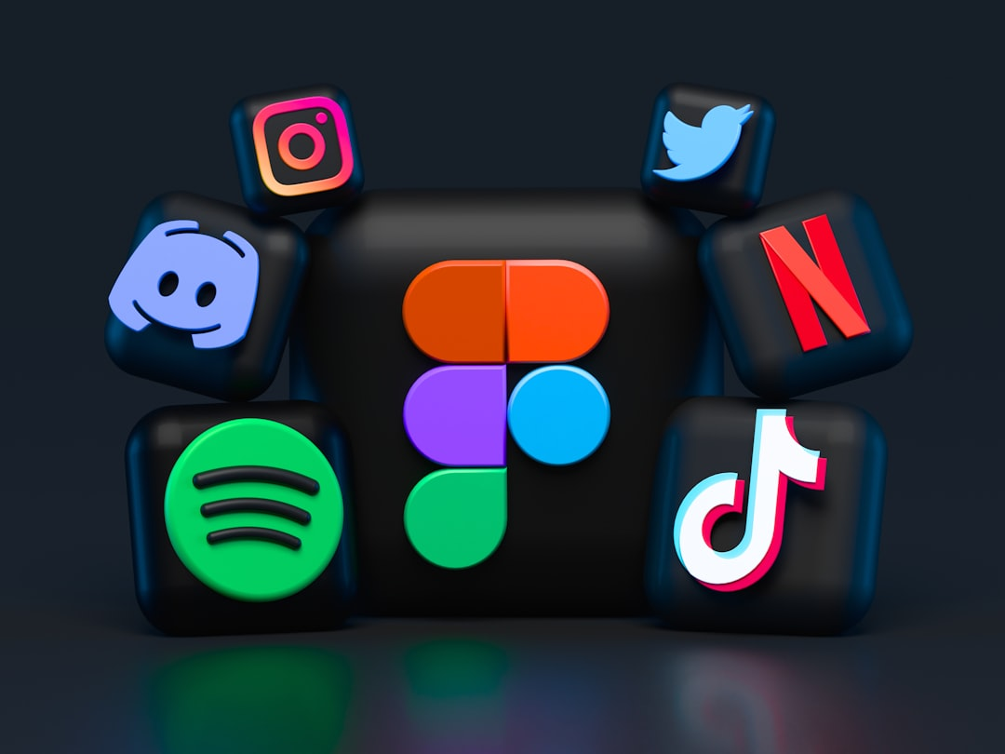
Applications of Generative AI
Image and Video Generation
Music and Audio Synthesis
Text and Language Generation
Poetry and Creative Writing
Art and Design

Slide 6
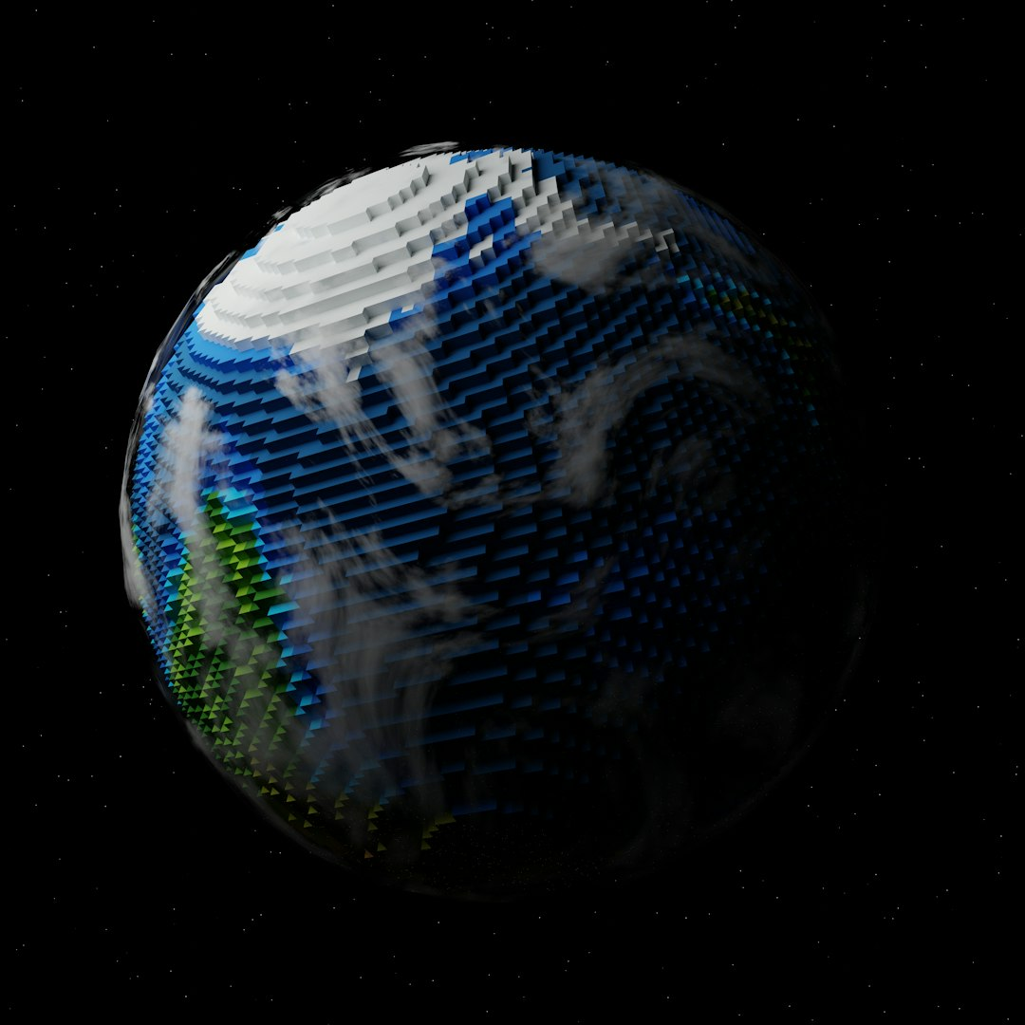
Real-World Examples
Deep Dream Generator
Prisma App
Amper Music
Google's Magenta
Adobe Fresco

Slide 7
Challenges and Limitations
Data Quality and Bias
Lack of Explainability
Overreliance on Human Feedback
Computational Resources
Regulatory Concerns

Slide 8
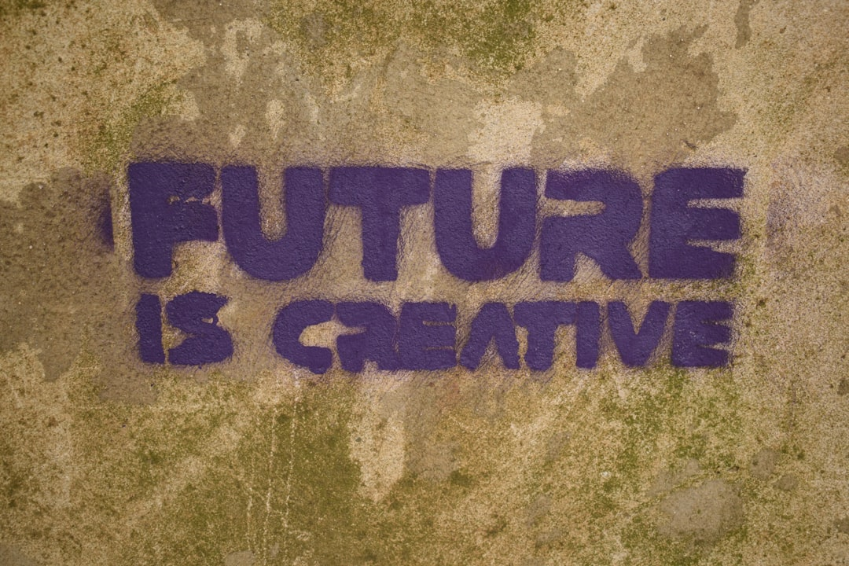
Future Directions
Explainability and Transparency
Human-AI Collaboration
Multimodal Generation
Real-World Applications
Ethics and Governance

Slide 9
Ethics and Governance
Bias and Fairness
Data Protection
Intellectual Property
Accountability
Regulatory Framework

Slide 10
Conclusion
Recap of key points
Future of generative AI
Potential impact on society

Slide 11
Thank You!
Questions & Discussion

