Slide 1
Plant Types and Classification
Created with AI Presentation Generator

Slide 2
Introduction
This presentation will explore the fascinating world of plants, covering their types, benefits, and importance in our ecosystem. Plants play a vital role in providing oxygen, food, and shelter. Understanding plants is crucial for sustainable living and environmental conservation.

Slide 3
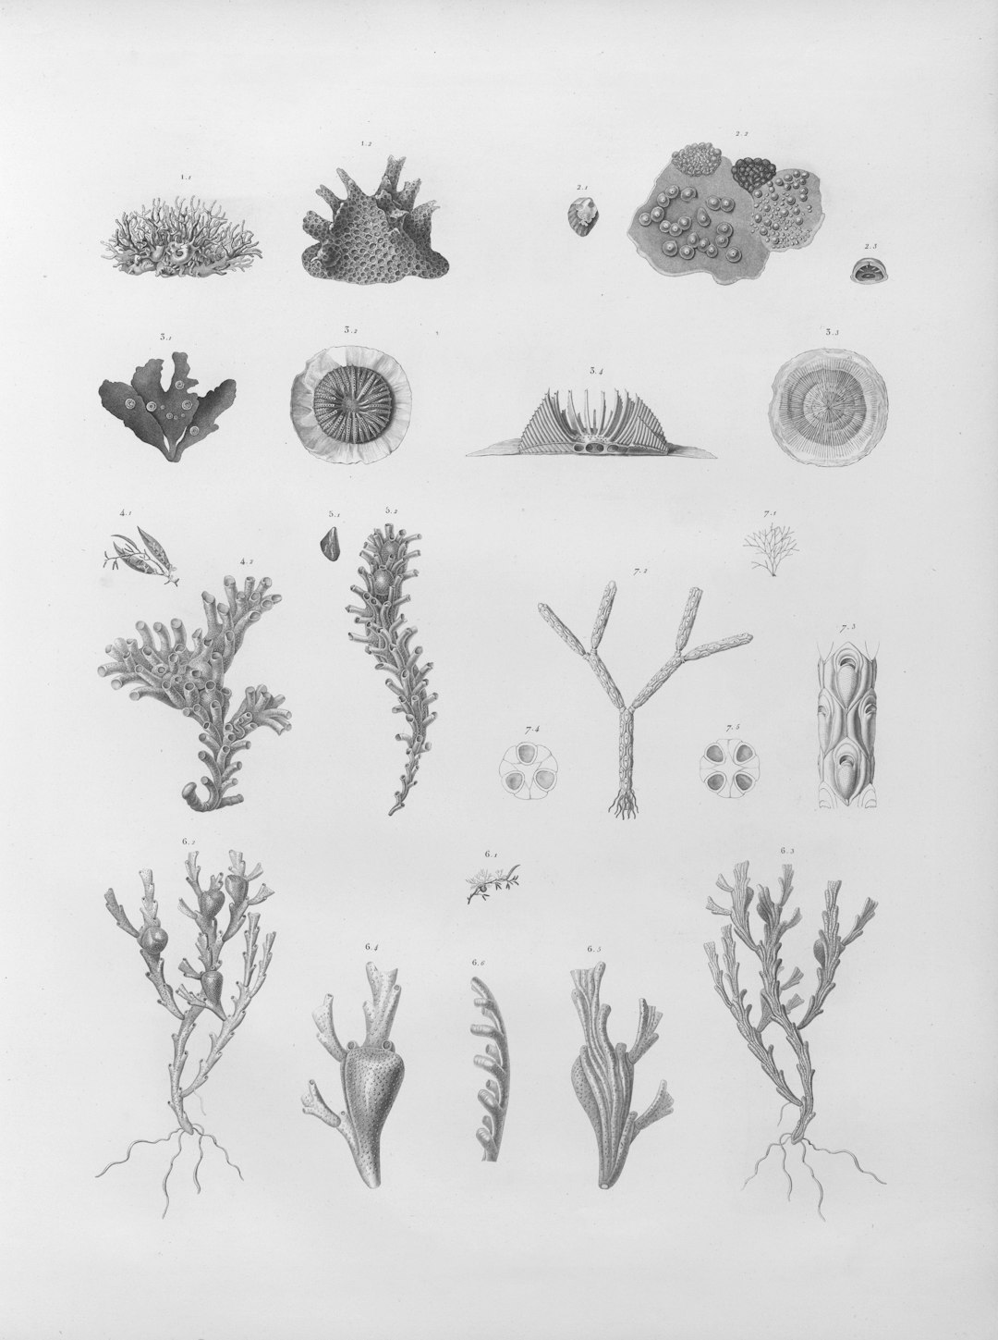
Plant Types and Classification
Plants are categorized into major groups, including angiosperms, gymnosperms, ferns, and mosses, each with distinct characteristics and adaptations.
Angiosperms, also known as flowering plants, account for the largest group, with over 400,000 species worldwide.
Gymnosperms, including conifers and cycads, are characterized by their cones and seeds.

Slide 4

Plant Benefits and Uses
Plants are essential for producing oxygen through photosynthesis, supporting life on Earth.
Plants provide food, clothing, shelter, and medicine, supporting human well-being and economic growth.
Plants also contribute to soil formation, erosion control, and water filtration, maintaining ecosystem balance.

Slide 5

Plant Importance in Ecosystems
Plants are a vital food source for animals, supporting complex food webs and nutrient cycles.
Plants regulate climate and weather patterns through transpiration and evapotranspiration.
Plant diversity and distribution influence local ecosystems, impacting biodiversity and ecosystem services.

Slide 6

Plant Conservation and Sustainability
Human activities, such as deforestation and pollution, threaten plant diversity and ecosystem health.
Sustainable practices, like reforestation and permaculture, can mitigate these impacts and promote ecosystem recovery.
Climate change affects plant growth, reproduction, and distribution, necessitating conservation efforts.

Slide 7
Conclusion
This presentation highlights the importance of plants in our ecosystem and emphasizes the need for conservation and sustainable practices.
By understanding plant diversity and benefits, we can promote environmental stewardship and sustainable living.
Future research and conservation efforts should focus on preserving plant species and ecosystems for future generations.

Slide 8
Thank You!
Questions & Discussion

