Slide 1
History of France in Football
Created with AI Presentation Generator

Slide 2
Introduction
The history of France in football is a rich and storied one, spanning centuries. From its humble beginnings to its current status as a football powerhouse, France has produced numerous talented players, skilled coaches, and successful teams. This presentation aims to explore the key milestones, achievements, and personalities that have shaped the country's football history.

Slide 3
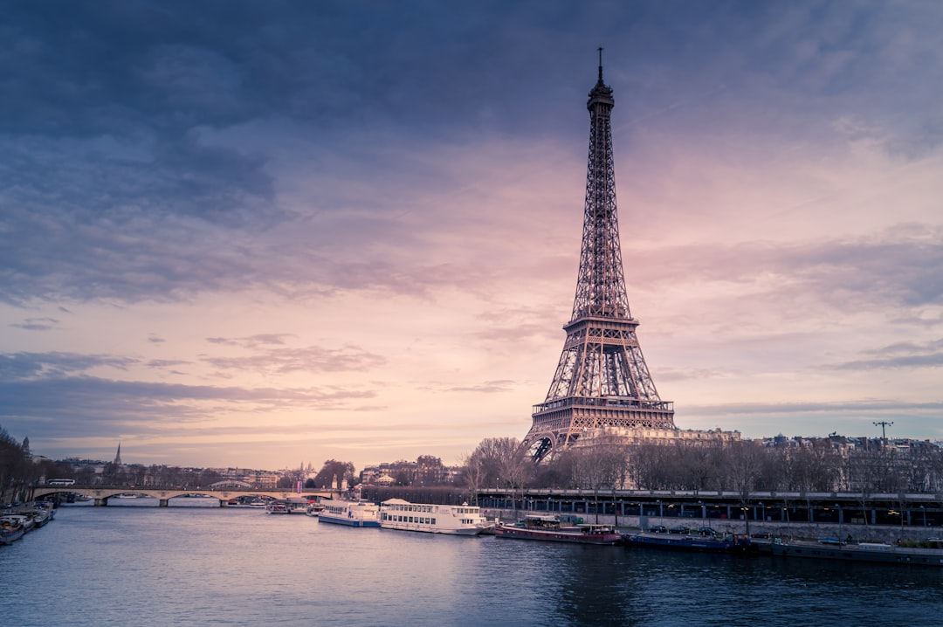
Early Years
Emergence of football in France
First football clubs
Early French international matches

Slide 4

Interwar Period
Rise of French football
Emergence of iconic players
Development of French football tactics

Slide 5
Post-War Era
French football's decline
Emergence of new coaching styles
Rise of French clubs in European competitions

Slide 6

The Golden Years
French football's resurgence
Emergence of dominant French teams
Success in major international tournaments

Slide 7
Key Players
Raymond Kopa
Just Fontaine
Michel Platini
Zinedine Zidane
Thierry Henry

Slide 8
Notable Coaches
Gaston Barreau
Albert Batteux
Michel Hidalgo
Aimé Jacquet
Didier Deschamps

Slide 9
Major Tournament Success
1998 FIFA World Cup
2000 European Championship
2018 FIFA World Cup
2020 UEFA European Championship

Slide 10
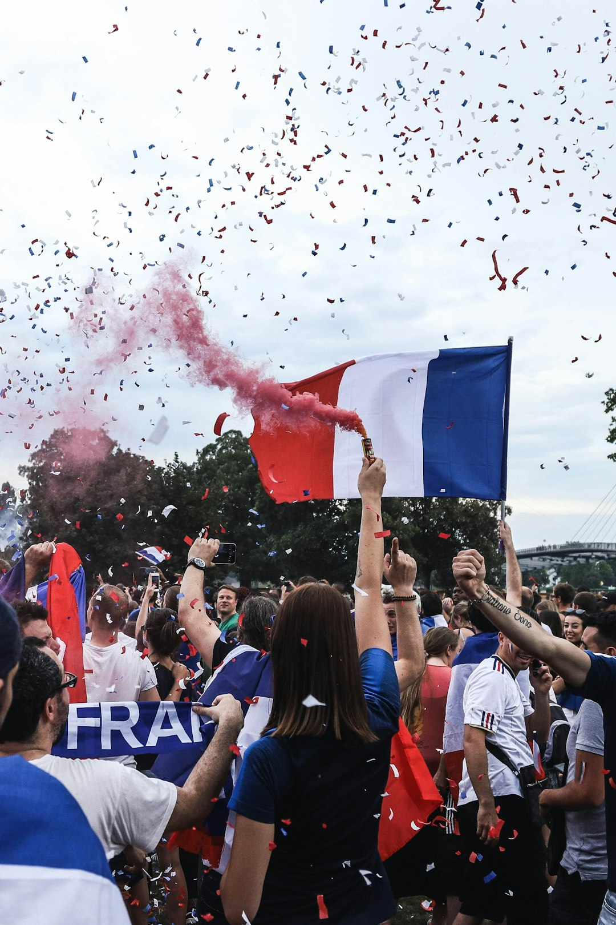
Impact on French Culture
Football's popularity in France
Influence on French language and media
Football as a unifying force in society

Slide 11
Legacy and Future
French football's current state
Emerging talent and prospects
Expectations for future success

Slide 12

Conclusion
Summary of key points and takeaways
Future outlook and recommendations
Q&A and discussion

