Slide 1
A History of France in Football
Created with AI Presentation Generator

Slide 2
Introduction
France, a nation renowned for its rich football heritage, has a history that spans over a century. The country's passion for the sport has seen it rise to become one of the most successful teams in the world. From its humble beginnings to its current status as a football powerhouse, France's journey is a fascinating one that is steeped in tradition, triumph, and tragedy.

Slide 3
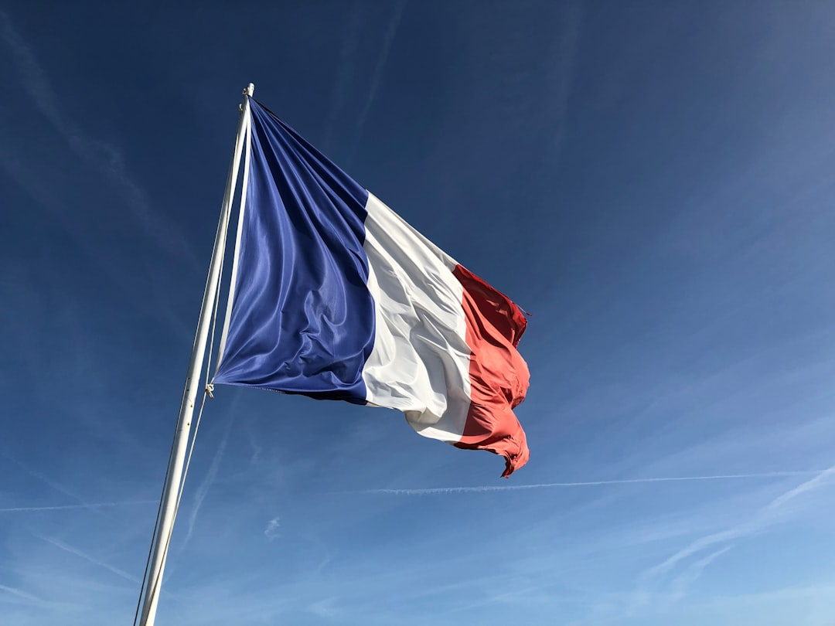
Early Years of French Football (1890s-1920s)
The first football club in France was founded in 1894, and by the 1920s, the sport had gained popularity across the country.
The French Football Federation (FFF) was established in 1919, marking a significant milestone in the sport's development in France.
The early years of French football saw the country participate in international competitions, including the FIFA World Cup, which France hosted in 1938.

Slide 4
Post-War Resurgence (1940s-1960s)
In the aftermath of World War II, French football experienced a resurgence, with the country winning its first major international trophy in 1958.
The French national team, led by the charismatic coach Albert Batteux, secured a historic victory at the 1958 FIFA World Cup in Sweden.
This success marked a turning point in French football, as the country began to establish a strong reputation on the international stage.

Slide 5
The Golden Generation (1970s-1980s)
The 1970s and 1980s saw the emergence of a golden generation of French players, including the likes of Michel Platini and Jean-Pierre Papin.
Under the guidance of coach Michel Hidalgo, France won the 1984 European Championship, marking a major milestone in the country's football history.
This period also saw France establish itself as a consistent presence in major international tournaments, including the FIFA World Cup.

Slide 6
Modern Era (1990s-2000s)

Slide 7
Zidane and the 2006 World Cup
In 2006, France, led by the iconic midfielder Zinedine Zidane, won the FIFA World Cup in Germany.
Zidane's leadership and vision on the pitch were instrumental in France's success, as the country secured a historic victory in the final against Italy.
This triumph marked a major milestone in French football history, as the country celebrated its second World Cup victory.

Slide 8
The 2018 World Cup
In 2018, France, led by the young and dynamic coach Didier Deschamps, won the FIFA World Cup in Russia.
The French national team, featuring a talented group of players, including Kylian Mbappé and Paul Pogba, secured a historic victory in the final against Croatia.
This triumph marked a major milestone in French football history, as the country secured its second World Cup victory in 20 years.

Slide 9

Conclusion
France's history in football is a rich and fascinating one, marked by tradition, triumph, and tragedy. From its humble beginnings to its current status as a football powerhouse, the country has experienced a journey that is steeped in passion, dedication, and a love for the sport. As France continues to evolve and grow as a football nation, its legacy and tradition will undoubtedly continue to inspire future generations of players and fans.

