Slide 2
The History of France in Football
Created with AI Presentation Generator

Slide 3
Introduction
France has a rich and storied history in football, with a legacy that spans over a century. From humble beginnings to international success, the country has produced some of the greatest players and teams in the sport's history. This presentation will explore the evolution of football in France, highlighting key milestones, achievements, and cultural influences that have shaped the nation's passion for the game.

Slide 4
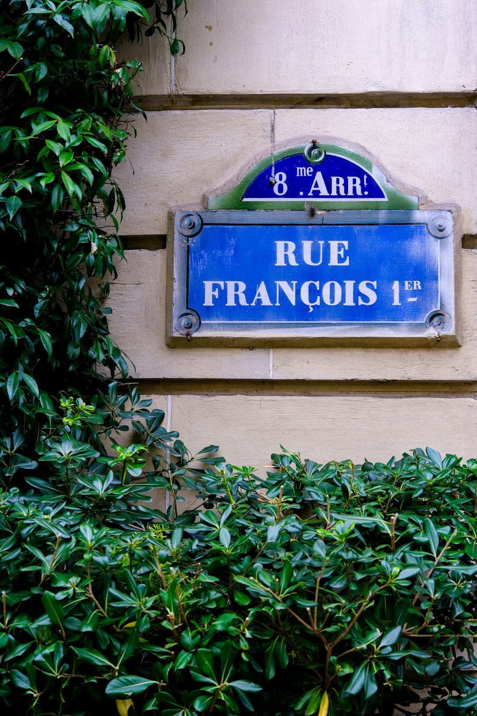
Early Years of French Football
The first French football club, Standard Athletic Club de Paris, was founded in 1889, marking the beginning of the sport's development in the country.
The French Football Federation (FFF) was established in 1919, paving the way for the country's participation in international competitions.
In the early 20th century, French clubs began competing in European competitions, with the first appearance in the European Cup in 1956.

Slide 5
Post-War Era and the Rise of French Football
The post-war period saw a significant resurgence in French football, with the country's national team winning its first major international trophy in 1958, the World Cup.
The iconic team of that era, led by players like Raymond Kopa and Just Fontaine, was known for its attacking style of play and charismatic leadership.
French clubs began to attract top talent from around the world, with the likes of Eusébio and Pelé featuring for clubs in the country.

Slide 6
The Golden Generation of French Football
The 1980s and 1990s saw the emergence of a new generation of French footballers, including Zinedine Zidane, Thierry Henry, and David Ginola.
This group of players revolutionized the sport in France, introducing a more physical and tactical style of play that would go on to influence the country's national team for years to come.
The success of French clubs in European competitions, including the 1993 European Cup Winners' Cup, solidified the country's reputation as a football powerhouse.

Slide 7
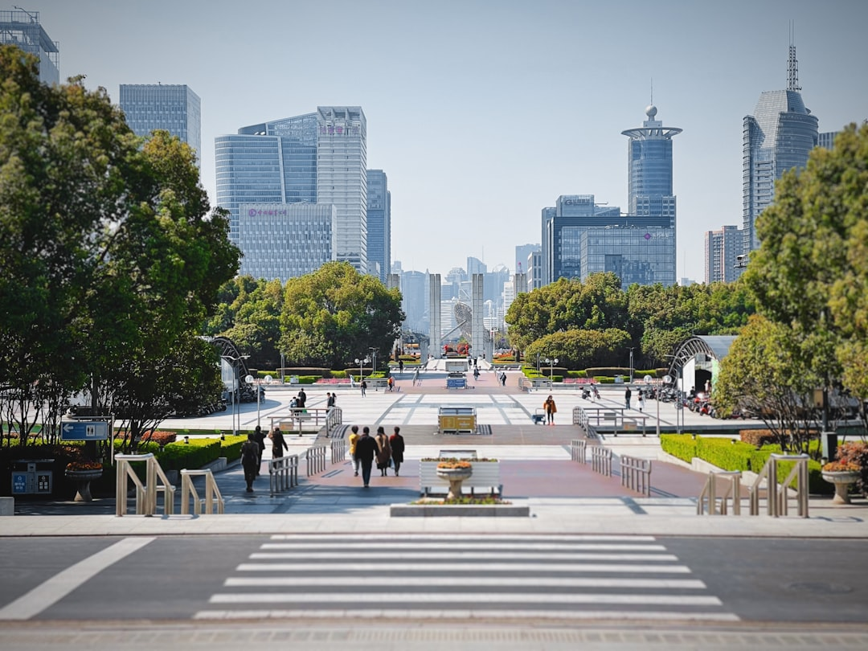
Modern French Football

Slide 8
French Football and Culture
Football has a profound impact on French culture, with matches often serving as a catalyst for national pride and identity.
The sport has also played a significant role in shaping French society, with football clubs often serving as community hubs and sources of local pride.
The iconic Stade de France, built for the 1998 World Cup, has become a symbol of French football and a testament to the country's passion for the sport.

Slide 9
International Competitions and French Success
Before / Option A
After / Option B
France has enjoyed significant success in international competitions, including five World Cup titles and two European Championship victories.
French clubs have also enjoyed success in European competitions, including multiple Champions League titles and European Cup Winners' Cup victories.
The country's national team has also had notable success in the UEFA Nations League, finishing as runners-up in the inaugural tournament.

Slide 10
French Football and Global Influence
French football has had a significant impact on the global game, with the country's style of play and coaching methods influencing clubs and national teams around the world.
The success of French players in international competitions has also helped to promote the sport and attract new fans to the country.
The French Football Federation's commitment to youth development and grassroots initiatives has also helped to spread the sport globally.

Slide 11

Conclusion
France's rich history in football is a testament to the country's passion and dedication to the sport. From its early beginnings to its current status as a global football powerhouse, France has consistently produced top talent and achieved significant success on the international stage.

