Slide 2
The History of France in Football
Created with AI Presentation Generator

Slide 3
Introduction
France has a rich history in football, spanning over a century, with a plethora of talented players, successful teams, and iconic moments that have contributed significantly to the country's football heritage. The French football federation was established in 1919, and since then, the country has emerged as a major force in international football competitions. This presentation aims to explore the evolution of football in France, highlighting key milestones, notable players, and significant achievements that have shaped the nation's football identity.

Slide 4

Early Years (1900s-1940s)
The first French international football match was played in 1904, marking the beginning of the country's involvement in international competitions.
France's early years in football were marked by modest success, with the team competing in the inaugural FIFA World Cup in 1930.
The French football federation was initially formed in 1919, with the aim of promoting football development and international participation.

Slide 5
Post-War Era (1940s-1970s)
The post-war era saw a significant resurgence in French football, with the team reaching the FIFA World Cup final in 1958.
This period was characterized by the emergence of iconic players like Raymond Kopa and Just Fontaine, who played crucial roles in France's rise to prominence.
The introduction of the European Cup in 1955 further solidified France's position in European football, with French clubs competing in the prestigious tournament.

Slide 6
Golden Generation (1980s-1990s)
The 1980s and 1990s are often regarded as the golden era of French football, with the emergence of talented players like Michel Platini, Jean-Pierre Papin, and Zinedine Zidane.
This period saw France reach the World Cup final in 1986 and 1998, with the team ultimately winning the tournament in 1998.
The French national team's success during this period was characterized by a distinctive playing style, which emphasized creativity, skill, and flair.

Slide 7
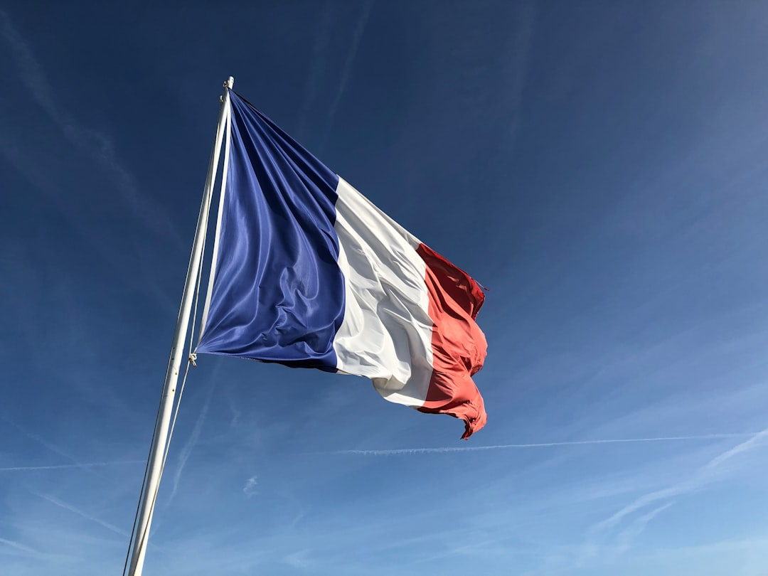
Modern Era (2000s-Present)

Slide 8
Notable Players
Michel Platini is widely regarded as one of the greatest French footballers of all time, winning the Ballon d'Or three times in the 1980s.
Zinedine Zidane is another iconic player, leading France to World Cup victory in 1998 and winning the FIFA World Player of the Year award in 1998 and 2000.
Kylian Mbappé is a young and talented player who has already made a significant impact on the French national team, winning the FIFA World Cup in 2018.

Slide 9
Tribute to the Past
Before / Option A
After / Option B
The Stade de France, built for the 1998 FIFA World Cup, has become a symbol of French football, hosting numerous international matches and tournaments.
The museum provides a unique insight into the evolution of French football, highlighting key milestones, notable players, and significant achievements.
The French national football team's museum, located in the Stade de France, serves as a tribute to the country's football heritage, showcasing memorabilia and artifacts from the team's history.

Slide 10
Conclusion
France's rich history in football is a testament to the country's passion and dedication to the sport. From its early years to the present day, French football has evolved significantly, with a plethora of talented players, successful teams, and iconic moments contributing to the nation's football heritage. This presentation has highlighted key milestones, notable players, and significant achievements that have shaped the nation's football identity.

