Slide 1
History of France in Football
Created with AI Presentation Generator

Slide 2
Introduction
France has a rich history in football, with a long tradition of producing talented players and successful teams. The country has experienced periods of dominance, as well as times of decline. However, with the emergence of new talents and innovative coaching methods, France is once again becoming a force to be reckoned with in the world of football.

Slide 3
Early Years
French Football Association
First International Match
French League Established

Slide 4
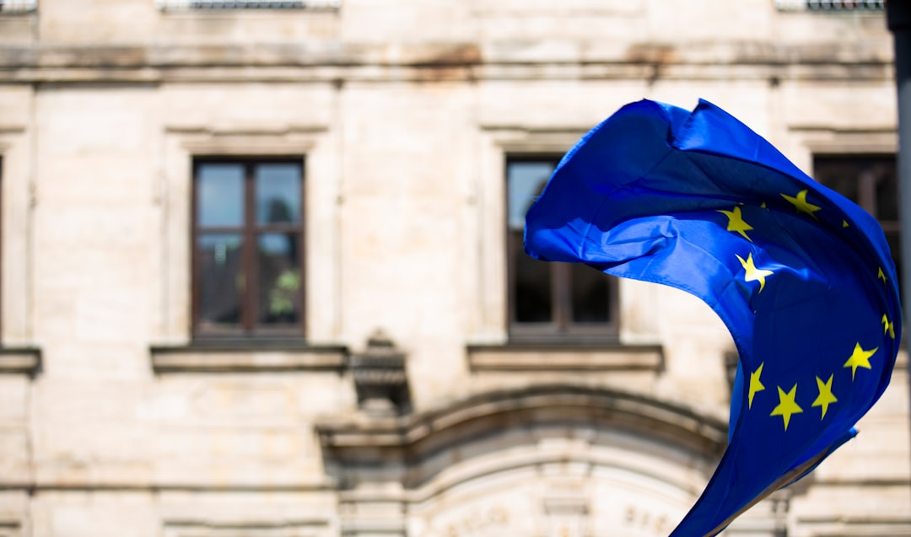
The Golden Age
European Championship Success
World Cup Victory
Dominant French Teams

Slide 5

Post-War Era
French Football Decline
Emergence of New Talent
French Teams in European Competitions

Slide 6
Modern Era
French Football Renaissance
Talented Young Players
Successful French Coaches

Slide 7
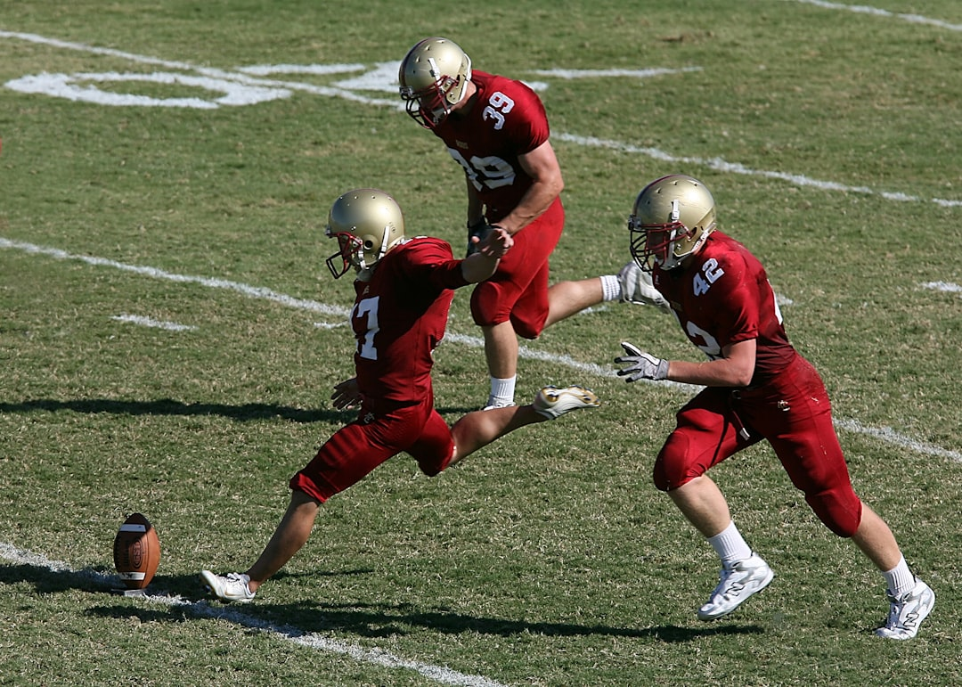
Notable Players
Zinedine Zidane
Thierry Henry
Kylian Mbappé

Slide 8
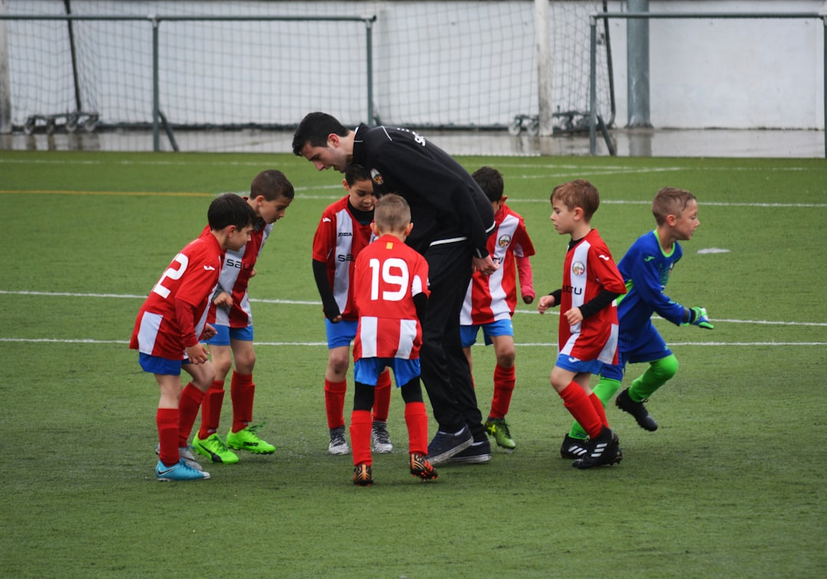
Notable Coaches
Michel Hidalgo
Aimé Jacquet
Didier Deschamps

Slide 9

World Cup Success
1998 World Cup Victory
2018 World Cup Victory
French World Cup History

Slide 10
European Championship Success
1984 European Championship
2000 European Championship
French European Championship History

Slide 11
French Football Culture
Passionate Fans
Rich Football Heritage
French Football Traditions

Slide 12
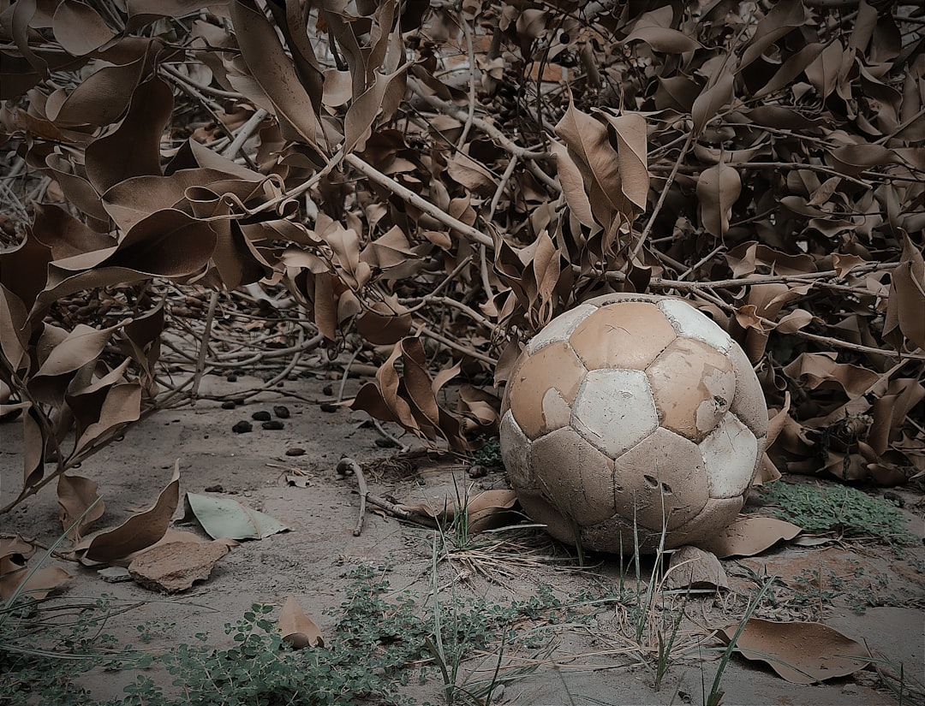
Conclusion
France has a proud history in football, with a legacy of successful teams and talented players. As the country continues to evolve and produce new talent, it is clear that the future of French football is bright. With a rich football culture and a deep passion for the sport, France is poised to remain a major player in the world of football.

