Slide 1
Third World Countries: Understanding the Challenges and Opportunities
Created with AI Presentation Generator

Slide 2
Introduction
Third World countries have long been a subject of interest and concern for the international community. Despite significant progress in recent years, these countries continue to face numerous challenges that hinder their economic and social development. This presentation aims to provide an overview of the key issues affecting Third World countries, exploring the complex interplay of factors that shape their economies, societies, and futures. Understanding these challenges is crucial for policymakers, donors, and aid organizations seeking to support the development of these countries.

Slide 3
Geographic and Demographic Characteristics
The term "Third World" was originally used to describe countries that were not aligned with either the Western (First World) or Eastern (Second World) blocs during the Cold War. Today, it encompasses a diverse group of countries, often characterized by their shared economic and social challenges.
Third World countries are generally located in Africa, Asia, and Latin America, and are often characterized by large and rapidly growing populations, urbanization, and migration.
These countries often face significant challenges in meeting the basic needs of their populations, including access to healthcare, education, and clean water.

Slide 4


Slide 5
Economic Challenges
Many Third World countries struggle with persistent poverty, unemployment, and inequality, which can lead to social unrest and political instability. This is often due to a lack of economic diversification, underdeveloped infrastructure, and limited access to credit and other financial services.
The informal economy is a significant sector in many Third World countries, where workers lack social protections and face exploitation. This can perpetuate poverty and inequality.
External factors, such as climate change, global economic shocks, and fluctuations in commodity prices, can further exacerbate economic challenges in these countries.

Slide 6
Social and Cultural Challenges
Third World countries often face significant social challenges, including high rates of child mortality, maternal mortality, and HIV/AIDS. These challenges are often linked to inadequate healthcare systems, lack of access to education, and cultural practices that perpetuate inequality.
Women and girls in Third World countries often face significant barriers to education, employment, and economic empowerment, perpetuating cycles of poverty and inequality.
Traditional cultural practices and social norms can perpetuate inequality and limit opportunities for marginalized groups.

Slide 7
Opportunities for Development
Despite the many challenges facing Third World countries, there are opportunities for development and growth. For example, many countries have made significant progress in reducing poverty and improving access to basic services.
The rise of emerging markets and digital technologies has created new opportunities for trade, investment, and innovation in these countries.
International cooperation and aid can play a critical role in supporting development in Third World countries, by providing access to finance, expertise, and knowledge.

Slide 8
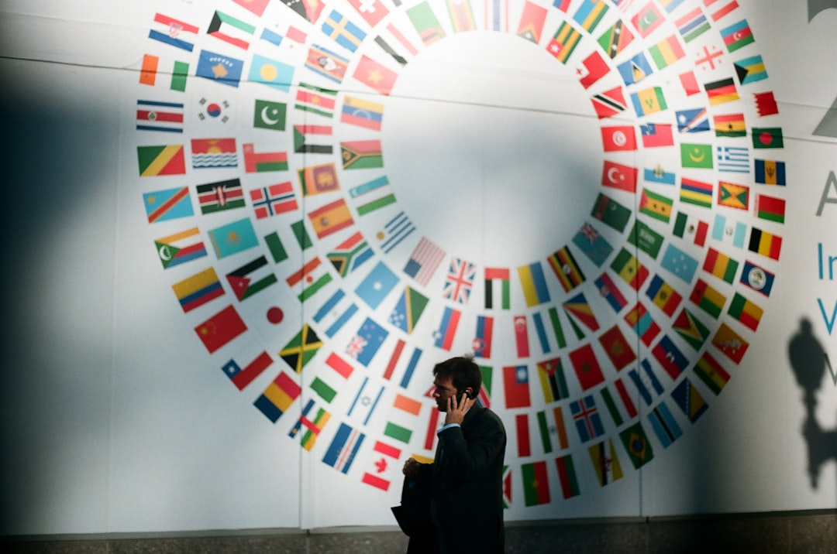

Slide 9
Role of International Cooperation
International cooperation and aid can help address the economic, social, and cultural challenges facing Third World countries. This can involve providing access to finance, technical assistance, and knowledge.
Donor countries and organizations can also play a critical role in advocating for the rights and interests of Third World countries, and promoting global justice and equity.
Effective international cooperation requires a commitment to partnership, mutual respect, and shared responsibility.

Slide 10
Challenges in International Cooperation
Despite the potential benefits of international cooperation, there are significant challenges in its implementation. These include lack of coordination, unequal power dynamics, and competing interests.
Donor countries and organizations often face domestic pressures and competing priorities, which can limit their ability to provide effective support to Third World countries.
Corruption, mismanagement, and poor governance can also undermine the effectiveness of international aid and cooperation.

Slide 11
Sustainable Development Goals (SDGs)
The SDGs provide a global framework for addressing the economic, social, and environmental challenges facing Third World countries. The goals are ambitious and far-reaching, and will require significant investments of time, resources, and expertise.
The SDGs emphasize the importance of partnership, cooperation, and mutual respect in achieving sustainable development.
The SDGs also recognize the critical role of the private sector, civil society, and other non-state actors in supporting development in Third World countries.

Slide 12
Conclusion
Third World countries face significant challenges in their economic, social, and cultural development. However, there are also opportunities for growth and progress.
International cooperation and aid can play a critical role in supporting development in these countries, but it requires a commitment to partnership, mutual respect, and shared responsibility.
The SDGs provide a framework for promoting sustainable development and reducing inequality in Third World countries.

