Slide 1
Pizzia
A Project By:
Ammar Alam, Abdul Basit
M.Mustafa, Hamza Amir
[My Pizza Day Treat]

Slide 3
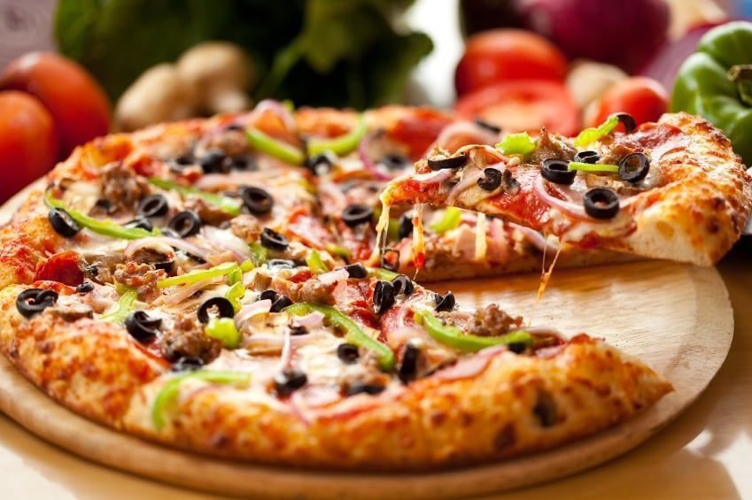

Slide 4




Slide 5
How did we Build it?

Slide 6
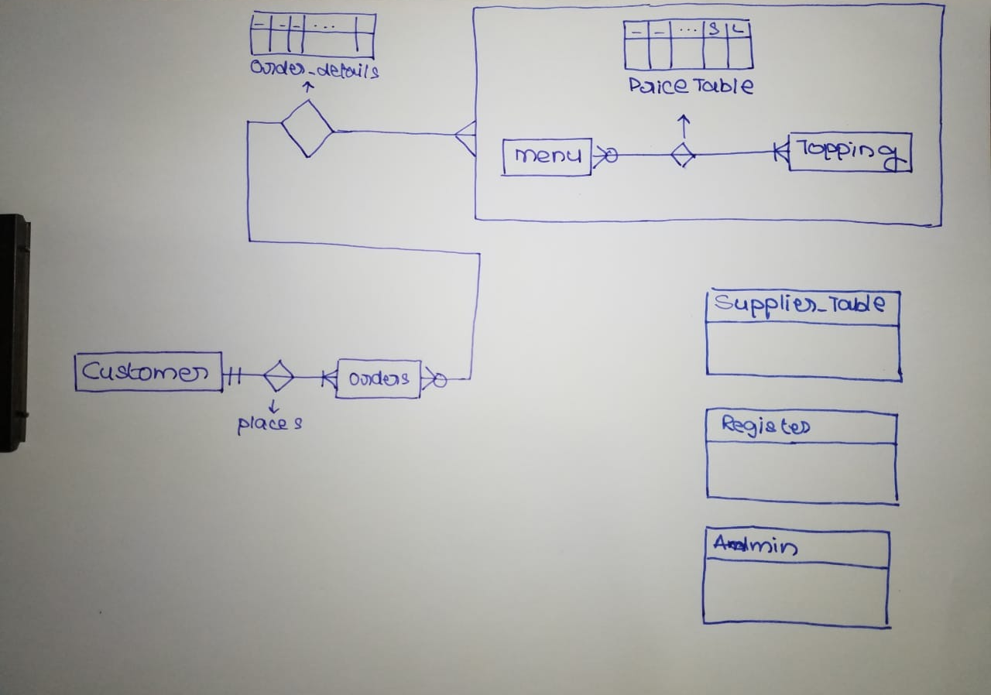

Slide 7
Live Demo

Slide 8
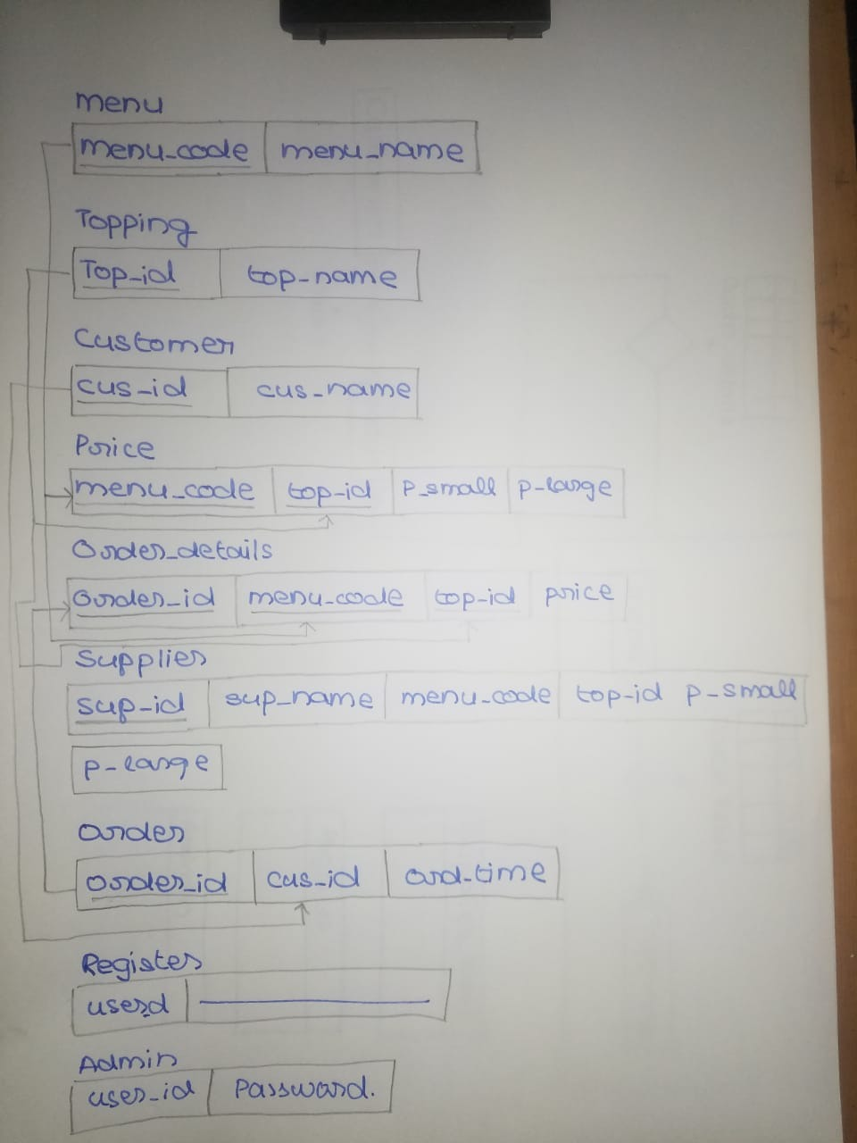

Slide 9

Let’s Order!

Slide 10
Explore Features

Slide 11
Live Presentation

Slide 12
Questions…
Notes:
All Three

Slide 13
Pizzia
A Project By:
Ammar Alam, Abdul Basit
M.Mustafa, Hamza Amir
[My Pizza Day Treat]

