Slide 1
RTOS In A Nutshell
By: Khaled Hossameldein

Slide 2

Agenda
Introduction To Real Time Operating Systems
Introduction To FreeRTOS
Tasks In Depth
How Tasks Synchronize And Communicate
RTOS Main Problems

Slide 3
Agenda
Introduction To Real Time Operating Systems
What Is Real-Time Systems ?
Difference Between GPOS And RTOS
RTOS In Software Layered Architecture
RTOS Components And Terminologies
Schedulers And SysTick
Introduction To FreeRTOS
Tasks In Depth
How Tasks Synchronize And Communicate
RTOS Main Problems

Slide 4
What Is Real-Time Systems ?
Real Time System is a system where the correct functioning of the system depends on the results produced by the system and the time at which these results are produced.
Real-time system
Hard real-time
Soft real-time

Slide 5
Difference Between GPOS and RTOS
Real-Time Operating Systems:
Deterministic : No random execution pattern
Predictable response times
Time bound
Preemptive kernel
Priority based scheduling
It works under worst case assumptions
Limited memory resources

Slide 6
Difference Between GPOS and RTOS
General Purpose Operating Systems:
Not Deterministic : random execution pattern
Un-predictable response times
No time bound
Non-Preemptive kernel
Priorities are dynamically adjusted
Unlimited memory resources

Slide 7
RTOS In Software Layered Architecture
Application
RTOS
HAL
MCAL
Hardware

Slide 8
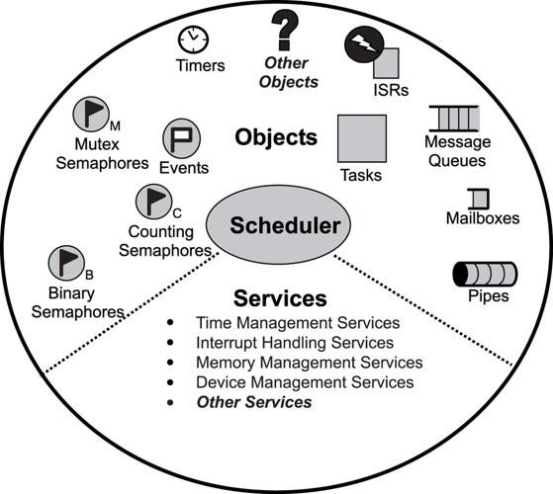
RTOS Components And Terminologies
Important Terminologies:
Interrupt service routine
Scheduling
Dispatcher
Context switching
Tasks
Idle task
Priority
Preemption

Slide 9
RTOS Components And Terminologies
RTOS Components:
Scheduler
Communication Mechanism: Semaphores, Message Queues, Queues, etc
Timing Services: Clocks, Timers, etc
Memory Management: Variable-size heaps, fixed-size heaps, etc

Slide 10
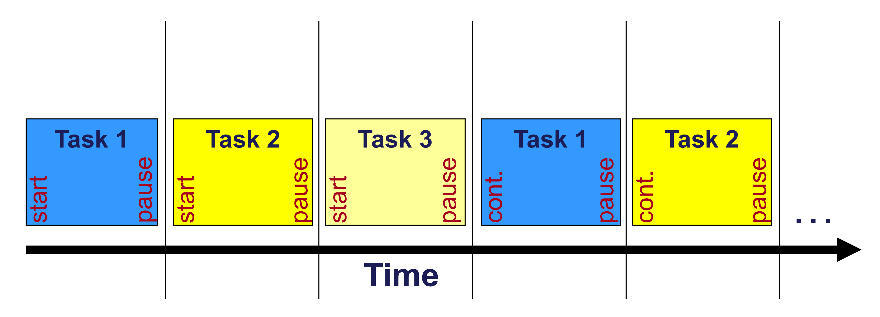
Schedulers And SysTick
Scheduling is the process which decides which task and process should be accessed and run at what time by the system resources.

Slide 11
Schedulers And SysTick
The system tick is the time unit that OS timers and delays are based on. The system tick is a scheduling event - i.e. it causes the scheduler to run and may cause a context switch.
Tick
Tick
Tick
Tick
Tick

Slide 12
Agenda
Introduction To Real Time Operating Systems
Introduction To FreeRTOS
What Is FreeRTOS ?
FreeRTOS Characteristics
FreeRTOS Layered Architecture
Porting FreeRTOS
Tasks In Depth
How Tasks Synchronize And Communicate
RTOS Main Problems

Slide 13

What Is FreeRTOS ?
FreeRTOS is an open source real-time operating system kernel for embedded devices that has been ported to 35 microcontroller platforms.

Slide 14
FreeRTOS Characteristics
FreeRTOS is widely used in embedded applications due to:
Open source.
Excellent documentation and wide community.
Ported on many architectures.
Reliable.
Flexible.
Wide range of services.
Low power consumption.
Small in memory size. (less than 10KB)

Slide 15
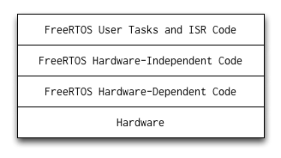
FreeRTOS Layered Architecture
FreeRTOS software architecture is designed to ease the process of porting to a different hardware architecture.

Slide 16
Porting FreeRTOS
FreeRTOS can be ported to more than 35 architectures using one of the following methods:
Method 1 : Using a pre-defined and pre-configured demo project and modifying application layer and RTOS configuration in “FreeRTOSConfig.h” header file
Method 2 : Using source and header files directly from FreeRTOS official distribution and configuring project from scratch depending on target architecture

Slide 17
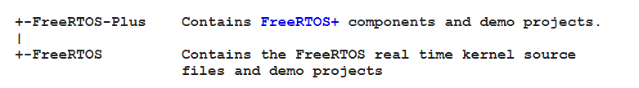
Porting FreeRTOS
FreeRTOS official distribution contains a structured directory that includes all source and header files needed to port FreeRTOS on many architectures. From the top, the download is split into two sub directories; FreeRTOS and FreeRTOS-Plus. These are shown below:

Slide 18
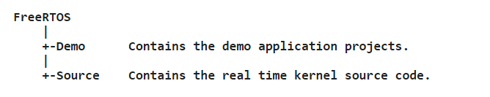
Porting FreeRTOS
FreeRTOS kernel source files and demo projects, are contained in a further two sub directories as shown below:
The core RTOS code is contained in three files, which are called called tasks.c, queue.c and list.c. These three files are in the FreeRTOS/Source directory.

Slide 19
Porting FreeRTOS
Each supported processor architecture requires a small amount of architecture specific RTOS code. This is the RTOS portable layer, and it is located in the FreeRTOS/Source/Portable/[compiler]/[architecture] sub directories, where [compiler] and [architecture] are the compiler used to create the port, and the architecture on which the port runs, respectively.
The sample heap allocation schemes are also located in the portable layer. The various sample heap_x.c files are located in the FreeRTOS/Source/portable/MemMang directory.

Slide 20
Agenda
Introduction To Real Time Operating Systems
Introduction To FreeRTOS
Tasks In Depth
Task Structure
Task States
Task TCB
Context Switching
Create A Task In FreeRTOS
How Tasks Synchronize And Communicate
RTOS Main Problems

Slide 21
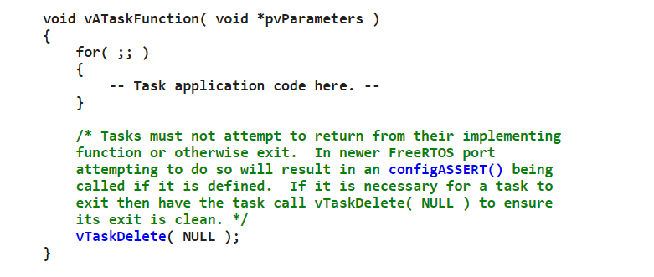
Task Structure
A task is a set of program instructions that are loaded in memory. They are normally implemented as an infinite loop, and must never attempt to return or exit from their implementing function. Tasks can however delete themselves. A task should have the following structure:

Slide 22
Task Structure
The most common task types used in embedded systems are :
Initialization task
Cyclic task
Event-based task
Interrupt-based task

Slide 23
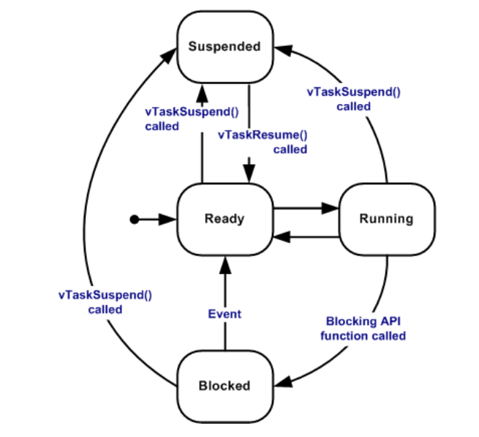
Task States
A task can exist in one of the following states:
Ready
Running
Suspended
Blocked

Slide 24
Task TCB
A task control block (TCB) is a data structure used by kernels to maintain information about a task. Each task requires its own TCB and the user assigns the TCB in user memory space (RAM). It includes mainly the following data:
Program counter
Stack pointer
Task ID
Task priority
Task name
CPU registers
Etc..

Slide 25
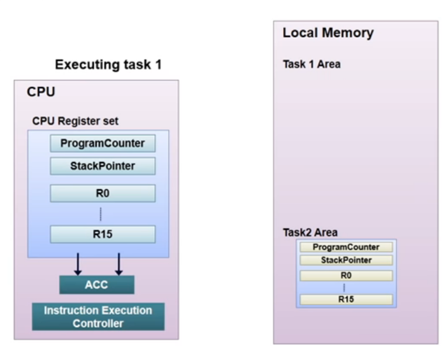
Context Switching
Context switching is the process of saving the context of a task being suspended and restoring the context of a task being resumed .

Slide 26
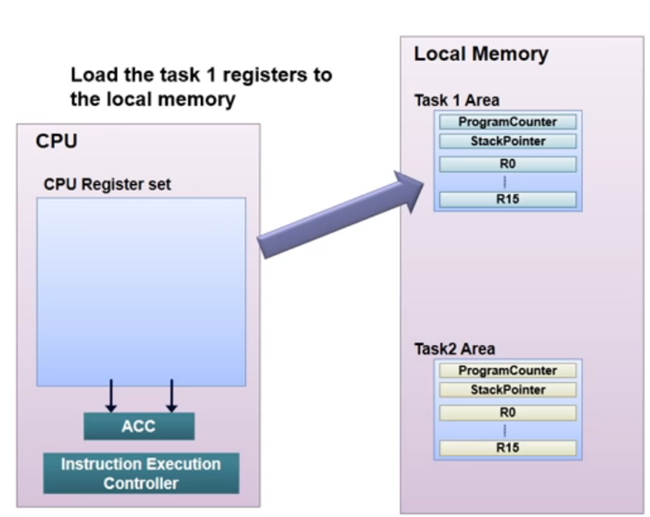

Context Switching

Slide 27
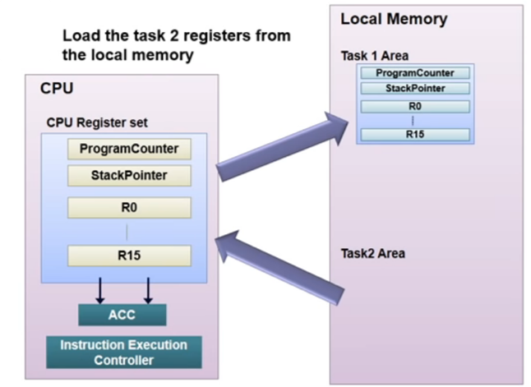
Context Switching

Slide 28
Create A Task In FreeRTOS
The open source FreeRTOS provides many APIs to create, configure, and manipulate tasks. Lets talk about xTaskCreate API which receives the following parameters:
pvTaskCode : Pointer to the task entry function
pcName : A descriptive name for the task
usStackDepth : The number of words (not bytes!) to allocate for use as the task's stack
pvParameters : A value that will passed into the created task as the task's parameter
uxPriority : The priority at which the created task will execute
pxCreatedTask : Used to pass a handle to the created task out of the xTaskCreate() function

Slide 29
Agenda
Introduction To Real Time Operating Systems
Introduction To FreeRTOS
Tasks In Depth
How Tasks Synchronize And Communicate
Task Synchronization. (Semaphores – Mutex – Event flags)
Task Inter-Communication. (Messages Queues – Mailbox )
RTOS Main Problems

Slide 30
Task Synchronization
In a multitasking environment, you sometimes need to synchronize the order of operations between two or more tasks. For example, some tasks may need the results of another task before executing, Also synchronizing access to shared memory. RTOS uses the following methods to achieve tasks synchronization:
Semaphore
Mutex
Event flag

Slide 31
Task Synchronization
A semaphore is a variable or abstract data type used to control access to a common resource by multiple processes in a concurrent system such as a multitasking operating system. There are two types of semaphores:
Counting semaphore
Binary semaphore

Slide 32
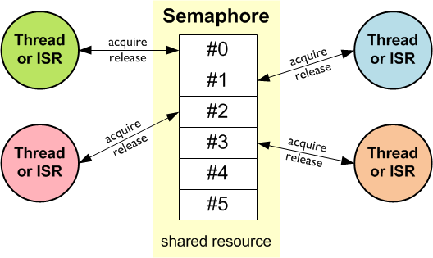
Task Synchronization
Examples On Counting Semaphores:

Slide 33
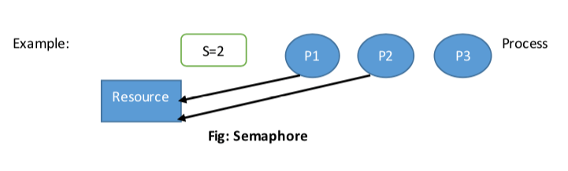
Task Synchronization

Slide 34
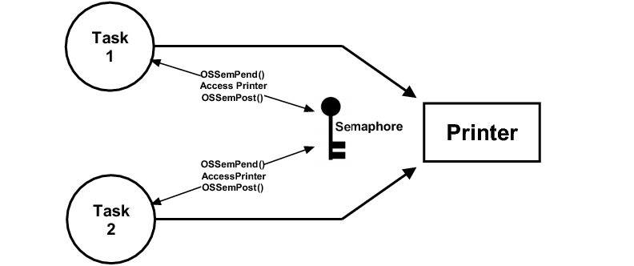
Task Synchronization
Example On Binary Semaphores:

Slide 35
Task Synchronization
Mutex is a synchronization mechanism for enforcing limits on access to a resource in an environment where there are many threads of execution. A lock is designed to enforce a mutual exclusion concurrency control policy.

Slide 36
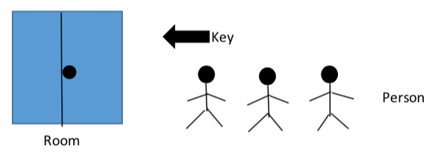
Task Synchronization
Example On Mutex:

Slide 37
Task Synchronization
Mutex Vs. Binary Semaphore:
Semaphore | Mutex
Semaphore is a signaling mechanism. | Mutex is a locking mechanism.
Semaphore allow multiple program threads to access a finite instance of resources. | Mutex allow multiple program thread to access a single resource but not simultaneously.
Semaphore value can be changed by any process acquiring or releasing the resource. | Mutex object lock is released only by the process that has acquired the lock on it.
Semaphore can be categorized into counting semaphore and binary semaphore. | Mutex is not categorized further.

Slide 38
Task Synchronization
Event Flags are used when a task needs to synchronize with the occurrence of multiple events. The task can be synchronized when any of the events have occurred, which is called disjunctive synchronization (logical OR). A task can also be synchronized when all events have occurred, which is called conjunctive synchronization (logical AND).

Slide 39
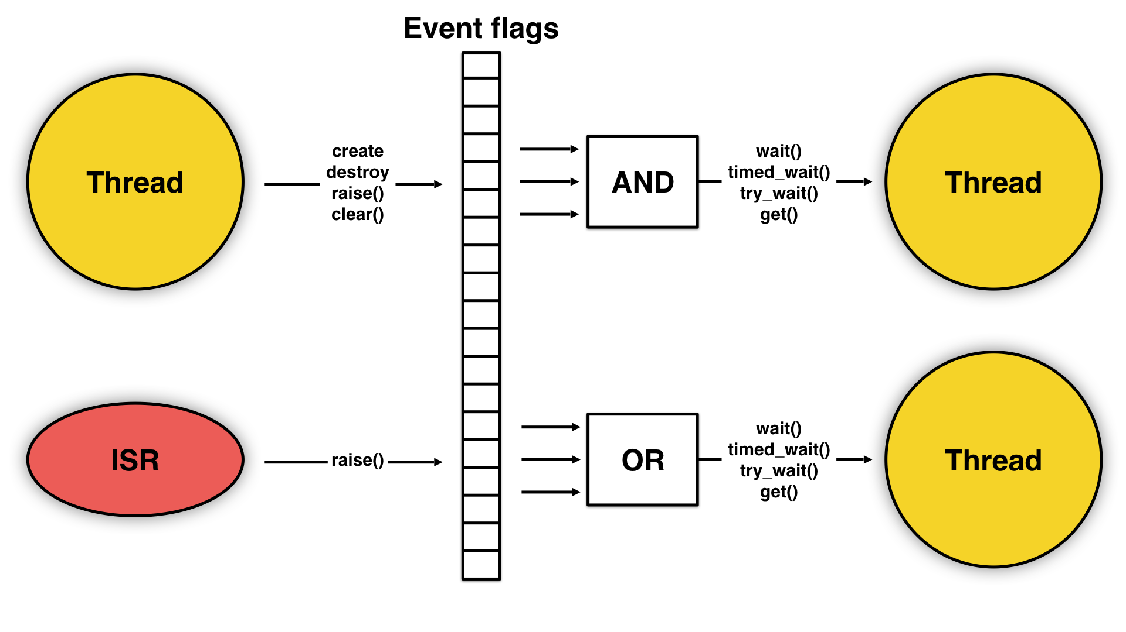
Task Synchronization
Example On Event Flags:

Slide 40
Task Inter-Communication
A message queue is a number of buffers of a fixed or maximum size that is controlled by the RTOS and also a queue for tasks that are waiting for messages. The size and the number of buffers are specified when the message queue is created.

Slide 41
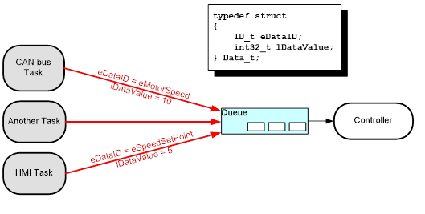
Task Inter-Communication
Example On Message Queue:

Slide 42
Task Inter-Communication
A mailbox is simply a storage location, big enough to hold a single variable of type ADDR, access to which is controlled so that it may be safely utilized by multiple tasks. One task can write to a mailbox. It is then full, and no task can send to it until a task does a read on the mailbox or the mailbox is reset. Trying to send to a full mailbox or read from an empty one may result in an error or task suspension

Slide 43
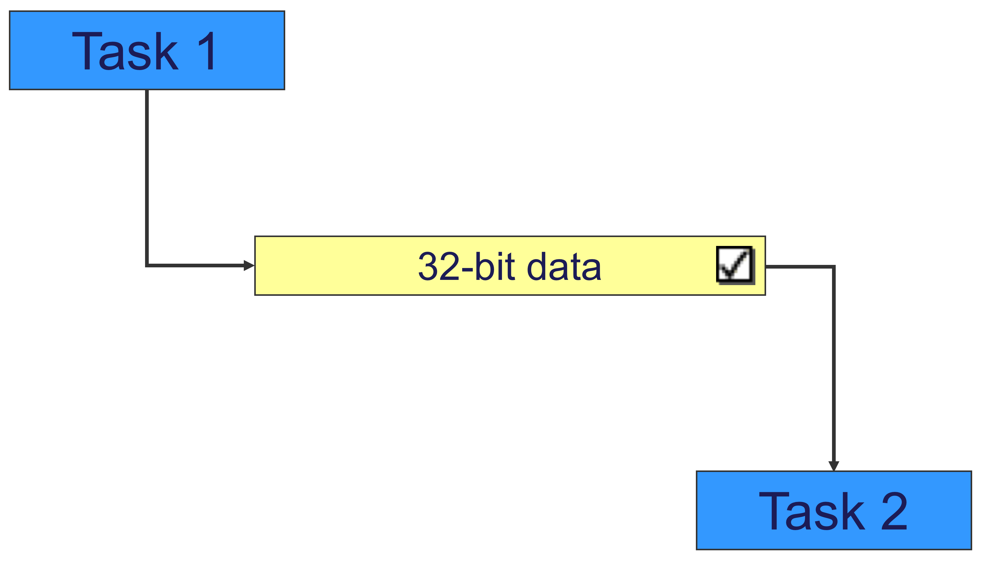
Task Inter-Communication
Example On Mailbox:

Slide 44
Agenda
Introduction To Real Time Operating Systems
Introduction To FreeRTOS
Tasks In Depth
How Tasks Synchronize And Communicate
RTOS Main Problems
Priority Inversion And Inheritance
DeadLocks

Slide 45
Priority Inversion And Inheritance
Priority inversion is a scenario in scheduling in which a high priority task is indirectly preempted by a lower priority task effectively inverting the relative priorities of the two tasks.

Slide 46
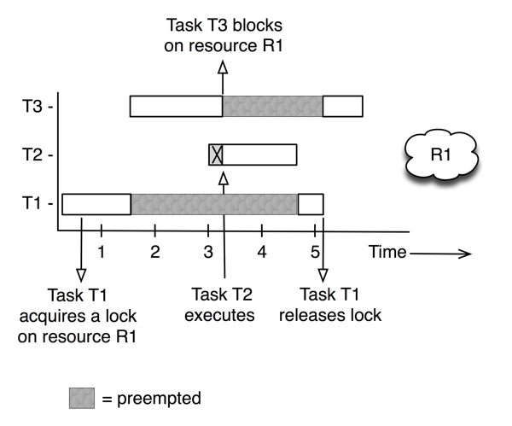
Priority Inversion And Inheritance
Example On Priority Inversion:

Slide 47
Priority Inversion And Inheritance
Priority inheritance is the solution of priority inversion problem, Its that when a job blocks one or more high-priority jobs, it ignores its original priority assignment and executes its critical section at an elevated priority level.

Slide 48
Deadlocks
A deadlock occurs when a process or thread enters a waiting state because a requested system resource is held by another waiting process, which in turn is waiting for another resource held by another waiting process. If a process is unable to change its state indefinitely because the resources requested by it are being used by another waiting process, then the system is said to be in a deadlock

Slide 49
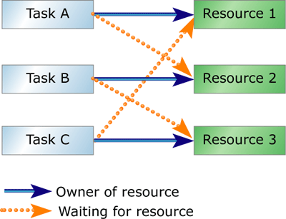
Deadlocks
Example On Deadlock:

Slide 50
Deadlocks
A deadlock can arise if and only if all of the following conditions hold simultaneously in a system :
Mutual exclusion
Hold and wait or resource holding: a process is currently holding at least one resource and requesting additional resources which are being held by other processes
No preemption: a resource can be released only voluntarily by the process holding it
Circular wait: each process must be waiting for a resource which is being held by another process

Slide 51
Important FreeRTOS Links
FreeRTOS API documentation : https://www.freertos.org/a00106.html
FreeRTOS directory structure : https://www.freertos.org/a00017.html
FreeRTOS configuration file : https://www.freertos.org/a00110.html
FreeRTOS memory management : https://www.freertos.org/a00111.html
How FreeRTOS works (article) : https://www.aosabook.org/en/freertos.html

Slide 52
THANK YOU

