Slide 1

Traffic Risk Prediction
Ammar Shaikh
Harshit Narang
Ran Wei
Sohom Chatterjee
Texas A&M University

Slide 2
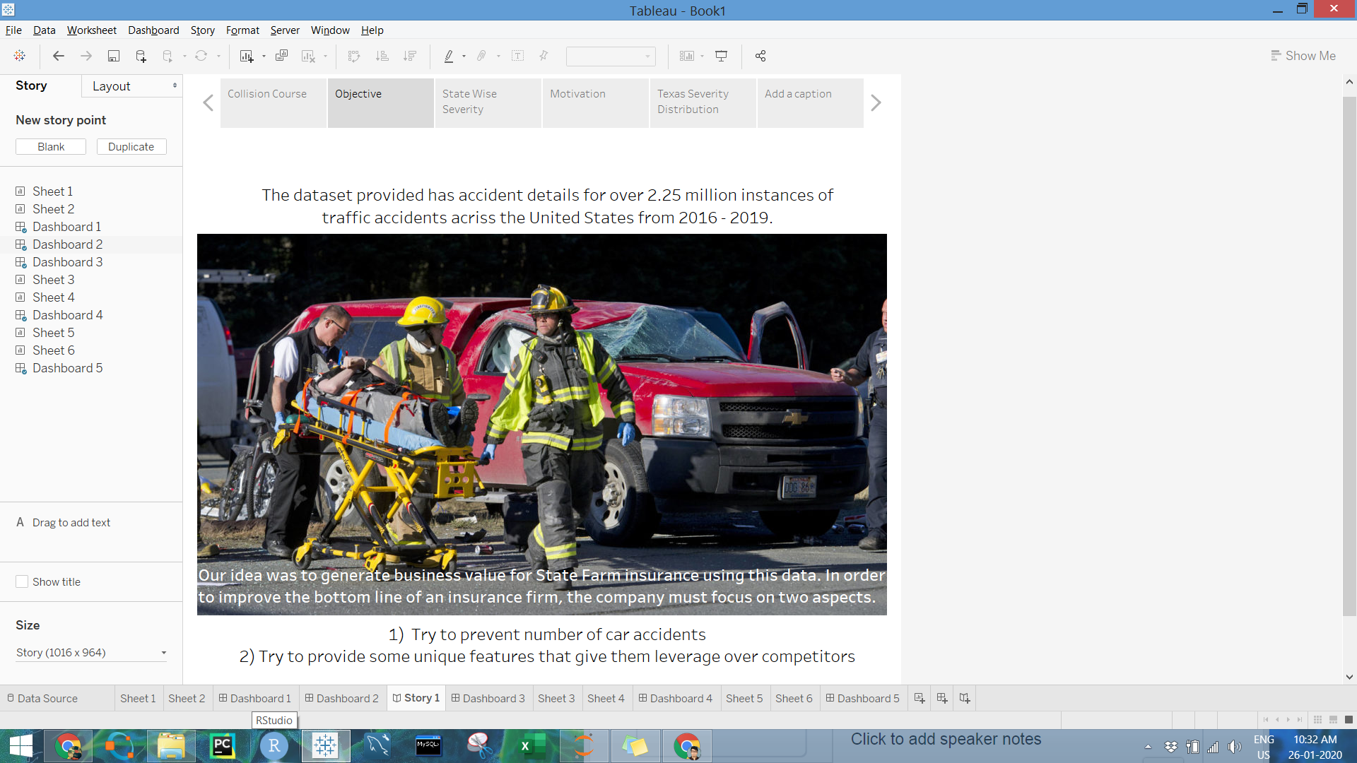
Motivation

Slide 3
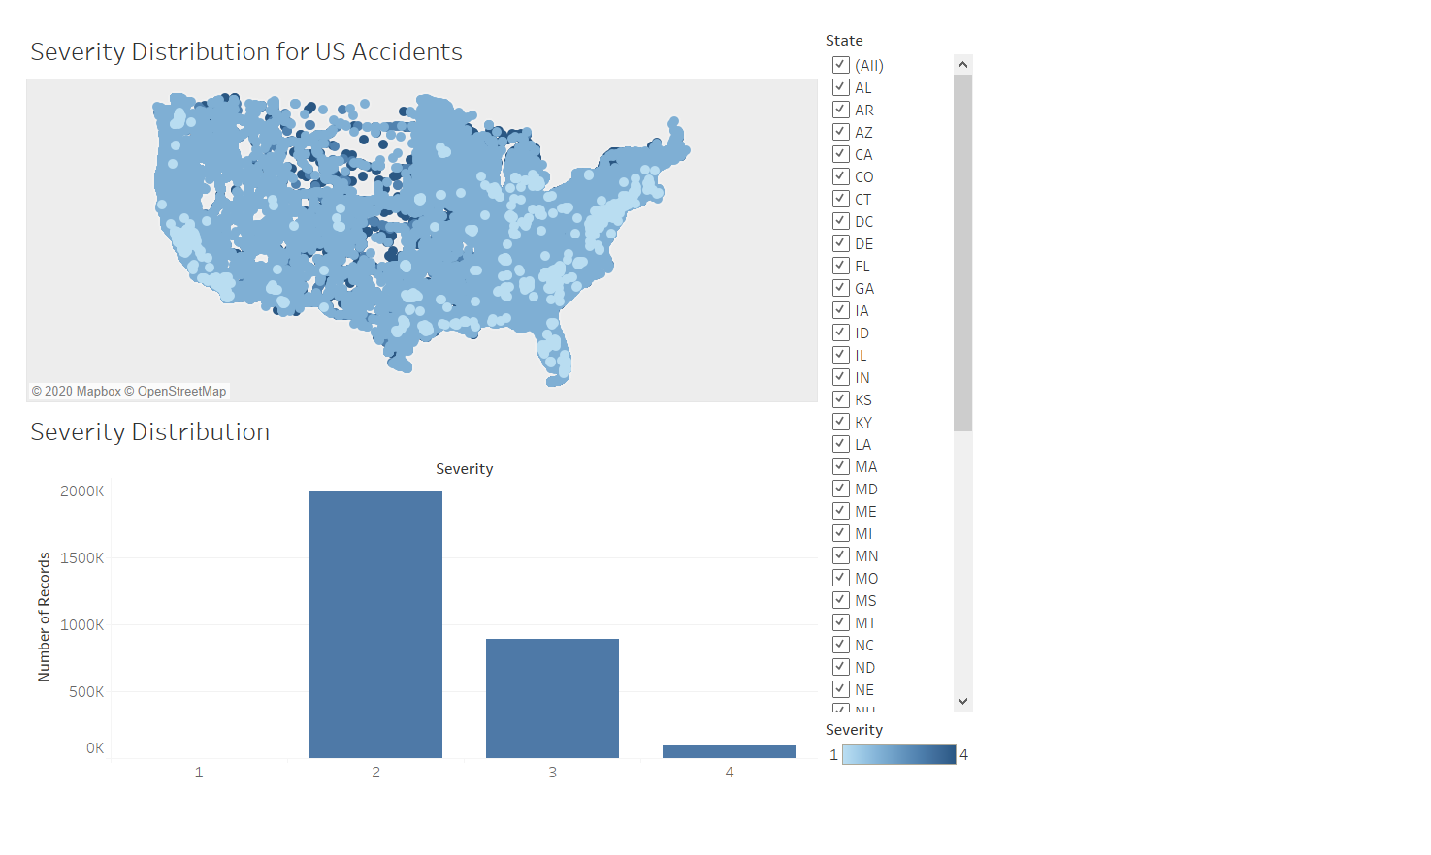
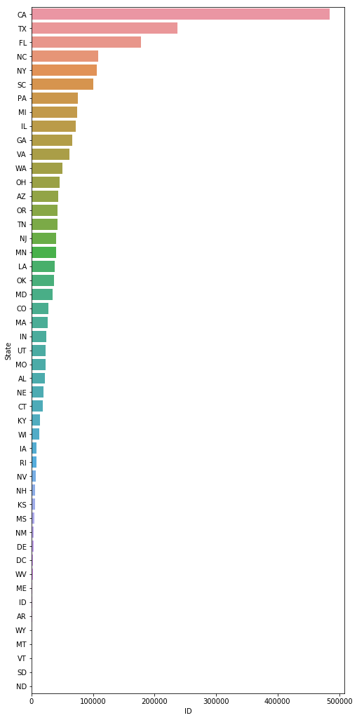
State Wise Severity Distribution for US Accidents

Slide 4
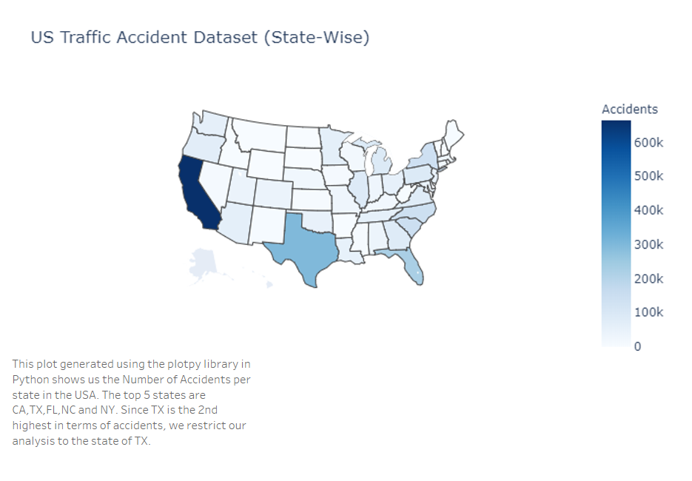
This data can help StateFarm decide quote prices for future customers and potential markets for expansion. The states with fewer number of accidents are the regions to target.

Slide 5
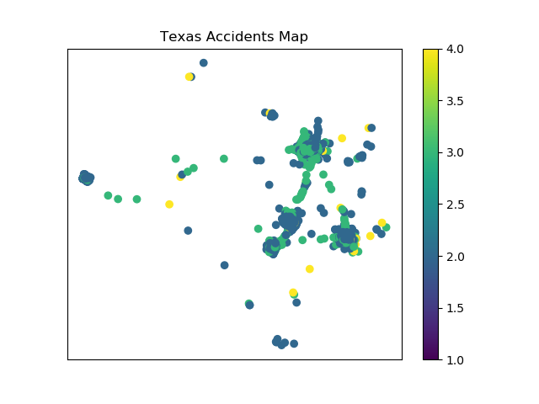
Accident Distribution for Texas
The accident distribution of the TX gives us some important insights. We see that there are more accidents at the three cities of Houston, Dallas and San-Antonio-Austin, although the severity is less.

Slide 6

Random Forest
Random Forest is an ensemble of decision trees which vote to decide the output class in classification problems.
Random Forest is robust to suboptimal feature selection because each tree only takes a subset of the input feature set at random.
The voting scheme increase prediction accuracy by using the knowledge of a group instead of one.

Slide 7
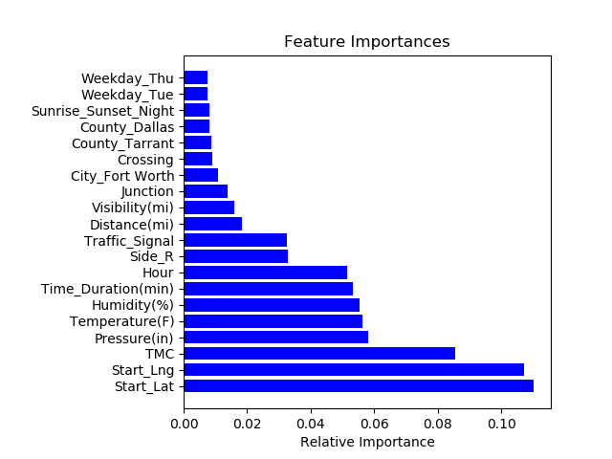
Random Forest Cont’d
Train/Test Split: 200860/50215
Initial Model: Variables: 961 Accuracy: 0.872
Simplified Model: Variables: 9 Accuracy: 0.872

Slide 8
The Innovation
Using our Random Forest model we could predict the severity of the car crashes at an 87% accuracy.
We could also identify the most important features for this model.
Using these features as input, and collecting real time spatio-temporal data about the customer, State Farm can add a feature to their app, using which if a customer enters their travelling route they can predict the chances of a severe accident occurring and send the customer a notification to prevent the same.
This prevents crashes as well as helps State Farm provide a feature that gives it leverage over its competitors, which it can use as a marketing strategy.

Slide 9
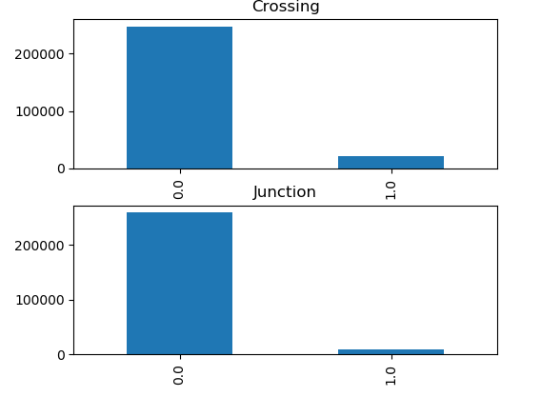
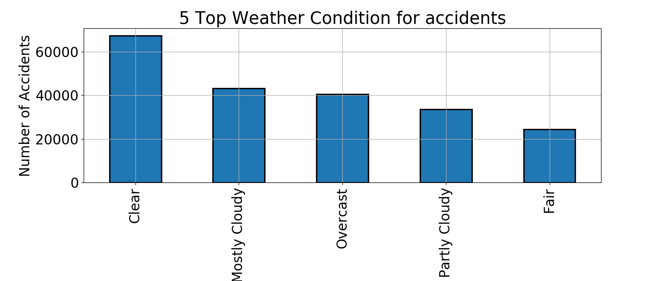
Additional Insights
This example shows that clear weather gives a higher probability of accidents compared to other days. Perhaps customers stay careful during worse weather. This feature is used in the model to predict the accidents

Slide 10
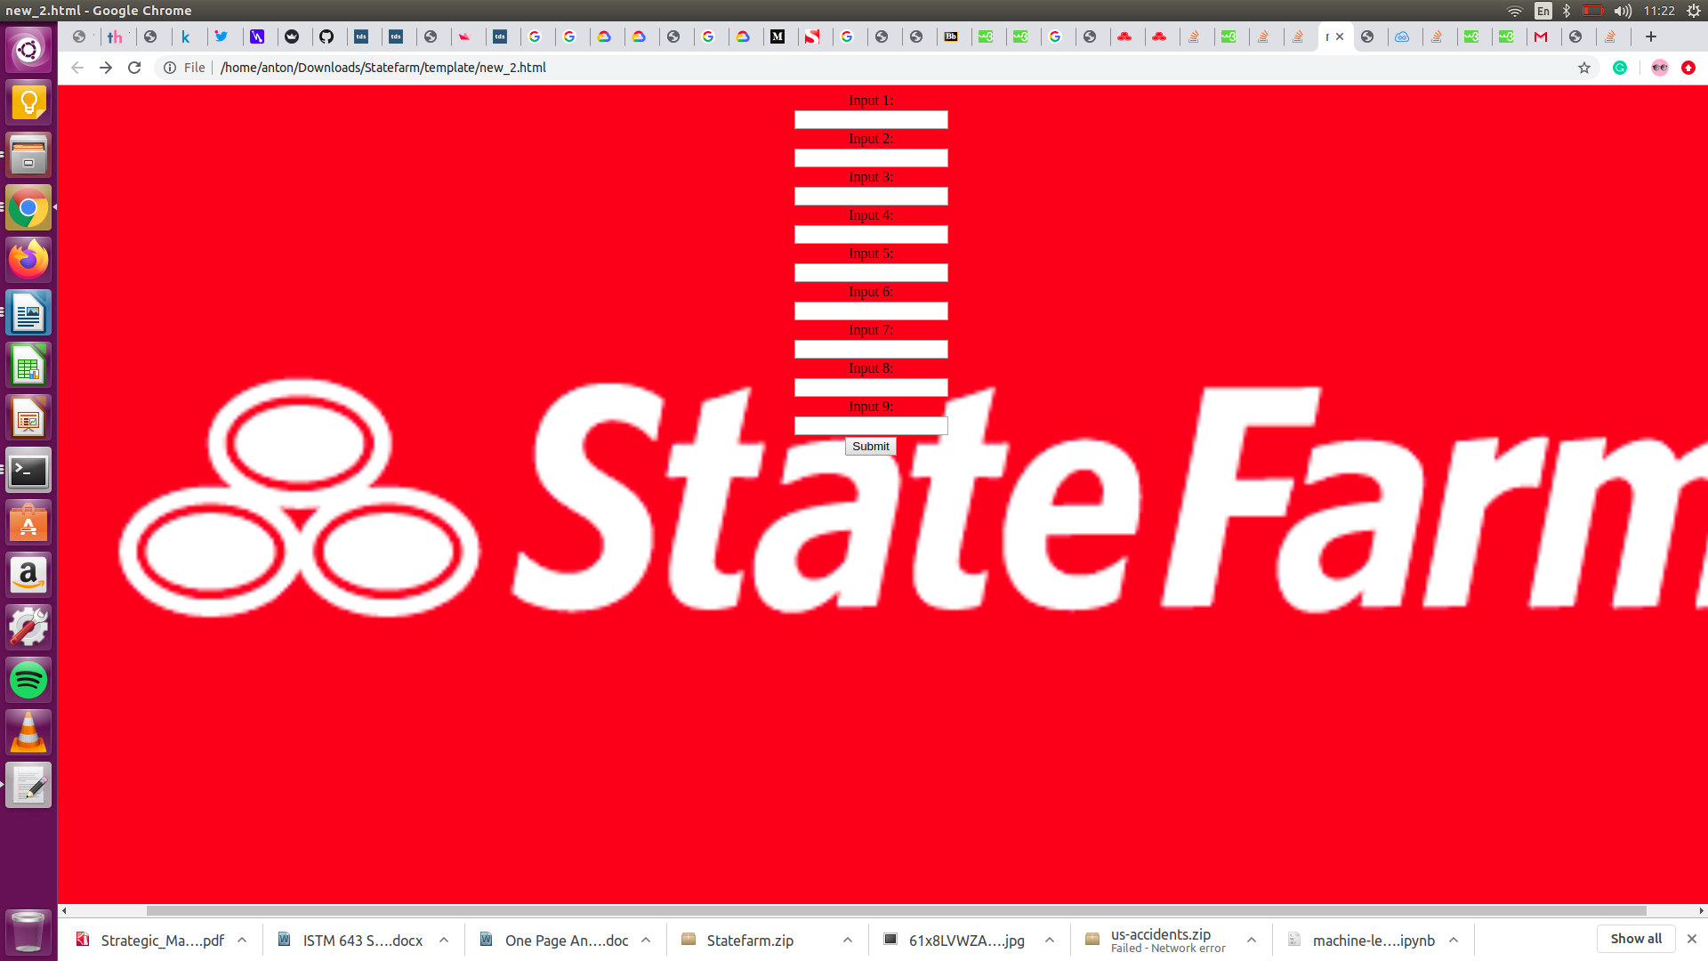
Website Deployment
We demonstrate the machine learning model using a website, where we can input certain important features and the output is the severity prediction.
We have used html and css to build a front end application and we used flask to connect our front end with the back end model which we developed using Python libraries and wrapped it using Python Flask.

Slide 11
Conclusion
Using the data, we provide State-farm analysis on prospective markets for expansion, and a feature which they can add to their applications for preventing crashes as well as marketing a crash preventing feature which helps them attract new customer base.
Since this model has considerable accuracy of 87%, we can use it to predict chances of accident and send these notifications to the customer to prevent accidents, thereby helping improve the company’s bottom line.

Slide 12
Thank you!
Special thanks to Medium blogger Ronghui Zhou, Ph.D. for inspiring our machine learning pipeline

