Slide 1
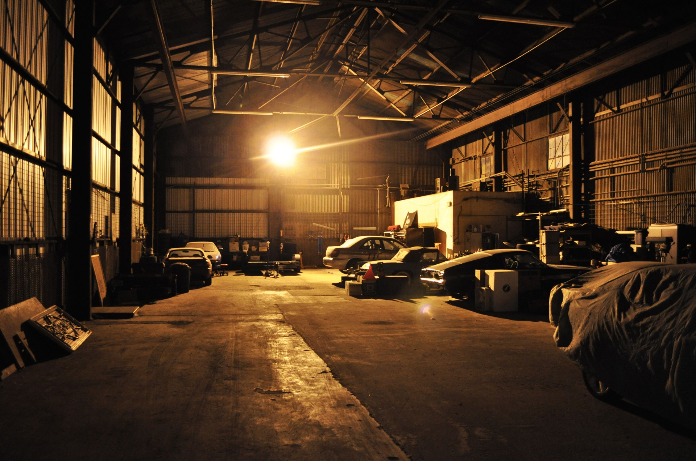

AUTOMOTIVE EXPERT SYSTEM
AMMAR SYATBI
MUHAMMAD IRFAN

Slide 2

INTRODUCTION
As we all know , modified cars are increasing these day usually seen in the street or in workshops. Most of this modifiers or tuners are car enthusiast or motorsports fan. Even for standard car user there must be time upgrading is needed. No matter in what category people would still have problem in determining parts to upgrade. It is a human nature to have the very best we can get on everything we have. Automotive Expert System was designed to fulfill that needs. Although the system is consider small that it covers only standard cars and 4x4 vehicle but it has wide range of parts and substantial expertise on solving problems. With great interface design and system flow , user can have the ease of use thus spend shortest time possible on finding the right parts.

