Slide 1
Google WebLight Transformations Analysis
Ammar Tahir 20100212
Muhammad Adil Inam 20100180

Slide 2
Two Types of Analysis
External Analysis of the Objects fetched
`
Internal Analysis of the underlying HTML

Slide 3
External Analysis
Comparison of origin and non-origin requests and servers in the transformed and non-transformed pages.
Comparison of the ratio of different kinds external objects (JS , CSS , HTML, Image) fetched in the transformed and non-transformed pages.

Slide 4
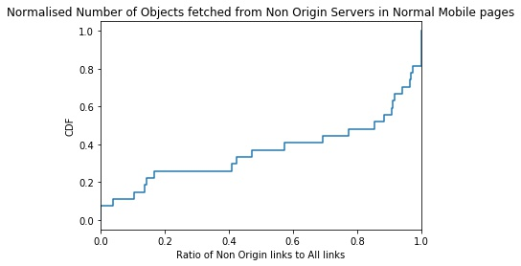
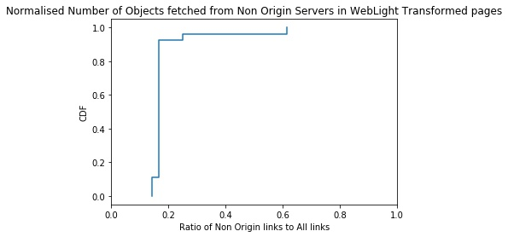
Non-Origin Requests Comparison
The ratio of non-origin to total requests is significantly larger in non-transformed pages as compared to transformed pages.

Slide 5
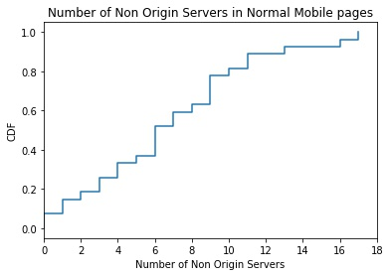
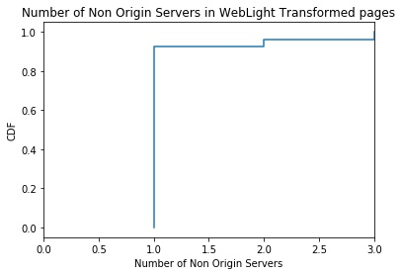
Non-Origin Servers Comparison
The number of non-origin servers are greater in number for non-transformed pages as compared to transformed pages.

Slide 6
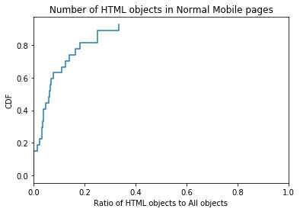
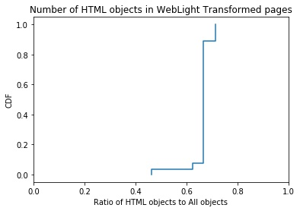
Ratio of HTML Objects
The ratio of html objects to total objects fetched is significantly higher in transformed pages as most of the external CSS and Js objects are embedded inside the html in transformed pages.

Slide 7
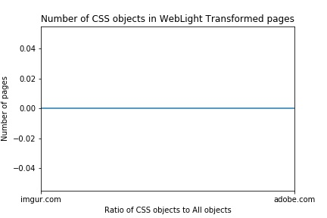
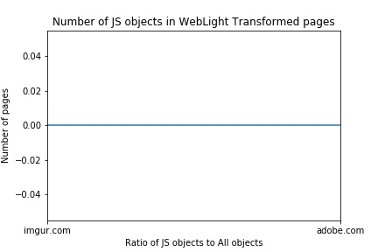
Ratio of Js and CSS Objects
The transformed pages in the sample dataset made no external CSS or JS object requests.

Slide 8
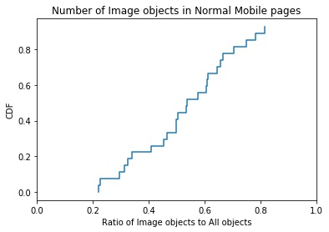
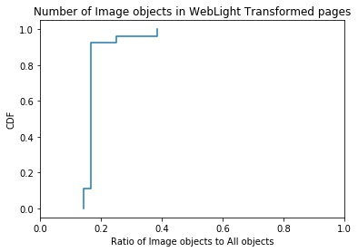
Ratio of Image Objects
The ratio of image objects to total objects fetched is significantly lower in transformed pages as most of the images are completely embedded inside the html in the transformed pages.

Slide 9
Internal Analysis of the underlying HTML
Parsing of both the transformed and non-transformed HTML pages
Comparison of different kind of HTML Tags (Image, Script, Division , Hyperlink) in transformed and non-transformed pages.
Average Difference of tags computed as:
Avg of [tag] in non-transformed pages - Avg of [tag] in transformed pages

Slide 10
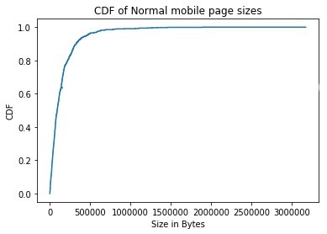
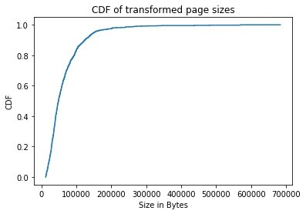
Page Size Comparison
The CDF plots clearly indicate that the page size of transformed pages is generally lesser than normal pages.

Slide 11
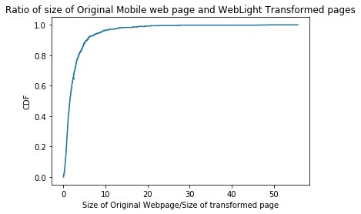
Ratio of Page Sizes
In the average case, the plot shows that there is a 2 to 3 times decrease in page size for transformed pages.

Slide 12
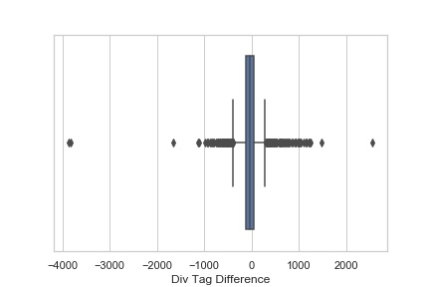
Difference of Division Tags
The division tags in the average case decrease in transformed pages due to decreased content. However, in some cases, the division tags may increase in transformed pages due to reformatting and embedded content.

Slide 13
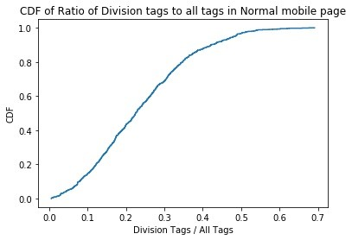
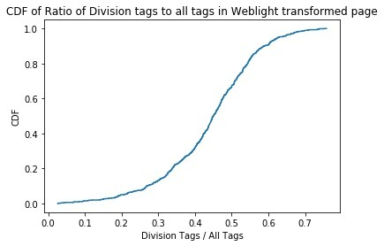
Ratio of Div Tags
The ratio of div tags to all tags in normal pages is smaller in number as compared to that of transformed pages in the average case. The increased ratio of div tags in transformed pages suggest the removal of other tags in the html document.

Slide 14
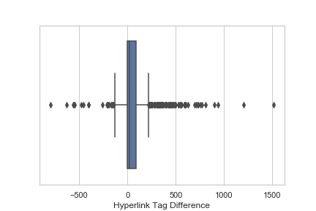
Difference of Hyperlink Tags
The hyperlink tags in the average case decrease in transformed pages due to decreased content and removal of advertisements and navigation bar. However, there are certain exceptions/outliers.

Slide 15
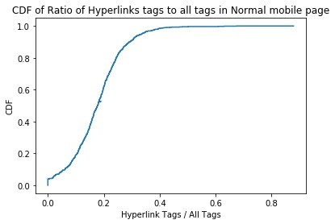
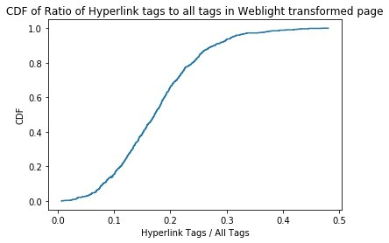
Ratio of Hyperlink Tags
The ratio of hyperlink tags to total tags in the page approximately displays the same trend for both the transformed and normal pages.

Slide 16
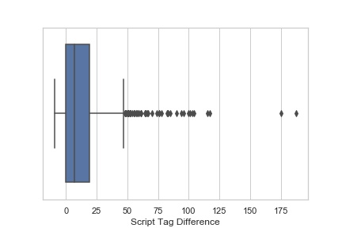
Difference of Script Tags
The script tags also usually reduce on average in transformed pages, however, the content within the script tags may change.

Slide 17
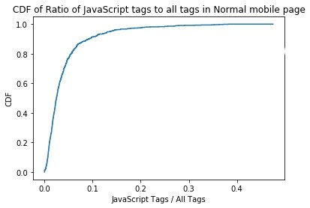
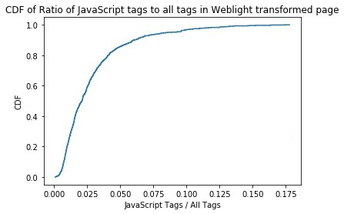
Ratio of Script Tags
The ratio of script tags to all tags usually decrease in WebLight transformed pages suggesting the removal of certain JavaScript content in the transformed pages.

Slide 18
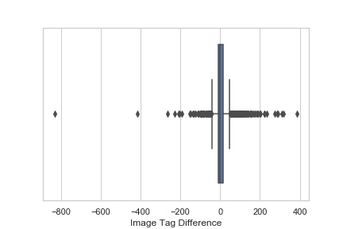
Difference of Image Tags
The image tags slightly decrease in transformed pages on average. However, one possible reason for increased image tags in some transformed pages is that images fetched from hyperlinks etc. are converted to img tags in transformed pages.

