Slide 1
Learning Google WebLight Transformations Using Machine Learning Techniques
Ammar Tahir
Muhammad Adil Inam

Slide 2
What is Google Web Light?
Faster, Lighter Pages to people searching on slow mobile clients.
Transcode web pages on the fly into an optimized version
Load pages faster while saving data
Major Transformations:
Removal of certain JavaScript (Animations, User Interaction etc. )
Removal of certain Page Content (Ads, Snack Bars, Top Banners etc.)
Reformatting of Data (Font Styles, CSS files changed)
Compression and Removal of Images

Slide 3

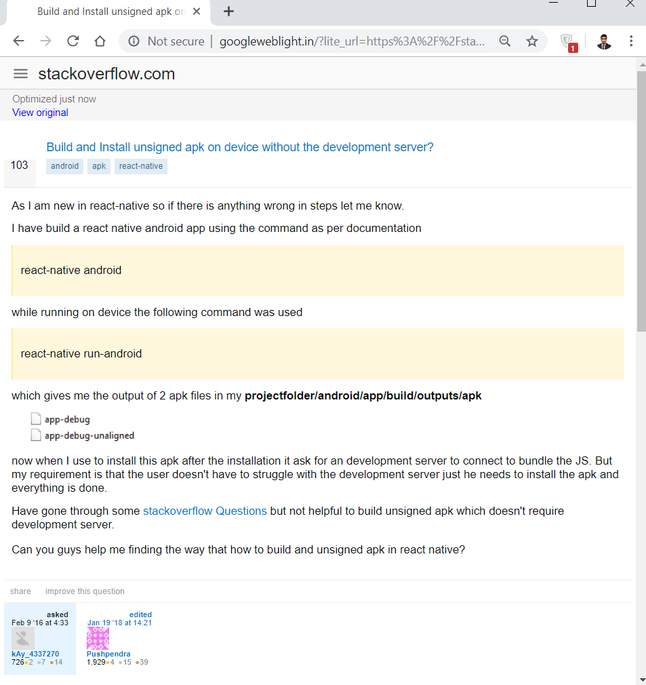
Visual Analysis
Actual Page
Transformed Page

Slide 4
Data Collection
Collected a dataset of around 2000 original and transformed pages
Several Techniques were tried: wget, appium, selenium etc.
Challenges of Pages not transformed, censorship and redirect issues
Wget used with certain header to collect transformed and original pages for both mobile and web
Iterative Data Cleaning and Collection
Non-Transformed pages collected as well

Slide 5
Two Types of Analysis
External Analysis of the Objects fetched
Comparison of origin and non-origin requests and servers in the transformed and non-transformed pages.
Comparison of the ratio of different kinds external objects (JS , CSS , HTML, Image) fetched in the transformed and non-transformed pages.
Internal Analysis of the underlying HTML
Parsing of both the transformed and non-transformed HTML pages
Comparison of different kind of HTML Tags (Image, Script, Division , Hyperlink) in transformed and non-transformed pages.

Slide 6
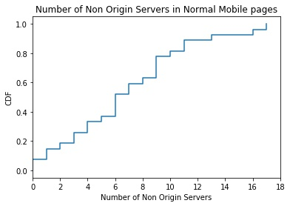
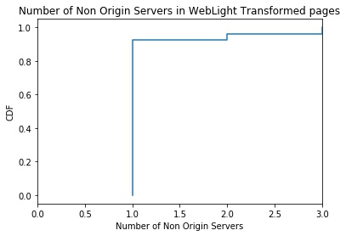
Non-Origin Servers Comparison
The number of non-origin servers are greater in number for non-transformed pages as compared to transformed pages.

Slide 7
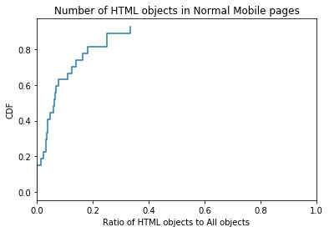
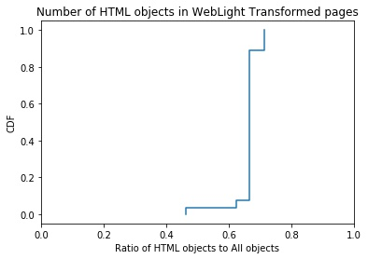
Ratio of HTML Objects
The ratio of html objects to total objects fetched is significantly higher in transformed pages as most of the external CSS and Js objects are embedded inside the html in transformed pages.

Slide 8
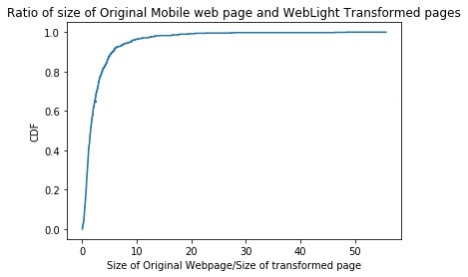
Ratio of Page Sizes
In the average case, the plot shows that there is a 2 to 3 times decrease in page size for transformed pages.

Slide 9
Tag Level Analysis
Ran script on our 1284 pages.
Distinct tags in Original page decreased from 150 to 25 in transformed
Some tags absent in transformed pages: p, link, noscript, h1, h2, h3…
Count of other tags changed drastically:
Div: 232k → 397k (increase)
Img 37k → 51k (increase)
ul 16k → 271 (decrease)
Script 20k → 12k (decrease)

Slide 10
Building a Machine Learning based model
Training a model that takes as input an HTML page and outputs a transformed page similar to what Web Light would do.
Challenges:
No related work
Not an easy problem to map directly to an already solved ML problem
Parsing issues
Coarse data

Slide 11
Some Approaches
Natural Language Processing:
Deciding on granularity of input
Difficulty in tokenizing
Model takes too long to train
Computer Vision problem:
Lesser features to learn
Interested in HTML transformations
Can be an extension to this project
Pattern Matching

Slide 12
Why Pattern Matching
To reduce complexity of problem
Text remains conserved on both pages
Tag level Analysis:
A huge number of tags cannot be mapped from original page to transformed page
Distinct tags in Original page decreased from 150 to 25 in transformed
Some tags absent in transformed pages: p, link, noscript, h1, h2, h3…
Count of other tags changed drastically

Slide 13
Collecting tag information
Text from page does not change a lot during transformation
What tags surround same text on both pages
Make mappings based on this comparison
Collecting tags: Hierarchical Tag parsing

Slide 14
Hierarchical Tag Parsing
HTML Code:
<html>
<head>
<title>
<img src="none.png">
<div>Test</div>
</title>
</head>'
<body>
<h1>Parse me!</h1>
</body>
</html>
Stack (top)

Slide 15
Hierarchical Tag Parsing
HTML Code:
<html>
<head>
<title>
<img src="none.png">
<div>Test</div>
</title>
</head>'
<body>
<h1>Parse me!</h1>
</body>
</html>
Stack (top)
html

Slide 16
Hierarchical Tag Parsing
HTML Code:
<html>
<head>
<title>
<img src="none.png">
<div>Test</div>
</title>
</head>'
<body>
<h1>Parse me!</h1>
</body>
</html>
Stack (top)
head
html

Slide 17
Hierarchical Tag Parsing
HTML Code:
<html>
<head>
<title>
<img src="none.png">
<div>Test</div>
</title>
</head>'
<body>
<h1>Parse me!</h1>
</body>
</html>
Stack (top)
title
head
html

Slide 18
Hierarchical Tag Parsing
HTML Code:
<html>
<head>
<title>
<img src="none.png">
<div>Test</div>
</title>
</head>'
<body>
<h1>Parse me!</h1>
</body>
</html>
Stack (top)
img
title
head
html

Slide 19
Hierarchical Tag Parsing
HTML Code:
<html>
<head>
<title>
<img src="none.png">
<div>Test</div>
</title>
</head>'
<body>
<h1>Parse me!</h1>
</body>
</html>
Stack (top)
div
img
title
head
html

Slide 20
Hierarchical Tag Parsing
HTML Code:
<html>
<head>
<title>
<img src="none.png">
<div>Test</div>
</title>
</head>'
<body>
<h1>Parse me!</h1>
</body>
</html>
Stack (top)
div
img
title
head
html
“Test” : [ html, head, title, img, div ]

Slide 21
Hierarchical Tag Parsing
HTML Code:
<html>
<head>
<title>
<img src="none.png">
<div>Test</div>
</title>
</head>'
<body>
<h1>Parse me!</h1>
</body>
</html>
Stack (top)
div
img
title
head
html

Slide 22
Hierarchical Tag Parsing
HTML Code:
<html>
<head>
<title>
<img src="none.png">
<div>Test</div>
</title>
</head>'
<body>
<h1>Parse me!</h1>
</body>
</html>
Stack (top)
img
title
head
html

Slide 23
Hierarchical Tag Parsing
HTML Code:
<html>
<head>
<title>
<img src="none.png">
<div>Test</div>
</title>
</head>'
<body>
<h1>Parse me!</h1>
</body>
</html>
Stack (top)
head
html

Slide 24
Hierarchical Tag Parsing
HTML Code:
<html>
<head>
<title>
<img src="none.png">
<div>Test</div>
</title>
</head>'
<body>
<h1>Parse me!</h1>
</body>
</html>
Stack (top)
body
html

Slide 25
Hierarchical Tag Parsing
HTML Code:
<html>
<head>
<title>
<img src="none.png">
<div>Test</div>
</title>
</head>'
<body>
<h1>Parse me!</h1>
</body>
</html>
Stack (top)
h1
body
html

Slide 26
Hierarchical Tag Parsing
HTML Code:
<html>
<head>
<title>
<img src="none.png">
<div>Test</div>
</title>
</head>'
<body>
<h1>Parse me!</h1>
</body>
</html>
Stack (top)
h1
body
html
“Parse me!” : [ html, body, h1 ]

Slide 27
Hierarchical Tag Parsing
HTML Code:
<html>
<head>
<title>
<img src="none.png">
<div>Test</div>
</title>
</head>'
<body>
<h1>Parse me!</h1>
</body>
</html>
Stack (top)
h1
body
html

Slide 28
Hierarchical Tag Parsing
HTML Code:
<html>
<head>
<title>
<img src="none.png">
<div>Test</div>
</title>
</head>'
<body>
<h1>Parse me!</h1>
</body>
</html>
Stack (top)
body
html

Slide 29
Hierarchical Tag Parsing
HTML Code:
<html>
<head>
<title>
<img src="none.png">
<div>Test</div>
</title>
</head>'
<body>
<h1>Parse me!</h1>
</body>
</html>
Stack (top)
html

Slide 30
Hierarchical Tag Parsing
HTML Code:
<html>
<head>
<title>
<img src="none.png">
<div>Test</div>
</title>
</head>'
<body>
<h1>Parse me!</h1>
</body>
</html>
Stack (top)
“Test” : [ html, head, title, img, div ]
“Parse me!” : [ html, body, h1 ]

Slide 31
Hierarchical Tag Parsing
Original Page:
“Test” : html, head, title, img, div
“Parse me!”: html, body, h1
Transformed Page:
“Test\n” : html, head, div, img, div
“Parse me”: html, body, div, div
HTML Code:
<html>
<head>
<title>
<img src="none.png">
<div>Test</div>
</title>
</head>'
<body>
<h1>Parse me!</h1>
</body>
</html>
Stack (top)

Slide 32
Hierarchical Tag Parsing
Original Page:
“Test” : html, head, title, img, div
“Parse me!”: html, body, h1
Transformed Page:
“Test\n” : html, head, div, img, div
“Parse me”: html, body, div, div
HTML Code:
<html>
<head>
<title>
<img src="none.png">
<div>Test</div>
</title>
</head>'
<body>
<h1>Parse me!</h1>
</body>
</html>
Stack (top)
String
Matching

Slide 33
Hierarchical Tag Parsing
Original Page:
“Test” : html, head, title, img, div
“Parse me!”: html, body, h1
Transformed Page:
“Test\n” : html, head, div, img, div
“Parse me”: html, body, div, div
HTML Code:
<html>
<head>
<title>
<img src="none.png">
<div>Test</div>
</title>
</head>'
<body>
<h1>Parse me!</h1>
</body>
</html>
Stack (top)
String
Matching
“html head title img div” : “html head div img div”
“html body h1” : “html body div div”
(~15k such datapoints)

Slide 34
Choice of Model
After having extracted tag sequences, we mapped problem to Machine Translation problem.
We chose Encoder-Decoder model because of its ability to perform well on sequences of variable length.

Slide 35
Model Specifications
Encoder-Decoder NMT model
Batch size = 512
Epochs = 30
Validation split = 0.2
Accuracy = 92%

Slide 36
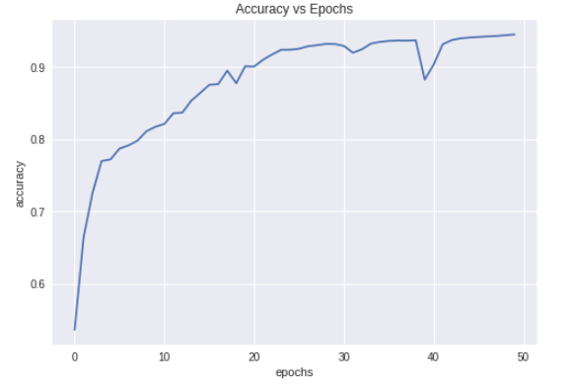
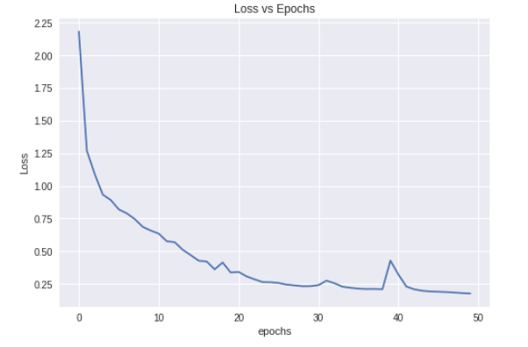
Accuracy and Loss

Slide 37
From tag Sequences to HTML page
Creation of m-ary tree from each sequence
Step by step merging of all m-ary trees to get one m-ary tree
Tree traversal to retrieve HTML page

Slide 38


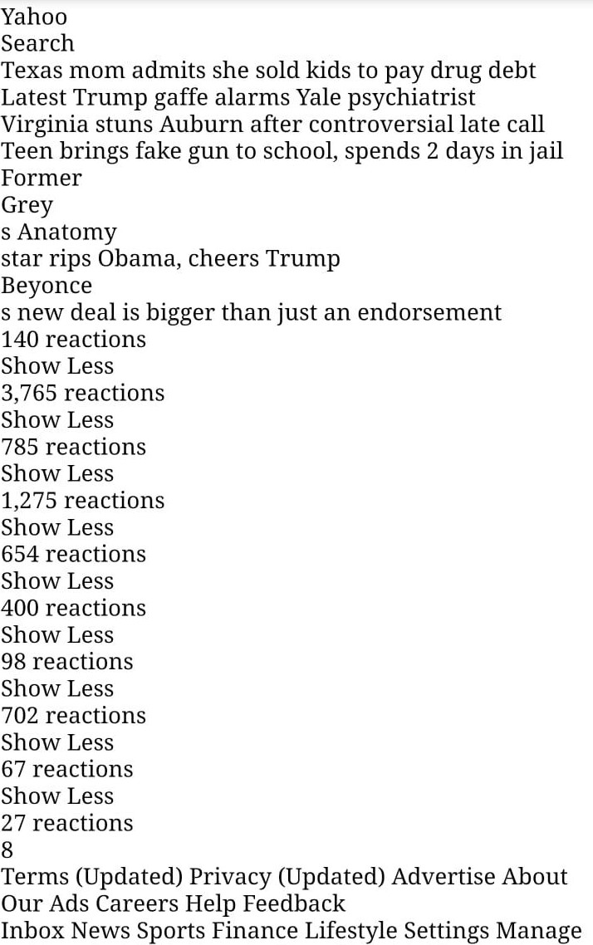
A prediction from model
Actual Web Page
WebLight transformed Web page
Web page predicted via our model

Slide 39
Next Step
Improving this model by incorporating attributes of tags as well
Handling absence and addition of content
Improving by considering images, style and scripts

Slide 40
Thank you!

