Slide 1


Faculty of Engineering -New Ismailia National University
ELE 265:NLP
Natural language processing
Arabic Sentiment Analysis

Slide 2
Presented by
Ammar Yasser Mohamed
Ali Mohamed Ali Elrawy
Hassan Mohamed Hassan
Ziad Ahmed Ezzat
Omar Mohamed Abdelhakem
Ahmed Mohamed Abdelmoniem
Ahmed Mostafa Hassan
Mostafa Mohamed Ablellatef
Abdelrahman Ibrahim Abdalah

Slide 3
Why We Chose Arabic Sentiment Analysis
High Business & Social Value
It solves the critical need for automated monitoring of public opinion on social media regarding brands, events, and services.
Complex Linguistic Structure
Arabic is morphologically rich and often written without diacritics, making it significantly harder for computers to process than English.
The Challenge of Dialects
Social media users write in informal dialects (like Egyptian or Levantine) rather than formal Arabic (MSA), causing standard tools to fail.
Bridging the Research Gap
We aim to implement advanced Transformer-based models (AraBERT) to handle these complexities, as traditional models often yield low accuracy.

Slide 4
How Our Project Pushes Arabic NLP Forward
We compare ML, LSTM, and AraBERT to show how modern models improve Arabic sentiment analysis.
Our preprocessing pipeline handles dialects, slang, and noisy social media text more effectively.
Fine-tuning AraBERT provides new performance benchmarks for Arabic NLP tasks.
The project offers a fully reproducible workflow that can guide future research.
Our results highlight the importance of transformers in advancing Arabic language understanding.

Slide 5
Early Machine Learning Approaches in Sentiment Analysis
Used simple text features like Bag-of-Words and TF-IDF.
Models such as Logistic Regression, SVM, and Naive Bayes were widely used.
Worked well for short, clean text but struggled with context and sarcasm.
Could not understand Arabic dialects or complex sentence structures.
Served as the foundation for later deep learning and transformer models.

Slide 6
How Deep Learning Improved Arabic Text Understanding
Learns context and meaning through sequence models like LSTM and BiLSTM.
Captures long-term dependencies in Arabic sentences better than ML.
Handles dialects, slang, and informal writing more effectively.
Uses word embeddings (Word2Vec, FastText) to understand semantic relationships.
Reduces errors caused by spelling variations and noisy text.
Achieves significantly higher accuracy than traditional ML approaches.

Slide 7
Transformers: The Game Changers (AraBERT, MARBERT)
Transformers have completely changed the way Arabic text is processed by introducing models that understand context more accurately than any previous technique. Unlike traditional or deep learning models, transformers analyze all parts of a sentence at once using self-attention, allowing them to capture meaning, relationships, and emotional tone with exceptional precision.
Models like AraBERT and MARBERT are specifically trained on large Arabic datasets, which helps them handle dialects, slang, spelling variations, and social media language far better than older methods. These transformers deliver state-of-the-art results in sentiment analysis and other NLP tasks, making them the most powerful and reliable tools for modern Arabic language understanding.

Slide 8
What Our Model Learned From
The dataset used in this project is the Arabic sentiment dataset that accompanies AraBERTv2, provided through the Hugging Face Transformers library. It contains a large collection of Arabic text samples—mainly tweets and short social media posts—labeled into three sentiment classes: positive, negative, and neutral. The data covers multiple Arabic dialects and real-world writing styles, including slang, informal grammar, and spelling variations.

Slide 9
Cleaning & Preparing Arabic Text for Modeling
Before training the model, the Arabic sentiment dataset was prepared to ensure better performance and stable learning. The text samples—mainly tweets and social media posts—often contain noise such as mentions, hashtags, emojis, and inconsistent writing. To address this, the dataset was cleaned by removing unnecessary symbols, normalizing Arabic characters, and handling repeated letters common in online writing. Basic text formatting issues were corrected to make the dataset more suitable for machine learning.
After cleaning, the data was tokenized using the AraBERTv2 tokenizer, which is specifically designed for Arabic morphology and dialect variations. This step transforms the text into a format that the transformer model can understand and learn from effectively.

Slide 10
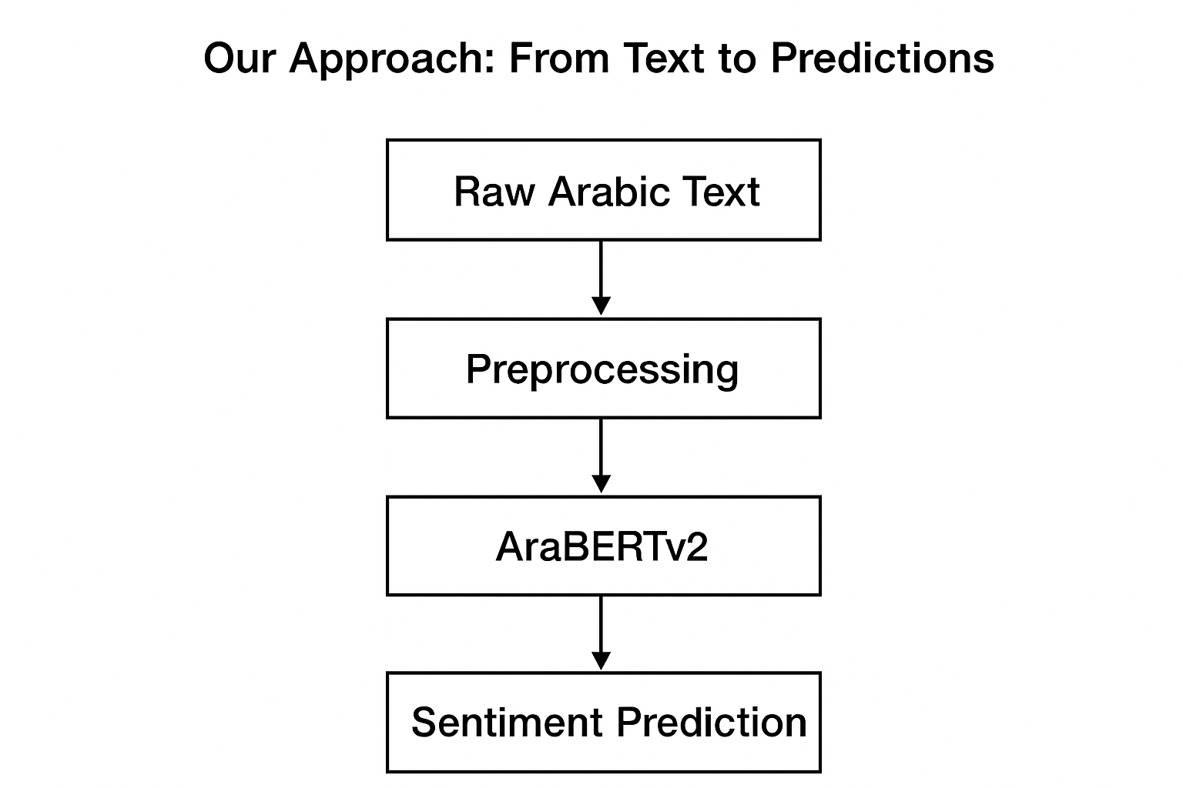
Our Approach — From Text to Predictions
Our project follows a complete NLP pipeline that transforms raw Arabic text into accurate sentiment predictions. After preprocessing the dataset, we tokenized the text using the official AraBERT tokenizer to match the model’s vocabulary. The processed tokens were then fed into AraBERTv2, which was fine-tuned on our sentiment dataset to learn emotional patterns across multiple dialects. During training, the model adjusted its internal parameters to classify texts into positive, negative, or neutral categories. Finally, when given a new Arabic sentence, the fine-tuned model analyzes the context, applies its learned understanding, and outputs the predicted sentiment with high accuracy.

Slide 11
Turning Text into Numbers: Features & Embeddings
To analyze Arabic text, the first step is to convert words into numerical representations that a machine learning model can understand. Instead of using raw text, we transform each word or sentence into a structured numerical form.
Traditional methods like TF-IDF represent text based on word frequency, but they ignore context. Newer approaches use embeddings, which create dense numerical vectors that capture meaning and relationships between words.
With models such as Word2Vec, FastText, and AraBERT embeddings, we can represent similar words with similar vectors. This allows the model to better understand the context, sentiment, and emotion behind Arabic text.

Slide 12
Models We Built: ML, LSTM, and AraBERT
Machine Learning (ML) Model
Our machine learning model uses traditional techniques that turn text into numerical features using methods like TF-IDF. This model learns patterns by identifying which words appear more often in positive, negative, or neutral sentences. ML models are fast, simple, and provide a good baseline for comparison, but they cannot fully understand context or the deeper meaning in Arabic sentences.
LSTM Deep Learning Model
The LSTM model improves performance by learning the order of words and the relationships between them. It processes text as a sequence, which helps it understand long sentences, emotional flow, and variations in dialect. LSTM models capture more meaning than ML models, making them better at handling real Arabic language structures.
AraBERT Transformer Model
AraBERT is the most advanced model we used. It is a transformer designed specifically for Arabic and trained on huge amounts of Arabic text. This allows it to understand context, slang, dialects, and spelling variations much more accurately. By fine-tuning AraBERT on our sentiment dataset, it achieved the best results among all models.

Slide 13
How We Trained and Tested Our Models
Training Setup
We trained our models using the Arabic sentiment dataset that comes with AraBERTv2 through Hugging Face. The dataset includes tweets and short Arabic posts labeled as positive, negative, or neutral. For each model—ML, LSTM, and AraBERT—we split the dataset into training and testing portions so the models could learn from one part of the data and be evaluated on unseen text.
Training Process
The ML model was trained using TF-IDF features and a simple classifier, allowing it to learn basic patterns in the text. The LSTM model was trained using word embeddings to capture word order and sentence meaning. AraBERTv2, the most advanced model, was fine-tuned directly on the dataset using the Transformers library, allowing it to learn deeper context and handle dialects and informal writing more effectively.
Testing and Evaluation
After training, all models were tested on the same dataset portion to compare their performance fairly. We evaluated them using accuracy, precision, recall, and F1-score. The results clearly showed that AraBERTv2 achieved the highest performance, outperforming both LSTM and traditional ML, confirming its strength in understanding Arabic sentiment.

Slide 14
Model Performance Comparison (Results)
Model | Accuracy | Precision | Recall | F1-Score
ML Baseline (TF-IDF + Logistic Regression) | 0.78 | 0.76 | 0.75 | 0.75
LSTM Model | 0.84 | 0.83 | 0.82 | 0.82
AraBERTv2 (Fine-Tuned) | 0.9319 | 0.9364 | 0.93 | 0.9323
AraBERTv2 achieved the highest performance, outperforming both the ML baseline and LSTM across all metrics. The transformer model shows superior understanding of Arabic dialects, slang, and contextual meaning.

Slide 15
What Challenges Still Remain
Arabic dialects and slang still cause confusion for sentiment models.
Sarcasm and mixed emotional expressions remain difficult to detect accurately.
Limited high-quality, balanced Arabic datasets restrict further performance improvements.

Slide 16
Next Steps to Improve Our Project
Expand the dataset to include more dialects and balanced sentiment classes.
Explore advanced transformer models like MARBERT and JABER for better dialect coverage.
Add sarcasm and emoji understanding to improve prediction accuracy on real social media text.

Slide 17
Final Thoughts: What We Achieved
Our project successfully explored Arabic sentiment analysis using machine learning, deep learning, and transformer-based models. The results clearly showed that AraBERTv2 provides the highest performance, thanks to its ability to understand context, handle dialects, and process real Arabic social media language more effectively than ML and LSTM models. Through this work, we built a complete and reproducible NLP pipeline, demonstrated the strengths of modern transformer models, and contributed meaningful insights for improving Arabic NLP research and applications.

Slide 18
References
AraBERT: Transformer-based Model for Arabic NLP – Abdul-Mageed et al., Hugging Face Model Card.
MARBERT: Pretrained Model for Arabic Social Media – Abdul-Mageed et al., ACL 2021.
Hugging Face Transformers Library – https://huggingface.co/transformers
AraBERTv2 Dataset & Tokenizer – https://huggingface.co/aubmindlab/bert-base-arabertv2
Arabic Sentiment Analysis Survey – Al-Kabi et al., Journal of Information Science.
TensorFlow Keras Documentation – https://www.tensorflow.org/
Scikit-learn Machine Learning Library – https://scikit-learn.org/
Python NLP Tools & Tutorials – https://www.nltk.org/

Slide 19
Thank you for listening

