Slide 1
Data Structures and Algorithms (AT70.02)
Comp. Sc. and Inf. Mgmt.
Asian Institute of Technology
Instructor: Prof. Sumanta Guha
Slide Sources: CLRS “Intro. To Algorithms” book website
(copyright McGraw Hill)
adapted and supplemented

Slide 2
CLRS “Intro. To Algorithms”
Ch. 30: Polynomials and the FFT

Slide 3
A degree-bound of a polynomial is any integer n > its degree.
A coefficient representation of a polynomial of degree-bound n:
A(x) = Σ_{j=0..n-1} a_{j} x^{j}
A point-value representation of a polynomial of degree bound n:
{(x₀, y₀), (x₁, y₁), …, (x_{n-1}, y_{n-1})}
where x_{i} are distinct and y_{i} = A(x_{i})
Ex : Write 2x³ + 4x² – x + 7 in a point-value form.
Finding a point-value rep from a coefficient rep is called evaluation. Evaluation can be done in O(n²) time using Horner’s rule:
A(x) = Σ_{j=0..n-1} a_{j} x^{j =} a₀ + x(a₁ + x(a₂ + … + (a_{n-2} + xa_{n-1}))…)
Finding a coefficient rep from a point-value rep is called interpolation. Interpolation can be done in O(n²) time using Lagrange’s formula:
A(x) =Σ_{k=0..n-1} y_{k} Π_{j≠k} (x – x_{j}) / Π_{j≠k} (x_{k} – x_{j})
Ex : Given the point-value rep {(1, 3), (2, -1), (3, 7), (4, 0)} find a coefficient rep.

Slide 4
Point-value reps are efficient for certain operations on polynomials, e.g., addition, multiplication can be done in O(n) time in point-value rep.
If point-value rep of A is {(x₀, y₀), (x₁, y₁), …, (x_{n-1}, y_{n-1})}
and point-value rep of B is {(x₀, y’₀), (x₁, y’₁), …, (x_{n-1}, y’_{n-1})},
then point-value rep of the sum polynomial A+B is
{(x₀, y₀ + y’₀), (x₁, y₁ + y’₁), …, (x_{n-1}, y_{n-1} + y’_{n-1})}
For multiplication of polynomials we must use an extended point-value rep because the degree-bound of the product is the sum of the degree-bounds of the multiplicands.
E.g., if the degree-bounds of both A and B are n then the degree-bound of A*B is 2n, so that 2n point-value pairs are needed to determine A*B.
Therefore, the standard point-value reps {(x₀, y₀), (x₁, y₁), …, (x_{n-1}, y_{n-1})} for A and {(x₀, y’₀), (x₁, y’₁), …, (x_{n-1}, y’_{n-1})} for B are not “enough” as multiplying will give only n point-value pairs for A*B.

Slide 5
Instead, we must evaluate both A and B at 2n points to write the
extended point-value rep of
A as {(x₀, y₀), (x₁, y₁), …, (x_{2n-1}, y_{2n-1})}
and the extended point-value rep of
B as {(x₀, y’₀), (x₁, y’₁), …, (x_{2n-1}, y’_{2n-1})},
so that the point-value rep of the product polynomial
A*B is {(x₀, y₀y’₀), (x₁, y₁y’₁), …, (x_{2n-1}, y_{2n-1}y’_{2n-1})}.
Multiplication in coefficient rep is more difficult. If
A(x) = Σ_{j=0..n-1} a_{j} x^{j} and B(x) = Σ_{j=0..n-1} b_{j} x^{j} then the product
C(x) = Σ_{j=0..2n-2} c_{j} x^{j} , where c_{j} = Σ_{k=0..j} a_{k}b_{j-k}.
The vector c is called the convolution of the vectors a and b, and denoted c = a ⊗ b.
The standard method of multiplication in coefficient rep takes O(n²) time.

Slide 6
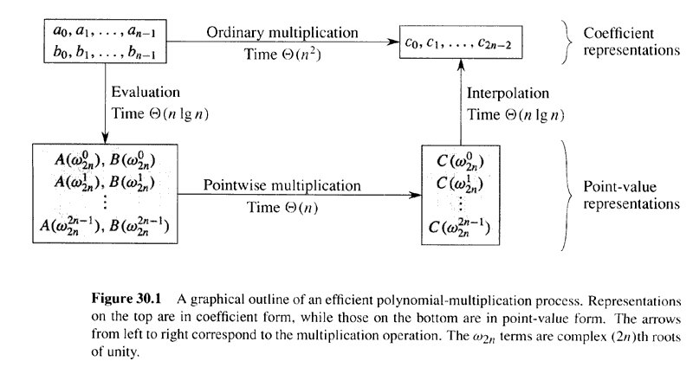
Strategy for fast multiplication of polynomials given coefficient reps
(faster than Horner’s method !)
(faster than Lagrange’s formula !)

Slide 7
Complex Arithmetic
Complex n th root of unity is a complex number ω such that
ω^{n} = 1.
Note, e^{iu} = cos u + i sin u.
Therefore, e^{2πi} = 1 ⇒ ω_{n} = e^{2πi/n} is a complex n th of unity. ω_{n} is called the principal n th root of unity.
There are exactly n different n th roots of unity:
1 = ω_{n}⁰, ω_{n} = ω_{n}¹, ω_{n}², …, ω_{n}^{n-1}, i.e., e^{2kπi/n}, where k = 0, …,n-1.
Ques: What are the cube roots of unity? Fourth roots?

Slide 8
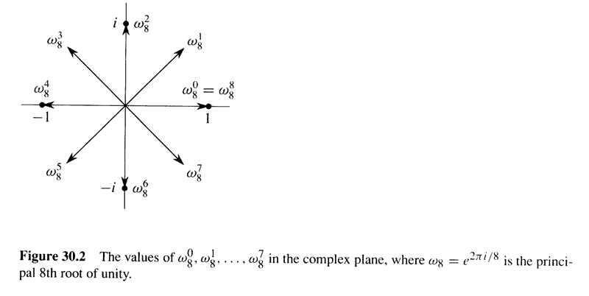
1

Slide 9
Complex Arithmetic
Cancellation Lemma:
For any integers n ≥ 0, k ≥ 0, and d > 0,
ω_{dn}^{dk} = ω_{n}^{k}
Halving Lemma:
If n > 0 is even, then the squares of the n complex n th roots of unity are the n/2 complex n/2 th roots of unity (each counted twice).
Summation Lemma:
For any integer n ≥ 1 and non-zero integer k not divisible by n,
Σ_{j=0..n-1} (ω_{n}^{k} )^{j} = 0
Proofs: …

Slide 10
DFT
To implement the strategy for fast multiplication we want to evaluate A(x) = Σ_{j=0..n-1} a_{j} x^{j} at ω_{n}⁰, ω_{n}¹, … , ω_{n}^{n-1} (the n complex n th roots of unity).
Assume that n is a power of 2 (we can always pad A(x) with zero coefficients to reach the next power of 2).
The result of the evaluation is
y_{k} = A(ω_{n}^{k}) = Σ_{j=0..n-1} a_{j} ω_{n}^{kj} , for k =0, 1, …, n-1.
The vector y = (y₀, y₁, …, y_{n-1}) is called the Discrete Fourier Transform (DFT) of the coefficient vector a = (a₀, a₁, …, a_{n-1}). We also write y = DFT_{n}(a).
The plan is to use a divide-and-conquer strategy, called Fast Fourier Transform (FFT), to compute DFT_{n} in O(nlog n) time.
The FFT will take advantage of special properties of the complex roots of unity.

Slide 11
FFT
A(x) = a₀ + a₁x + … a_{n-1}x^{n-1} (assume n is a power of 2)
Separately use the even-indexed and odd-indexed coefficients of A to define two new polynomials of half the degree-bound:
A^{[0]}(x) = a₀ + a₂x + a₄x² +… a_{n-2}x^{n/2-1}, and
A^{[1]}(x) = a₁ + a₃x + a₅x² +… a_{n-1}x^{n/2-1}
Now, A(x) = A^{[0]}(x²) + xA^{[1]}(x²)
Therefore, evaluating A(x) at ω_{n}⁰, ω_{n}¹, …, ω_{n}^{n-1} reduces to evaluating A^{[0]}(x) and A^{[1]}(x) at (ω_{n}⁰)², (ω_{n}¹)², …, (ω_{n}^{n-1})² and combining the results according to the preceding equation.
By the halving lemma, (ω_{n}⁰)², (ω_{n}¹)², …, (ω_{n}^{n-1})² consists of the n/2 complex n/2 th roots of unity (each counted twice). Therefore, evaluating the polynomial A(x) at the n complex n th roots of unity (i.e., DFT_{n}) has been reduced to evaluating two polynomials at the n/2 complex n/2 th roots of unity (i.e., two instances of DFT_{n/2}). Divide-and-conquer ! ⇒ Recursion !

Slide 12
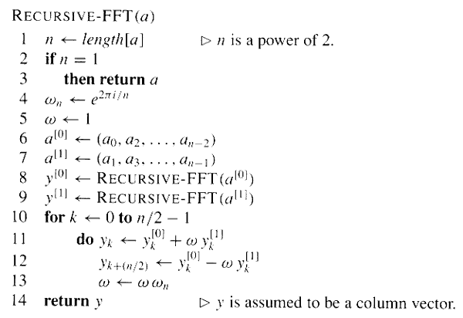
Time recurrence: T(n) = 2T(n/2) + Θ(n) ⇒ Time complexity: Θ(n log n) !

Slide 13
FFT Example
See FFTexample.pdf
Exercise: Use RECURSIVE-FFT to find DFT(2, 1, -1, 1)*.
*Answer: DFT(2, 1, -1, 1) = (3, 3, -1, 3)

Slide 14
Interpolation (inverse DFT) using FFT
Because DFT_{n} (a₀, a₁, …, a_{n-1}) = (y₀, y₁, …, y_{n-1}), where
y_{k} = A(ω_{n}^{k}) = Σ_{j=0..n-1} a_{j} ω_{n}^{kj} , we can write it as the matrix product y = DFT_{n} (a) = V_{n}a, where V_{n} is called the Vandermonde matrix :
y₀ 1 1 1 1 … 1 a₀
y₁ 1 ω_{n} ω_{n}² ω_{n}³ … ω_{n}^{n-1} a₁
y₂ 1 ω_{n}² ω_{n}⁴ ω_{n}⁶ … ω_{n}^{2(n-1)} a₂
y₃ 1 ω_{n}³ ω_{n}⁶ ω_{n}⁹ … ω_{n}^{3(n-1)} a₃
.
.
.
y_{n-1} 1 ω_{n}^{n-1} ω_{n}^{2(n-1)} ω_{n}^{3(n-1)} … ω_{n}^{(n-1)(n-1)} a_{n-1}
where the (j, k)th entry of V_{n} is ω_{n}^{jk} , for j, k = 0, 1, …, n – 1.
V_{n}
=

Slide 15
Inverse Vandermonde
Interpolation requires the inverse operation DFT_{n}⁻¹, viz.,
a = DFT_{n}⁻¹(y) = V_{n}⁻¹ y. The entries of the inverse of the
Vandermonde matrix are given by:
Theorem 30.7
For j, k = 0, 1, …, n-1, the (j, k)th entry of V_{n}⁻¹ is ω_{n}^{-jk} / n.
Proof: Must show that V_{n}⁻¹ V_{n} = I_{n} (the n x n identity matrix). Use
the Summation Lemma (complete yourself!).

Slide 16
Inverse Vandermonde
V_{n}⁻¹
a₀ 1 1 1 1 … 1 y₀
a₁ 1 ω_{n}⁻¹ ω_{n}⁻² ω_{n}⁻³ … ω_{n}^{-(n-1)} y₁
a₂ 1 ω_{n}⁻² ω_{n}⁻⁴ ω_{n}⁻⁶ … ω_{n}^{-2(n-1)} y₂
a₃ = V_{n}⁻¹y = 1/n 1 ω_{n}⁻³ ω_{n}⁻⁶ ω_{n}⁻⁹ … ω_{n}^{-3(n-1)} y₃
… … … …
a_{n-1} 1 ω_{n}^{-(n-1)} ω_{n}^{-2(n-1)} ω_{n}^{-3(n-1)} … ω_{n}^{-(n-1)(n-1)} y_{n-1}
where the (j, k)th entry of V_{n}⁻¹ is ω_{n}^{-jk} / n,
for j, k = 0, 1, …, n – 1.

Slide 17
From a = DFT_{n}⁻¹(y) = V_{n}⁻¹y we have
a_{j} = 1/n Σ_{k=0..n-1} y_{k}ω_{n}^{-jk} , for j = 0, 1, …, n-1
Compare this with the DFT operation y = DFT_{n}(a) = V_{n}a, where
y_{j} = Σ_{k=0..n-1} a_{k} ω_{n}^{jk} , for j = 0, 1, …, n-1
We see that DFT_{n}⁻¹ can be computed by modifying FFT to
Switch a and y
Replace ω_{n} by ω_{n}⁻¹
Divide each element of the result by n.

Slide 18
INVERSE-FFT-SUB
y
y
y
–1
–2πi /n
y^{[0]} ← (y₀, y₂, …, y_{n – 2})
y^{[1]} ← (y₁, y₃, …, y_{n – 1})
INVERSE-FFT-SUB
a
y
INVERSE-FFT-SUB
a
y
a
a
a
a
a
a
–1
a
a
INVERSE-FFT(y) return INVERSE-FFT-SUB(y) / n

Slide 19
INVERSE-FFT Example
Compute DFT⁻¹(3, 3, -1,3) using INVERSE-FFT (see FFT exercise)
First run INVERSE-FFT-SUB(3, 3, -1,3):
n = 4
ω₄⁻¹ = 1/i = -i
ω = 1
y^{[0]} = (3, -1)
y^{[1]} = (3, 3)
a^{[0]} = I-F-S(3, -1) = (2, 4) (see next slide)
a^{[1]} = I-F-S(3, 3) = (6, 0) (see next slide)
for k = 0:
a₀ = a₀^{[0]} + ωa₀^{[1]} = 2 + 6 = 8
a₂ = a₀^{[0]} – ωa₀^{[1]} = 2 – 6 = -4
for k = 1:
ω = ω ω₄⁻¹ = -i
a₁ = a₁^{[0]} – ia₁^{[1]} = 4 – 0 = 4
a₃ = a₁^{[0]} + ia₁^{[1]} = 4 + 0 = 4
So, I-F-S(3, 3, -1, 3) = (8, 4, -4, 4) → DFT⁻¹(3, 3, -1,3) =
INVERSE-FFT(3, 3, -1, 3) = I-F-S(3, 3, -1, 3) / 4 = (2, 1, -1, 1)

Slide 20
INVERSE-FFT Example cont.
Calculate I-F-S(3, -1):
n = 2
ω₂⁻¹ = 1/-1 = -1
ω = 1
y^{[0]} = (3)
y^{[1]} = (-1)
a^{[0]} = I-F-S(3) = (3) (as base case)
a^{[1]} = I-F-S(-1) = (-1) (as base case)
for k = 0:
a₀ = a₀^{[0]} + ωa₀^{[1]} = 3 + (-1) = 2
a₁ = a₀^{[0]} – ωa₀^{[1]} = 3 – (-1) = 4
So, I-F-S(3, -1) = (2, 4)
Calculate yourself I-F-S(3, 3).
Answer: I-F-S(3, 3) = (6, 0).
Note when calculating INVERSE-FFT-SUB, that the recursive calls on lines 8 and 9 are to INVERSE-FFT-SUB, not INVERSE-FFT!

Slide 21
Since DFT_{n} can be implemented using the FFT in Θ(n log n) time, and DFT_{n}⁻¹ can be implemented using the inverse FFT in Θ(n log n) time as well, our strategy for fast multiplication of polynomials is complete.
In many practical applications, e.g., signal processing, the convolution operation is important. Because of the following theorem we see that convolution takes time Θ(n log n) too.
Theorem 30.8 (Convolution Theorem)
For any two vectors a and b of length n, where n is a power of 2,
a ⊗ b = DFT_{2n}⁻¹( DFT_{2n}(a) ⋅ DFT_{2n}(b) )
where the vectors a and b are padded with 0’s to length 2n and
⋅ denotes the component-wise product of two 2n-element vectors.
Proof: Convolution of two vectors = multiplication of polynomials with these two vectors as coefficient vectors…

Slide 22
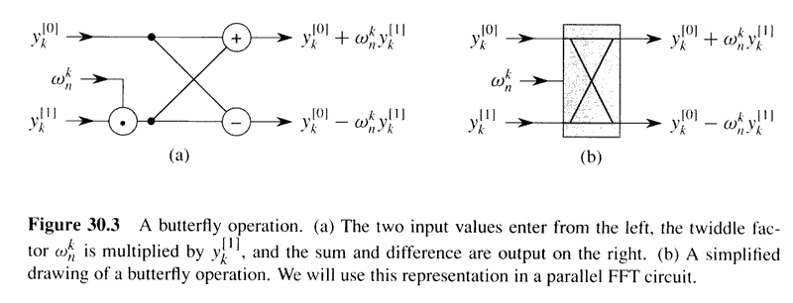
Making the FFT faster
Common subexpression
Twiddle factor

Slide 23
for k ← 0 to n /2 – 1
do t ← ωy_{k}^{[1]}
y_{k} ← y_{k}^{[0]} + t
y_{k+(n/2)} ← y_{k}^{[0]} – t
ω ← ωω_{n}
replace!

Slide 24
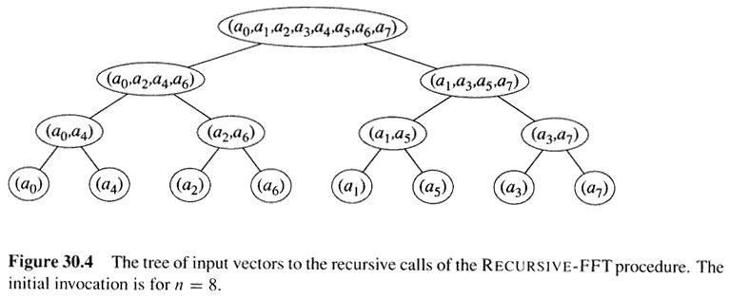
From Recursion to Iteration
0
1
2
3
4
5
6
7
Array A
for s ← 1 to lg n
do for k ← 0 to n – 1 by 2^{s}
do combine the two 2^{s-1}-element DFTs in
A[k .. k + 2^{s-1} – 1] and A[k + 2^{s-1} .. k + 2^{s} – 1]
into one 2^{s}-element DFT in A[k .. k + 2^{s} – 1]

Slide 25
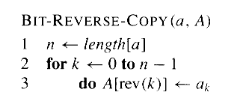
A
Element
index
000 100 010 110 001 101 011 111
Array
position
000
001
010
011
100
101
110
111
The position of element a_{i} in the array A is given by the reversal of the bits of i.
Therefore, the array is initialized by the following:

Slide 26
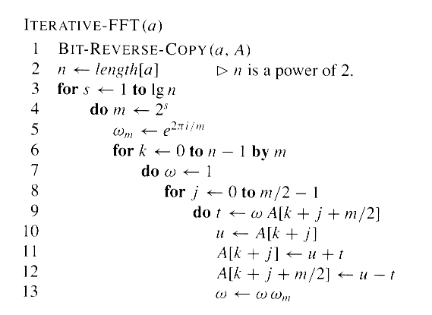
for k ← 0 to n /2 – 1
do t ← ωy_{k}^{[1]}
y_{k} ← y_{k}^{[0]} + t
y_{k+(n/2)} ← y_{k}^{[0]} – t
ω ← ωω_{n}
compare!

Slide 27
Problems
Ex. 30.1-5
Ex. 30.2-4
Ex. 30.2-2
Ex. 30.3-1
Prob. 30-4

