Slide 1
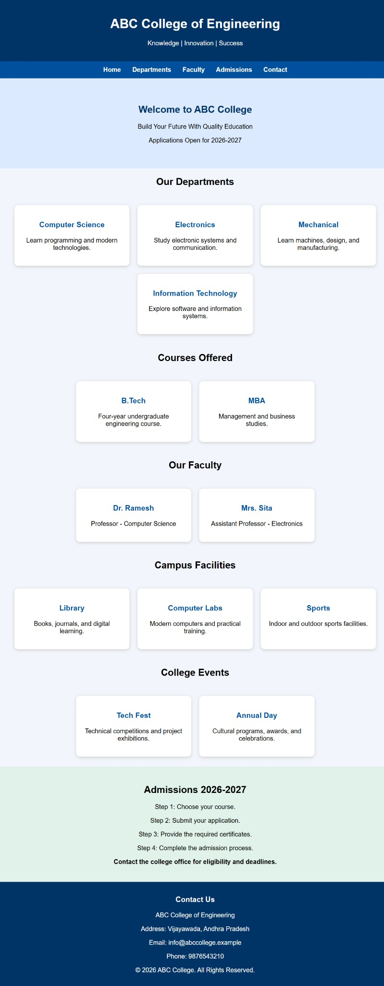
WEB DEVELOPMENT CASE STUDIES
Case Study 2: College Information and Admission Website
Student :A . kowshikvarma Roll Number: 26001440
Branch: CSD Section: 2
This website provides students and parents with essential college information in one place. It introduces departments, courses, faculty, campus facilities, events, and the admission process.
Main Features
Departments and courses: presents options such as Computer Science, Electronics, Mechanical Engineering, Information Technology, B.Tech, and MBA.
Faculty and facilities: shares faculty details and highlights the library, computer labs, and sports facilities.
Admissions and contact: explains application steps for 2026–2027 and provides college contact details.
Purpose: To help prospective students explore programs and understand how to apply.
Figure 1: Website screenshot.

Slide 2
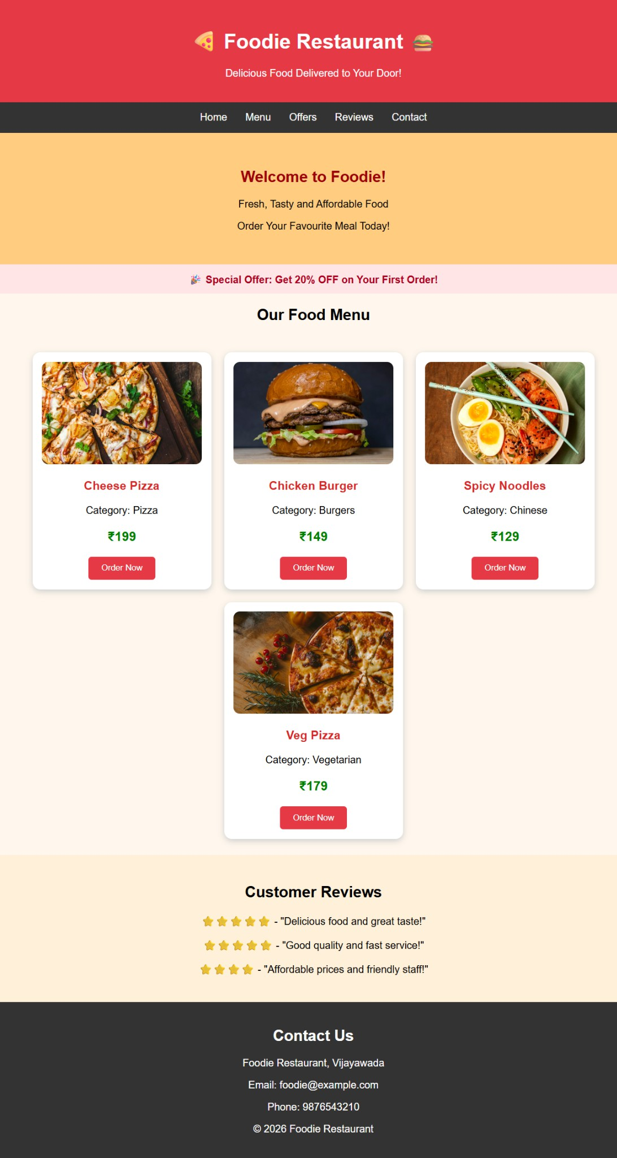
Case Study 8: Online Food Ordering Website
This website allows customers to browse a restaurant menu and compare dishes, categories, and prices. Food images and product cards make choices easy to understand.
Main Features
Food menu: displays cheese pizza, chicken burger, spicy noodles, and vegetarian pizza with images and prices.
Offers and reviews: highlights a first-order discount and shows customer feedback.
Ordering and contact: includes Order Now buttons, navigation links, and restaurant contact details.
Purpose: To present an attractive online menu and help customers start an order.
Figure 2: Website screenshot.

Slide 3
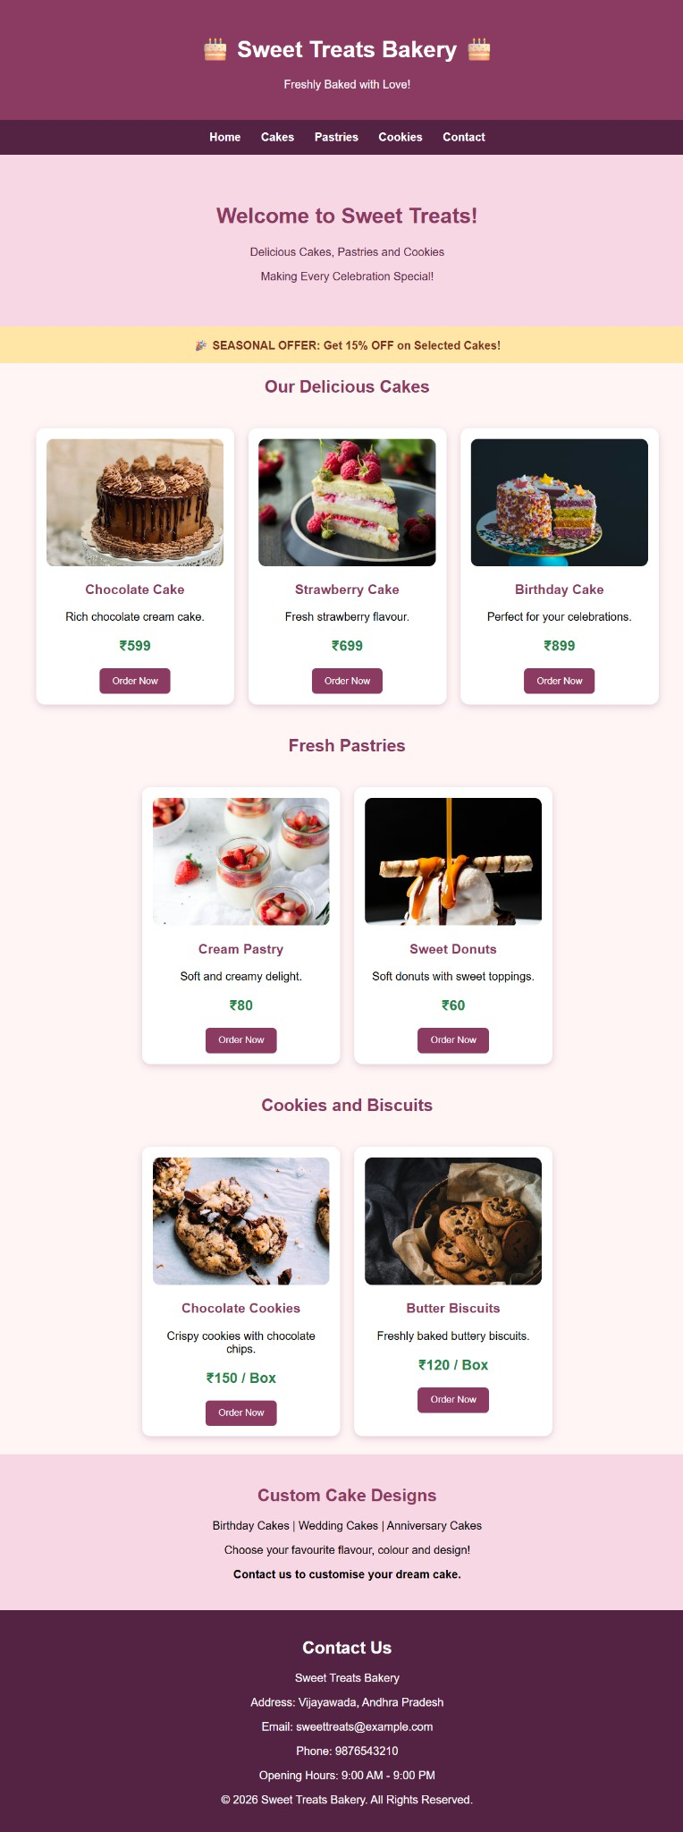
Case Study 9: Bakery and Cake Shop Website
This website showcases cakes, pastries, cookies, and biscuits. Product photos, descriptions, and prices help customers find treats for everyday use and special occasions.
Main Features
Product categories: separates cakes, pastries, and cookies or biscuits for easy browsing.
Prices and promotions: lists product prices and a seasonal offer on selected cakes.
Custom cakes and contact: promotes birthday, wedding, and anniversary designs and gives contact details and opening hours.
Purpose: To advertise bakery products and encourage customers to order or enquire about custom cakes.
Figure 3: Website screenshot.

