Slide 1

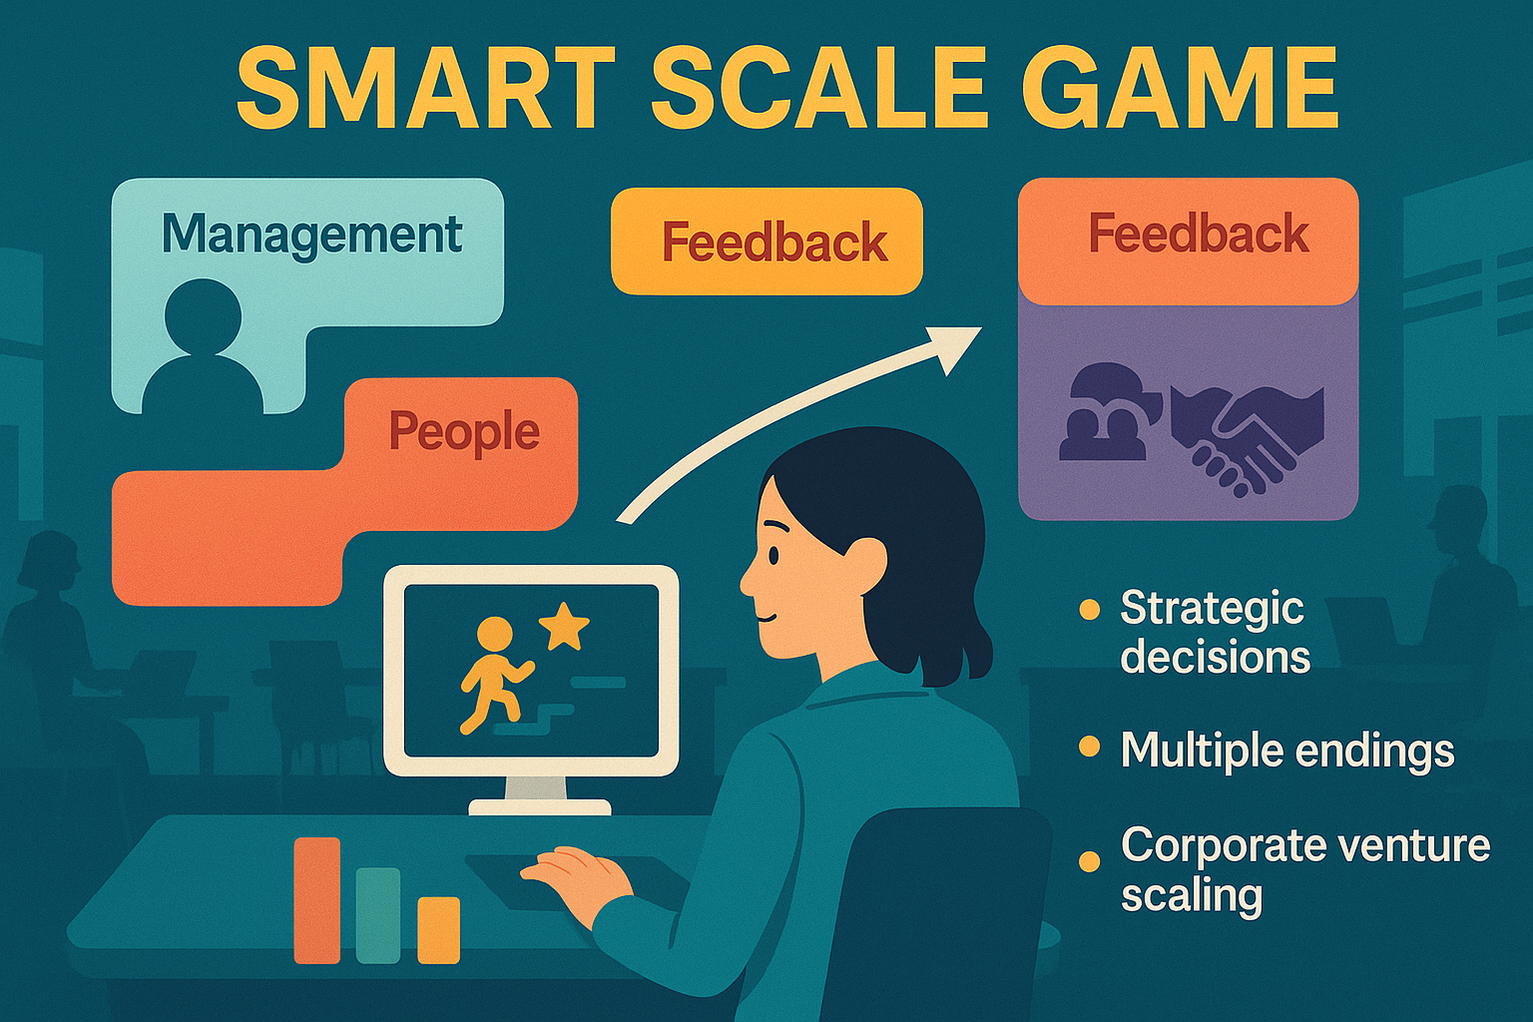
The Smart Scale Game
A Business Simulation Experience
CORPORATE ENTREPRENEURSHIP MODULE
Salter, A. (2025) Smart Scale Game: A Business Simulation for Corporate Entrepreneurship Education. Available at: https://github.com/ammon-salter-del/smart-scale-game

Slide 2
Your Mission
You are the new director of a corporate venture at Neptune Corporation, a global consumer goods company.
QUICK FACTS
30-45
Your task: scale this promising venture into Neptune's next major brand — in just 12 months.
minutes to play
12
months to simulate
3
You'll face real business dilemmas, make consequential decisions, and experience the results of your leadership.
ventures to choose from

Slide 3
How It Works
Choose Your Venture
Set Your Strategy
Respond to Emails
See the Results
Pick from 3 different corporate ventures, each with unique challenges
Decide your growth ambition: local, regional, or global expansion
Your team sends you dilemmas via email. Read carefully and decide.
Watch how your decisions affect your venture's performance
Every decision matters. There are no "undo" buttons — just like real business.

Slide 4
Your Dashboard
Key metrics to watch as you lead your venture
📈
💰
📋
Market Reach
Profit / Loss
Template
How many markets you've entered. Your main target.
Your financial performance. Running out of money ends badly.
Your operational maturity. How repeatable is your model?
👥
🎯
💡
Team Morale
Purpose
Innovation
Team happiness and energy. Low morale causes problems.
Mission alignment. Are you staying true to your venture's goals?
Creative capacity. Your ability to adapt and improve.
💡 Tip: These metrics interact with each other. Neglecting one will eventually hurt the others.

Slide 5
The Email Interface
Your team communicates through realistic business emails
📖 Read Carefully
Each email contains context that matters for your decision
FROM: Sarah Chen, Operations Lead
Regional Expansion Decision Needed
Hi Director, we have an opportunity to expand into the Midwest region ahead of schedule. However, our template isn't fully tested yet...
⚖️ Weigh Trade-offs
Most options have pros and cons — there's rarely one "right" answer
YOUR OPTIONS:
A) Expand now — seize the opportunity
🎯 Consider Context
What's your current situation? What do your metrics tell you?
B) Wait until template is ready
C) Pilot with limited resources first
🔒 Decisions Are Final
Once you choose, you live with the consequences

Slide 6
WARNING: Don't Rush!
The game detects and penalizes hasty decision-making
WHAT HAPPENS IF YOU CLICK TOO FAST
THE SOLUTION
📉 Reduced Benefits — Positive effects from your choices are cut by 50%
Take your time.
📈 Amplified Problems — Negative effects are increased by 40%
Read each email thoroughly before choosing.
The game expects you to spend at least 8-10 seconds reading each decision. This is a learning experience, not a speed test.
😞 Morale Drops — Your team loses confidence in hasty leadership
🏆 Lower Final Score — Hasty decisions count against your performance tier
Real executives don't make snap decisions on major business dilemmas. Neither should you.
Bottom line: Rushing = poor results. Engage thoughtfully = better outcomes.

Slide 7

How You're Evaluated
Your final performance tier depends on multiple factors
PERFORMANCE TIERS
WHAT MATTERS FOR YOUR TIER
Tier 4: Scaling Champion
Exceptional results across all dimensions
📈 Market Reach
Did you hit your growth targets?
Tier 3: Rising Star
Strong performance with room to grow
💰 Financial Health
Did you stay within budget?
Tier 2: Solid Performer
Met baseline expectations
👥 Team Morale
Is your team still engaged?
Tier 1: Learning Experience
Completed but with challenges
⚡ Decision Quality
Tier 0: Early Exit
Too many hasty decisions will lower your tier — even with good metrics!
Terminated before 12 months

Slide 8
Ready to Begin? 🚀
🎯
BEFORE YOU START
✓ Find 30-45 minutes of uninterrupted time
Your Goal
✓ Use a laptop or desktop (not phone)
Scale your venture to target market reach while keeping the venture healthy and team engaged.
✓ Close other tabs and distractions
✓ Commit to reading each email carefully
⚠️ Remember: Rushing = Poor Results
✓ Remember: no "right" answers, only trade-offs
Good luck, Director!
Salter, A. (2025) Smart Scale Game: A Business Simulation for Corporate Entrepreneurship Education. Available at: https://github.com/ammon-salter-del/smart-scale-game

