Slide 1
Digital Humanities
Applications from the creation of technology

Slide 2
What does dh have to offer?
Freedom of information, ability to share and collaborate on research in open and unrestricted ways
Ability to find more sources
Ability to allow a wide range of interested individuals to participate

Slide 3
What does DH have to offer?
How will this new technology improve the productivity and quality of work and provide new understanding to the profession?

Slide 4
What does dh have to offer?
Do computers change the way historians understand history, or do they just make it easier to type, disseminate, and collaborate research—things historians already do?

Slide 5
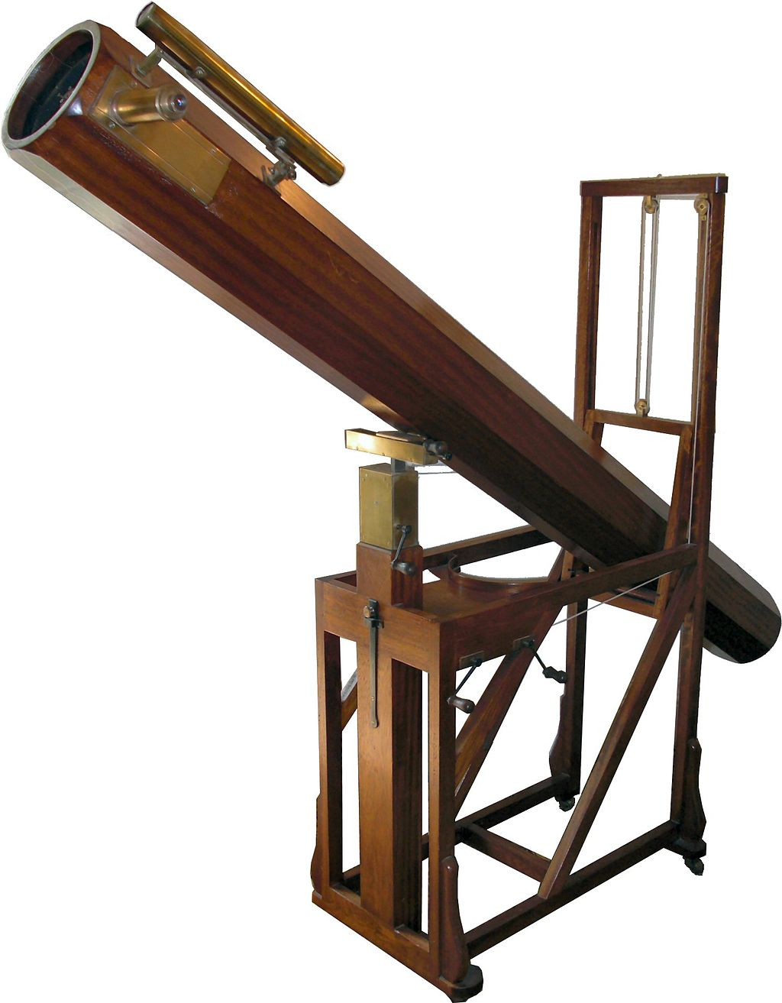
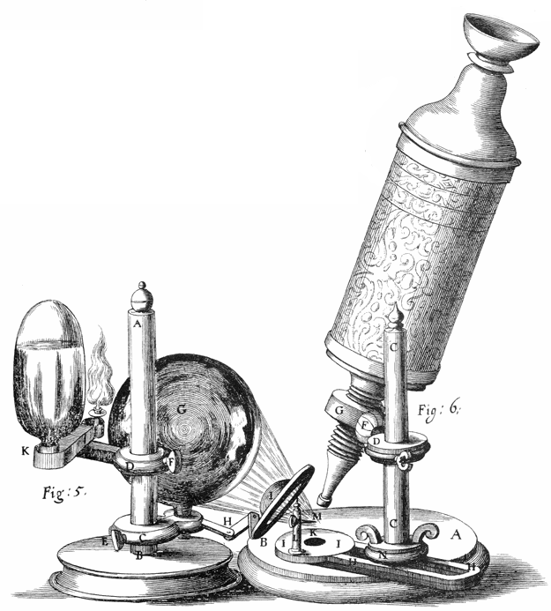
“Robert Hooke.” Wikipedia, the Free Encyclopedia, September 8, 2014. http://en.wikipedia.org/w/index.php?title=Robert_Hooke&oldid=623967312.
“William Herschel.” Wikipedia, the Free Encyclopedia, September 8, 2014. http://en.wikipedia.org/w/index.php?title=William_Herschel&oldid=624693452.
Notes:
Technology changes fields of study!

Slide 6
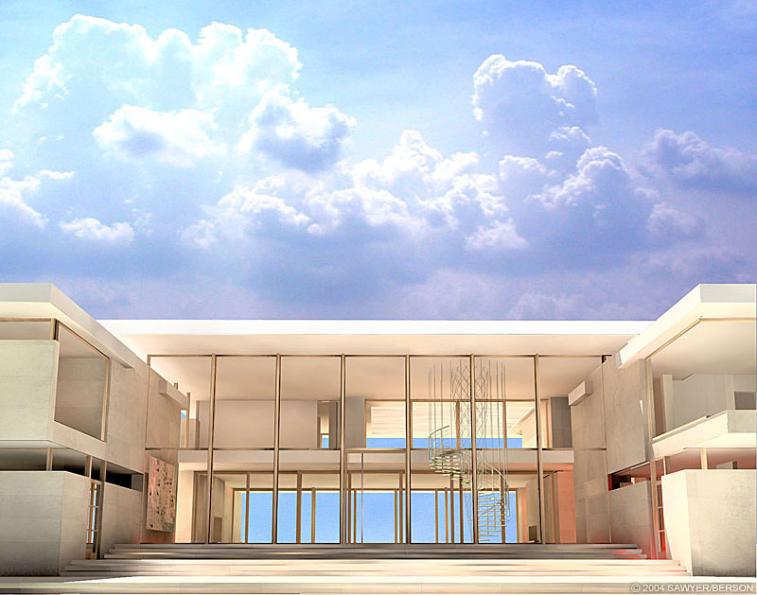
http://timboyle.com/southampton-house/
Notes:
Architects use software to create more accurately, design in more reality, and produce more variety.

Slide 7
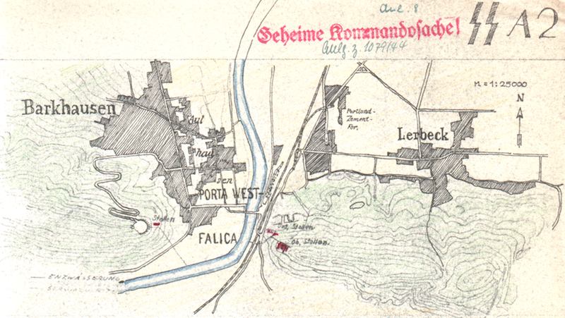

Slide 8
Mining during the nineteenth century left large, open mines in the Wittekindsberg and Jakobsberg hills that are situated on opposite banks of the Weser River from one another, near Minden, North Rhine-Westphalia, Germany

Slide 9
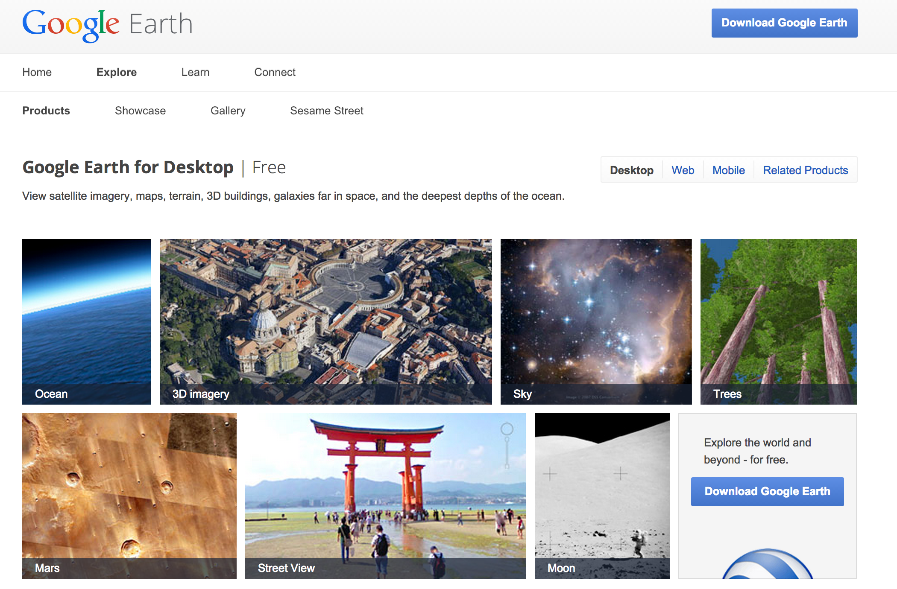

Slide 10
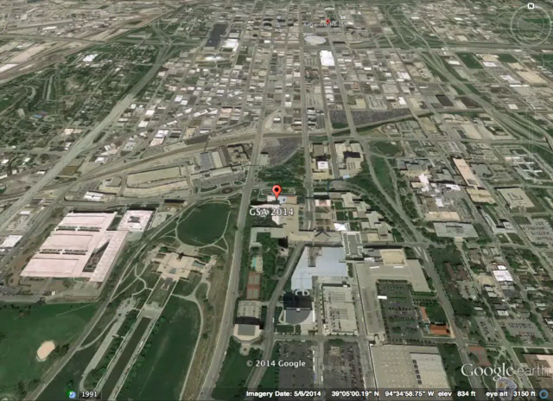

Slide 11
What is digital Humanities?
Day of DH results for 2009-2014
YEAR | # of Definitions
2009 | 21
2010 | 75
2011 | 177
2012 | 248
2013 | 278
2014 | 522

Slide 12
What is digital Humanities?
“Application of computer-based methods for the Humanities. Though, on some occasions, I prefer "Humanities Computing" to make clearer that these applications often have to be developed and that a lot of basic research is required. What I do not like about the term "DH" is that it implies that there is digital humanities as opposed to non-digital humanities. But there is not. In the future, computer-based methods will be naturally used by any scholar. It is not like experimental vs. theoretical physics.”
- Malte Rehbein, University of Wuerzburg, Germany

Slide 13
What is digital Humanities?
“Who the hell knows....I certainly don’t”
- Ethan Watrall, Michigan State University

Slide 14
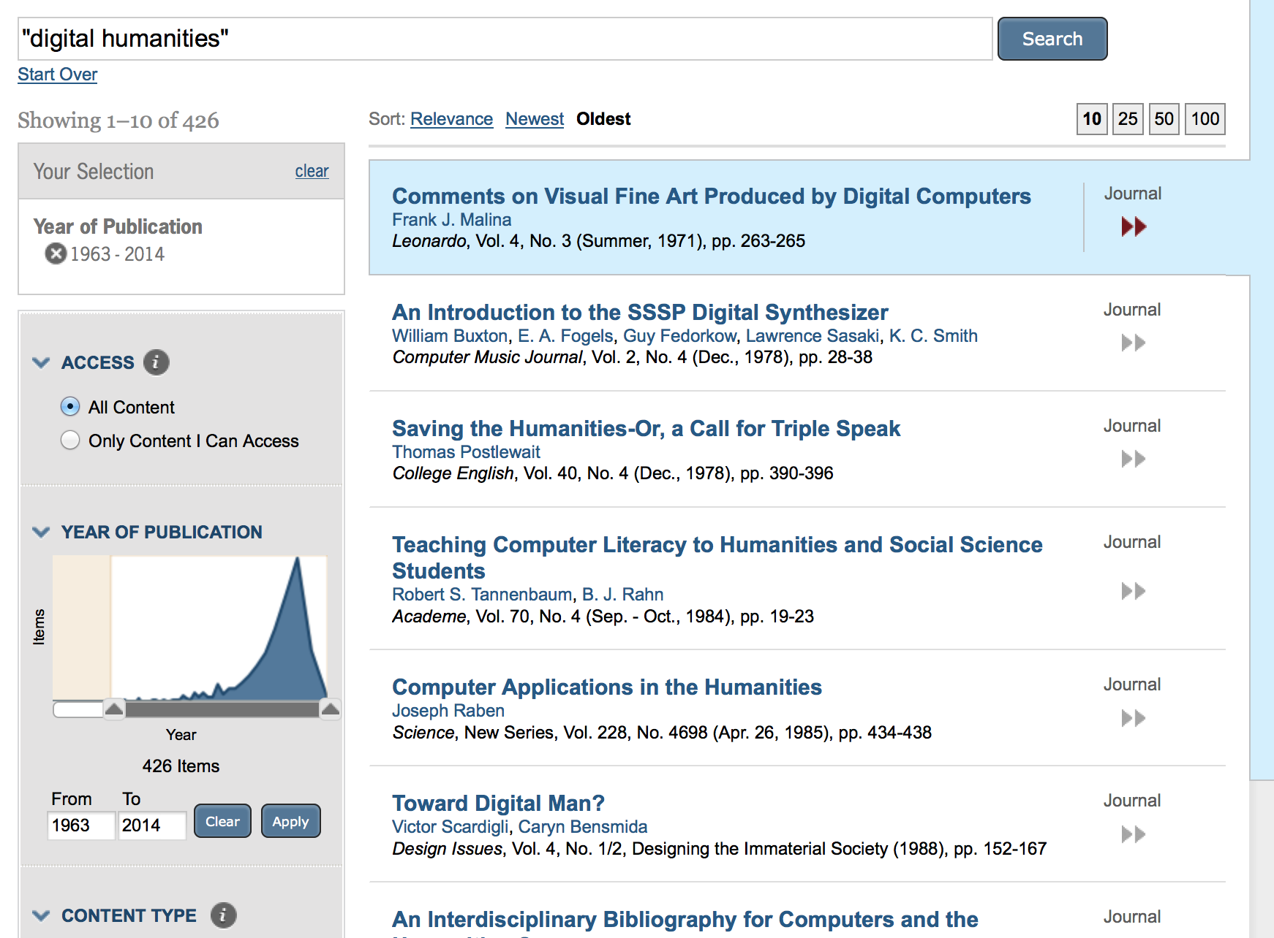
Notes:
Digital Humanities is on the rise

Slide 15


Slide 16
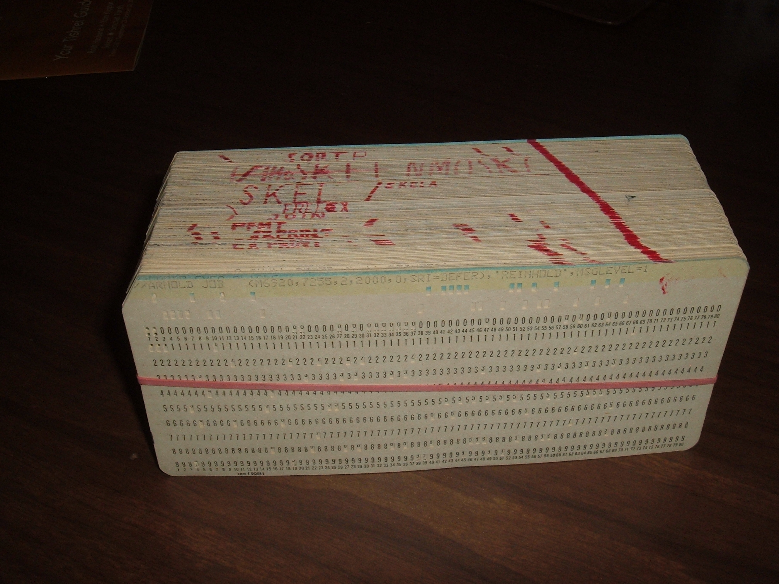

Slide 17
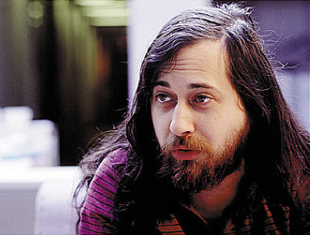


Slide 18


Slide 19
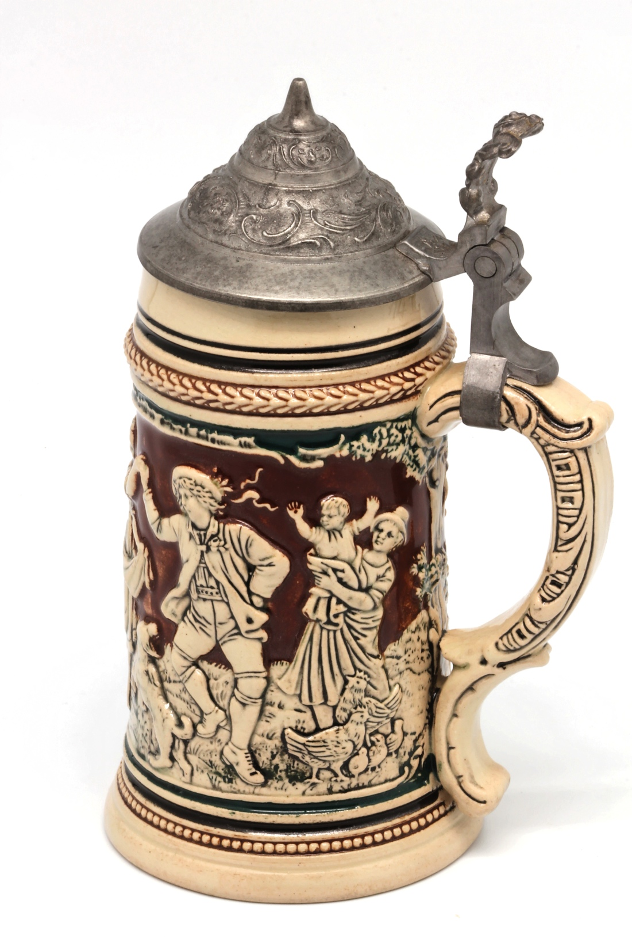
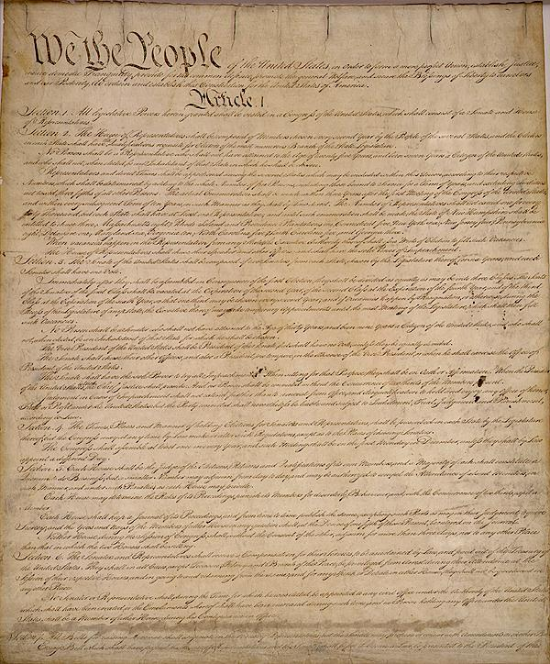
Free as in beer
Free as in speech
Without monetary cost
Without restrictions

Slide 20
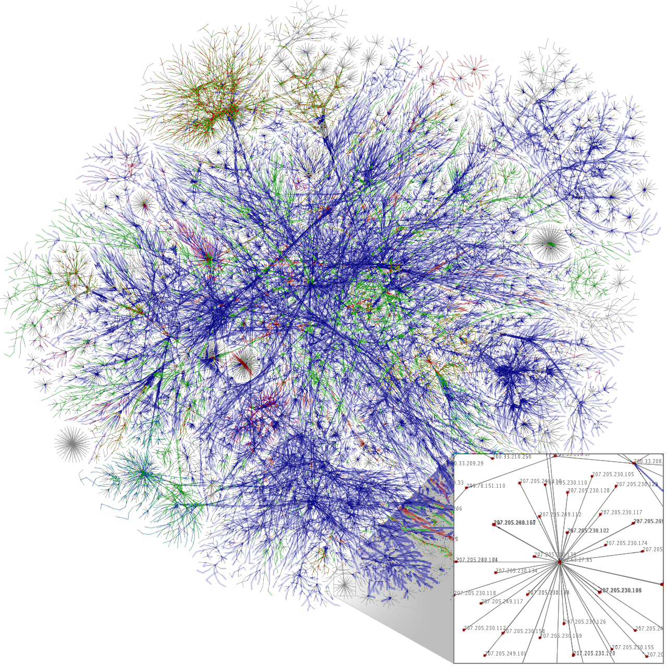
“Internet.” Wikipedia, the Free Encyclopedia, September 10, 2014. http://en.wikipedia.org/w/index.php?title=Internet&oldid=624579003.
Notes:
Internet, World Wide Web and computer applications can change Humanities.

Slide 21
Free Software/Open Source | Humanities
Free/open software | Free/open scholarship
Access to code | Access to research
Change code | Add/edit research
Disseminate software | Disseminate scholarship
Collaborative creation of software/Internet | Collaborative creation of scholarship
Software (finished product) | Scholarship (finished product)
Code (what makes up software) | Research (what makes up scholarship)

Slide 22
Internet/WWW | Humanities
Any user allowed to contribute | Any individual allowed to contribute
Central goal of creating connections | Central goal of creating scholarship
Bad code discarded | Faulty research ignored

Slide 23
Greater distribution of resources and source material
Interaction and collaboration with sources
Acceptance of any who provide

Slide 24
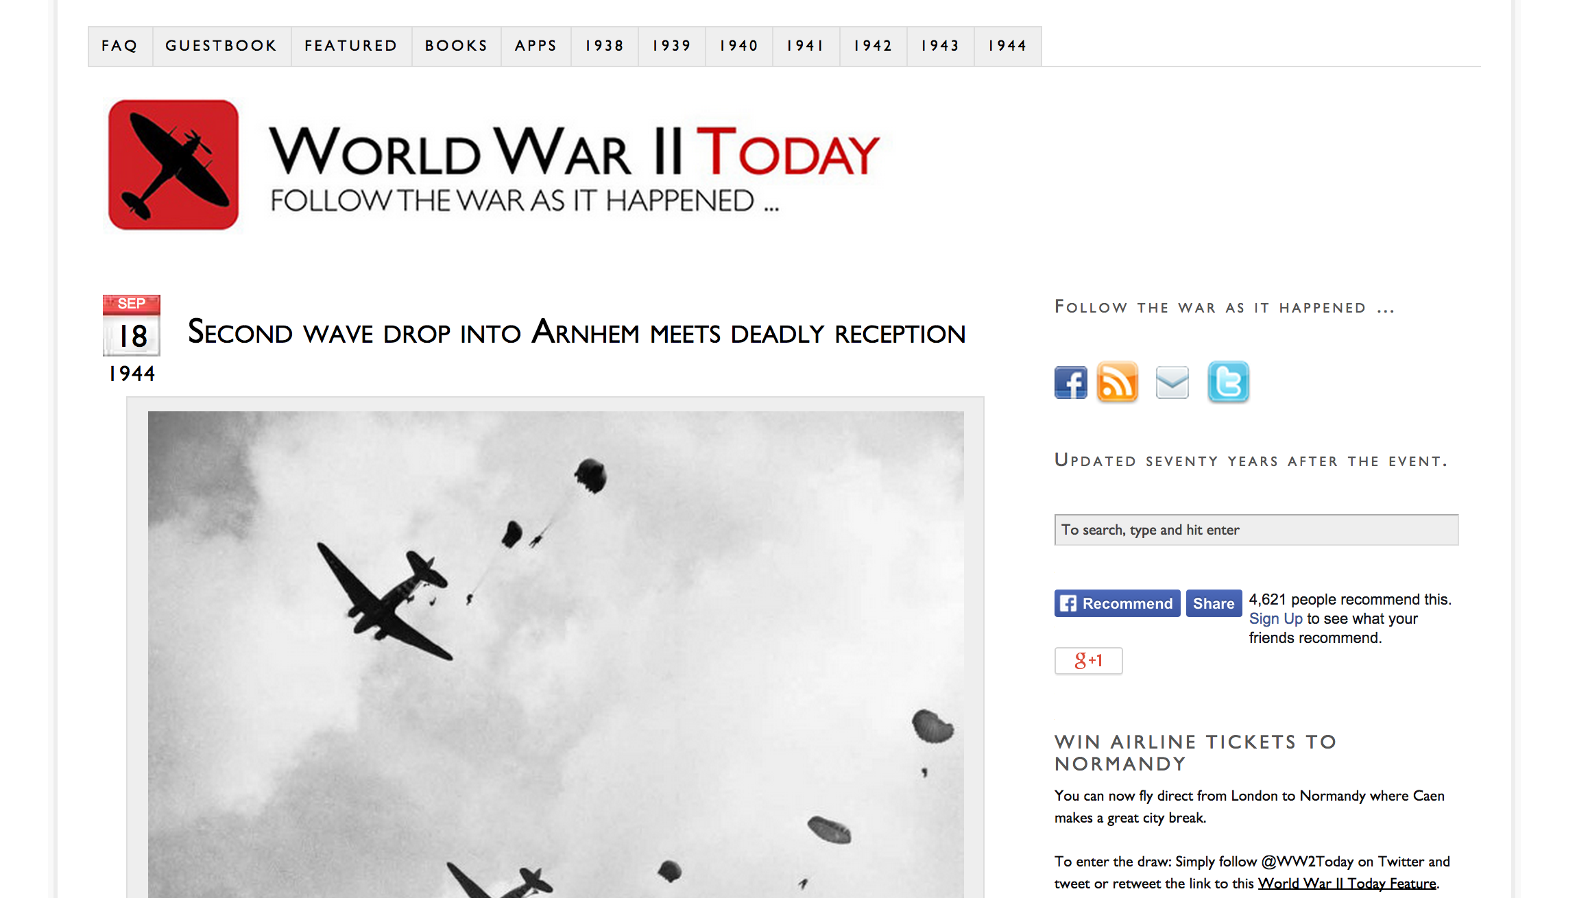

Slide 25
“Web sites provide an excellent opportunity to present history in a new way, providing for the inclusion of a much greater volume of original or primary source material than would be possible in a conventional book, including many more photographic records than could be economically included in a book.”
http://ww2today.com/faq

Slide 26
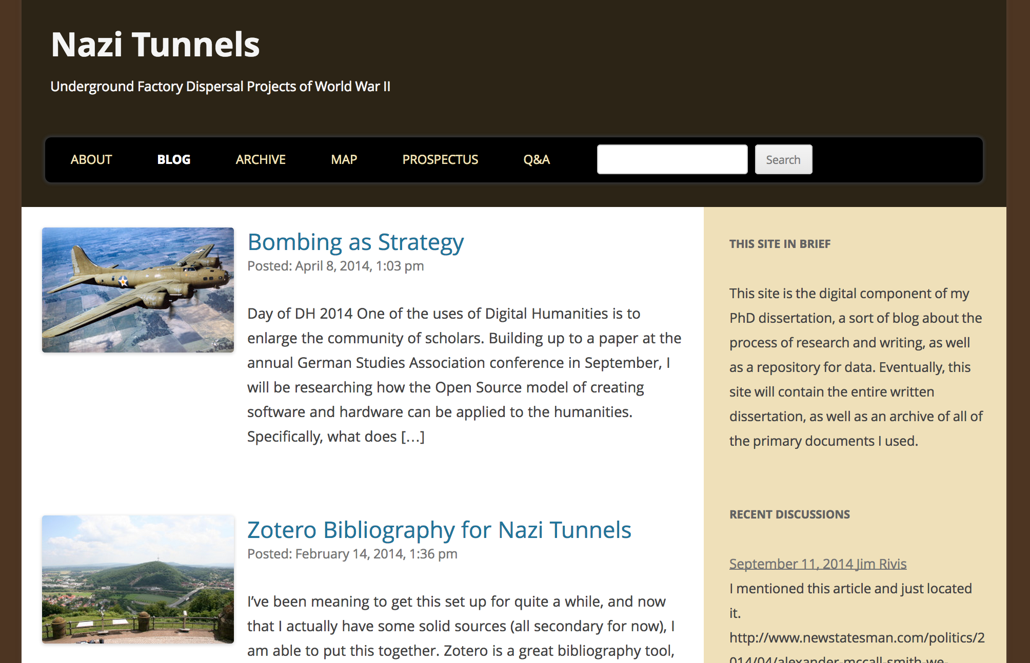

Slide 27
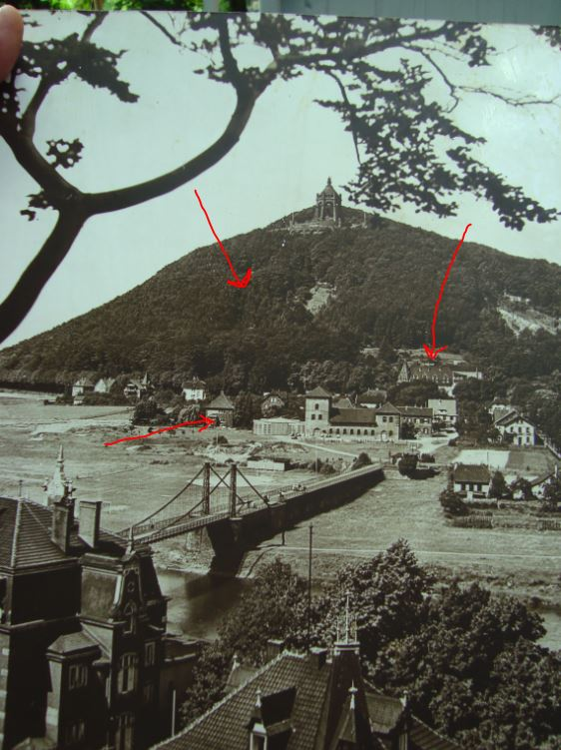

Slide 28
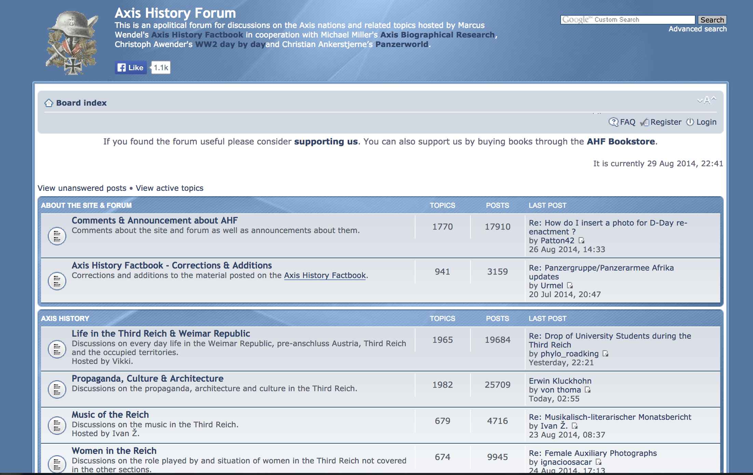

Slide 29
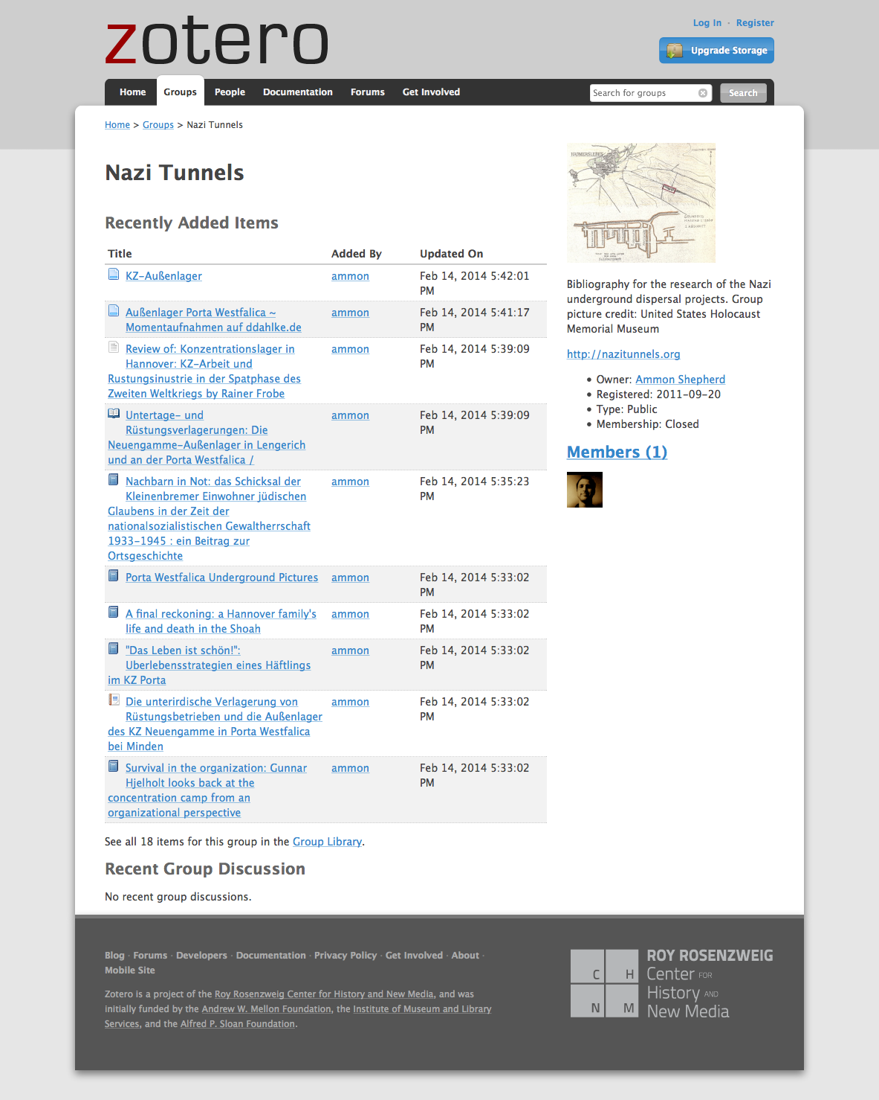

Slide 30
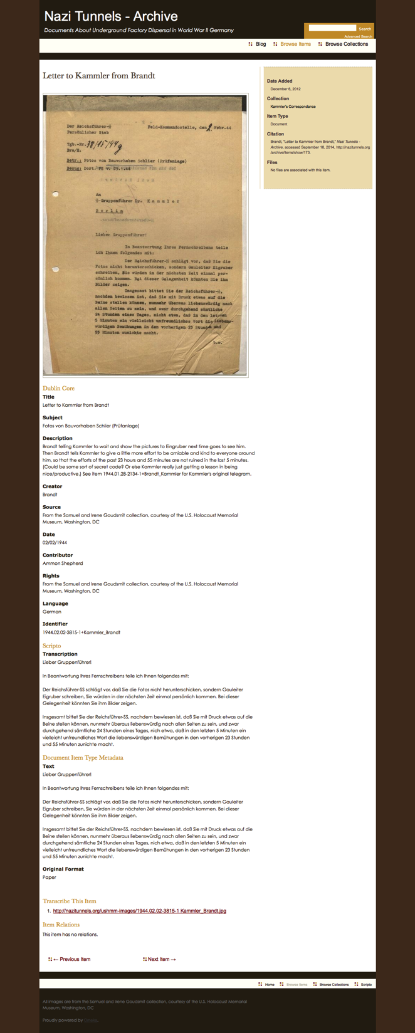

Slide 32
What does dh have to offer?
Freedom of information, ability to share and collaborate on research in open and unrestricted ways
Ability to find more sources
Ability to allow a wide range of interested individuals to participate

