Slide 1
Modul - Internet of Things (IoT) - 05 – Vorlesung IoT Platformen
Prof. Dr. Marcel Tilly
Fakultät Informatik, Cloud Computing

Slide 2
Überblick
21. März Einführung in das Internet der Dinge
28. März IoT Architekturen
4. April Things und Sensoren
11. April From Device to Cloud
18. April Vorlesungsfrei – Ostern
25. April IoT Analytics
02. Mai Big Data in IoT
9. Mai Data Exploration
16. Mai IoT Platformen
23. Mai Entwicklung einer IoT Lösung
30. Mai Vorlesungsfrei; Christi Himmelfahrt
05. Juni opt. Gastvortrag – Digitalisierung
13. Juni Data Science in IoT
20. Juni Vorlesungsfrei – Fronleichnam
27. Juni Intelligente Cloud und intelligente Edge
04. Juli PStA Abschlusspraesentationen
PStA

Slide 3
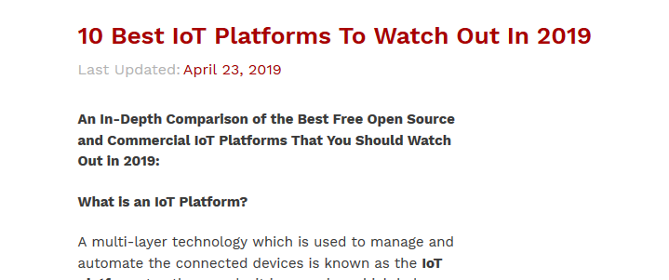
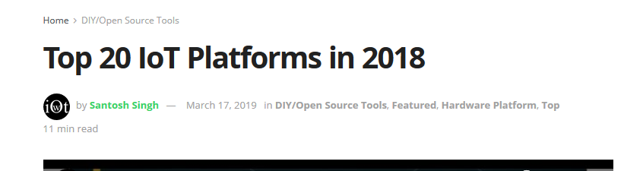
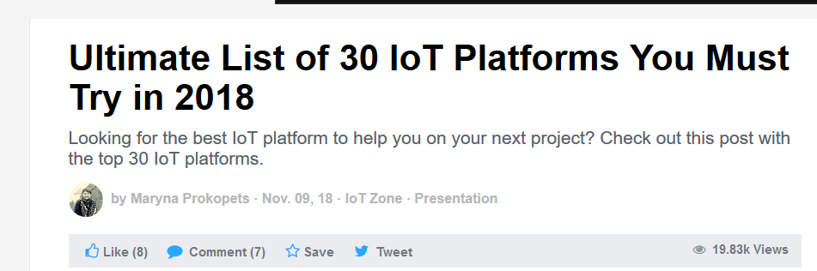

Slide 4
IoT Platform
AWS IoT
Google Cloud IoT
Microsoft Azure IoT
IBM Watson IoT
Oracle IoT
SalesForce IoT
Bosch IoT
ThingsIO.AI
Cisco IoT
Thingworx
Kaa
Samsung Artik
HPE Universal IoT
Bsquare DataV
Siemens MindSphere
Ayla Networks IoT
GE Predix
Taken from: https://dzone.com/articles/ultimate-list-of-30-iot-platforms-for-your-iot-pro

Slide 5
IoT Architecture (Draft)
Connectivity
Speed Layer
Data Stream
(Kafka, Spark, …)
Data Ingest
(MQTT Broker)
Query
UI
(BI)
Data Analytics
(Exploration, ML,…)
Views via Map and Reduce
(Haddop)
Immutable Master Data
(Data Lake)
Devices(Things)
Batch Layer

Slide 6
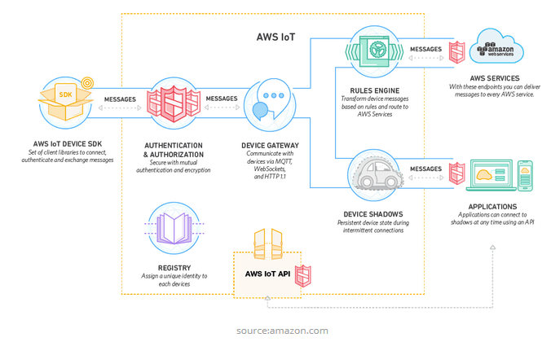
Amazon Web Services (AWS) IoT
Main features of AWS IoT platform are:
Registry for recognizing devices
Software Development Kit for devices
Device Shadows
Secure Device Gateway
Rules engine for inbound message evaluation

Slide 7
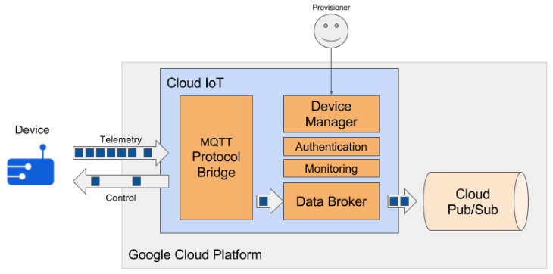
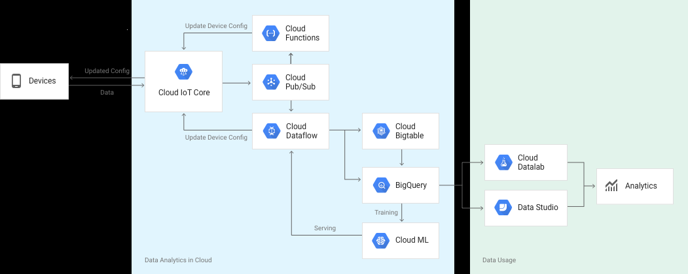
Google Cloud IoT

Slide 8
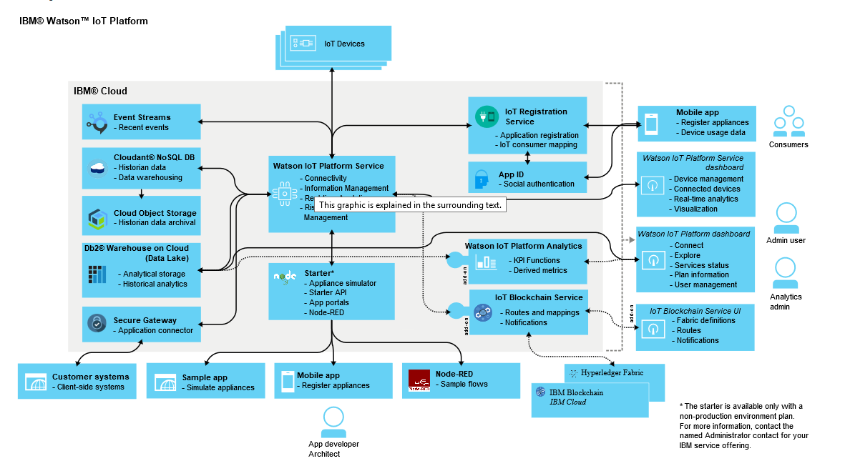
IBM Watson IoT
source: https://www.ibm.com/support/knowledgecenter/en/SSQP8H/iot/overview/architecture.html

Slide 9
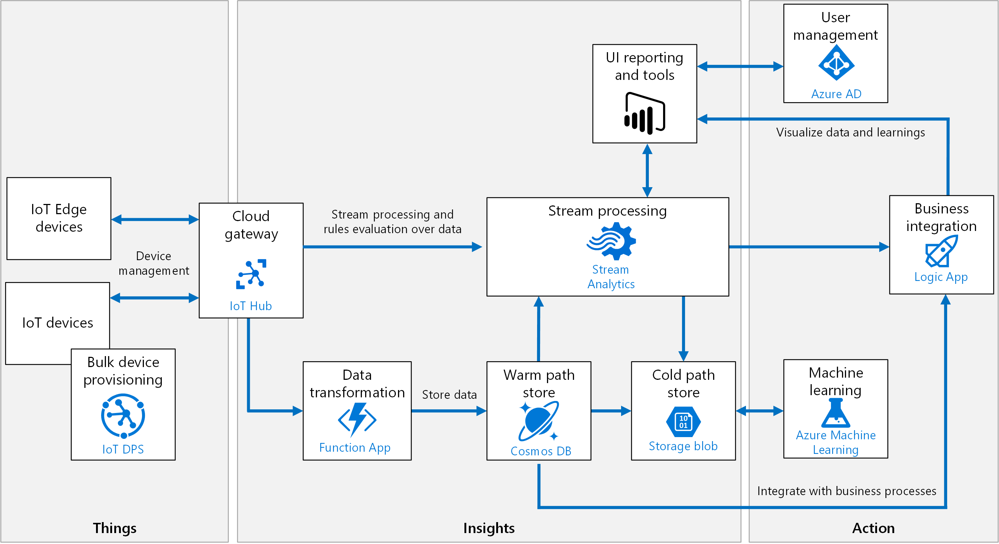
Microsoft Azure IoT
Source: https://docs.microsoft.com/en-us/azure/architecture/reference-architectures/iot/

Slide 10
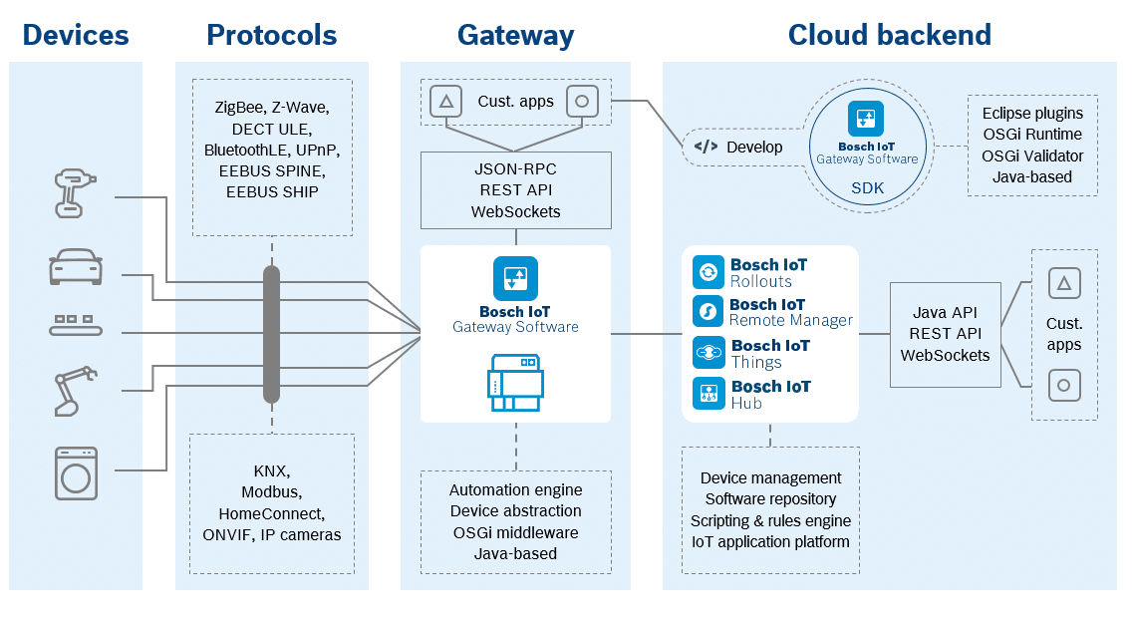
Bosch IoT Suite
source: https://blog.bosch-si.com/bosch-iot-suite/release-9-1-bosch-iot-gateway-software-available-now/

Slide 11
Requirements for an IoT Platform
Device SDK
Protocol
Authentication and Security (TLS)
Gateway
Protocol Support (HTTP(s), MQTT)
Authentication/Autorisation
Data Ingress
Device Control
(Device Twin)
Backend
Data Transformation
Data Processing
Data Storage
Analytics
ML
Business Intelligence
Thing
Connectivity
Data
Analytics

Slide 12
IoT Platform Architecture (v0.2)
Things
Connectivity
Data
Analytics
IoT Gateway
SDK
BI
Auth
Device Control
Transformation
(Function)
Device Registry
Data Stream
(Kafka, Spark, …)
Query
Data Ingest
(MQTT Broker)
Transformation
(Function)
Views via Map and Reduce
Data Ingest
(HTTP)
Data Analytics
(Exploration, ML,…)
Immutable Master Data
(Data Lake)
Auth

