Slide 1
Modul - Internet of Things (IoT) - 00-Einführung
Prof. Dr. Marcel Tilly
Fakultät Informatik, Cloud Computing

Slide 2
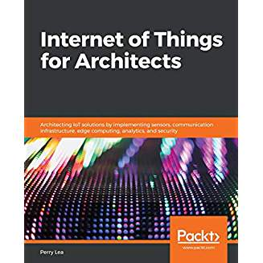
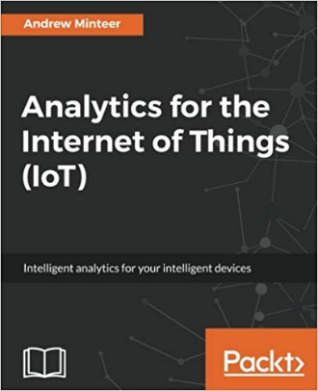
Organisatorisches
Modulbeschreibung: https://hsro-inf-iot.github.io/
Vorlesungstermin: Donnerstag, 08:00 - 11:15 (1.5h Vorlesung + 1.5h Übungen); Raum B0.11
Leistungsnachweis
PStA : Die Projektarbeit wird im Rahmen der Übung durchgeführt. Abschlusspräsentation ist am 04. Juli (letzter Vorlesungstermin!)
Empfohlene Literatur
Perry Lea: Internet of Things for Architects: Architecting IoT solutions by implementing sensors, communication infrastructure, edge computing, analytics, and security (Englisch Edition)
Andrew Minteer: Analytics for the Internet of Things (IoT): Intelligent analytics for your intelligent devices (Englisch Edition)

Slide 3
Überblick
21. März Einführung in das Internet der Dinge
28. März IoT Architekturen
4. April Things und Sensoren
11. April From Device to Cloud
18. April Vorlesungsfrei – Ostern
25. April IoT Analytics
02. Mai Big Data in IoT
9. Mai Data Exploration
16. Mai IoT Platformen
23. Mai Entwicklung einer IoT Lösung
30. Mai Vorlesungsfrei; Christi Himmelfahrt
05. Juni opt. Gastvortrag – Digitalisierung
13. Juni Data Science in IoT
20. Juni Vorlesungsfrei – Fronleichnam
27. Juni Intelligente Cloud und intelligente Edge
04. Juli PStA Abschlusspraesentationen
PStA

Slide 4
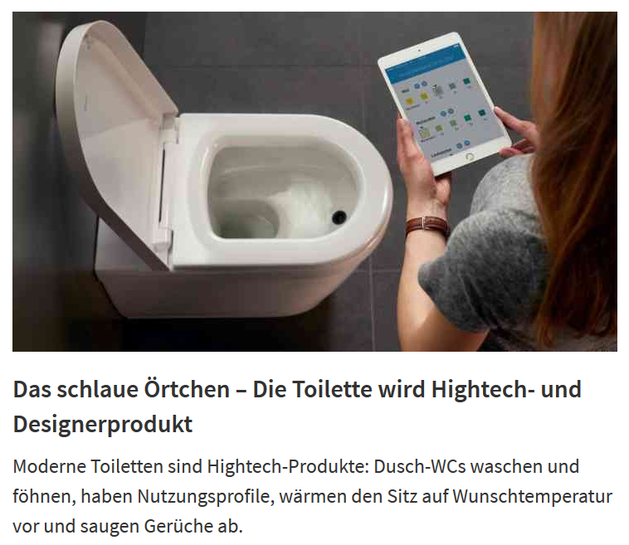
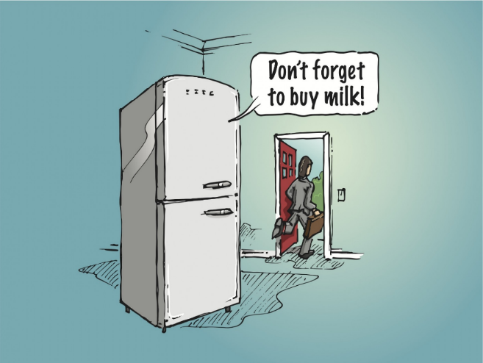
The “Internet of Things” or IoT is cool. I know this because everyone tells everyone else how cool it is. Ask anyone and they will give you their own definition of what IoT means and why it is cool.
-- Steven Sinofsky

Slide 5
Internet of Things = IoT
Wie misst man ob eine Thema cool ist?
Google Suche nach “Internet of Things” -> ~ 2.500.000.000 Treffer
zum Vergleich
„Taylor Swift“ -> ~ 628.000.000 Treffer
oder
„Bayern München“ -> ~ 300.000.000 Treffer
Wissenschaftliche Artikel zu IoT ca. 3.070.000 Ergebnisse
Stand: 20.03.2019

Slide 6
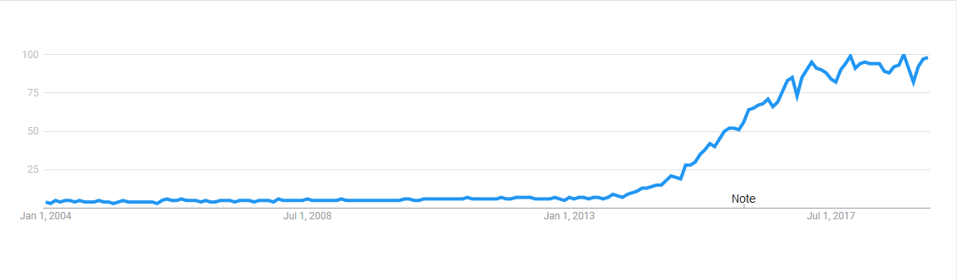
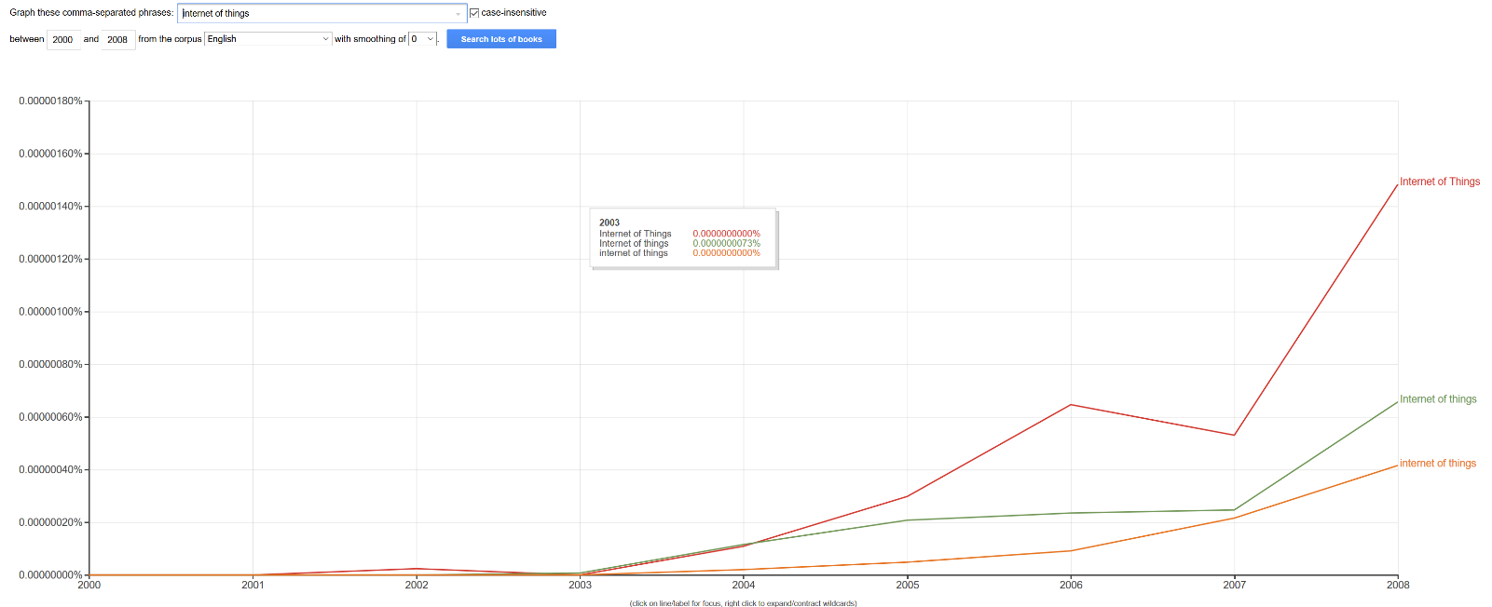
Trends in Internet
Google Trends: „IoT“
Google Books Ngam Viever: „Internet of Things“

Slide 7
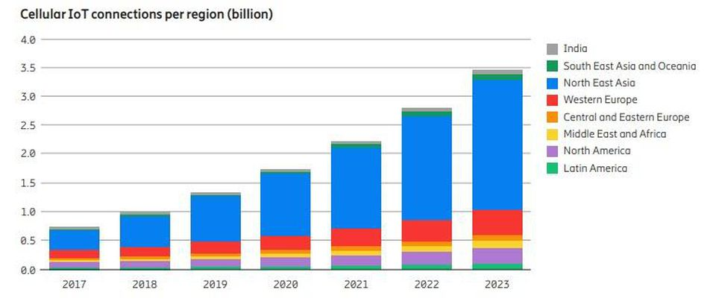
IoT Potential
Ericsson is forecasting the number of cellular IoT connections is expected to reach 3.5B in 2023, increasing at a CAGR of 30% (CAGR = Compound Annual Growth Rate).
https://www.forbes.com/sites/louiscolumbus/2018/12/13/2018-roundup-of-internet-of-things-forecasts-and-market-estimates/#499cf567d838

Slide 8
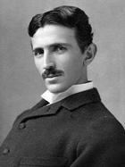
Geschichte Internet of Things
„When wireless is perfectly applied the whole earth will be converted into a huge brain, which in fact it is, all things being particles of a real and rhythmic whole. We shall be able to communicate with one another instantly, irrespective of distance. Not only this, but through television and telephony we shall see and hear one another as perfectly as though we were face to face, despite intervening distances of thousands of miles; and the instruments through which we shall be able to do his will be amazingly simple compared with our present telephone. A man will be able to carry one in his vest pocket.“
— Nikola Tesla, "When woman is boss", Colliers, January 30, 1926
Image taken from:

Slide 9
History of Internet of Things (1/6)
1949
The bar code is conceived when 27 year-old Norman Joseph Woodland draws four lines in the sand on a Miami beach. Woodland, who later became an IBM engineer, received (with Bernard Silver) the first patent for a linear bar code in 1952. More than twenty years later, another IBMer, George Laurer, was one of those primarily responsible for refining the idea for use by supermarkets.
1955
Edward O. Thorp conceives of the first wearable computer, a cigarette pack-sized analog device, used for the sole purpose of predicting roulette wheels. Developed further with the help of Claude Shannon, it was tested in Las Vegas in the summer of 1961, but its existence was revealed only in 1966.
1960
Morton Heilig receives a patent for the first-ever head-mounted display.
1967
Hubert Upton invents an analog wearable computer with eyeglass-mounted display to aid in lip reading.
October 29, 1969
The first message is sent over the ARPANET, the predecessor of the Internet.

Slide 10
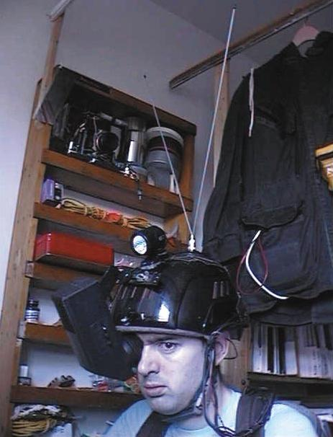
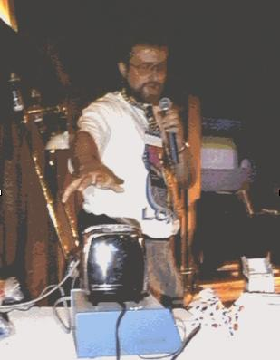
History of Internet of Things (2/6)
1973
Mario Cardullo receives the first patent for a passive, read-write RFID tag.
1974
A Universal Product Code (UPC) label is used to ring up purchases at a supermarket for the first time.
1977
CC Collins develops an aid to the blind, a five-pound wearable with a head-mounted camera that converted images into a tactile grid on a vest.
1981
While still in high school, Steve Mann develops a backpack-mounted “wearable personal computer-imaging system and lighting kit.”
1982
Members of the Carnegie-Mellon Computer Science department install micro-switches in the Coke vending machine and connect them to the PDP-10 departmental computer so they could see on their computer terminals how many bottles were present in the machine and whether they were cold or not.
1989
“The Internet Toaster”, Working together with his friend Simon Hackett, John Romkey rose to the occasion and connected a Sunbeam Deluxe Automatic Radiant Control Toaster to the Internet at Interop’89
1980 protoype with 1.5’’ CRT (1)
Images taken from: (1) http://wearcam.org/ieeecomputer/r2025.htm
(2) https://www.livinginternet.com/i/ia_myths_toast.htm
Hackett demonstrating the
Toaster (2)

Slide 11
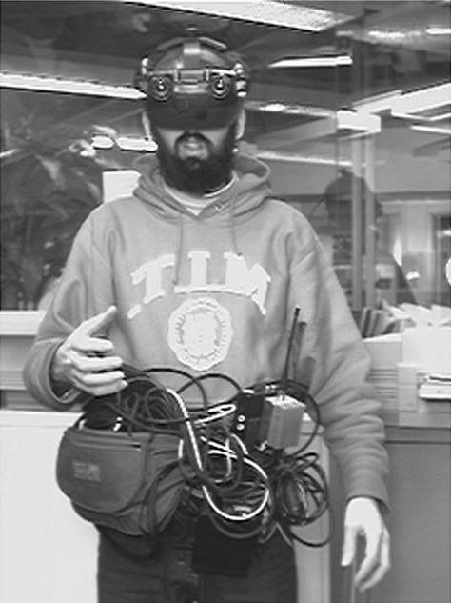
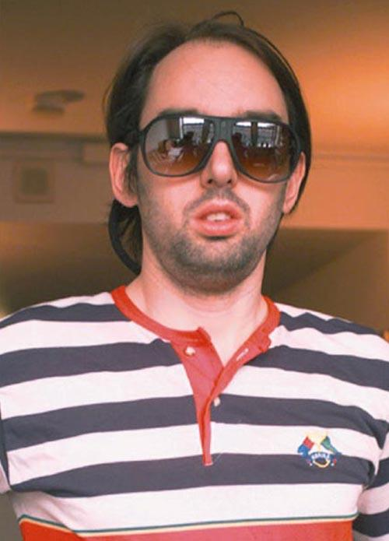
History of Internet of Things (3/6)
September 1991
Xerox PARC’s Mark Weiser publishes “The Computer in the 21st Century” in Scientific American, using the terms “ubiquitous computing” and “embodied virtuality” to describe his vision of how “specialized elements of hardware and software, connected by wires, radio waves and infrared, will be so ubiquitous that no one will notice their presence.”
1993
Columbia University’s Steven Feiner, Blair MacIntyre, and Dorée Seligmann develop KARMA--Knowledge-based Augmented Reality for Maintenance Assistance. KARMA overlaid wireframe schematics and maintenance instructions on top of whatever was being repaired.
1994
Xerox EuroPARC’s Mik Lamming and Mike Flynn demonstrate the Forget-Me-Not, a wearable device that communicates via wireless transmitters and records interactions with people and devices, storing the information in a database.
1994
Steve Mann develops a wearable wireless webcam, considered the first example of lifelogging.
Early 1990s setup
1994 version

Slide 12
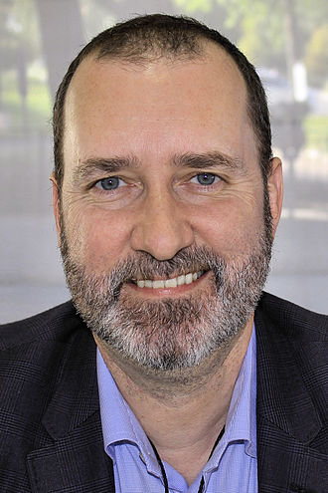
History of Internet of Things (4/6)
1995
Siemens sets up a dedicated department inside its mobile phones business unit to develop and launch a GSM data module called “M1” for machine-to-machine (M2M) industrial applications, enabling machines to communicate over wireless networks. The first M1 module was used for point of sale (POS) terminals, in vehicle telematics, remote monitoring and tracking and tracing applications.
December 1995
MIT’s Nicholas Negroponte and Neil Gershenfeld write in “Wearable Computing” in Wired: “For hardware and software to comfortably follow you around, they must merge into softwear… The difference in time between loony ideas and shipped products is shrinking so fast that it's now, oh, about a week.”
1999
The Auto-ID (for Automatic Identification) Center is established at MIT. Sanjay Sarma, David Brock and Kevin Ashton turned RFID into a networking technology by linking objects to the Internet through the RFID tag.
1999
Kevin Ashton, the Executive Director of Auto-ID Labs at MIT, was the first to describe the Internet of Things, while making a presentation for Procter & Gamble:“…If we had computers that knew everything there was to know about things, using data they gathered without any help from us, we would be able to track and count everything and greatly reduce waste, loss and cost. We would know when things needed replacing, repairing or recalling and whether they were fresh or past their best.”
https://en.wikipedia.org/wiki/Kevin_Ashton

Slide 13
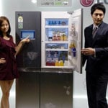

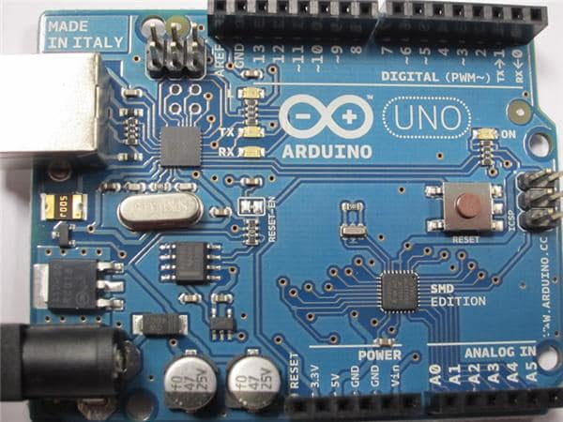
History of Internet of Things (5/6)
2000
Starting off what is now becoming a meme, LG announces it's first Internet refrigerator plans
April 2002
Jim Waldo writes in “Virtual Organizations, Pervasive Computing, and an Infrastructure for Networking at the Edge,” in the Journal of Information Systems Frontiers: “…the Internet is becoming the communication fabric for devices to talk to services, which in turn talk to other services. Humans are quickly becoming a minority on the Internet, and the majority stakeholders are computational entities that are interacting with other computational entities without human intervention.”
2005
Ahead of its time, the Nabaztag (Now a part of Aldebaran Robotics) was originally manufactured by the company Violet and created by Rafi Haladjian and Olivier Mével. The little WiFi enbabled rabbit was able to alert and speak to you about stock market reports, news headlines, alarm clock, RSS-Feeds, etc as well as connect to each other. The statement was "if you can even connect rabbits, then you can connect anything"
A team of faculty members at the Interaction Design Institute Ivrea (IDII) in Ivrea, Italy, develops Arduino.

Slide 14
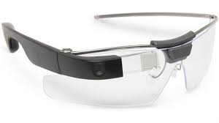
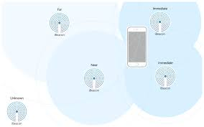
History of Internet of Things (6/6)
2009
Google starts self-driving cars
2011
Gartner adds IoT to the Hype Cycle
2013
Google creates advanced smart glasses
2014
Apple creates iBeacon protocol for Beacons
The number of devices exceed the number of people

Slide 15
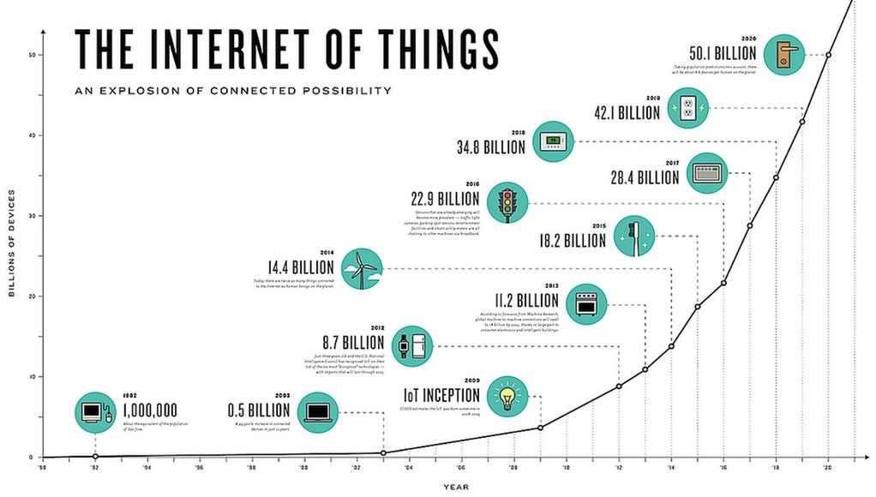
Device Growth

Slide 16
The “Internet Of Things” … ... is neither really about “Things” … … nor really about “The Internet” … … its about creating systems … … that make our daily lives better … … safer, more reliable, more efficient … … and more fun!
Clemens Vasters; Architect; Microsoft Azure

Slide 17
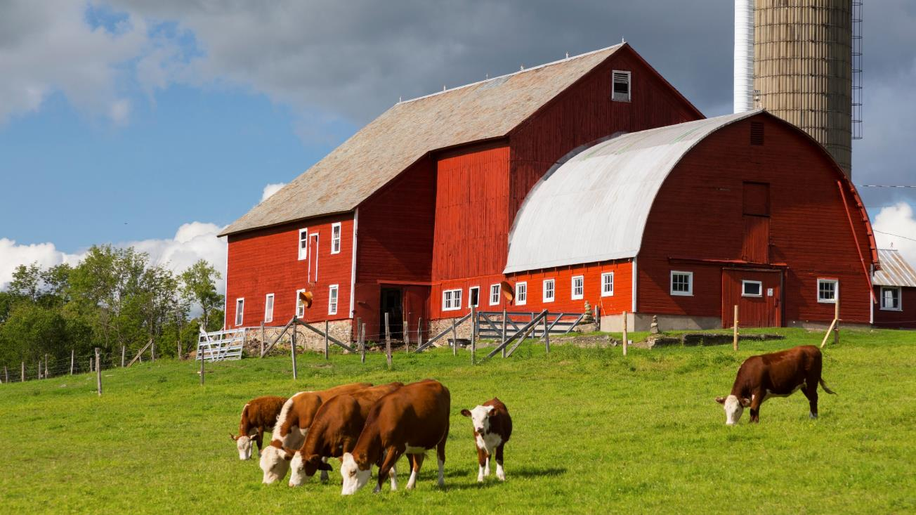
Every company is a data company…

Slide 18
Activity Pattern
Steps
Start of Estrus Detected
Optimum For Artificial Insemination
Probable Female
Probable Male
16 Hours Later
12th 9:00
12th 9:00
12th 17:00
13th 7:00
13th 9:00
13th 17:00
Elapsed time
Source: http://www.fujitsu.com/global/about/resources/news/press-releases/2013/1015-01.html
Notes:
Estrus lasts only for 12-18 hours every 21 days
Occurs mostly between 10 pm and 8 am

Slide 19
Architecture of an Internet of Things Solution
NETWORK
ANALYTICS
“Cow Step” Service
COWSHED
BASE STATION
CLOUD CENTER
INTERNET
DIPOLE ANTENNA
RECEIVER
HOUSE/OFFICE
3G CARD
ROUTER
PEDOMETER
SENSOR
COMMUNICATION

Slide 20
Defining Internet of Things (10.000 ft)
Things
Connectivity
Data
Analytics
Internet of Things spans from end-to-end
Fire
Pollution Control
Emergency
Manufacturing Integration and Automation
Automation
Smart Cities
Remote Servicing
Smart Home
Cars
Aircraft
Water
Public
Safety
Lighting
Traffic
Smart Mobility
Buses
Smart Factory
Comfort
Trains
Waste
Law Enforcement
Security
Safety
Bikes
Vessels
Trucks
Predictive and Reactive Maintenance
Notes:
Talking Points
The truth is, there is no standard definition for the Internet of Things. If you have heard or read about IoT, chances are you’ve come across a number of different perspectives
Despite how complex IoT seems, it essentially comes down to four areas:
Physical “things” such as line of business assets, including industry devices or sensors
Those “things” have connectivity to the internet, to each other, and to people
Those “things” collect and communicate data—this may include information gathered from the environment or inputted by users
And then there are analytics performed on that data that enable people or machines to take action
Transition:
So how do you apply these components or building blocks to your business transformation journey

Slide 21
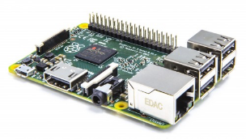
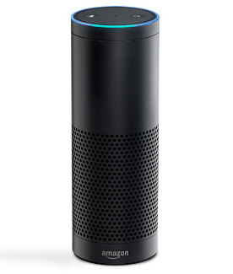
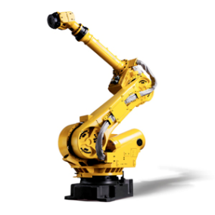
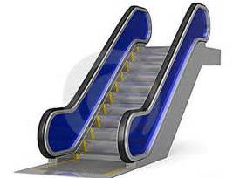
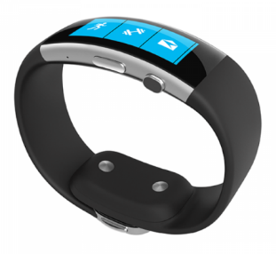
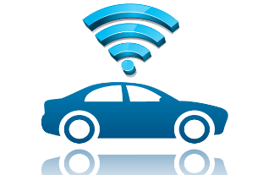
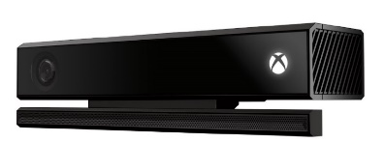
Things
Challenges
Technology
Memory
Processor
Energy (Battery) , lifetime
Security
Various generations (old vs new)
Heterogeneous platforms
Provisioning
Variety of device categories (sensor, gateways)
Variety of device types
Programming languages
Microcontroller vs OS powered
C, Java, Python, JavaScript, C++, C#, ….

Slide 22
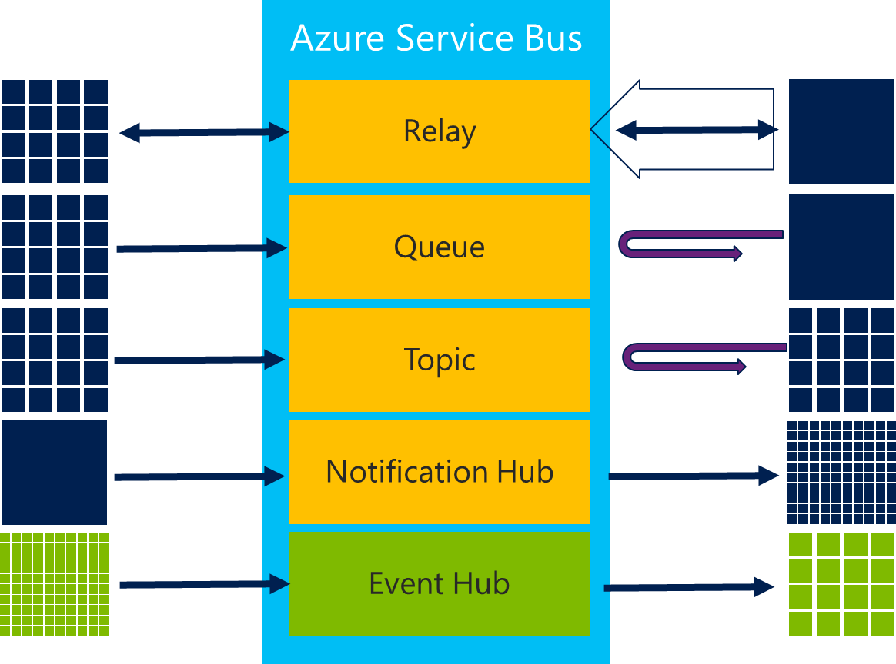
Connectivity
Challenges
Technology
Amount of connected things
Variety of protocols
Variety of communication pattern
Security
Variety of topologies
Discovery
Coverage
Partial connectivity
Device-/Configuration Management
HTTPs, MQTT, AMQP, CoAP
CAN, Modbus,
Bluetooth Low Energy (BLE), Zigbee
6LowPan
OPC-UA
LORA, MIOTY, …
Topology
Communication Pattern
directly connected
gateway connected

Slide 23
Data Storage
Challenges
Technology
Amount of Data (Big Data) - Volume
Speed of Data (Data Rate) - Velocity
Data format (semantics) - Variety
Data trust
Data quality
SQL
Map-and-Reduce (Hadoop)
Stream Processing (Spark)

Slide 24
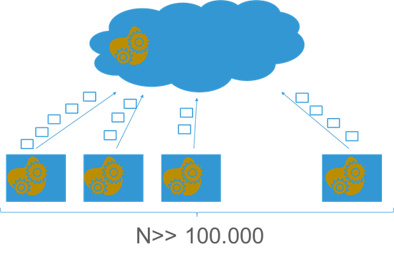
Analytics Insights
Challenges
Technology
Amount of Data
Quality of Data (Bias)
Insights
Data understanding (Exploration)
Scale
Execution of Analytics/ Distribution
Machine Learning
Why global?
Data born in the cloud: There is data which is created in the cloud
“Wisdom of the crowd“: Correlate and aggregate data from various sources to extract knowledge
Global view
Scale and history
Why local analytics?
Data born locally and action is required local
Data Reduction: Not all data needs to be sent to the cloud
Connectivity: Devices are not always connected
Privacy: User is concerned about privacy

