Slide 1
Modul - Internet of Things (IoT) - 05/06 – Vorlesung *Big Data
Prof. Dr. Marcel Tilly
Fakultät Informatik, Cloud Computing

Slide 2
Überblick
21. März Einführung in das Internet der Dinge
28. März IoT Architekturen
4. April Things und Sensoren
11. April From Device to Cloud
18. April Vorlesungsfrei – Ostern
25. April IoT Analytics
02. Mai Big Data in IoT
9. Mai Data Exploration
16. Mai IoT Platformen
23. Mai Entwicklung einer IoT Lösung
30. Mai Vorlesungsfrei; Christi Himmelfahrt
05. Juni opt. Gastvortrag – Digitalisierung
13. Juni Data Science in IoT
20. Juni Vorlesungsfrei – Fronleichnam
27. Juni Intelligente Cloud und intelligente Edge
04. Juli PStA Abschlusspraesentationen
PStA

Slide 3
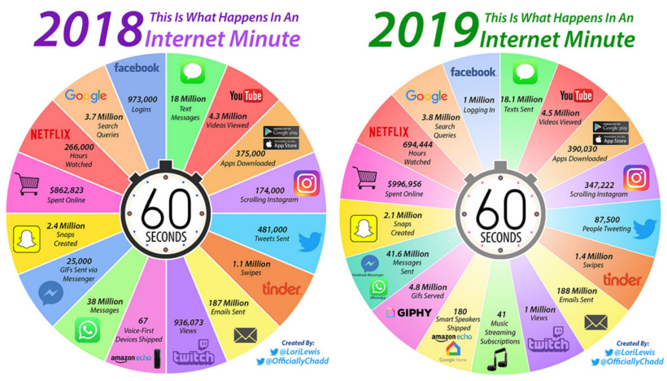

Slide 4
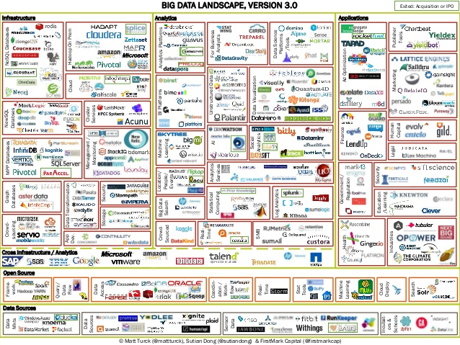

Slide 5
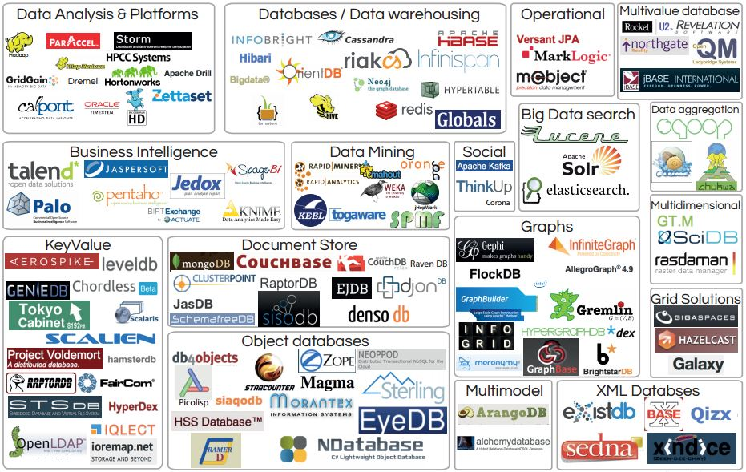

Slide 6
Motivation
Process lots of data
Google processed > 24 petabytes of data per day
A single machine cannot serve all the data
You need a distributed system to store and process in parallel
Parallel programming?
Threading is hard!
How do you facilitate communication between nodes?
How do you scale to more machines?
How do you handle machine failures?

Slide 7
MapReduce
MapReduce provides
Automatic parallelization, distribution
I/O scheduling
Load balancing
Network and data transfer optimization
Fault tolerance
Handling of machine failures
Need more power: Scale out, not up!
Large number of commodity servers as opposed to some high end specialized servers

Slide 8


Introduction into MapReduce

Slide 9
MapReduce: Map

Slide 10
MapReduce: Reduce

Slide 11
Typical problem solved by MapReduce
Read a lot of data
Map: extract something you care about from each record
Shuffle and Sort
Reduce: aggregate, summarize, filter, or transform
Write the results

Slide 12
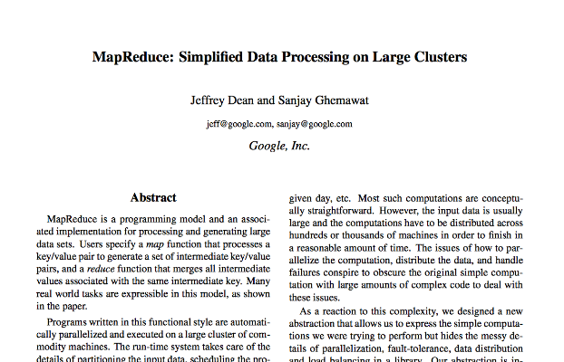
How did it start?
Extension to Google File System (GFS, 2003)
MapReduce paper published 2004 at OSDI
Used to recalculate search indices
Became synonymous for BigData
➔ Hadoop

Slide 13
MapReduce workflow
Input Data
Output Data
Worker
write
Output
File 0
local
write
Worker
Split 0
read
Split 1
Worker
Split 2
Output
File 1
Worker
Worker
remote
read,
sort
Map
extract something you care about from each record
Reduce aggregate, summarize, filter, or transform

Slide 14
Mappers and Reducers
Need to handle more data? Just add more Mappers/Reducers!
No need to handle multithreaded code ☺
Mappers and Reducers are typically single threaded and deterministic
Determinism allows for restarting of failed jobs
Mappers/Reducers run entirely independent of each other
In Hadoop, they run in separate JVMs

Slide 15
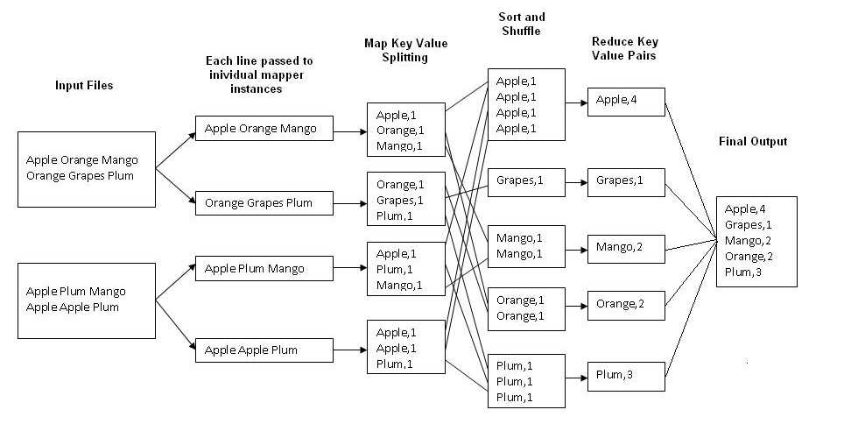
Example: Word Count
http://kickstarthadoop.blogspot.ca/2011/04/word-count-hadoop-map-reduce-example.html

Slide 16
Mapper
Reads in input pair <Key,Value>
Outputs a pair <K’, V’>
Let’s count number of each word in user queries (or Tweets/Blogs)
The input to the mapper will be <queryID, QueryText>:
<Q1,“The teacher went to the store. The store was closed; the store opens in the morning. The store opens at 9am.” >
The output would be:
<The, 1> <teacher, 1> <went, 1> <to, 1> <the, 1> <store,1> <the, 1> <store, 1> <was, 1> <closed, 1> <the, 1> <store,1> <opens, 1> <in, 1> <the, 1> <morning, 1> <the 1> <store, 1> <opens, 1> <at, 1> <9am, 1>

Slide 17
Reducer
Accepts the Mapper output, and aggregates values on the key
For our example, the reducer input would be:
<The, 1> <teacher, 1> <went, 1> <to, 1> <the, 1> <store, 1>
<the, 1> <store, 1> <was, 1> <closed, 1> <the, 1> <store, 1> <opens,1> <in, 1> <the, 1> <morning, 1> <the 1> <store, 1> <opens, 1> <at, 1> <9am, 1>
The output would be:
<The, 6> <teacher, 1> <went, 1> <to, 1> <store, 3> <was, 1> <closed, 1> <opens, 1> <morning, 1> <at, 1> <9am, 1>
Notes:
Input is typically sorted, output is output exactly as is
All inputs with the same key must go to the same reducer!

Slide 18
MapReduce
Hadoop
Program
fork
fork
fork
Master
assign
map
assign
reduce
Input Data
Output Data
Transfer peta-scale data through network
Worker
write
Output
File 0
local
write
Worker
Split 0
read
Split 1
Worker
Split 2
Output
File 1
Worker
Worker
remote
read,
sort
Map
Reduce

Slide 19
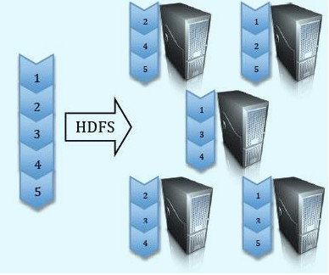
Hadoop Distributed File System (HDFS)
Split data and store 3 replica on commodity servers

Slide 20
λ Lambda Architecture
now
Gap
time
Created by Nathan Marz (worked at BackType, Twitter, Developed Storm)
Architecture for generic, scalable and fault-tolerant data processing
Robust system that is fault-tolerant against hardware failures and human mistakes
Addresses the problem of timely insights

Slide 21
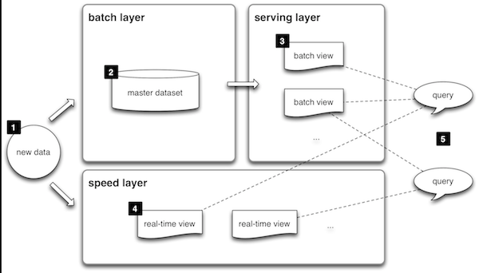
Lambda Architecture
All data entering the system is dispatched to both the batch layer and the speed layer for processing.
The batch layer has two functions: (i) managing the master dataset (an immutable, append-only set of raw data), and (ii) to pre-compute the batch views.
The serving layer indexes the batch views so that they can be queried in low-latency, ad-hoc way.
The speed layer compensates for the high latency of updates to the serving layer and deals with recent data only.
Any incoming query can be answered by merging results from batch views and real-time views.

Slide 22
IoT Architecture
Connectivity
Speed Layer
Data Stream
(Kafka, Spark, …)
Data Ingest
(MQTT Broker)
Query
UI
(BI)
Data Analytics
(Exploration, ML,…)
Views via Map and Reduce
(Haddop)
Immutable Master Data
(Data Lake)
Devices(Things)
Batch Layer

Slide 23
Data Analysis with Python

Slide 24
Python Libraries for Data Science
Many popular Python toolboxes/libraries:
NumPy
SciPy
Pandas
SciKit-Learn
Visualization libraries
matplotlib
Seaborn
and many more …

Slide 25
NumPy
NumPy
introduces objects for multidimensional arrays and matrices, as well as functions that allow to easily perform advanced mathematical and statistical operations on those objects
provides vectorization of mathematical operations on arrays and matrices which significantly improves the performance
many other python libraries are built on NumPy
Link: http://www.numpy.org/

Slide 26
SciPy
SciPy:
collection of algorithms for linear algebra, differential equations, numerical integration, optimization, statistics and more
part of SciPy Stack
built on NumPy
Link: https://www.scipy.org/scipylib/

Slide 27
Pandas
Pandas:
adds data structures and tools designed to work with table-like data (similar to Series and Data Frames in R)
provides tools for data manipulation: reshaping, merging, sorting, slicing, aggregation etc.
allows handling missing data
Link: http://pandas.pydata.org/

Slide 28
SciKit-Learn
SciKit-Learn:
provides machine learning algorithms: classification, regression, clustering, model validation etc.
built on NumPy, SciPy and matplotlib
Link: http://scikit-learn.org/

Slide 29
matplotlib
matplotlib:
python 2D plotting library which produces publication quality figures in a variety of hardcopy formats
a set of functionalities similar to those of MATLAB
line plots, scatter plots, barcharts, histograms, pie charts etc.
relatively low-level; some effort needed to create advanced visualization
Link: https://matplotlib.org/

Slide 30
Python Libraries for Data Science
Seaborn:
based on matplotlib
provides high level interface for drawing attractive statistical graphics
Similar (in style) to the popular ggplot2 library in R
Link: https://seaborn.pydata.org/

Slide 31
Data Frames attributes
Python objects have attributes and methods.
df.attribute | description
dtypes | list the types of the columns
columns | list the column names
axes | list the row labels and column names
ndim | number of dimensions
size | number of elements
shape | return a tuple representing the dimensionality
values | numpy representation of the data

Slide 32
Data Frames methods
Unlike attributes, python methods have parenthesis.
All attributes and methods can be listed with a dir() function: dir(df)
df.method() | description
head( [n] ), tail( [n] ) | first/last n rows
describe() | generate descriptive statistics (for numeric columns only)
max(), min() | return max/min values for all numeric columns
mean(), median() | return mean/median values for all numeric columns
std() | standard deviation
sample([n]) | returns a random sample of the data frame
dropna() | drop all the records with missing values

Slide 33
Missing Values
There are a number of methods to deal with missing values in the data frame:
df.method() | description
dropna() | Drop missing observations
dropna(how='all') | Drop observations where all cells is NA
dropna(axis=1, how='all') | Drop column if all the values are missing
dropna(thresh = 5) | Drop rows that contain less than 5 non-missing values
fillna(0) | Replace missing values with zeros
isnull() | returns True if the value is missing
notnull() | Returns True for non-missing values

Slide 34
Missing Values
When summing the data, missing values will be treated as zero
If all values are missing, the sum will be equal to NaN
cumsum() and cumprod() methods ignore missing values but preserve them in the resulting arrays
Missing values in GroupBy method are excluded (just like in R)
Many descriptive statistics methods have skipna option to control if missing data should be excluded . This value is set to True by default (unlike R)

Slide 35
Aggregation Functions in Pandas
Aggregation - computing a summary statistic about each group, i.e.
compute group sums or means
compute group sizes/counts
Common aggregation functions:
min, max
count, sum, prod
mean, median, mode, mad
std, var

Slide 36
Basic Descriptive Statistics
df.method() | description
describe | Basic statistics (count, mean, std, min, quantiles, max)
min, max | Minimum and maximum values
mean, median, mode | Arithmetic average, median and mode
var, std | Variance and standard deviation
sem | Standard error of mean
skew | Sample skewness
kurt | kurtosis

Slide 37
Graphics
 | description
distplot | histogram
barplot | estimate of central tendency for a numeric variable
violinplot | similar to boxplot, also shows the probability density of the data
jointplot | Scatterplot
regplot | Regression plot
pairplot | Pairplot
boxplot | boxplot
swarmplot | categorical scatterplot
factorplot | General categorical plot

Slide 38
Basic statistical Analysis
statsmodel and scikit-learn - both have a number of function for statistical analysis
The first one is mostly used for regular analysis using R style formulas, while scikit-learn is more tailored for Machine Learning.
statsmodels:
linear regressions
ANOVA tests
hypothesis testings
many more ...
scikit-learn:
kmeans
support vector machines
random forests
many more ...

