Slide 1
Modul - Internet of Things (IoT) - 01-Vorlesung
Prof. Dr. Marcel Tilly
Fakultät Informatik, Cloud Computing

Slide 2
Überblick
21. März Einführung in das Internet der Dinge
28. März IoT Architekturen
4. April Things und Sensoren
11. April From Device to Cloud
18. April Vorlesungsfrei – Ostern
25. April IoT Analytics
02. Mai Big Data in IoT
9. Mai Data Exploration
16. Mai IoT Platformen
23. Mai Entwicklung einer IoT Lösung
30. Mai Vorlesungsfrei; Christi Himmelfahrt
05. Juni opt. Gastvortrag – Digitalisierung
13. Juni Data Science in IoT
20. Juni Vorlesungsfrei – Fronleichnam
27. Juni Intelligente Cloud und intelligente Edge
04. Juli PStA Abschlusspraesentationen
PStA

Slide 3
Defining Internet of Things (10.000 ft)
Things
Connectivity
Data
Analytics
Internet of Things spans from end-to-end
Fire
Pollution Control
Emergency
Manufacturing Integration and Automation
Automation
Smart Cities
Remote Servicing
Smart Home
Cars
Aircraft
Water
Public
Safety
Lighting
Traffic
Smart Mobility
Buses
Smart Factory
Comfort
Trains
Waste
Law Enforcement
Security
Safety
Bikes
Vessels
Trucks
Predictive and Reactive Maintenance
Notes:
Talking Points
The truth is, there is no standard definition for the Internet of Things. If you have heard or read about IoT, chances are you’ve come across a number of different perspectives
Despite how complex IoT seems, it essentially comes down to four areas:
Physical “things” such as line of business assets, including industry devices or sensors
Those “things” have connectivity to the internet, to each other, and to people
Those “things” collect and communicate data—this may include information gathered from the environment or inputted by users
And then there are analytics performed on that data that enable people or machines to take action
Transition:
So how do you apply these components or building blocks to your business transformation journey

Slide 4

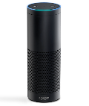
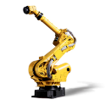
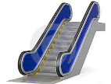
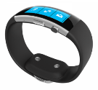


Things
Challenges
Technology
Memory
Processor
Energy (Battery) , lifetime
Security
Various generations (old vs new)
Heterogeneous platforms
Provisioning
Variety of device categories (sensor, gateways)
Variety of device types
Programming languages
Physical size
Inputs
Connectivity
Microcontroller vs OS powered
C, Java, Python, JavaScript, C++, C#, ….

Slide 5
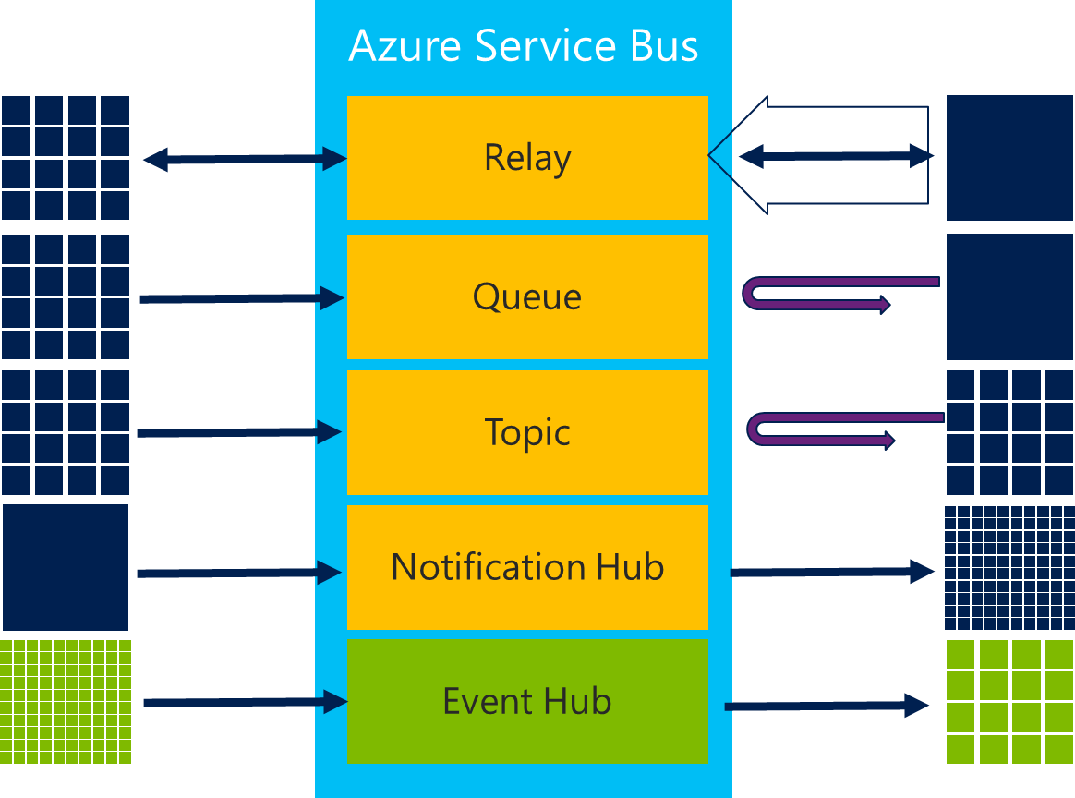
Connectivity
Challenges
Technology
Amount of connected things
Variety of protocols
Variety of communication pattern
Security
Variety of topologies
Discovery
Coverage
Partial connectivity
Stability
Bandwidth
Interference
Internationalisation
Device-/Configuration Management
HTTPs, MQTT, AMQP, CoAP
CAN, Modbus,
Bluetooth Low Energy (BLE), Zigbee
6LowPan
OPC-UA
LORA, MIOTY, …
Communication Pattern
Topology
directly connected
gateway connected

Slide 6
Data Storage
Challenges
Technology
Amount of Data (Big Data) - Volume
Speed of Data (Data Rate) - Velocity
Data format (semantics) - Variety
Data trust
Data quality
DSVGO (privacy)
Encryption (Transport security)
Compression
Data Selection
SQL
Map-and-Reduce (Hadoop)
Stream Processing (Spark)

Slide 7
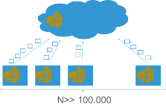
Analytics Insights
Challenges
Technology
Amount of Data
Quality of Data (Bias)
Insights
Data understanding (Exploration)
Scale
Execution of Analytics/ Distribution
Data Format
Error Handling
Correlation
Machine Learning
Why global?
Data born in the cloud: There is data which is created in the cloud
“Wisdom of the crowd“: Correlate and aggregate data from various sources to extract knowledge
Global view
Scale and history
Why local analytics?
Data born locally and action is required local
Data Reduction: Not all data needs to be sent to the cloud
Connectivity: Devices are not always connected
Privacy: User is concerned about privacy

Slide 8

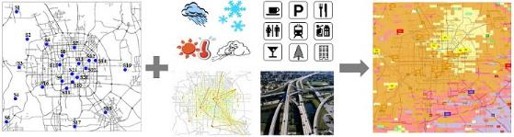
MSR ASIA (Jingbo Shang, Yu Zheng, Wenzhu Tong, Eric Chang, and Yong Yu)
http://research.microsoft.com/pubs/217455/frp0542-zheng-final.pdf
Inferring Gas Consumption and Pollution Emission of Vehicles throughout a City
Congestion and traffic jams cause drivers to waste gas, which on a mass scale causes greater air pollution that impacts on the environment and people's health. This study inferred the gas consumption and pollution emission of vehicles traveling on a city’s road network, using GPS trajectories generated by a sample of 32,000 taxicabs in Beijing over a period of two months.
http://urbanair.msra.cn/
Notes:
In this paper, we instantly infer the gas consumption and pollution emission of vehicles traveling on a city’s road network in current time slot, using GPS trajectories from a sample of vehicles (e.g., taxicabs). The knowledge cannot only be used to suggest cost-efficient driving routes but also identify the road segments where gas has been wasted significantly. In the meantime, the instant estimation of the pollution emission from vehicles can enable pollution alerts, and, in the long run, help diagnose the root cause of air pollution. In our method, we first compute the travel speed of each road segment using the GPS trajectories received recently. As many road segments are not traversed by trajectories (i.e., data sparsity), we propose a Travel Speed Estimation (TSE) model based on a context-aware matrix factorization approach. TSE leverages features learned from other data sources, e.g., map data and historical trajectories, to deal with the data sparsity problem. We then propose a Traffic Volume Inference (TVI) model to infer the number of vehicles passing each road segment per minute. TVI is an unsupervised Bayesian Network that incorporates multiple factors, such as the travel speed, weather conditions, and geographical features of a road. Given the travel speed and traffic volume of a road segment, the gas consumption and emission can be calculated based on existing environmental theories. We evaluated our method based on extensive experiments, using the GPS trajectories generated by over 32,000 taxis in Beijing over a period of two months. The results demonstrate the advantages of our method beyond baselines, validating the contribution of its components and finding interesting discoveries for social good.

Slide 9
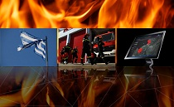
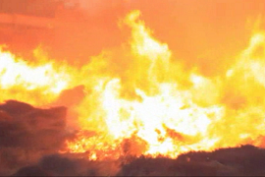
Fighting wildfires with data
Every second counts when combating a wildfire. Time lost can result in devastating loss of life or property. The University of the Aegean in Greece developed the VENUS-C Fire app—featuring Bing Maps, Microsoft Silverlight, and Windows Azure—to calculate and visualize the risk of wildfire ignition and to simulate fire propagation in the Greek island of Lesvos during its dry season. The university team generates a visualization of environmental factors each morning for the island’s fire management team, who then use the app to determine optimal resource allocation across the island for the day.

Slide 10
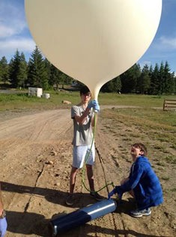
Windflow: AI Takes to the Skies
Research question: “Could we take the information that was already available and use it to predict wind conditions without needing any additional infrastructure?”
Could airplanes in flight be employed as a vast sensor network to determine atmospheric conditions?
Could data available today be used to infer winds on a large scale without special plane-based wind sensors and new infrastructure to access and combine signals from planes?
http://windflow.azurewebsites.net/
http://research.microsoft.com/en-us/um/people/horvitz/planesenors.pdf
Notes:
It turns out that data about the tens of thousands of flights over the United States each day are publicly available from the Federal Aviation Administration (FAA). That means people can view any commercial aircraft’s flight plan—the planned airspeed (fixed cruising speed relative to the air mass), altitude, distance, and route—as well as the observed groundspeed (speed relative to the ground), altitude, longitude, and latitude at any moment during the flight, with only a small time lag.
Because winds will change an aircraft’s flight path and affect the groundspeed, the researchers determined that they could estimate the wind conditions mathematically.
That sounds straightforward enough—if no wind is present, the groundspeed will match the airspeed and the plane will fly along its intended course. If you know the groundspeed and the airspeed, along with where the plane is heading and its actual course over the ground, you can calculate the wind speed and direction.
But one key piece of data was unavailable: The data provided by the FAA does not include information about where a plane is headed.
Solving this conundrum involved a creative leap—what Kapoor calls their “biggest intellectual aha moment.” They realized that winds exhibit a special property known as spatial regularity—that is, nearby airplanes are likely to encounter similar winds. They then figured out a way to exploit this property by taking observations from nearby wind stations, combining it with the FAA data, and then using a probabilistic model to infer the wind velocity. In essence, they came up with a way to solve a puzzle despite many missing pieces.

Slide 11
Domain: Manufacturing
Monitor manufacturing equipment
Improve your processes using industrial IoT solutions. Use sensors and advanced analytics to predict needed maintenance, and reduce unplanned downtime cutting into production time.
Provide predicitve maintenance to customers
Create new business models that offer predictive maintenance and performance monitoring for the equipment you produce, delivering a richer customer experience
Improve field services
Access sensor data to improve field service scheduling, ensuring the right technicians and tools are dispatched before potential issues become a major problem.

Slide 12
Domain: Transportation
Maintain vehicle performance
Keep vehicles on the road by predicting and monitoring maintenance needs—fixing potential issues during downtime to keep your business moving
Optimize fleet operations
Streamline logistics using real-time data and alerts to optimize delivery routes, monitor performance, and quickly respond to delays or issues as they happen.
Keep traffic moving
Monitor and process real-time traffic data to help manage transportation infrastructures, assess road conditions, and ease congestion.

Slide 13
Domain: Smart spaces
Create safer cities
Connect infrastructures to better regulate traffic, make emergency systems more efficient, and reduce police and emergency medical technician response time
Create smart buildings
Connect building devices and systems to bring more efficient operation and control to building owners, operators, and occupants.
Improve service, experience, and support
Increase service efficiency, from repairing broken street lamps to maintaining traffic lights to optimizing garbage truck routes

Slide 14
Domain: Healthcare
Evolve patient care
Allow patients to receive care away from their hospital at home, elsewhere around the world. With wearable sensors and service solutions, doctors can reduce readmissions and enable proactive care.
Monitor medical assets
Help your staff spend less time searching and more time with patients by better tracking and managing supplies and medicine—all on a cloud platform that's HIPAA compliant.
Track equipment usage
Enhance the overall well-being of patients by tracking how equipment is used, from employing hospital bed sensors to monitoring room temperature and hand washing stations
Maintain vital equipment
Ensure critical medical devices are ready to use when your patients need them most by fixing potential problems before they occur with predictive maintenance.

Slide 15
IoT vs IIoT vs Industry 4.0
IoT
IIoT
Industry 4.0
SmartHome
SmartMobility
SmartFactory
SmartCity
SmartLogistic
SmartRetail
Internet of Things:
Connection of all (smart) things (=physical objects) to a network (internet?) for all kind of domains and scenarios
Industrial Internet of Things:
Connection of all things in industry to enable new scenarios with business relevance (worldwide)
Industry 4.0:
Connection of all things in industry to enable new scenarios with business relevance (in Germany!)

Slide 16
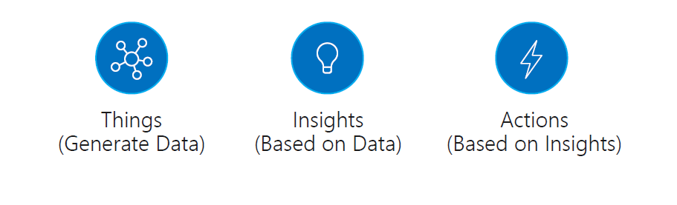
“IoT applications conceptually can be described as Things (or devices) sending data or events that are used to generate Insights, which are used to generate Actions to help improve a business or process”

Slide 17
Digital Feedback Loop
INSIGHTS
A realtime connection enables new breakthrough levels of insights that in turn drive informed actions
THINGS
ACTIONS

Slide 18

Use Case: Respond and recover quickly
With fragmented solutions |  | Maintain technicians onsite to determine and resolve issues |  | Take days or weeks to reroute and reconfigure devices | Search for data needed for root-cause analysis
 |  | 1 |  | 2 | 3
?!?
OR
OR
With IoT |  | Access devices remotely to diagnose and resolve issues |  | Complete corrections within hours, including rerouting processes and reconfiguring machines |  | Access comprehensive data immediately to perform root-cause analysis
 |  | 1 |  | 2 |  | 3

Slide 19
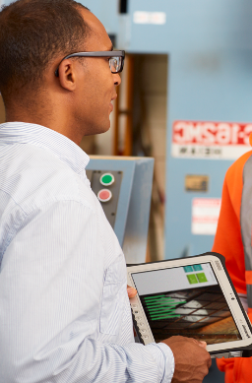
Use Case: Expand, change and scale easily
With fragmented solutions |  | Solve storage on your own using capacity planning, capital purchases and on-going maintenance |  | Connect new devices later after customizations and integration efforts are complete | Take weeks or months to modify and extend systems with custom connections
 |  | 1 |  | 2 | 3
+
+
With IoT |  | Exploit cloud solutions to scale instantly and pay for only what you need |  | Connect new devices now with little or no configuration required |  | Add to and extend systems faster by building on the extensible architecture
 |  | 1 |  | 2 |  | 3

Slide 20
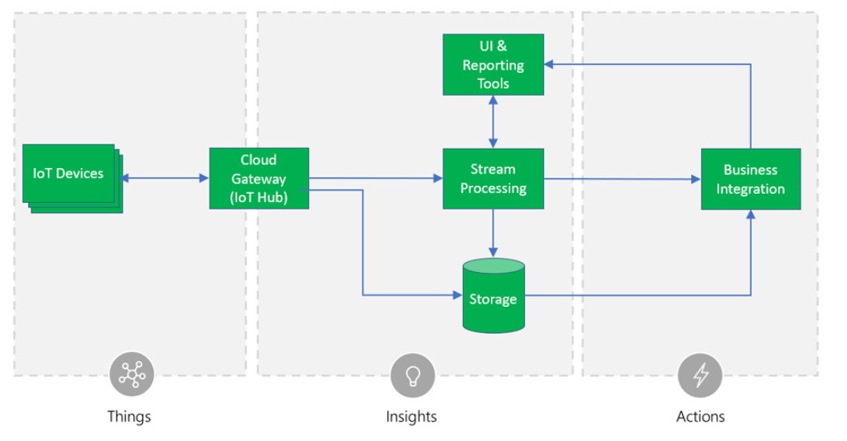
Core IoT Architecture

Slide 21
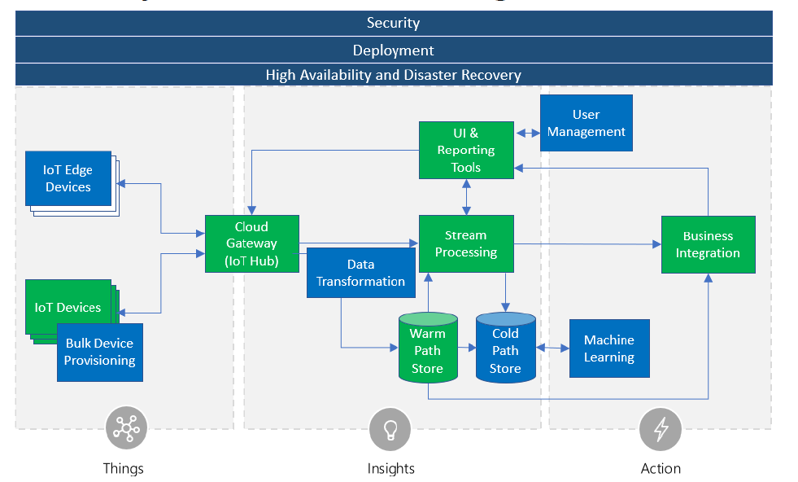
Core IoT Architecture & Non-functional Needs

Slide 22
Azure IoT Stack
Solutions (PaaS)
Solutions (SaaS)
Azure IoT (PaaS)
Partner repeatable solutions
Azure IoT Solution Accelerators
Azure IoT Central
IoT SaaS
Microsoft Dynamics Connected Field Service
Technologies (PaaS)
Device support
IoT
Edge
Data and Analytics
Visualization and Integration
Azure IoT Device SDK
Azure IoT Hub
Azure Stream Analytics
Azure HD Insight
Microsoft Flow
Azure Active Directory
Azure IoT certified devices
IoT Hub Device Provisioning Service
Azure Time Series Insights
Azure Data Lake Analytics
Azure Logic Apps
Microsoft Power BI
Security Program for Azure IoT
Azure Machine Learning
Azure Data Lake
Notification Hubs
Azure Monitor
Windows 10 IoT
Azure IoT Edge
Cosmos DB
Azure Websites

Slide 23

IoT Architecture
Power BI
Back end systems and processes
Devices
Web/ Mobile App
Storage blobs
Cosmos DB
IoT Hub
Stream Analytics
Event Hub
Web Jobs
Logic Apps
* Azure ML

Slide 24
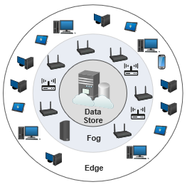
Edge-Fog-Cloud Architecture
Edge Layer: The outermost layer of the cloud is Edgelayer. The Edge is a collection of loosely coupled, voluntary and human-operated resources such as desktops,laptops, nano data centers, tablets, etc. As the name suggests, the resources reside at the edge of the network and are within one/two-hop distance from the IoT sensors and clients
Fog Layer: The Fog layer resides on top of the edge and is a consolidation of networking devices such as routers and switches with high computing capabilities and ability to run cloud application logic on their native architecture.

Slide 25
Iot Plattforms
Amazon Web Services
Google Cloud IoT
Azure IoT Suite
SAP
Salesforce IoT
IBM Watson Internet of Things (Bluemix)
Oracle Internet of Things
Cisco IoT Cloud Connect
Bosch IoT Suite
GE Predix
Siemens Mindsphere

Slide 26

The Internet of Things is not about the things or even the platform the same way we thought about motors or microprocessors. The big winners in IoT will be thinking about an entirely different future, not just connecting to things we already use today in ways we already use them.
Steven Sinofsky

