Slide 1
Modul - Internet of Things (IoT) - 03-Vorlesung
Prof. Dr. Marcel Tilly
Fakultät Informatik, Cloud Computing

Slide 2
Überblick
21. März Einführung in das Internet der Dinge
28. März IoT Architekturen
4. April Things und Sensoren
11. April From Device to Cloud
18. April Vorlesungsfrei – Ostern
25. April IoT Analytics
02. Mai Big Data in IoT
9. Mai Data Exploration
16. Mai IoT Platformen
23. Mai Entwicklung einer IoT Lösung
30. Mai Vorlesungsfrei; Christi Himmelfahrt
05. Juni opt. Gastvortrag – Digitalisierung
13. Juni Data Science in IoT
20. Juni Vorlesungsfrei – Fronleichnam
27. Juni Intelligente Cloud und intelligente Edge
04. Juli PStA Abschlusspraesentationen
PStA

Slide 3
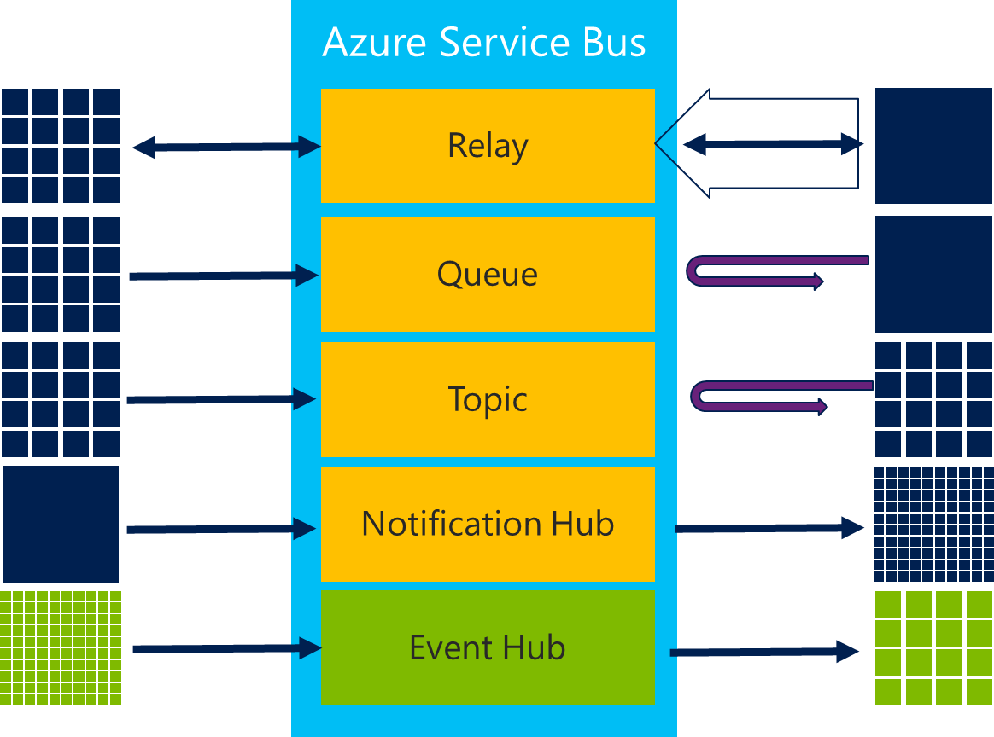
Connectivity
Challenges
Technology
Amount of connected things
Variety of protocols
Variety of communication pattern
Security
Variety of topologies
Discovery
Coverage
Partial connectivity
Stability
Bandwidth
Interference
Internationalisation
Device-/Configuration Management
HTTPs, MQTT, AMQP, CoAP
CAN, Modbus,
Bluetooth Low Energy (BLE), Zigbee
6LowPan
OPC-UA
LORA, MIOTY, …
Communication Pattern
Topology
directly connected
gateway connected

Slide 4
NON-IP based communication
Non-IP based communication is optimized for cost and energy usage
Samples:
Bluetooth
Zigbee
Z-Wave

Slide 5
Bluetooth (www.bluetooth.org)
Mainly used in phones, peripherals (keyboards, mouse, ..)
Invented around 1994 at Ericsson with the intent to get rid of cables
Intel and Nokia joined with focus to wirelessly link cell phones
2010 Nordic Semiconductor and Nokia developed Ultra Low Power Bluetooth (Bluetooth Low Energy BLE)
-> Created a new market with devise powered by a cell battery
BT is comprised by two wireless technology systems: Basic Rate (BR) and Low Energy (BLE)
Frequency: 2.4GHz ISM band
Range: – 100m
Supports beaconing: Beacons uses BLE and advertises presences (without connecting)

Slide 6
Zigbee
Based on IEEE 802.15.4 with target to enable IOT with constrained cost, power and space
Zigbee alliance was formed 2002, protocol was available in 2004
3 main components:
Zigbee controller (ZC): Highly capable device that is used to form the network functions
Zigbee router (ZR): Handles load of mesh network hopping and routing coordination.
Zigbee end device (ZED): The is a simple endpoint such as a light switch or a thermostat. It contains enough functionality to communicate with the coordinator

Slide 7
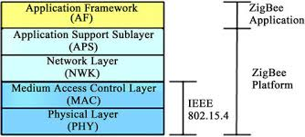
Zigbee Stack

Slide 8
Zigbee vs Bluetooth
Zigbee aims at automation whereas Bluetooth aims at connectivity of mobile devices in close proximity.
Zigbee uses low data rates, low power consumption on small packet devices while Bluetooth uses higher data rates, higher power consumption on large packet devices.
Zigbee networks support longer range devices and more in number compared to Bluetooth networks whose range is small.
Given Zigbee’s almost instant network join times(30 milliseconds) its more suitable for critical applications while Bluetooth’s longer join time is detrimental (3 seconds).

Slide 9
Z-Wave
For consumer and home automation and has 2100 products using it
Segment of lightning and HVAC control
Was created in 2001
Z-Wave Alliance member are: SmartThings, Honeywell, Belkin, Bosch, Carrier, ADT and LG
Uses the 900 MHz band, It is a closed protocol!
Components:
Controller device: This is the top-level device and provides the routing table for mesh networks
Slave device/node: These devices perform actions based on commands they receive.

Slide 10
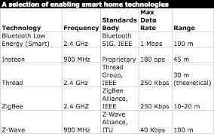
Overview NON-IP based Technologies

Slide 11
Low Power Wide Area Network
Requirements for LPWAN:
Long Range ( > km)
Low Power
Low Data Range
Different concepts:
LoRa (most popular!)
~ 9 miles distance
Rate 50 kbps
Battery life time 10 years
SIGFOX
MIOTY
IoT-LPWAN

Slide 12
LoRa Network Design

Slide 13
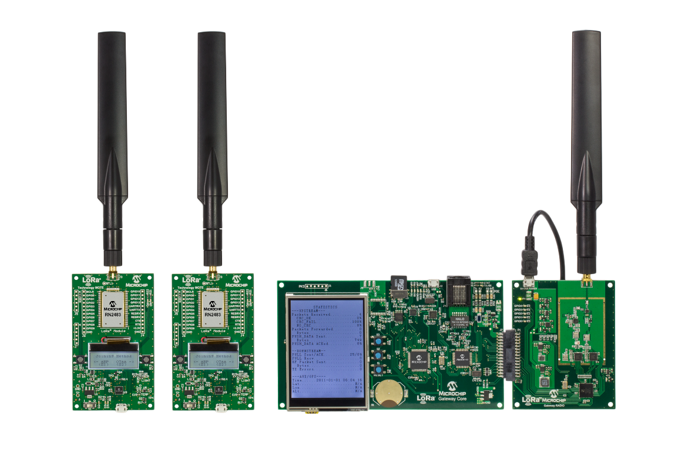
LoRa Concept
LoRa is a physical layer enabling long range communication links
LoRaWan is the communication protocol
LoRaWan is made for small devices and with focus on optimizing battery life
LoRa/ LoRaWan is extremely slow (do not send videos!)
LoRaWan is bidirectional … can send and receive data
LoRa Gateway
LoRa Motes
https://www.microchip.com/DevelopmentTools/ProductDetails/dv164140-1#additional-summary

Slide 14

https://www.iis.fraunhofer.de/de/jobs/summercamp.html

Slide 15
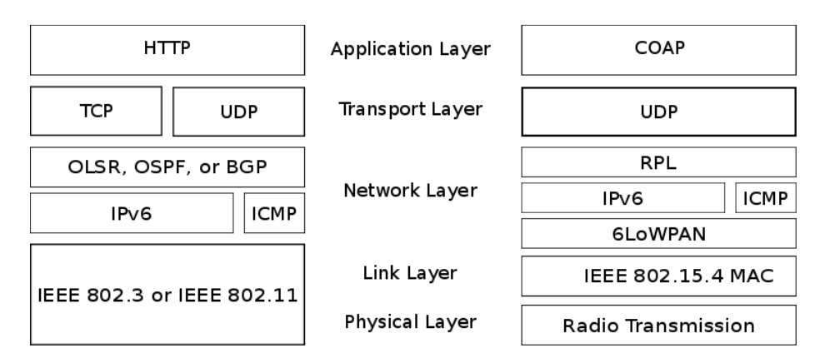
IP-based Protocols

Slide 16
What is 6LoWPAN?
6LoWPAN is an IETF Protocol designed for “Transmission of IPv6 Packets over IEEE 802.15.4 Networks” (rfc4944 , rfc6282)
6LoWPAN allows compression of IPv6 header and other headers such as UDP
IPv6 overhead reduction from 40bytes to e.g. 2/3 bytes
The 6Lo Working Group in IETF (https://tools.ietf.org/wg/6lo/) adapts 6LoWPAN protocol to other link layers technologies
E.g. 6LoWPAN for Bluetooth Low Energy is being finalized (https://tools.ietf.org/wg/6lo/draft-ietf-6lo-btle/)

Slide 17
Data Protocols
HTTP/ REST (Representational State Transfer)
IETF standard (RFC 2616 is HTTP/1.1)
CoAP (Constrained Application Protocol)
IETF standard (RFC 7252)
MQTT (Message Queuing Telemetry Transport)
soon (end 2014 ?) OASIS standard
AMQP (Advanced Message Queuing Protocol)
OASIS and ISO 19464 standard (1.0)

Slide 18
REST/ HTTP
The term representational state transfer (REST) was introduced and defined in 2000 by Roy Fielding in his doctoral dissertation.
Communicate statelessly
RESTful designs use standard HTTP methods: GET, PUT, POST and DELETE
Give resources an ID: Universal Resource Identifier (URI)
Link things together
A URI can be broken into a
Scheme : http://
Authority: www.th-rosenheim.de
Port : 8080
Path : /iot
Query :?id=“temperature”
The message via HTTP for the methods POST and PUT can contain a body
HTTP Header defines content-type

Slide 19
CoAP
The constrained Application Protocol (CoAP) is the product of the IETF (RFC7228)
First draft was created in 2014 by the IETF Constrained RESTful Environments (CoRE) working group
CoAP is based on concept of mimicking and replacing heavy HTTP with some lightweight protocol
CoAP is HTTP-like
Asynchronous message exchange (vs request-response)
Support for URI and content-types
CoAP has 2 layers:
Request/Response: Responsible for sending and receiving RESTful-based queries. REST queries are piggybacked on CON or NON message. A REST response is piggybacked on the corresponding ACK message.
Transactional layer: Handles single message exchanges between endpoints using one of the four basic message types.

Slide 20
CoAP
Constrained web protocol fulfilling M2M requirements
UDP binding with optional reliability supporting unicast and multicast requests
Asynchronous message exchanges
Low header overhead and parsing complexity
URI and Content-type support
Simple proxy and caching capabilities
Stateless HTTP mapping, allowing proxies to be built providing access to CoAP resources via HTTP in a uniform way or for HTTP simple interfaces to be realized alternatively over CoAP
Security binding to Datagram Transport Layer Security (DT
Address in CoAP is also styled like HTTP.
coap://host[:port]/path[?query]
CoAP uses requests such as GET, PUT, POST and DELETE

Slide 21
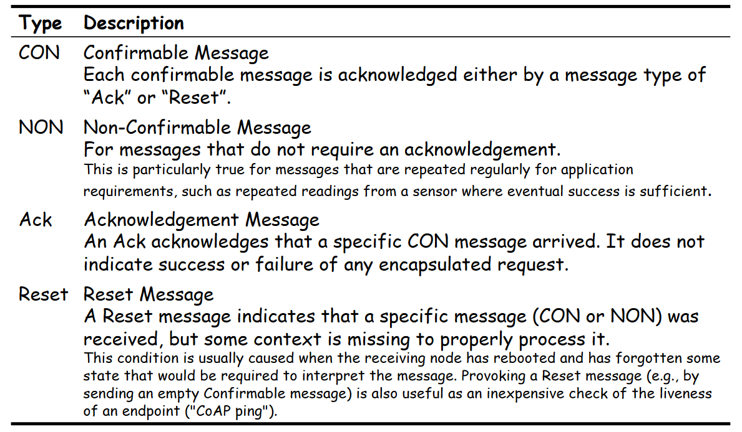
CoAP: Message Types

Slide 22
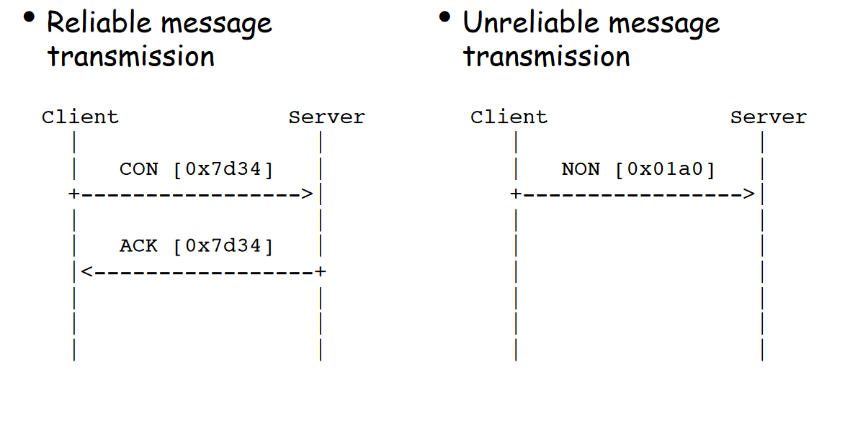
CoAP Messages

Slide 23
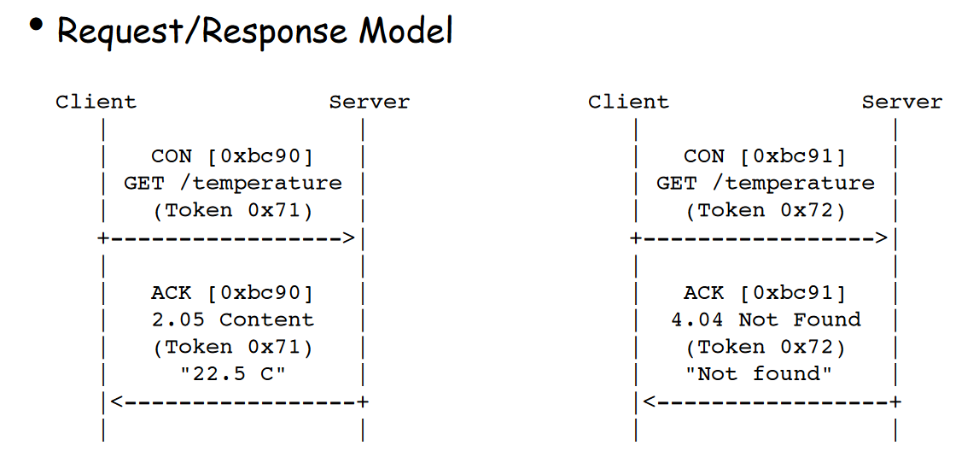
CoAP Request/Response

Slide 24
CoAP Sample
Client Server
| |
| |
+----->| Header: GET (T=CON, Code=1, MID=0x7d34)
| GET | Uri-Path: "temperature"
| |
| |
|<-----+ Header: 2.05 Content (T=ACK, Code=69, MID=0x7d34)
| 2.05 | Payload: "22.3 C"
| |
0 1 2 3
0 1 2 3 4 5 6 7 8 9 0 1 2 3 4 5 6 7 8 9 0 1 2 3 4 5 6 7 8 9 0 1
+-+-+-+-+-+-+-+-+-+-+-+-+-+-+-+-+-+-+-+-+-+-+-+-+-+-+-+-+-+-+-+-+
| 1 | 0 | 1 | GET=1 | MID=0x7d34 |
+-+-+-+-+-+-+-+-+-+-+-+-+-+-+-+-+-+-+-+-+-+-+-+-+-+-+-+-+-+-+-+-+
| 11 | 11 | "temperature" (11 B) ...
+-+-+-+-+-+-+-+-+-+-+-+-+-+-+-+-+-+-+-+-+-+-+-+-+-+-+-+-+-+-+-+-+
0 1 2 3
0 1 2 3 4 5 6 7 8 9 0 1 2 3 4 5 6 7 8 9 0 1 2 3 4 5 6 7 8 9 0 1
+-+-+-+-+-+-+-+-+-+-+-+-+-+-+-+-+-+-+-+-+-+-+-+-+-+-+-+-+-+-+-+-+
| 1 | 2 | 0 | 2.05=69 | MID=0x7d34 |
+-+-+-+-+-+-+-+-+-+-+-+-+-+-+-+-+-+-+-+-+-+-+-+-+-+-+-+-+-+-+-+-+
| "22.3 C" (6 B) ...
+-+-+-+-+-+-+-+-+-+-+-+-+-+-+-+-+-+-+-+-+-+-+-+-+-+-+-+-+-+-+-+-+

Slide 25
MQTT
MQTT is a lightweight publish/subscribe messaging protocol designed for M2M (machine to machine) telemetry in low bandwidth environments.
It was designed by Andy Stanford-Clark (IBM) and Arlen Nipper in 1999 for connecting Oil Pipeline telemetry systems over satellite.
Although it started as a proprietary protocol it was released Royalty free in 2010 and became an OASIS standard in 2014.
MQTT stands for MQ Telemetry Transport but previously was known as Message Queuing Telemetry Transport.
MQTT is fast becoming one of the main protocols for IOT (internet of things) deployments

Slide 26
MQTT
MQTT is a lightweight publish/subscribe messaging protocol designed for M2M (machine to machine) telemetry in low bandwidth environments.
It was designed by Andy Stanford-Clark (IBM) and Arlen Nipper in 1999 for connecting Oil Pipeline telemetry systems over satellite.
Although it started as a proprietary protocol it was released Royalty free in 2010 and became an OASIS standard in 2014.
MQTT stands for MQ Telemetry Transport but previously was known as Message Queuing Telemetry Transport.
MQTT is fast becoming one of the main protocols for IOT (internet of things) deployments

Slide 27
MQTT Versions
There are two versions of MQTT.
The original MQTT which was designed in 1999 and has been in use for many years and designed for TCP/IP networks.
MQTT-SN which was specified in around 2013, and designed to work over UDP, ZigBee and other transports.
MQTT-SN doesn’t currently appear to be very popular. and the specification hasn’t changed for several years

Slide 28
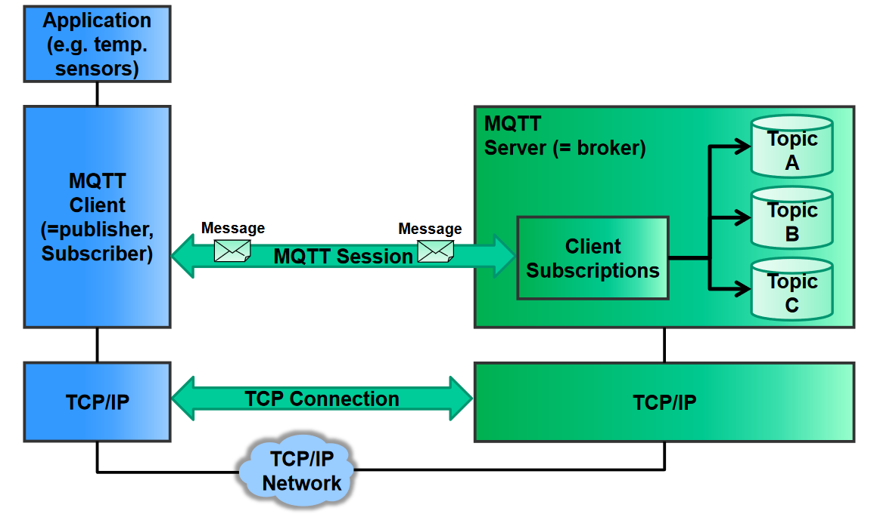
MQTT 1/2
The core elements of MQTT are clients, servers(=brokers), sessions, subscriptions and topics

Slide 29
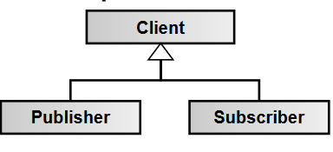

MQTT 2/2
MQTT client(=publisher, subscriber):
Clients subscribe to topics to publish and receive messages. Thus subscriber and publisher are special roles of a client.
MQTT server(=broker): Servers run topics, i.e. receive subscriptions from clients on topics, receive messages from clients and forward these, based on client’s subscriptions, to interested clients.
Topic: Technically, topics are message queues. Topics support the publish/subscribe pattern for clients. Logically, topics allow clients to exchange information with defined semantics. Example topic: Temperature sensor data of a building.

Slide 30
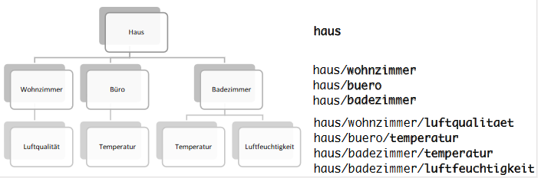
MQTT Topic Names
Topics are defined by a UTF-8-String which has the form of
haus/badezimmer/temperatur
https://opus.hs-offenburg.de/frontdoor/deliver/index/docId/2771/file/THESIS_MARIO_SALLAT.pdf

Slide 31
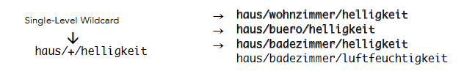


MQTT Topic Filtering
Single-Level Wildcard +
Multi-Level Wildcard #
Topics with $ (internal only, topic is refused!)

Slide 32
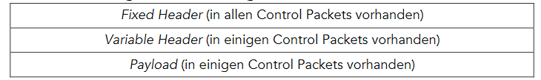
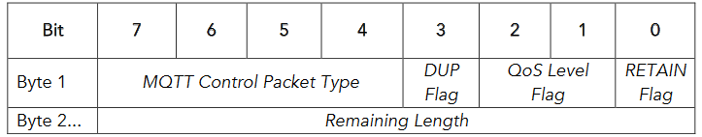
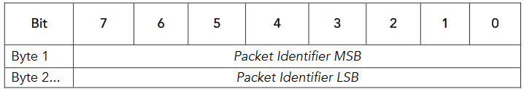
MQTT Message Format

Slide 33
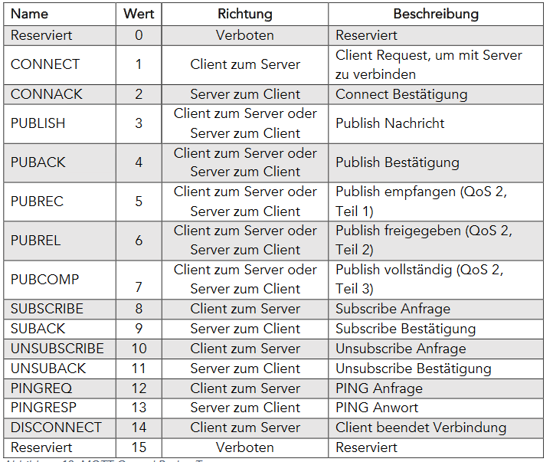
MQTT Message Format

Slide 34
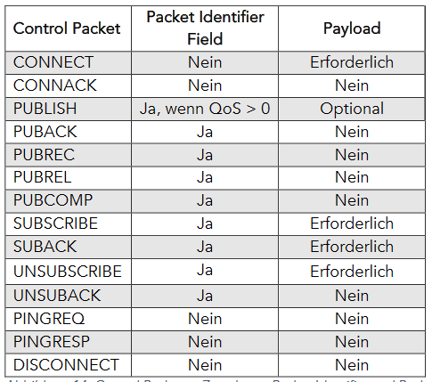
MQTT Message Format

Slide 35
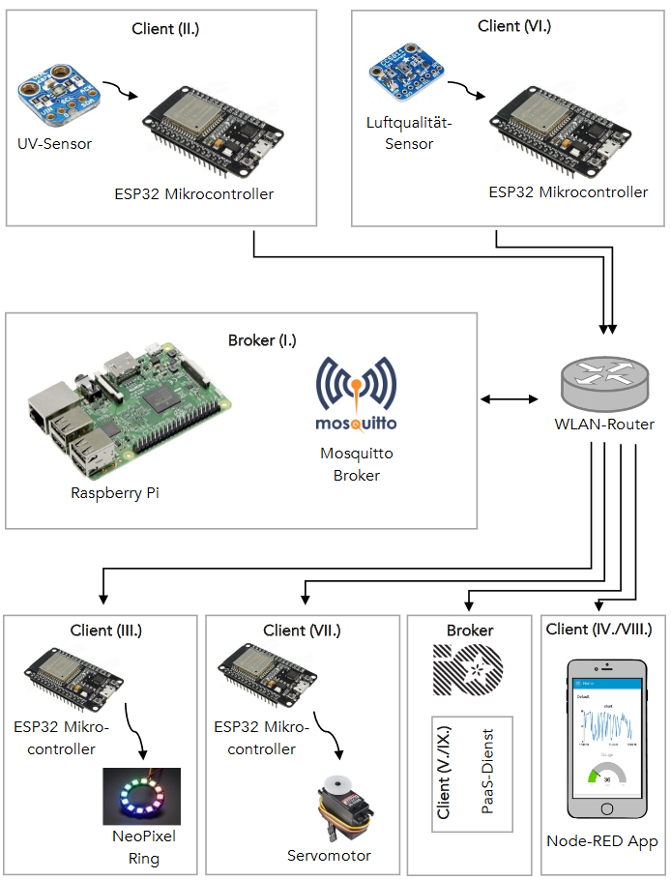
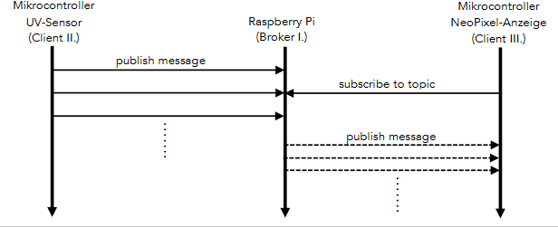
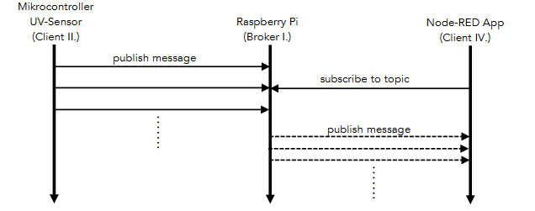
MQTT Sample

