Slide 1
Modul - Internet of Things (IoT) - 05 – Vorlesung IoT Platformen
Prof. Dr. Marcel Tilly
Fakultät Informatik, Cloud Computing

Slide 2
Überblick
21. März Einführung in das Internet der Dinge
28. März IoT Architekturen
4. April Things und Sensoren
11. April From Device to Cloud
18. April Vorlesungsfrei – Ostern
25. April IoT Analytics
02. Mai Big Data in IoT
9. Mai Data Exploration
16. Mai IoT Platformen
23. Mai Entwicklung einer IoT Lösung
30. Mai Vorlesungsfrei; Christi Himmelfahrt
05. Juni opt. Gastvortrag – Digitalisierung
13. Juni Data Science in IoT
20. Juni Vorlesungsfrei – Fronleichnam
27. Juni Intelligente Cloud und intelligente Edge
04. Juli PStA Abschlusspraesentationen
PStA

Slide 3
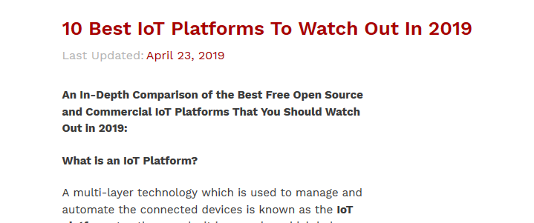
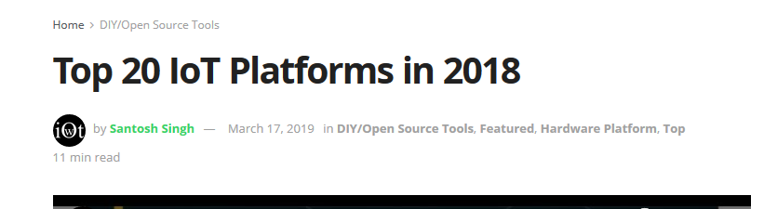
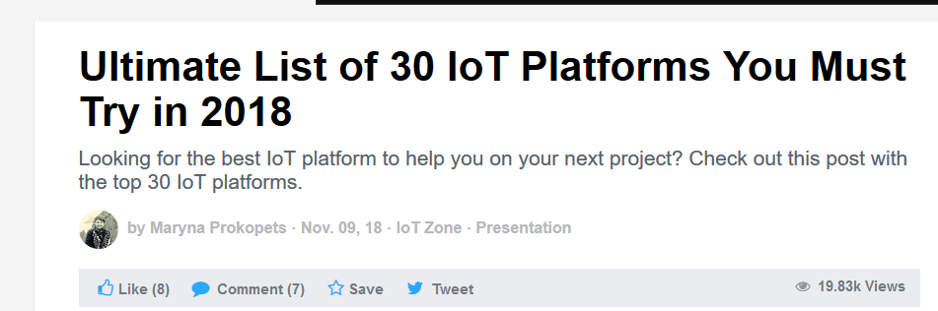

Slide 4
IoT Platform
AWS IoT
Native integration with the rich Amazon ecosystem
Specific industry domain agnostic
Magnificent scalability and customization potential
Google Cloud IoT
Supports both cloud and edge computing
Providing reliable and secure storage of data
Includes Cloud Machine Learning, BigQuery, and other services for storing, analyzing, and visualizing the data from your sensors
Automatic and custom firmware updates, secure connections, etc.
Microsoft Azure IoT
Support a very large number of devices
Excellent scalability
Strong security
High reliability with 99.95 percent of uptime
Backend service integration
IBM Watson IoT (aka Bluemix)
IoT platform offers an advanced integration with machine learning capabilities
Good support for IoT developers by providing tools for easy and fast application development
Taken from: https://dzone.com/articles/ultimate-list-of-30-iot-platforms-for-your-iot-pro

Slide 5
IoT Platform
Oracle IoT
SalesForce IoT
Bosch IoT
Good security and reliability
On-line and offline storage
Good prototype capabilities
Cost-effective
ThingsIO.AI
Siemens MindSphere
Focuses on reducing the downtime of critical equipment
Scalable connectivity (cloud and edge)
Runs on AWS and Azure
Ayla Networks IoT
GE Predix
Fokus on industrial applications.
Good solution scale
It is designed to analyze and efficiently transfer huge volumes of data from assets to edge devices, cloud, etc.
Taken from: https://dzone.com/articles/ultimate-list-of-30-iot-platforms-for-your-iot-pro

Slide 6
IoT Architecture (Draft)
Connectivity
Speed Layer
Data Stream
(Kafka, Spark, …)
Data Ingest
(MQTT Broker)
Query
UI
(BI)
Data Analytics
(Exploration, ML,…)
Views via Map and Reduce
(Haddop)
Immutable Master Data
(Data Lake)
Devices(Things)
Batch Layer

Slide 7
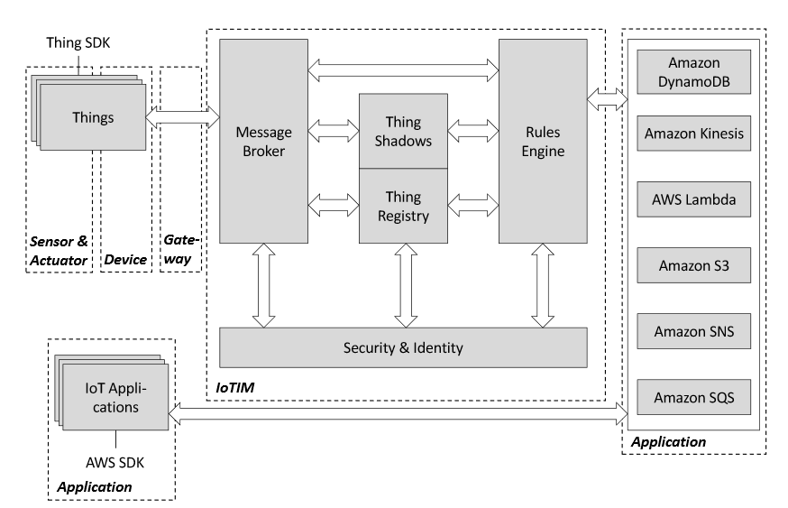
Amazon Web Services (AWS) IoT
Main features of AWS IoT platform are:
Registry for recognizing devices
Software Development Kit for devices
Device Shadows
Secure Device Gateway
Rules engine for inbound message evaluation
Source: https://www.iaas.uni-stuttgart.de/publications/INBOOK-2018-01-A-Detailed-Analysis-of-IoT-Platform-Architectures-Concepts-Similarities-and-Differences.pdf

Slide 8
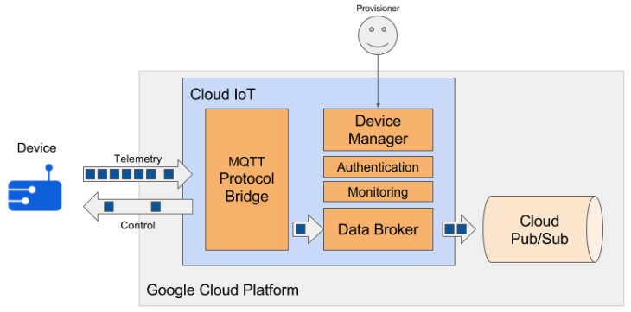
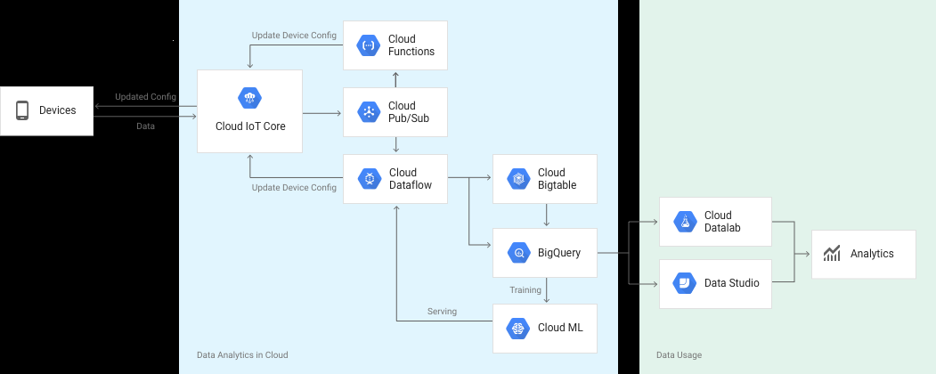
Google Cloud IoT

Slide 9
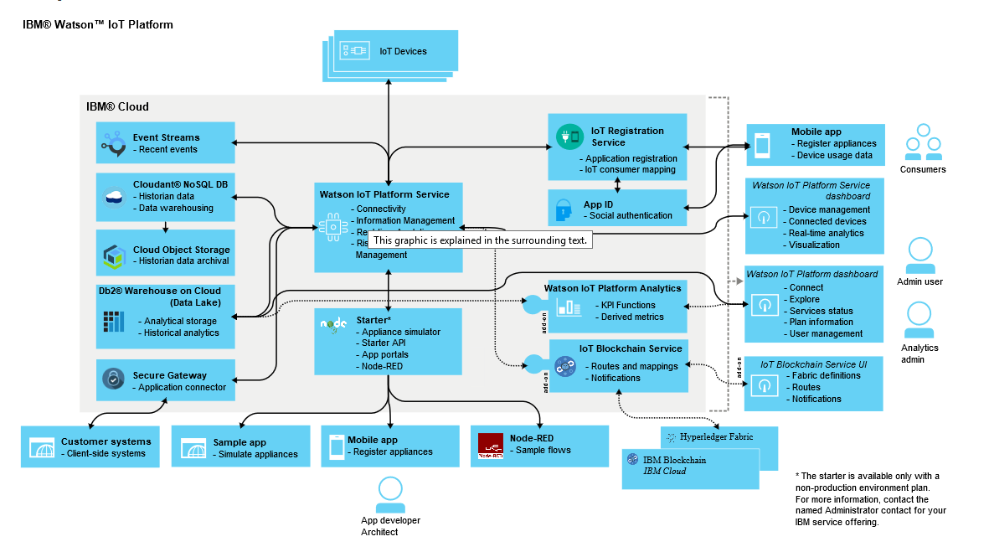
IBM Watson IoT
source: https://www.ibm.com/support/knowledgecenter/en/SSQP8H/iot/overview/architecture.html

Slide 10
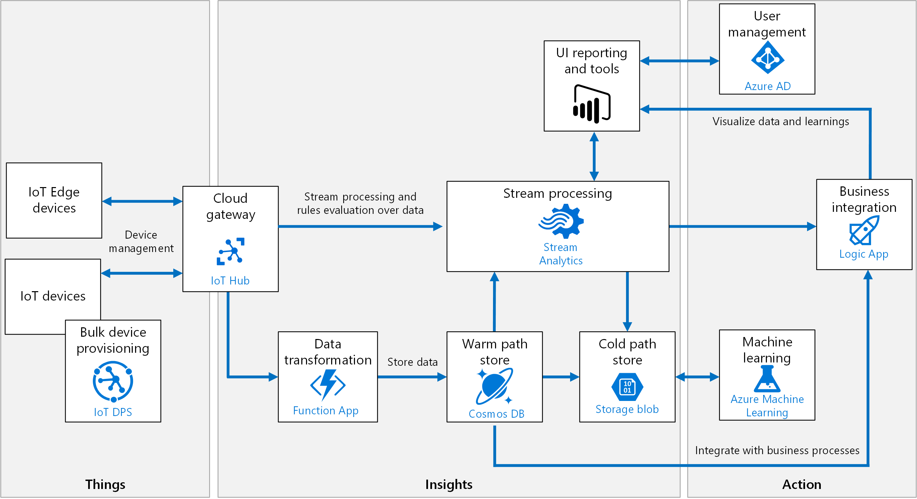
Microsoft Azure IoT
Source: https://docs.microsoft.com/en-us/azure/architecture/reference-architectures/iot/

Slide 11
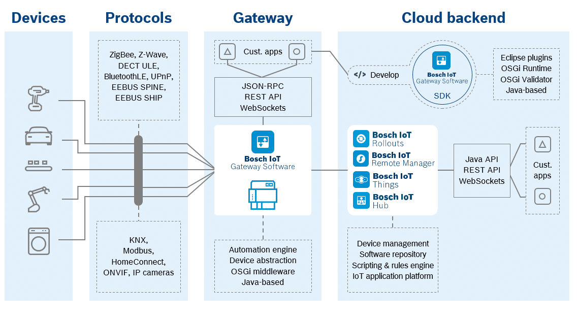
Bosch IoT Suite
source: https://blog.bosch-si.com/bosch-iot-suite/release-9-1-bosch-iot-gateway-software-available-now/

Slide 12
Requirements for an IoT Platform
Device SDK
Protocol
Authentication and Security (TLS)
Sensors and Actuators
Gateway
Protocol Support (HTTP(s), MQTT)
Authentication/Autorisation
Data Ingress
Device Control
(Device Twin)
Backend
Data Transformation
Data Processing
Data Storage
Analytics
ML
Business Intelligence
Thing
Connectivity
Data
Analytics

Slide 13
IoT Platform Architecture (v0.2)
Things
Connectivity
Data
Analytics
IoT Middleware
BI
S
A
Device Control
Transformation
(Function)
SDK
Device Registry
Data Stream
(Kafka, Spark, …)
Auth
Query
Data Ingest
(MQTT Broker)
Transformation
(Function)
Views via Map and Reduce
Data Ingest
(HTTP)
Data Analytics
(Exploration, ML,…)
Immutable Master Data
(Data Lake)
Auth

