Slide 1
Modul - Internet of Things (IoT) - 05 – Vorlesung – IoT Lösung
Prof. Dr. Marcel Tilly
Fakultät Informatik, Cloud Computing

Slide 2
Überblick
21. März Einführung in das Internet der Dinge
28. März IoT Architekturen
4. April Things und Sensoren
11. April From Device to Cloud
18. April Vorlesungsfrei – Ostern
25. April IoT Analytics
02. Mai Big Data in IoT
9. Mai Data Exploration
16. Mai IoT Platformen
23. Mai Entwicklung einer IoT Lösung
30. Mai Vorlesungsfrei; Christi Himmelfahrt
05. Juni opt. Gastvortrag – Digitalisierung
13. Juni Data Science in IoT
20. Juni Vorlesungsfrei – Fronleichnam
27. Juni Intelligente Cloud und intelligente Edge
04. Juli PStA Abschlusspraesentationen
PStA

Slide 3
IoT Platform Architecture (v0.2)
Things
Connectivity
Data
Analytics
IoT Middleware
BI
S
A
Device Control
Transformation
(Function)
SDK
Device Registry
Data Stream
(Kafka, Spark, …)
Auth
Query
Data Ingest
(MQTT Broker)
Transformation
(Function)
Views via Map and Reduce
Data Ingest
(HTTP)
Data Analytics
(Exploration, ML,…)
Immutable Master Data
(Data Lake)
Auth

Slide 4
IoT Platform Architecture (v0.3)
Things
Connectivity
Data
Analytics
IoT Middleware
BI
S
A
Device Control
Transformation
(Function)
SDK
Device Registry
Data Stream
(Kafka, Spark, …)
Auth
Query
Data Ingest
(MQTT Broker)
Transformation
(Function)
Views via Map and Reduce
Data Ingest
(HTTP)
Data Analytics
(Exploration, ML,…)
Immutable Master Data
(Data Lake)
Auth

Slide 5
Azure Storage
Blobs
Storage for any type of data, analogous to files in a file system, with individual blobs storing up to 4.75 TB of data
Queues
Reliable messaging for workflow processing and for communication between applications or application components
Tables
NoSQL storage of semi-structured data for rapid development and fast access to large quantities of data
Files
File sharing using Server Message Block (SMB) protocol
Notes:
Microsoft Azure Storage is a set of services that allows you to store large volumes of data in a cost-effective manner and in a way that makes the data readily and reliably available to services and applications that consume it. Data committed to Azure Storage can be stored in blobs, tables, queues, or files. Azure blobs are ideal for storing images, videos, and other types of data, and are frequently used to provide input to and capture output from other Azure services such as Azure Stream Analytics. Azure tables provide NoSQL storage for semi-structured data. Azure queuessupport queued message transfers between applications (or parts of applications) and can be used to make applications more scalable and robust by loosely coupling them together. Finally, Azure Files use the Server Message Block (SMB) protocol to share files through the cloud and access storage as network drives.
Data stored in Microsoft Azure Storage can be accessed over HTTP or HTTPS using straightforward REST APIs, or it can be accessed using rich client libraries available for many popular languages and platforms, including .NET, Java, Android, Node.js, PHP, Ruby, and Python. The Azure Portal includes features for working with Azure Storage, but richer functionality is available from third-party tools, many of which are free and some of which work cross-platform.

Slide 6
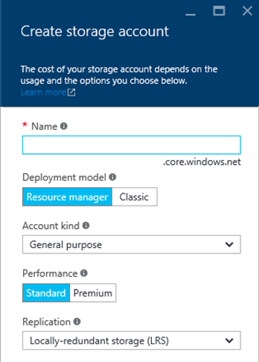
Storage Accounts
Up to 500 TB of data per account
Maximum of 200 storage accounts per subscription
Two types of accounts
"General purpose" and "Blob storage"
Four types of replication
LRS, ZRS, GRS, and RA-GRS
Support optional 256-bit AES encryption for "data at rest"
Notes:
Locally redundant storage (LRS) maintains three copies of your data. LRS is replicated three times within a single facility in a single region. LRS protects your data from normal hardware failures, but not from the failure of a single facility.
Zone-redundant storage (ZRS) maintains three copies of your data. ZRS is replicated three times across two to three facilities, either within a single region or across two regions, providing higher durability than LRS. ZRS ensures that your data is durable within a single region.
Geo-redundant storage (GRS) is enabled for your storage account by default when you create it. GRS maintains six copies of your data. With GRS, your data is replicated three times within the primary region, and is also replicated three times in a secondary region hundreds of miles away from the primary region, providing the highest level of durability. In the event of a failure at the primary region, Azure Storage will failover to the secondary region. GRS ensures that your data is durable in two separate regions.
Read access geo-redundant storage (RA-GRS) replicates your data to a secondary geographic location, and also provides read access to your data in the secondary location. Read-access geo-redundant storage allows you to access your data from either the primary or the secondary location, in the event that one location becomes unavailable.

Slide 7
Azure Storage Architecture
Import / Export
Client Libraries
(.NET, Java, c++, Android, Python, Node.JS…)
SMB Client
REST
REST
REST
REST
SMB 2.1
Blob/Disk
Endpoint
Table
Endpoint
Queue
Endpoint
File Share
Endpoint
Front End Layer
Massive Scale Out & Auto Load Balancing Index Layer
Partition Layer
Distributed Replication Layer
Stream Layer

Slide 8
Blob Storage
Accounts
Containers
Blobs
images
schema.jpg
a4rlabs
Png/flow.png
documents
Labs.pdf
3 to 24 characters
0-9 and a-z
Unique within Azure
3 to 63 characters
0-9, a-z, and dashes
1 to 1,024 characters
Any characters (including slashes)
URL characters must be escaped
Max. 254 path segments
Notes:
Storage begins with a storage account, which can be created in the Azure Portal. Before you can create a blob, you must create a container to store it in. Think of containers as folders in a file system and blobs as the files themselves. Storage accounts must be uniquely named and conform to a rather severe set of restrictions since storage names are used to form DNS names.

Slide 9
Blob URLs
Accounts
Containers
Blobs
images
schema.jpg
a4rlabs
Png/flow.png
documents
Labs.pdf
https://a4rlabs.blob.core.windows.net/images/schema.jpg
Notes:
Once created, a blob can be referenced by URL. The URL is formed from the storage-account name, container name, and blob name. This doesn't mean all blobs are public; they're private by default. But they can be made public, and public blobs can be downloaded simply by typing their URLs into a browser.

Slide 10
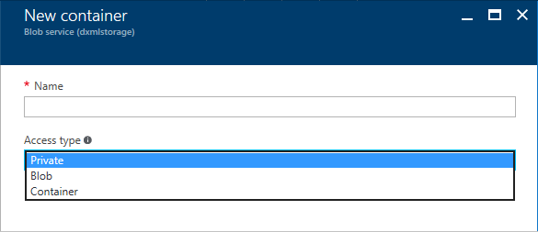
Storage Containers
Three access policies
Private – Blobs can't be read or enumerated anonymously
Container – Blobs can be read and enumerated anonymously
Blob – Blobs can be read anonymously, but cannot be enumerated
Notes:
Containers are private by default, which means only the storage-account owner (or someone who has an access key for the storage account or a valid SAS) can access its contents. However, setting the container's access policy to "Public Container" or "Public Blob" makes the container's blobs public. The difference between "Public Container" and "Public Blob" is that the latter allows the blobs in the container to be enumerated, while the latter does not.

Slide 11
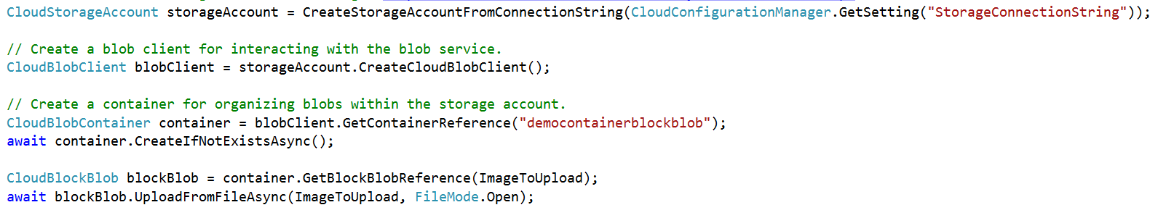
Abstractions – Blobs
Blobs – Massively scalable object store in the cloud
Simple REST interface (Put, Get, Delete)
Data sharing – share documents, pictures, video, music, etc.
Big Data – store raw data/logs and compute/map reduce over data
Backups – data and device backups

Slide 12
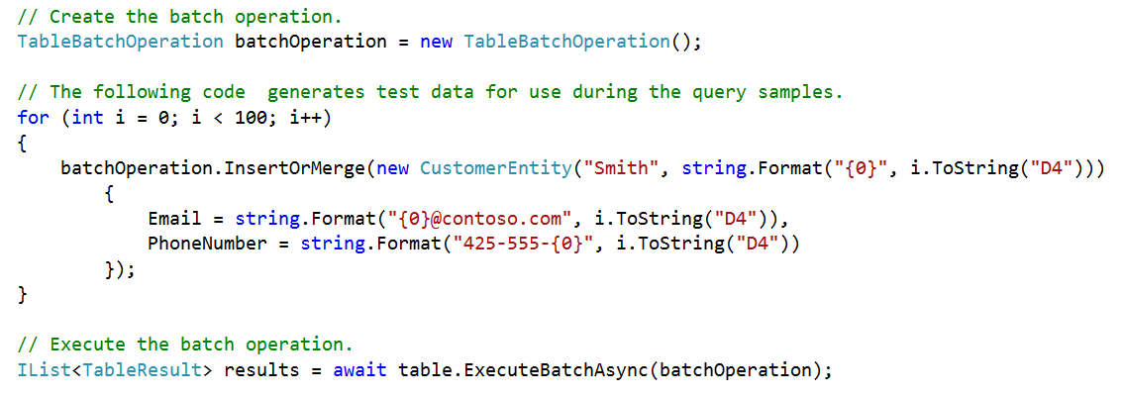
Abstractions – Tables
Tables – Massively scalable NoSQL cloud store
Key/Attribute(s) store at scale
Store user, device or any type of metadata for your service
Auto load balances partitions to meet traffic needs
OData protocol (AtomPub or JSON)

Slide 13
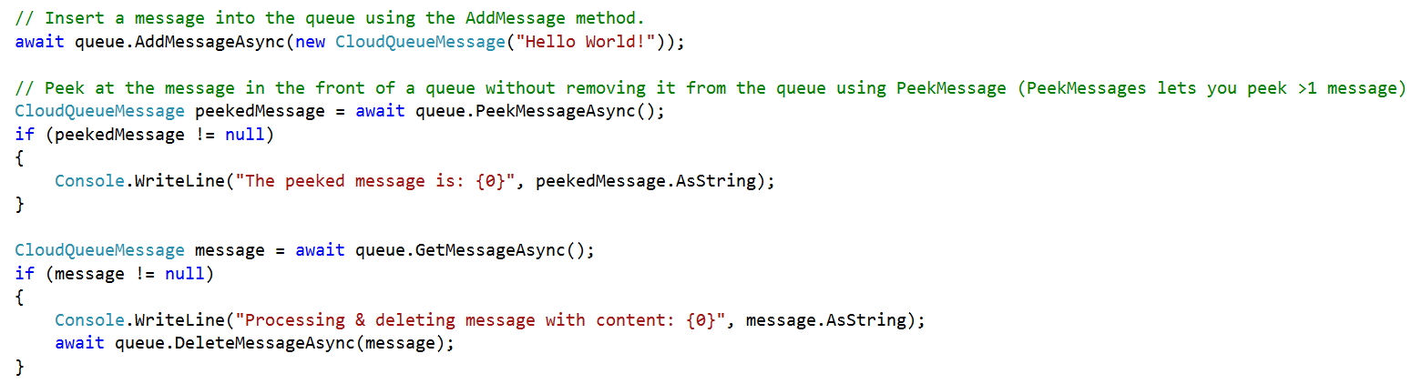
Abstractions – Queues
Queues – Reliable messaging system
Reliable, low latency, high throughput messaging system
Decouple components/roles
Web role to worker role communication
Allows roles to scale independently
Implement scheduling of asynchronous tasks
Building process/work flows

Slide 14
Abstractions – Files
Move on-premises applications to cloud
VMs can net use an SMB share using standard file APIs and semantics
SMB 2.1 protocol
VM and storage account within same region
Supports REST and SMB protocol access to same file share
Microsoft Azure
Share data stored in Azure Files among Azure VMs via SMB
Azure Storage
SMB
Blobs
Tables
REST API
Queues
REST API
Files

Slide 15
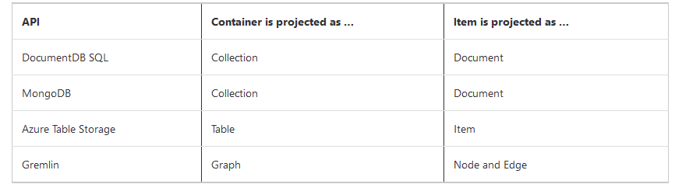
What is Azure COSMOS DB?
Each resource is uniquely identified by a stable and logical URI and represented as a JSON document
The overall resource model of an application using Azure Cosmos DB is a hierarchical overlay of the resources rooted under the database account and can be navigated using hyperlinks.
Using document-oriented APIs, container and item resources are projected as collection (container) and document (item) resources
For graph-oriented API access, the underlying container and item resources are projected as graph (container), node (item) and edge (item) resources respectively
Using a key-value API, table (container) and item/row (item) are projected

Slide 16
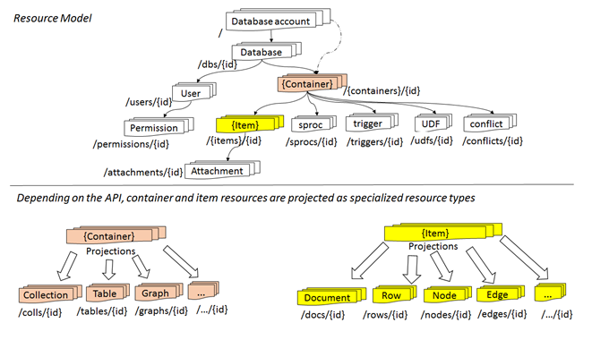
Resource Model
Single system image of globally distributed, URI addressable logical resources
Consistent, hierarchical overlay over horizontally partitioned entities
Extensible custom projections

Slide 17
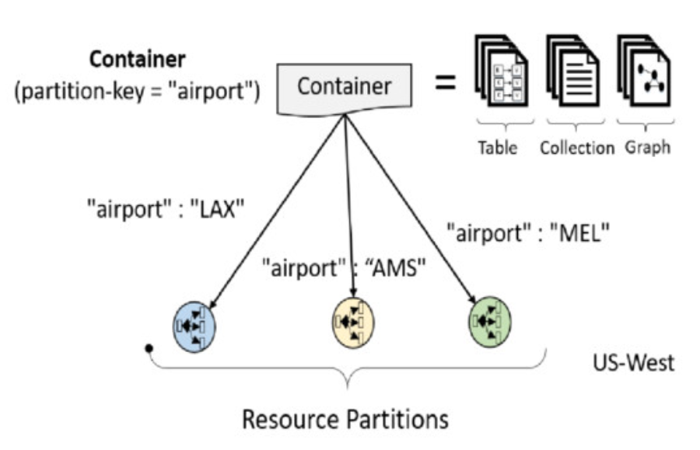
Horizontal partitioning
All resource are horizontally partitioned
Resource Partition
Consistent, highly available and resource governed, coordination primitive
Uniquely belongs to a tenant
Partition management is transparent and made highly responsive

Slide 18
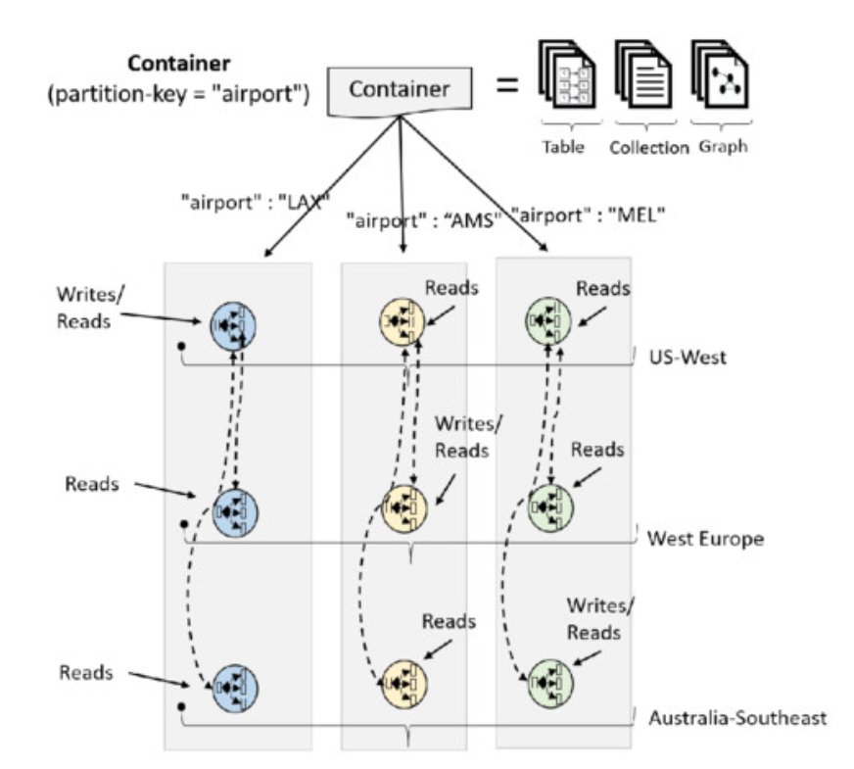
Global distribution
All resources are horizontally partitioned and vertically distributed
Nested consensus
Distribution can be within a cluster, x-cluster, x-DC, or x-region

Slide 19
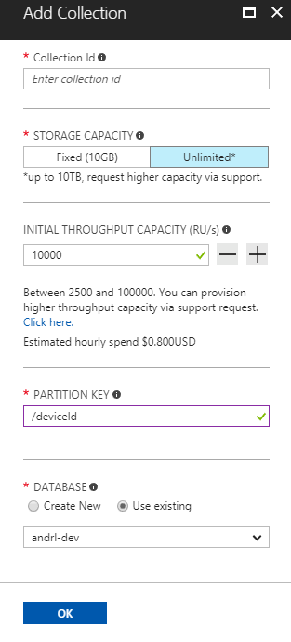
Container Representations
Account
Database
Database
Database
Database
=
Database
Container
Collection
Graph
Table
Database
Database
Item
Database
Database
Sproc
Trigger
UDF
Conflict
Item

