Slide 1
Modul - Internet of Things (IoT) - 04-Vorlesung
Prof. Dr. Marcel Tilly
Fakultät Informatik, Cloud Computing

Slide 2
Überblick
21. März Einführung in das Internet der Dinge
28. März IoT Architekturen
4. April Things und Sensoren
11. April From Device to Cloud
18. April Vorlesungsfrei – Ostern
25. April IoT Analytics
02. Mai Big Data in IoT
9. Mai Data Exploration
16. Mai IoT Platformen
23. Mai Entwicklung einer IoT Lösung
30. Mai Vorlesungsfrei; Christi Himmelfahrt
05. Juni opt. Gastvortrag – Digitalisierung
13. Juni Data Science in IoT
20. Juni Vorlesungsfrei – Fronleichnam
27. Juni Intelligente Cloud und intelligente Edge
04. Juli PStA Abschlusspraesentationen
PStA

Slide 4
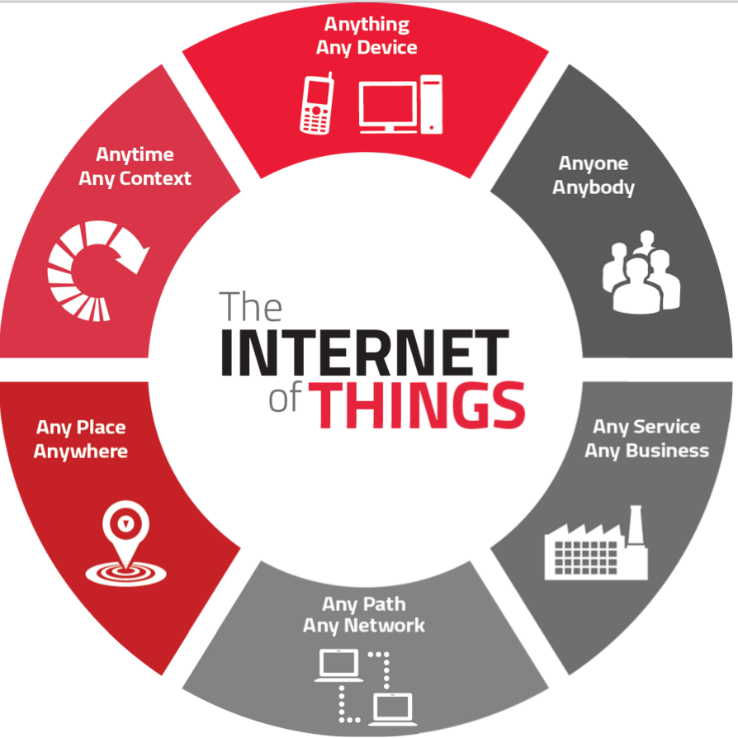

IoT Meets Big Data

Slide 5
Big Data Value Chain
Collection
Ingestion
Discovery & Cleansing
Integration
Analysis
Delivery
Collection – Structured, unstructured and semi-structured data from multiple sources
Ingestion – loading vast amounts of data onto a single data store
Discovery & Cleansing – understanding format and content; clean up and formatting
Integration – linking, entity extraction, entity resolution, indexing and data fusion
Analysis – Intelligence, statistics, predictive and text analytics, machine learning
Delivery – querying, visualization, real time delivery on enterprise-class availability
5

Slide 6
Understanding Streaming Data (1)
Question: “How many red cars are in the parking lot?”
Prerequisite: Data is static! (no cars leaving or entering!)
Answering with a relational database:
Walk out to the parking lot
Count vehicles that are: ‘Red’ and ‘Cars’
(FROM vhcl in ParkingLot
WHERE vhcl.type = “CAR”
&& vhld.color = “RED”
SELECT vhcl).Count()

Slide 7
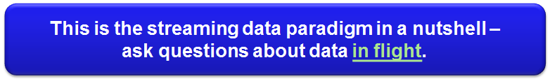
Understanding Streaming Data (2)
“How many trucks (red cars) went from right to left in the last 10 seconds”?
“How many green cars (= electrical cars) are passing every 60 minutes”?
“What is the running average speed of cars on the left lane compared to the right lane?

Slide 8
Data Stream in a Nutshell
A data stream is a continuous sequence of data tuples
Think of standard tuples of relational databases
+ time information (timestamp = TS)
That means:
Data is moving!
Continuously generated (assumed infinite!)
Potentially high pace.
System has to process data without first storing everything
TS
TS
TS
TS
TS
TS
TS
Tuple
Tuple
Tuple
Tuple
Tuple
Tuple
Tuple
time t

Slide 9
Data Stream Scenarios
Sensor networks for environmental monitoring
Avalanche risk level computation
Insights for agriculture
Air pollution (urban) monitoring
Real-time analysis of stock market changes
Computing statistics over streams, e.g., for decision support
Opportunities for reacting in real-time
Even with fully automated means: algorithmic trading
Social Media Analysis
Sentiment analysis of products
News and trend analysis
Industrial monitoring
Energy consumption and other key performance indicators (KPIs)
Predictive maintenance

Slide 10
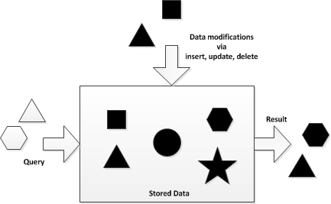
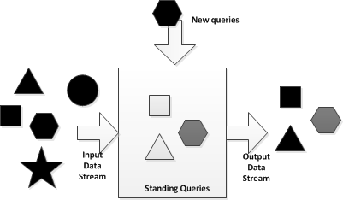
Streaming Data Paradigm
 | Database Applications | Data Streaming Applications
Concept | Persist data (&relations) (Data at Rest) | Volatile data streams (Data in Motion)
Strategy | Random access | Sequential access
Query Paradigm | Ad-hoc queries or requests | Continuous standing queries
Memory/Storage | (in theory) unlimited storage | Main memory limitations
Execution Time | Little or no time requirements (Seconds, hours, days) | Consideration of the order of the input (< 1 sec.)
Data Rate | Low rate (Hundreds of events/sec) | High rate (tens of thousands of events/sec or more)
Query Semantics | Declarative relational analytics | Declarative relational and temporal analytics
Accuracy | Assumes exact data | Assumes inaccurate data

Slide 11
Data Stream Terminology
Term | Notation | Description | Technology Sample
Tuple/ payload | p = <k1:v1, k2:v2, …> | A un-ordered list of named elements (e.g. JSON)
Event | e = <ts, p> | A timestamped tuple
Stream | s | A stream is a possibly infinite sequence of events
Source | src |> s | A source is emitting continuously events | Storm: Spout StreamInsight: IObservable
Operator | S_{1,in} .. S_{n,in}|> o |> s_{1,out}…S_{m,out} | Processor of n input streams producing m output stream of events | Storm: Bolt StreamInsight: Function
Topology | G = (src[1..n], o, sk) | A graph of calculation represented as a network (= query) with n sources and 1 sink
Sink | s |> sk | Consumes results of a Stream | StreamInsight: IObserver

Slide 12
Data Stream Topology
A standing query is an instance of a topology (=query graph)
A data stream engine handles heavy lifting for data streams
Data Stream Engine
Source2
Join
Source1
Filter
Project
Sink
Sourcen
Filter
Project
Sink
Input
Standing Queries
Output

Slide 13
Query Expressiveness
Stream Operations
Selection of events = filter
Calculations on the tuple payload = projection
Correlation of streams = join
Stream partitioning = grouping
Window Operations
Aggregation (sum, count, min, max…) over event windows
Ranking over event windows (topK)
User defined functions
window
TS
TS
TS
TS
TS
TS
TS
Tuple
Tuple
Tuple
Tuple
Tuple
Tuple
Tuple
time t

Slide 14
Query Expressiveness
var result = from e in inputStream
where e.id > 3
select new {
id = e.id,
W = (double)e.intW / 10 };
Filter
Projection
Correlation (Join)
Projection
var result = from eLeft in inputStream1
join eRight in inputStream2
on eLeft.id equals eRight.id
select new {
id = eLeft.id,
diff = eLeft.W - eRight.w };

Slide 15
Time Windows
A 10-second tumbling window
1
5
4
6
2
8
6
5
3
6
1
0
5
10
15
20
25
30
Time (seconds)
1
5
4
6
2
8
6
5
3
6
1
How many vehicles entered each toll both every 10 seconds?
SELECT TollId, COUNT(*) FROM EntryStream
TIMESTAMP BY EntryTime
GROUP BY TollId, TumblingWindow(second,10)

Slide 16
Time Windows
A 10-second Hopping Window with a 5-second “Hop”
1
5
4
6
2
8
7
5
3
6
1
0
5
10
15
20
25
30
1
5
4
6
2
4
6
2
8
6
8
6
5
3
5
3
6
1
Report every 5 seconds the total weight of cars that entered each toll both in the past 10 seconds
SELECT TollId, SUM(VehicleWeight) AS TotalWeight
FROM EntryStream TIMESTAMP BY EntryTime
GROUP BY TollId, HoppingWindow(second, 10 , 5)

Slide 17
Windows
Entry
1
5
0
5
10
15
20
25
Exit
1
5
1
1
5
5
Report all toll booths which have served more than 3 vehicle in the last 10 seconds
SELECT TollId, Count(*)
FROM EntryStream TIMESTAMP BY EntryTime
GROUP BY TollId, SlidingWindow(second, 10)
HAVING COUNT(*) > 3

Slide 18
Joining multiple streams
Calculate the time required for each car to pass the toll
(in maximum 15 minutes)
Toll Entry :
{“YZB 1245”, 3}
{“TYU 4587”, 7}
{“WAA 3423”, 2}
{“AB 2678”, 3}
Toll Exit :
{“YZB 1245”, 3}
{“WAA 3423”, 2}
{“TYU 4587”, 7}
{“AB 2678”, 3}
time
SELECT EN.LicensePlate, DATEDIFF(minute, EN.EntryTime, EX.ExitTime) AS TotalTime
FROM EntryStream EN TIMESTAMP BY EntryTime
JOIN ExitStream EX TIMESTAMP BY ExitTime
ON EN.TollId = EX.TollId AND EN.LicensePlate = EX.LicensePlate AND DATEDIFF(minute, EN, EX) BETWEEN 0 AND 15

Slide 19
Detecting absence of events
Report all cars that did not pass the toll booth within 5 minutes
Toll Entry :
{“YZB 1245”, 3}
{“TYU 4587”, 7}
{“WAA 3423”, 2}
{“AB 2678”, 3}
Toll Exit :
{“YZB 1245”, 3}
{“WAA 3423”, 2}
{“AB 2678”, 3}
time
SELECT EN.LicensePlate, EN.TollId FROM EntryStream EN TIMESTAMP BY EntryTime
LEFT OUTER JOIN ExitStream EX TIMESTAMP BY ExitTime
ON EN.TollId = EX.TollId AND EN.LicensePlate = EX.LicensePlate AND DATEDIFF(minute, EN, EX) BETWEEN 0 AND 5
WHERE EX.ExitTime IS NULL

Slide 20
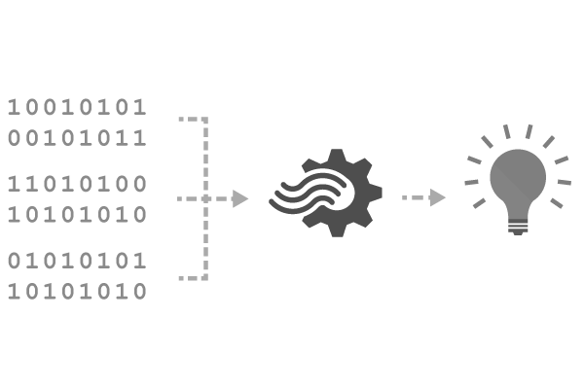
Reference Data
Seamless correlation of event streams with reference data
Static or slowly-changing data stored in blobs
Scanned for changes on a settable cadence
JOIN (INNER or LEFT OUTER) between streams and reference data sources
Reference data appears like another input in the query
SELECT myRefData.Name, myStream.Value
FROM myStream
JOIN myRefData
ON myStream.myKey = myRefData.myKey
Notes:
Next thing is the concept of reference data. This is very important because people want to shrink payload down because you are transporting data over network, GPRS etc.. they only send data that is very relevant. Payload might only look like sensor A, temp x. But, you need to know where this sensor maps to – in other words, where this located, which manufacturer did we get it from etc – in case it fails etc., So this is called reference data. This is data at rest. In ASA we let you add reference data. You can treat reference data as another stream to further augment your streaming data. Right now we only support reference data in Blobs. Can refresh these blobs @ 5 min frequency. Working actively on adding SQL. All I need to – instead of 2 streaming inputs – 1 ref data, 1 streams, Use same joins on reference data, AND augment the data before storing it. By the way, this is one of the more used features. You can refresh the blob too.

Slide 21
Technologies
Apache Spark: Fast and general engine for large-scale data processing
Apache Storm: Distributed real-time computation system to reliably process unbounded streams of data
Apache Flink: Scalable stream and batch processing
Apace Ignite: In-memory computing platform
Commercial:
Tibco Event Stream Processing
IBM Streams
Microsoft StreamInsight/ Azure Stream Analytics
Amazon AWS Kinesis Analytics

