Slide 1
Twitter Sentiment Analysis

Slide 2
Abstract
use of natural language processing, text analysis, computational linguistics
identify, extract, quantify, and study affective states and subjective information

Slide 3
Design
This project has 5 major stages in its life cycle:
Data Collection
Data Processing
Exploratory Analysis of the Data
Data Modeling
Interpreting the Data

Slide 4
Data
It contains 1,600,000 tweets extracted using the twitter API
It contains the following 6 fields:
sentment
Ids
Date
flag
User
text

Slide 5
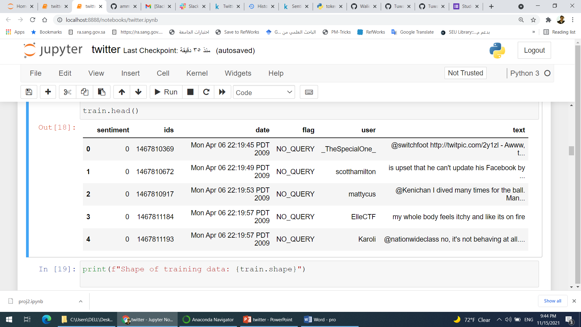
data

Slide 6
Algorithms
EDA
Logistic Regression

Slide 7
Tools
pandas
Numpy and Pandas for data manipulation
pyspark for modelling

