Slide 1
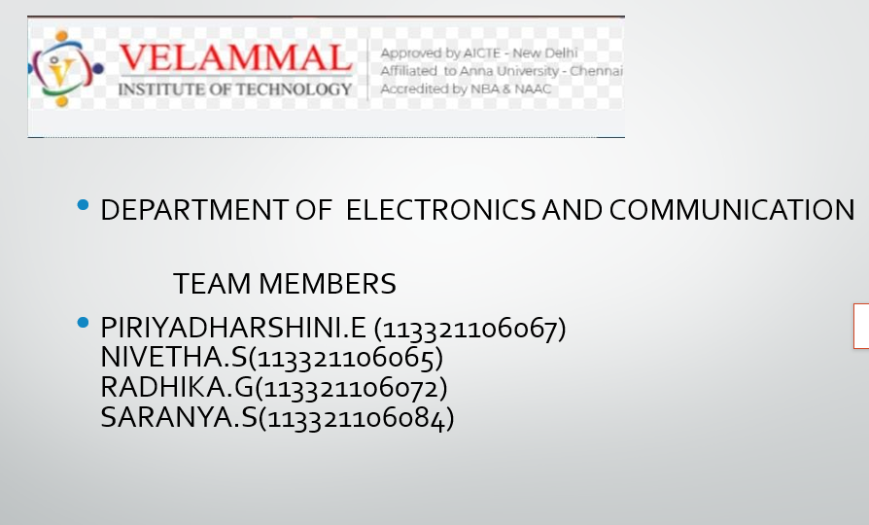


Slide 2
Innovations in chatbot using python

Slide 3
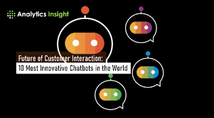
Innovations in chatbot

Slide 4
Why do we need innovations in chatbot
Innovations in chatbots are crucial for several reasons, as they contribute to the improvement, efficiency, and adaptability of chatbot applications. Here are some key reasons why innovations in chatbots are important:
Enhanced User Experience:
Innovations in chatbots can lead to a more natural and intuitive user experience. By incorporating advanced natural language processing (NLP), sentiment analysis, and multimedia support, chatbots can better understand user input and provide more relevant and engaging responses.
Increased Functionality:
Innovations allow chatbots to perform a broader range of tasks. By integrating with external services, APIs, and platforms, chatbots can provide users with a wider array of functionalities, from accessing real-time information to performing complex transactions.
Adaptation to Emerging Technologies:
The field of technology is constantly evolving. Innovations in chatbots enable them to stay current with the latest advancements, such as improvements in machine learning, artificial intelligence, and natural language understanding. This ensures that chatbots remain effective and competitive.

Slide 5
4 . Efficiency and Automation:
Innovations in automation and workflow integration can make chatbots more efficient in handling tasks and processes. This is particularly valuable in scenarios like customer support, where chatbots can automate routine inquiries, freeing up human agents for more complex issues.
5 . Efficiency and Automation:
Innovations in automation and workflow integration can make chatbots more efficient in handling tasks and processes. This is particularly valuable in scenarios like customer support, where chatbots can automate routine inquiries, freeing up human agents for more complex issues.
6 . Continuous Improvement:
Innovations support ongoing improvement and optimization. Regular updates, feature enhancements, and the incorporation of user feedback help chatbots evolve and adapt to changing user needs and expectations.
In summary, innovations in chatbots are essential for keeping pace with technological advancements, improving user experiences, expanding functionalities, and staying competitive in a rapidly evolving digital landscape.

Slide 6

How can we do innovations in chatbot
Innovating with chatbots in Python involves incorporating advanced features, technologies, or approaches to enhance the user experience and functionality. Here's a step-by-step guide on how you can implement innovations with a chatbot in Python:
Define Objectives:
Clearly outline the goals and objectives of your chatbot. Understand the specific problems it aims to solve or the tasks it should perform.
2 . Select a Framework or Library:
Choose a suitable Python framework or library for building your chatbot. Popular choices include ChatterBot, Rasa, and NLTK.
3 . Implement Natural Language Processing (NLP):
Enhance the chatbot's ability to understand and generate human-like responses by implementing advanced NLP techniques. Utilize pre-trained models like spaCy, BERT, or GPT.

Slide 7
5 . Voice Interaction:
Implement speech recognition using libraries like Speech Recognition. Integrate text-to-speech capabilities to enable voice interactions with the chatbot.
6 . Sentiment Analysis:
Use sentiment analysis libraries to gauge the user's emotions during the conversation. Adjust the chatbot's responses based on the detected sentiment
7 .Interactive Media and Rich Content:
Enable the chatbot to handle images, videos, and other rich media content. This can enhance user engagement, especially in scenarios where visual communication is important.
8 . Educational Chatbot Features:
If your chatbot is for educational purposes, implement features such as answering questions, providing explanations, and offering interactive quizzes.

Slide 8
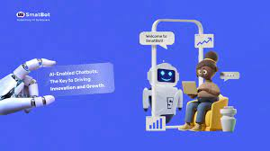

Slide 9
Applications of chatbot
Customer Support and Service:
Use chatbots with advanced natural language processing and sentiment analysis to provide efficient and personalized customer support. The chatbot can handle common queries, troubleshoot issues, and escalate complex problems to human agents when needed.
E-commerce and Sales :
Implement chatbots for e-commerce platforms to assist users with product recommendations, order tracking, and the purchasing process. Innovations like visual search and integration with recommendation engines can enhance the shopping experience.
Healthcare Assistance:
Develop healthcare chatbots that can assist users with medical queries, medication reminders, and provide general health information. Innovations like symptom analysis and integration with health databases can improve the accuracy of information.

Slide 10
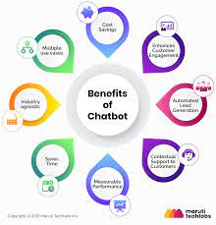

Slide 11
4 . Education and Training:
Create chatbots to assist students with learning materials, answer questions, and provide educational resources. Innovations in natural language understanding and adaptive learning can make the educational experience more engaging and effective.
5 . Travel and Hospitality:
Implement chatbots to assist travelers with flight bookings, hotel reservations, and travel-related information. Innovations like integration with travel APIs, real-time updates, and language translation can enhance the travel experience.
6 . Finance and Banking:
Develop chatbots for banking services, allowing users to check account balances, transfer funds, and receive financial advice. Innovations in security measures, such as biometric authentication, can enhance the safety of financial transactions.

Slide 12


