Slide 1
DFD
STUDENT PASSING PREDICTION SYSTEM

Slide 2
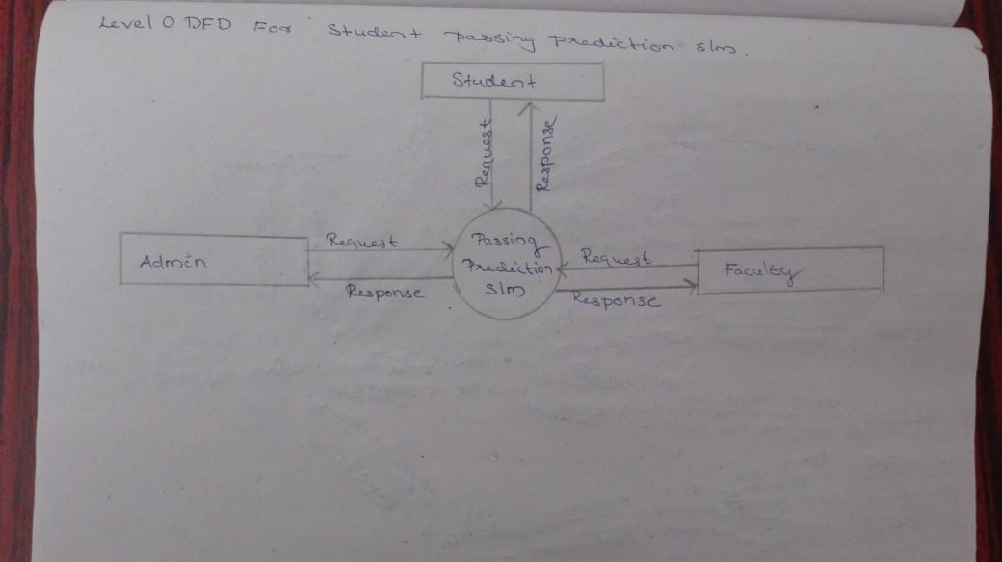
Level0 DFD

Slide 3
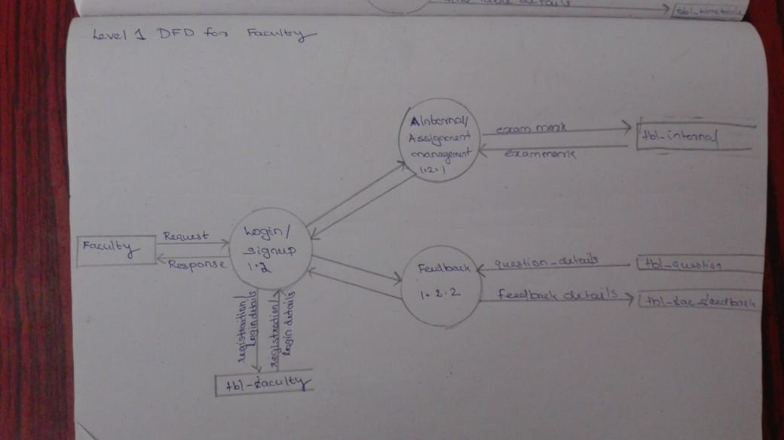
Level1 DFD For Teacher

Slide 4
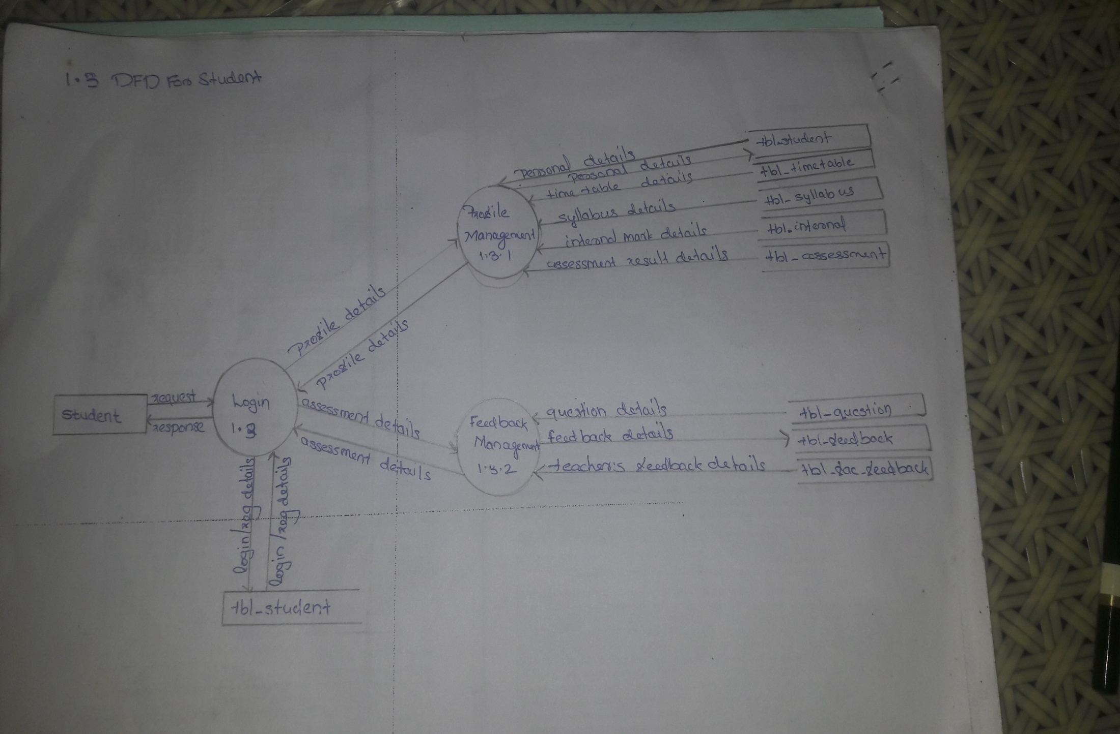
Level1 DFD For Student

Slide 5
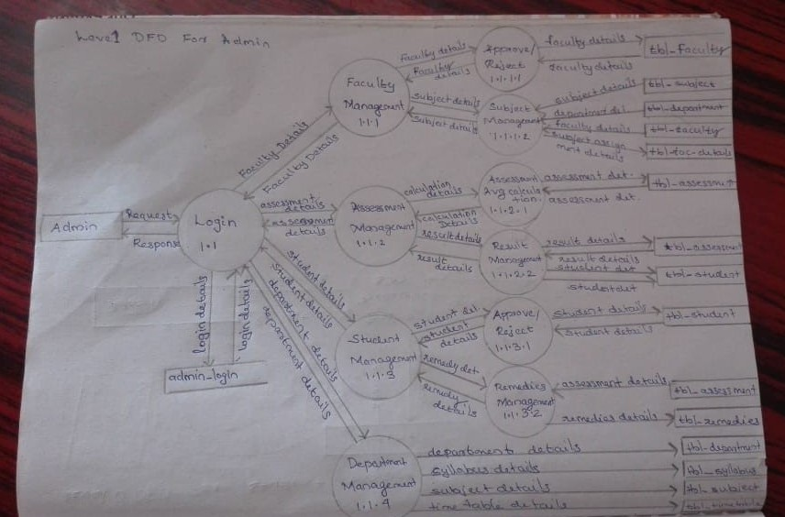
Level1 DFD For Admin

