Slide 1

Music Store Data Analysis
P. Murali Krishna
P. Srivani
Batch no :546

Slide 2
About Team:
Team leader:
Name: Murali Krishna
Qualification: B Tech (CSE)
Institution: Guru Nanak Institutions Technical Campus
Core Interests: I am interested in Data Analytics because I enjoy working with data, identifying patterns, solving problems.
Career Objective: To build a successful career in Data Analytics by applying my skills in SQL,
Python, Excel, and data visualization to analyse data, solve business problems, and generate
meaningful insights.
LinkedIn: https://www.linkedin.com/in/murali-krishna-213ba3301

Slide 3
Team Members:
Name: Srivani
Qualification: B Tech (CSE)
Institution: Guru Nanak Institutions Technical Campus
Core Interests: I am interested in Data Analytics because I enjoy working with data, identifying patterns, solving problems.
Career Objective: To build a successful career in Data Analytics by applying my skills in SQL,
Python, Excel, and data visualization to analyze data, solve business problems, and generate
meaningful insights.
LinkedIn: https://www.linkedin.com/in/pittala-srivani-a839812a8

Slide 4
⚙ AGENDA :
1. Business Problem
6. Queries and Insights
2. Problem Statement
7. Recommendation
3. Introduction
8. Conclusion
4. Project Objectives
9. Challenges and Experiences
5. Data Description

Slide 5
⚙ BUSINESS PROBLEM:
Difficulty in identifying top-selling music genres, artists, and tracks.
Lack of insights into customer purchasing behavior and preferences.
Challenges in analyzing revenue trends and sales performance across different regions.
Need for data-driven insights to identify growth opportunities and improve business decisions.
Difficulty in identifying high-value customers and understanding their contribution to overall revenue.
Limited visibility into music inventory and product performance, affecting business planning and sales strategies.

Slide 6
⚙ PROBLEM STATEMENT:
The music store generates large volumes of data related to customers, sales, invoices, and music inventory. However, the lack of structured data analysis makes it difficult to identify sales trends, understand customer purchasing behaviour, recognize top-performing artists and genres, and evaluate revenue across different regions.
This project aims to leverage SQL-based data analysis to uncover meaningful business insights, identify growth opportunities, optimize sales strategies, and support informed decision-making to improve overall business performance.

Slide 7
⚙ INTRODUCTION:
The Music Store Data Analysis project focuses on exploring and analysing a relational database using SQL to uncover valuable business insights. The project involves examining customer information, sales transactions, invoices, artists, albums, and music genres to understand business performance.
By applying SQL concepts such as joins, aggregate functions, subqueries, and Common Table Expressions (CTEs), the analysis identifies sales trends, customer purchasing behaviour, top-performing artists, and revenue patterns across different regions.

Slide 8
⚙ PROJECT OBJECTIVES:
Sales Performance Analysis:
Analyze sales transactions and revenue patterns to understand overall business performance and identify growth opportunities.
Customer Behavior Analysis:
Examine customer purchasing patterns to identify high-value customers and understand their contribution to total revenue.
Music Trend Analysis:
Identify popular genres, artists, and tracks based on sales data to understand customer preferences and music trends.
Geographic Sales Analysis:
Evaluate sales across different countries and regions to identify high-performing markets and regional business opportunities.
Employee Performance Analysis:
Analyze employee contributions and customer support activities to understand performance and operational effectiveness.

Slide 9
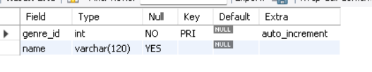

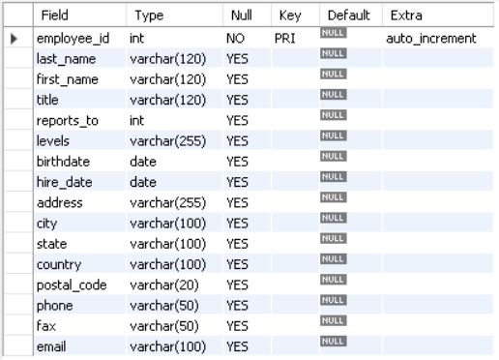
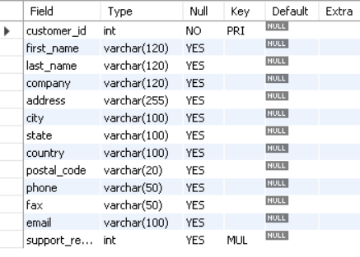
i. DATA DESCRIPTION:
Genre :
Mediatype:
Employee:
Customer:

Slide 10
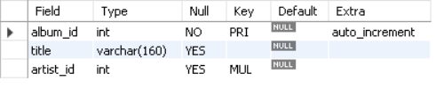

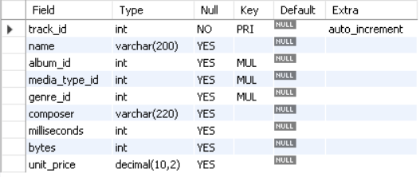
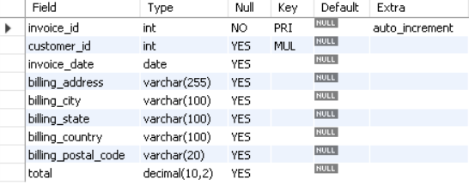
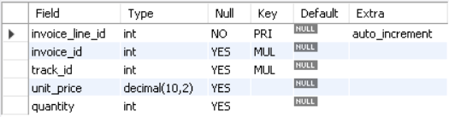

Album:
Artist:
Track:
Invoice:
InvoiceLine:
PlayList:

Slide 11
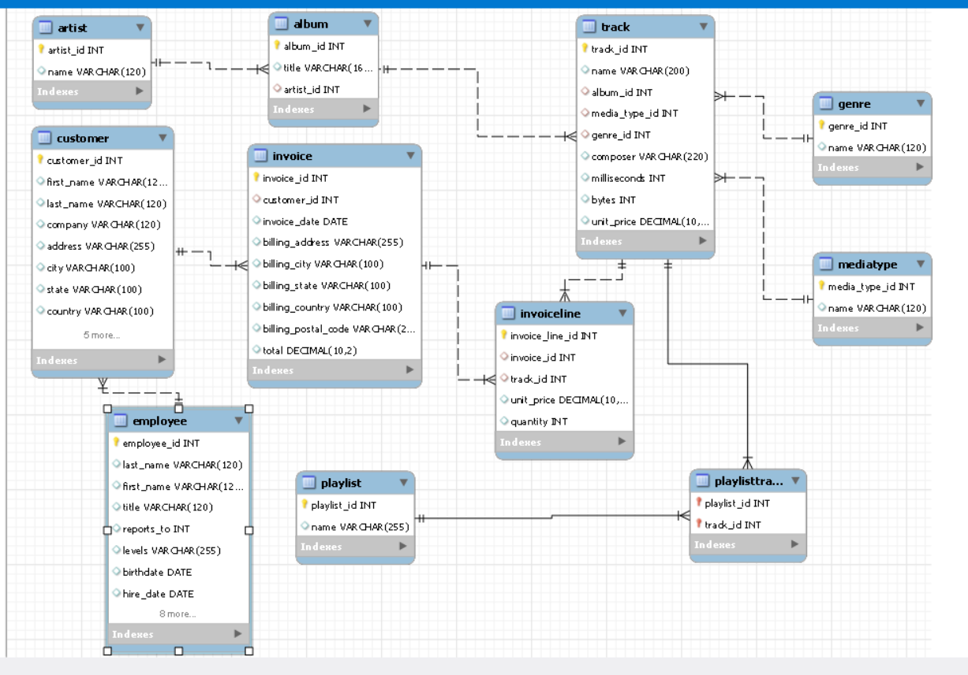
ii. ER Diagram
Database Schema — 11 Interrelated Tables

Slide 12
iii. Key Relationships :
Artist→ Album(1:M)
Invoice → InvoiceLine(1:M)
Album→ Track (1:M)
Track→ InvoiceLine(1:M)
Genre → Track (1:M)
Track→ PlaylistTrack(1:M)
MediaType → Track(1:M)
Employee→ Customer(1:M)
Customer→ Invoice(1:M)

Slide 13


USE CASE 1.1
Queries and Insights
❓ who is the senior most employee based on job title ?
Result :
SQL Query :
💡 Insight
Identifies the highest-ranking employee(s) in the organization.
Helps understand the organizational hierarchy and leadership structure.
⚙ How This Query Works :
Uses the Job Title column to identify the highest-level position.
Sorts/filters employees based on their organizational seniority.
Returns the employee(s) holding the senior-most job title.

Slide 14
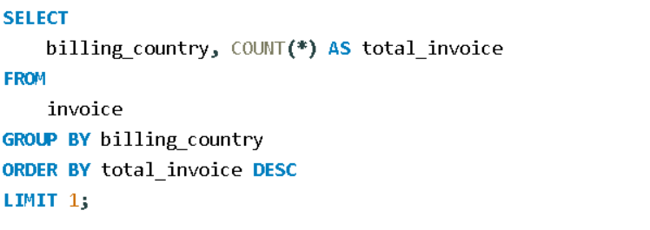

USE CASE 1.2
Queries and Insights
❓ Which country have the most Invoices ?
SQL Query :
Result :
💡 Insight
Identifies the country generating the most invoices.
Helps understand where the business has the highest customer transaction activity.
⚙ How This Query Works :
Groups invoices by billing country.
Counts the total invoices for each country.
Sorts the results in descending order.
LIMIT 1 returns the country with the highest number of invoices.

Slide 15
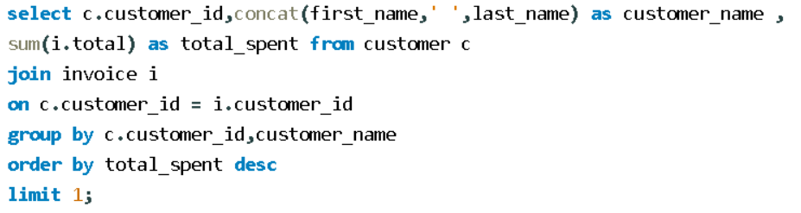

USE CASE 2.1
Queries and Insights
❓ Who is the best customer? - The customer who has spent the most money will be declared -- the best customer. Write a query that returns the person who has spent the most money ?
SQL Query :
Result :
💡 Insight
⚙ How This Query Works :
Joins Customer and Invoice tables using customer_id. Calculates each customer’s total spending using SUM(i.total).
Groups the results by customer.
Sorts spending in descending order and LIMIT 1 returns the highest-spending customer.
Identifies the highest-value customer based on total spending.
Helps understand customer value and purchasing contribution to the business.

Slide 16
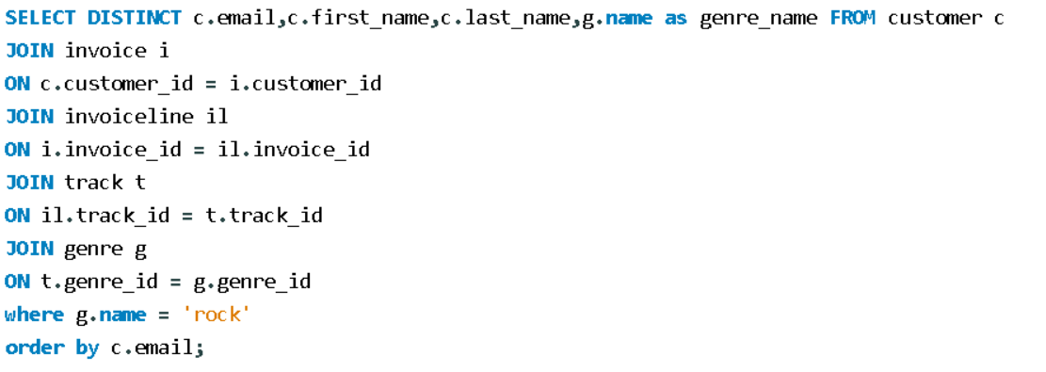
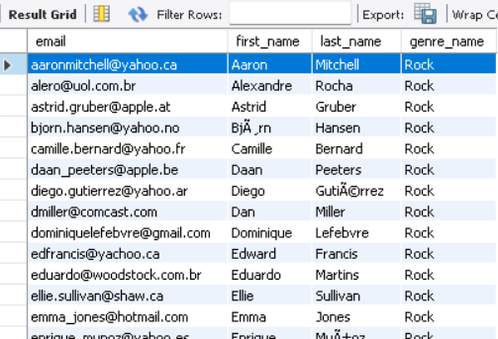
USE CASE 2.2
Queries and Insights
❓ Write a query to return the email, first name, last name, & Genre of all Rock Music listeners.
Return your list ordered alphabetically by email starting with A ?
SQL Query :
Result
💡 Insight
Identifies customers who listen to Rock music.
Helps understand genre preferences and supports targeted music recommendations or marketing.
⚙ How This Query Works :
Joins Customer, Invoice, InvoiceLine, Track, and Genre tables.
Filters records where the genre is Rock.
Uses DISTINCT to avoid duplicate customers.
Sorts the results alphabetically by email.

Slide 17
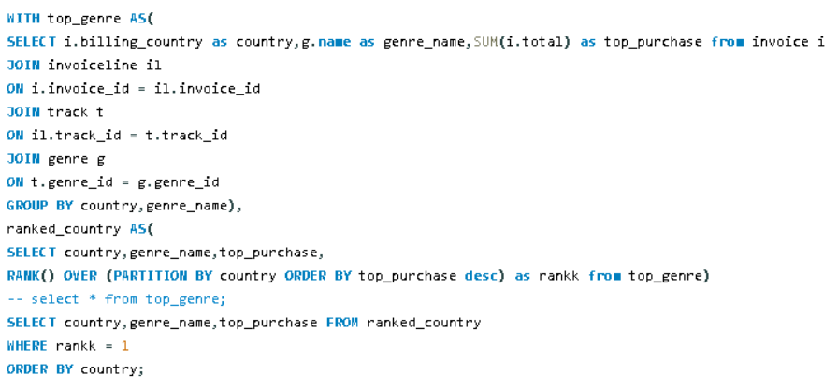
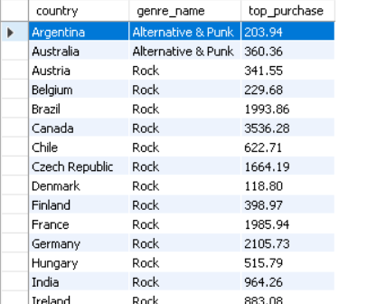
Queries and Insights
USE CASE 2.3
❓ We want to find out the most popular music Genre for each country. We determine the most
popular genre as the genre with the highest amount of purchases. Write a query that returns each country along with the top Genre. For countries where the maximum number of purchases is shared, return all Genres ?
SQL Query :
Result
💡 Insight
Identifies the most popular music genre in each country.
Helps understand regional music preferences and supports targeted recommendations and marketing.
⚙ How This Query Works :
Calculates total purchases for each country and genre using SUM(). Uses RANK() to rank genres within each country based on purchases. RANK() = 1 selects the most purchased genre(s). Includes all genres when there is a tie.

Slide 18
⚙ RECOMMENDATIONS:
Improve sales by focusing on popular genres and best-selling tracks.
Enhance customer loyalty through personalized offers.
Optimize pricing based on sales performance.
Expand marketing efforts in high-revenue regions.
Integrate SQL with Power BI for interactive dashboards.
Implement predictive analytics for sales forecasting and customer recommendations.

Slide 19
⚙ CONCLUSION:
Data Exploration: Analysed relational datasets to understand customer behaviour, sales patterns, and music preferences.
SQL Analysis: Applied joins, aggregations, subqueries, and filtering to extract meaningful insights.
Trend Identification: Identified top customers, popular genres, best-selling tracks, and revenue patterns.
Business Insights: Evaluated purchasing trends and sales performance to identify growth opportunities.

Slide 20
⚙ CHALLENGES AND EXPERIENCES:
01.Table Relationships & Joins : Understood table relationships and applied appropriate SQL joins to retrieve meaningful data from multiple tables.
02. Data Consistency : Maintained data integrity by understanding primary key and foreign key constraints and ensuring consistency across related tables.
03. Aggregation & Business Metrics : Used aggregate functions (SUM, COUNT, AVG) to calculate revenue, identify top customers, and analyze popular music genres.
04. Data Handling : Worked with date formats and extracted meaningful information from raw data fields to perform accurate SQL analysis.
05. Query Optimization : Improved query performance through appropriate filtering, efficient joins, and indexing concepts.

Slide 21
Q & A
Questions & Answers
Feel free to ask anything about the Music Store Data Analysis SQL Project

Slide 22
THANK YOU

